Slide 1


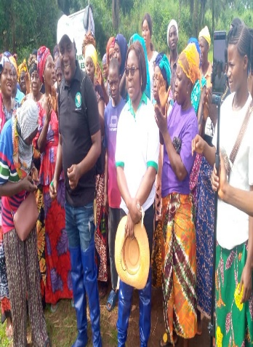
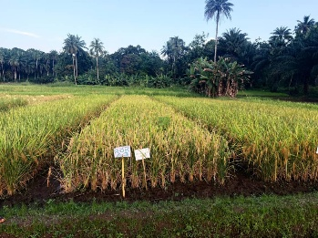
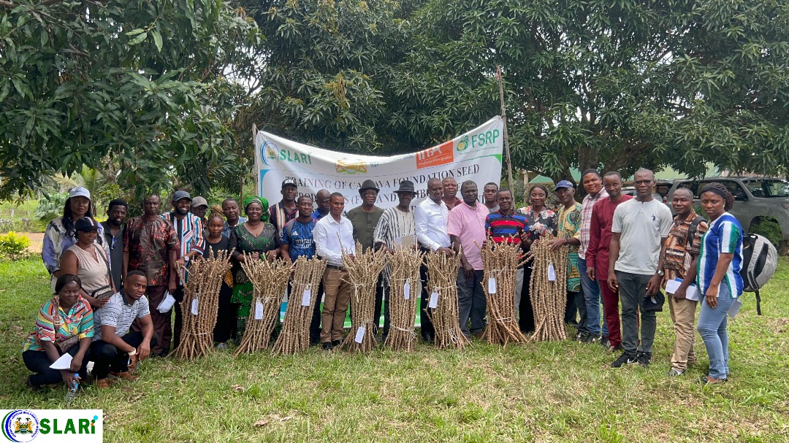
SIERRA LEONE AGRICULTURAL RESEARCH INSTITUTE
22nd REGULAR MEETING OF SLARI COUNCIL
OVERVIEW OF RESEARCH, TECHNOLOGY AND INNOVATION DEVELOPMENT ACTIVITIES IN SLARI
Prince E. Norman (PhD)
DDG, Res., Technol., and Innov Devt, SLARI
Source: RARC Annual Report, 2025
Source: NARC Annual Report, 2025
Held at RARC Conference Room, 16th-18st December, 2025.

Slide 2
Presentation Outline
Introduction
Status of research activities
Lessons learnt
Monograph & related assignments
Acknowledgement

Slide 3
Introduction
Global popn is projected to increase to 8.6 B in 2030, 9.8 B in 2050 and 11.2 B in 2100, with an annual increase of 83 M people (UNDESA, 2017).
Increasing popn without corresponding increase in crop productivity leads to hunger and starvation.
Vision. A resilient, innovation‑driven agricultural research system that measurably improves agricultural productivity, incomes, and nutrition while preserving the natural resource base and taking advantage of technological advancements.
Mission. To generate, adapt, validate and broker demand‑led, climate‑smart agricultural knowledge and technologies; commercialize responsibly under clear public‑interest guardrails; provide timely evidence for agricultural policy; and build national research capacity in line with Sierra Leone’s development priorities..

Slide 4
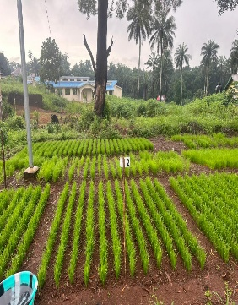
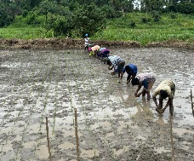
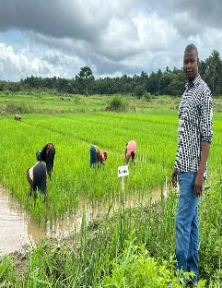
RARC
NAME OF PROJECT | OBJECTIVES | BRIEF SUMMARY | CURRENT STATUS
Regional Rice Value Chain Support Project (RRVCP) Dr. Nabieu (AGRA, KAFACI, FSRP, RRVCP) | Farmers capacity building, Breeder and Foundation Seeds Production Capacity building of the institute | The is an institutional support project to SLARI. The project, procured a vehicle for RARC which is now used by the DG, supported SLARI to produce breeder and foundation seeds, train farmers in Tormabum and kambia | Harvesting and processing are ongoing
Kanu et al., 2025

Slide 5
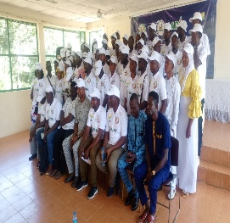
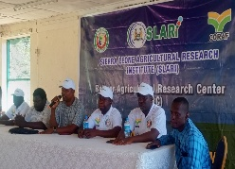
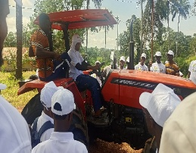
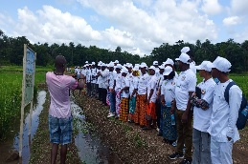
RARC cont’d
NAME OF PROJECT | OBJECTIVES | BRIEF SUMMARY | CURRENT STATUS
CORAF/ECOWAS youth training programme | Train youth on mangrove rice production, processing and marketing techniques Develop attractive business plans | The project target is to train 150 youths and 75of them have been trained in the first set based on the MOU and budget provided. We are now waiting for funds to carry out the second training. | In progress
Kanu et al., 2025

Slide 6
RARC cont’d
NAME OF PROJECT | OBJECTIVES | BRIEF SUMMARY | CURRENT STATUS
Dr. Coolson (AfricaRice) | Evaluation and identification of rice breeding lines in the various agro ecologies in Sierra Leone that are high yielding, tolerance to the major abiotic stresses and resistance to biotic stresses, with good phenotypic and market acceptability with high nutritional value. to accelerate the release of new varieties that promote both income generation and good health; Develop climate-resilient rice varieties, for tolerance to Flooding, Iron toxicity and salinity | (1) Multi Environmental Trial (Rainfed upland) Evaluation of 60 upland genotype – in one location Rokupr Onfarms Trials involving 50 farmers in the upland and lowland ecologies Evaluation of Rice genotype for tolerance to Salinity, flooding and iron toxicity for climatic variability adaption in Sierra Leone. | (1)Harvesting have completed drying and weighing is in progress, data inputting is also in Progress (2) A field day was organized for the various actors across the rice value chain 98 participants, including farmers, millers, seed producers and traders evaluate the new varieties. (3) Harvesting is in progress for the various location. Data inputting is also in progress

Slide 7
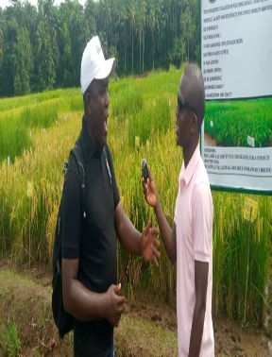
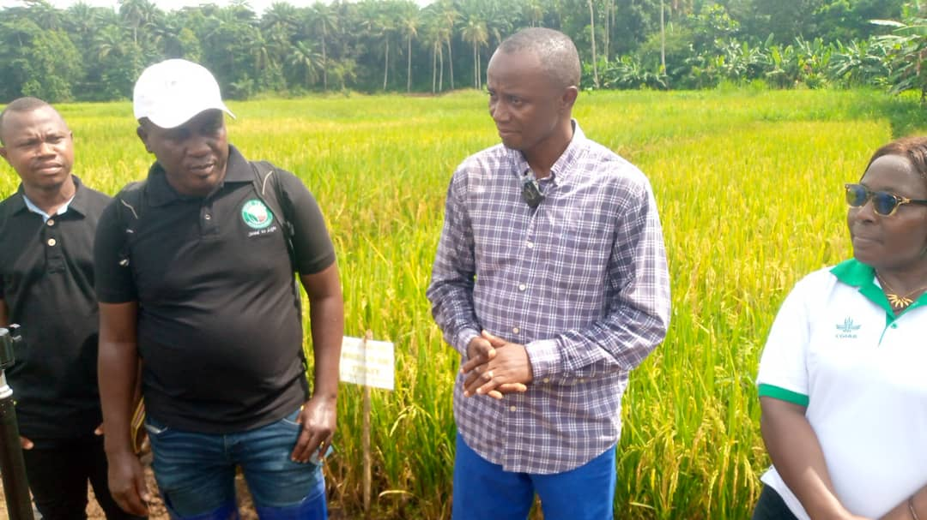
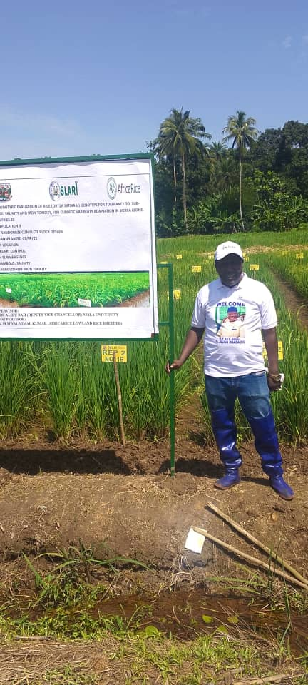
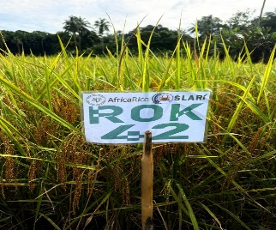
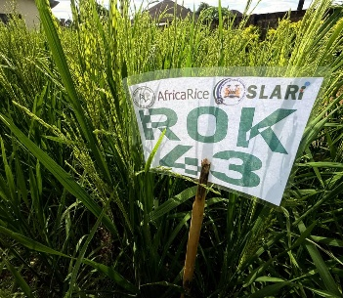
RARC cont’d
NEWLY RELEASED LOWLAND VARIETIES ROK42 AND SUB1 ONE UPLAND VARIETY ROK 43

Slide 8
RARC cont’d
NAME OF PROJECT | OBJECTIVES | BRIEF SUMMARY | CURRENT STATUS
Development of Pest Monitoring and Eco-Friend Control Technologies in Africa (Sierra Leone) (Monitoring the Occurrence of Maize FAW, Spodopters frugiperda and Development of Eco-Friendly Control Technologie in Sierra Leone) Mr. Swaray (KAFACI) Dr. Abdulai (KAFACI) | To enhance biological information on the target pest by monitoring occurrence, density and damage for sustainable agriculture in Africa. To develop pest management and prediction systems for sustainable control | Maize (Zea mays L.) is an important staple food and feed crop in Sierra Leone, and is predominantly grown by smallholder farmers. Production of this crop coupled with the livelihood of the growers is threatened by the invasion and widespread infestation of the fall army worm (FAW), Spodoptera frugiperda which has led to considerable maize yield loss. Due to its ability to rapidly spread and impose extensive damage across maize fields, FAW poses a serious threat to the food and nutrition security and livelihoods of many Sierra Leonean farmers. In maize, FAW attacks all crop stages from seedling emergence to ear development. Investigating the occurrence, damage and density of the pest and developing an eco-friendly control technologies for sustainable control is a prerequisite of this work | Completed vegetative data collection. Reproductive stage pest monitoring activities are ongoing

Slide 9
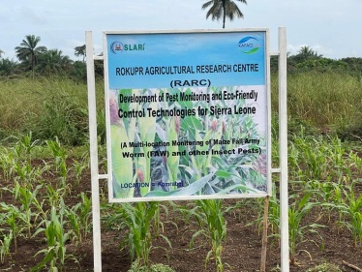
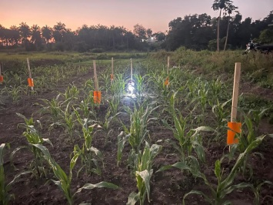
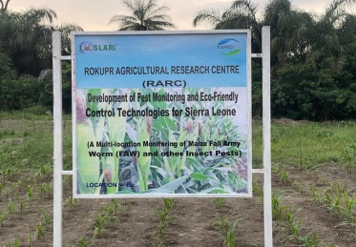
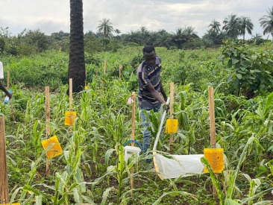
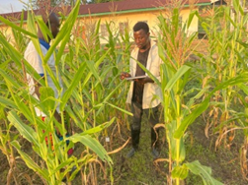
RARC cont’d

Slide 10
RARC cont’d
NAME OF PROJECT | OBJECTIVES | BRIEF SUMMARY | CURRENT STATUS
Mr Alie Conteh | To evaluate and identify rice breeding lines in the various agro ecologies in Sierra Leone that are high yielding, tolerance to the major abiotic stresses and resistance to biotic stresses, with good phenotypic and market acceptability with high nutritional value. to accelerate the release of new varieties that promote both income generation and good health; To develop climate-resilient rice varieties, for tolerance to flooding, iron toxicity and salinity. | Multi Environmental Trial (Rainfed upland) Evaluation of 60 upland genotype – in one location Rokupr; Onfarm Trials involving 50 farmers in the upland and lowland ecologies; Evaluation of Rice genotype for tolerance to Salinity, flooding and iron toxicity for climatic variability adaption in Sierra Leone. | (1)Harvesting have completed drying and weighing is in progress, data inputting is also in Progress (2) A field day was organized for the various actors across the rice value chain 98 participants, including farmers, Millers, seed producers and traders evaluate the new varieties. (3) Harvesting is in progress for the various location. Data inputting is also in progress

Slide 11
NARC
NAME OF PROJECT | OBJECTIVES | BRIEF SUMMARY | CURRENT STATUS
Effects of phosphorus fertilizer and lime application on the growth, yield, and seed quality of groundnut on the upland soil of Njala: Experiment 1 | To determine optimum rate for phosphorus application on groundnut To determine the effects of different application levels of phosphorus on the growth, yield and seed quality of the two groundnut genotypes. | (1) Trial was laid out in a 2 × 4 factorial arrangement in a RCBD with three replicates (2) Two groundnut genotypes (SLINUT 2 and a Local variety) + four levels of P (0kgP₂O₅/ha, 20kgP₂O₅/ha, 40kg P₂O₅/ha and 60kg P₂O₅/ha) (3) Improved 62.9% higher pod yield relative to the local check. | (1)Harvesting has completed. (2) Further analysis and report writing are in progress.

Slide 12
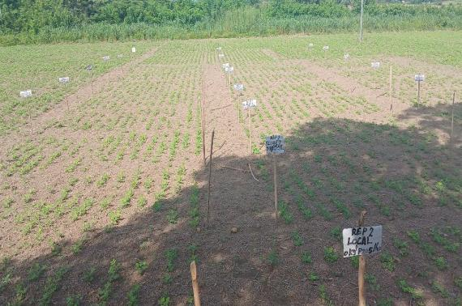
Table 1: Influence of ground variety on number of filled pods, 100 seed weight and yield
Variety | Filled pod | 100 seed wt | Plot yield (kg/ha)
SLINUT 2 | 39.0 (56.9%) | 37.6 (63.7%) | 939 (62.9%)
Local variety | 29.5 | 26.06 | 553
Mean | 34.4 | 31.8 | 746
LSD(0.05) | 17.16 | 2.95 | 222.8
CV (%) | 28.5 | 10 | 34.1
Table 2: Effect of Phosphorus level on shelling percentage of the two groundnut varieties
Phosphorus level ( P₂O₅ ) | Shelling percentage ( %)
0 kg/ha | 58.0
20kg/ha | 66.89 (53.6%)
40kg/ha | 59.89
60kg/ha | 65.45
Mean | 62.58
LSD (0.05) | 5.97
CV (%) | 7.7
Groundnut trial

Slide 13
NARC
NAME OF PROJECT | OBJECTIVES | BRIEF SUMMARY | CURRENT STATUS
Effects of phosphorus fertilizer and lime application on the growth, yield, and seed quality of groundnut on the upland soil of Njala: Experiment 2 | To determine the appropriate liming rate for increased groundnut productivity;. To determine the effect of liming on soil acidity (pH); To assess combined effects of phosphatic fertilizer with different liming rates on the growth and yield of groundnut | Design: RCBD in 3 reps Two groundnut varieties T1=0t/ha lime (Dolomite) + P fertilizer; T2=2t/ha lime +P fertilizer; T3=4t/ha +P fertilizer; Plot size – 4.8 m × 3 m. Data collected Preliminary analysis done | (1) Data analysis and report writing are ongoing

Slide 14
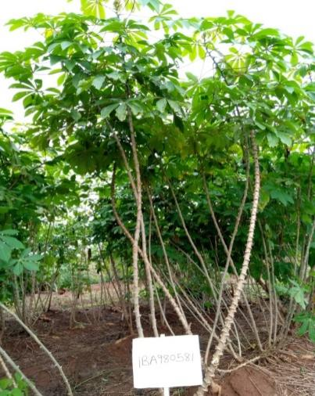
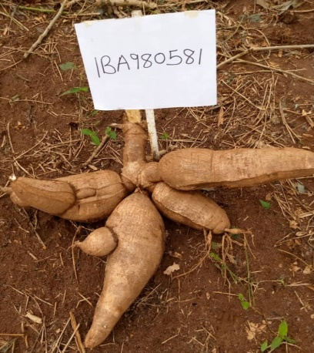
Preliminary analysis shows significant differences (p < 0.02) among the three treatments.
Highest yield (1138kg/ha) was obtained from the application of 2 t/ha lime in combination with 20kg P₂0₅/ha whilst the 0t/ha lime gave the lowest yield of 695kg/ha.
RELEASE OF SIX CASSAVA VARIETIES IN SIERRA LEONE
Six cassava varieties developed and released between 2004 and 2025 by IITA for four market segments.
These varieties were selected based on their importance in food and nutritional security, tested and released in Sierra Leone on October 9^{th,} 2025, by the varietal release committee
Dixon (IBA980581)
Yield – 25.6 t/ha
Dry matter - 28 %
Starch - 20 %
Plant type – Umbrella
Stem colour - Grey
Petiole colour – Purple
Leaf colour – Light green
Leaf shape – Lanceolate
Growth habit – Straight
Granulated and paste product

Slide 15
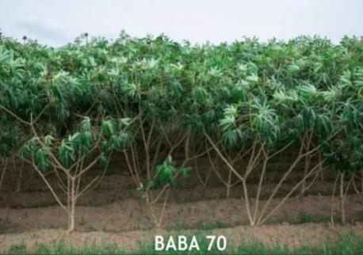
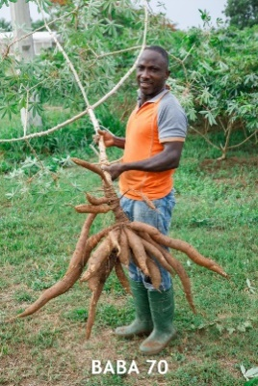
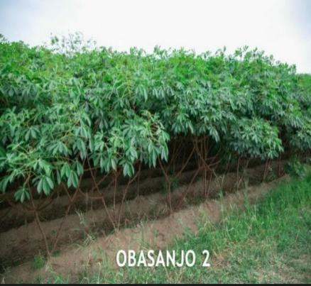
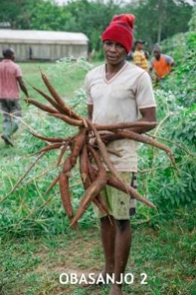
Released cassava varieties
Baba 70 (IBA00070)
Yield – 30.2 t/ha; Dry matter - 32 %
Starch - 23 %; Plant type - Compact
Stem colour - Light brown
Petiole colour - Purple
Leaf colour - Light green
Leaf shape - Lanceolate
Growth habit - Zig-zag
Obasanjo 2 (TMS13F1342P0022)
Yield – 35.1 t/ha
Dry matter – 33 %
Starch – 24 %
Plant type - Umbrella
Stem colour - Light brown
Petiole colour - Light green
Leaf colour - Light green
Leaf shape - Lanceolate
Growth habit - zig-zag

Slide 16
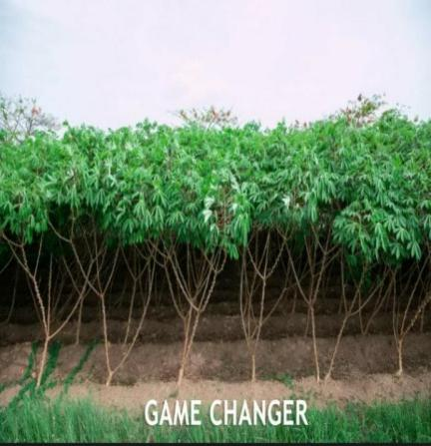
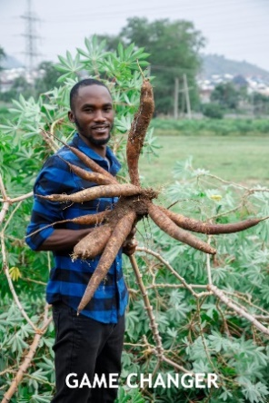
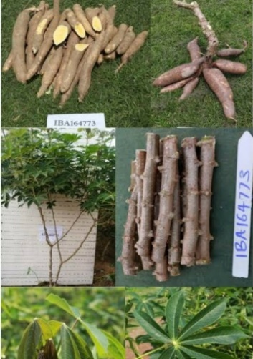
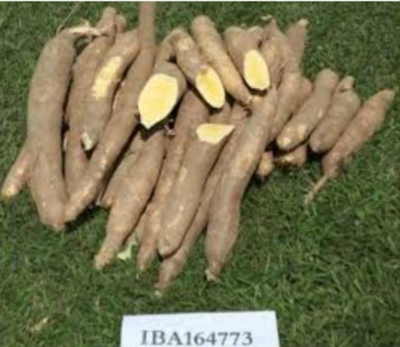
Released cassava varieties
Game changer (TMS13F1160P0004)
Yield – 23.2 t/ha; Dry matter - 37 %
Starch - 26 %; Plant type - Compact
Stem colour - Light brown; Petiole colour – Red; Leaf colour - Light green; Leaf shape - Lanceolate
Growth habit - Zig-zag
Stable dry matter
No Hunger (IBA164773)
Yield – 25.2 t/ha
Dry matter - 29 %
Plant type - Compact
Stem colour - Light brown
Petiole colour – Light Green
Leaf colour - Dark green
Leaf shape - Lanceolate
Growth habit - Zig-zag
Biofortified food processing

Slide 17
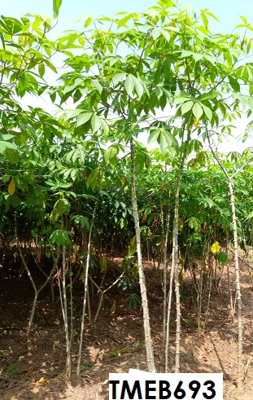
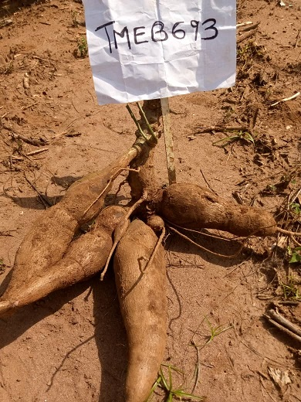
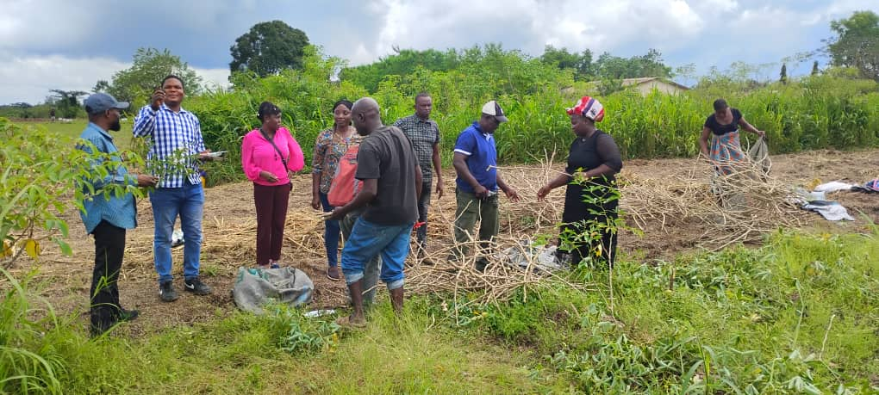
Poundable (TMEB693)
Yield - 22 t/ha
Dry matter - 20 %
Starch - 21 %
Plant type - Erect
Stem colour - Dark brown
Petiole colour - Purple
Leaf colour - Deep green
Leaf shape - Lanceolate
Growth habit – Straight
Fresh market
Figure 2: Harvesting of generation one of breeder seed fields at NARC
Figure 1: Field establishment rate of 2024/2025 breeder seed production at NARC

Slide 18
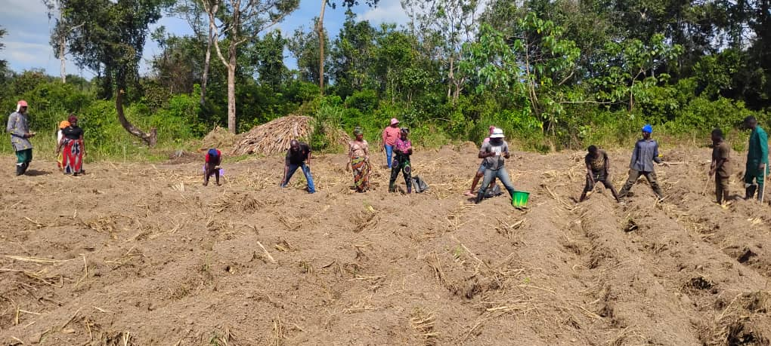
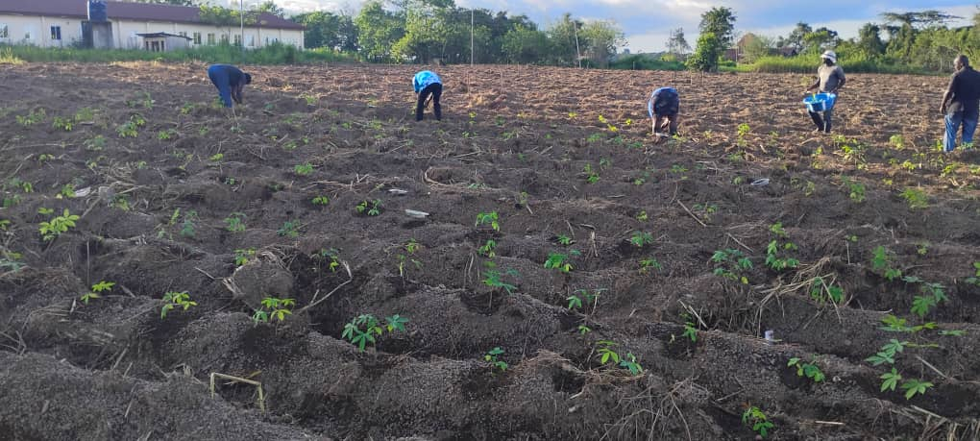
Released cassava varieties
Figure 4: Transplanting of the first batch of SAH plantlets into the Nursery Field at NARC
Figure 3: Planting of generation two of breeder seed fields at NARC
Table 3. Foundation Seed Producer beneficiaries
Category | Target | Actual | Performance (%)
Males | 2 | 6 | 300
Females | 2 | 2 | 100
Youths | 0 | 4 | 0
Total | 4 | 8 | 200

Slide 19
Table 4. Progress on achievement of project result areas
Result Area | Target | Actual | Performance (%)
Ratoon breeder seed fields to establish 7 ha of breeder seed fields. | 7 | 7 | 100
Installation of pilot irrigation systems for the SAH nursery | Installation of drip irrigation for 1 ha | 0 | 0
1ha SAH plantlet nursery transplantation to the field. | 1ha SAH plantlet field establishment | 0.7 | 70
Retrieve selected list from the coordination unit, verify by calls and physical visitation, select, and conduct technical and business training to at least 4 foundation seed producers (FSPs) across 4 districts. | Select and train at least 4 FSPs. 8 FSPs were selected and trained | 8 | 200
Development and review of FSPs of training modules and manuals on seed production fundamentals, seed production technologies, quality assurance and phytosanitary measures, seed production business model, seed handling, storage, and record keeping. | Six training modules were developed, and an intensive training program was executed, including the development of a district-specific conservative business plan | 11 | 100
Engagement and onboarding of the private sector, and setting up the SAH facility with the private sector |  | 0 | 0

Slide 20
Table 5. Aflatoxin Management and Aflasafe Application
NAME OF PROJECT | OBJECTIVES | BRIEF SUMMARY | CURRENT STATUS
Meeting Phytosanitary Standards (Aflatoxin Mitigation) in Critical Value Chains under the Feed Salone Strategy | To raise awareness of aflatoxin contamination in maize and groundnut;. To demonstrate the use and benefits of Aflasafe biocontrol technology; To Distribute Aflasafe samples for field-level adoption; Strengthen knowledge among lead farmers and agricultural officers on safe, sustainable crop production practices. | A total of 180 farmers (90 maize and 90 groundnut) participated across three provinces Application rate: 10 kg/ha (maize or groundnut) Storage: Proper drying and aeration to prevent contamination; Testing: Importance of aflatoxin testing for trade compliance; Field Demonstrations and Product Distribution; Evaluation and Follow-Up; Next Steps: Aflasafe Research and Manufacturing Facility at the Njala Agricultural Research Center (NARC) | Beneficiaries trained

Slide 21
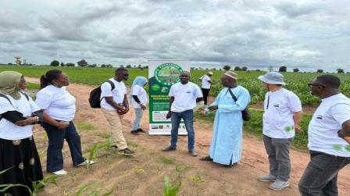
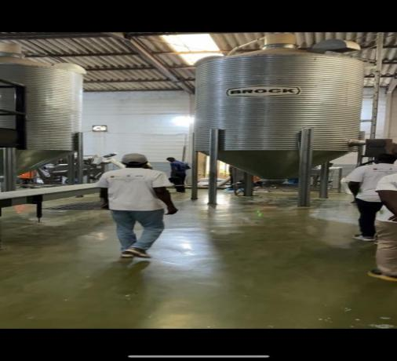
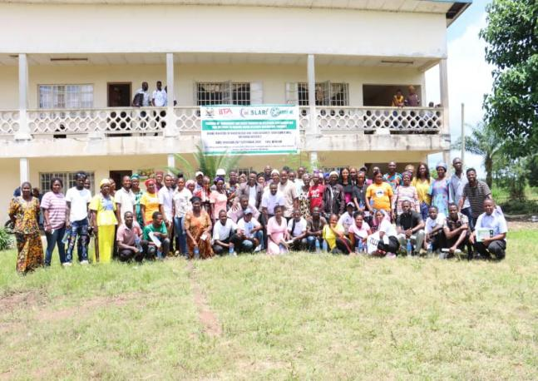
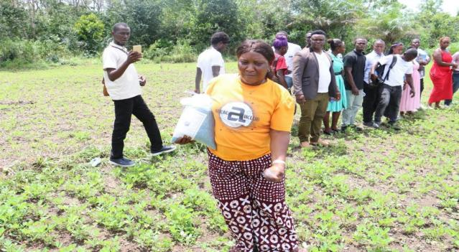
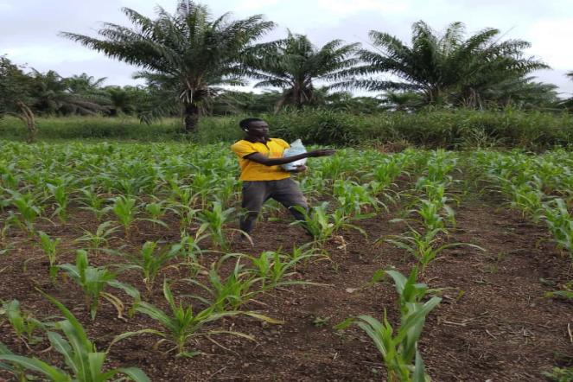
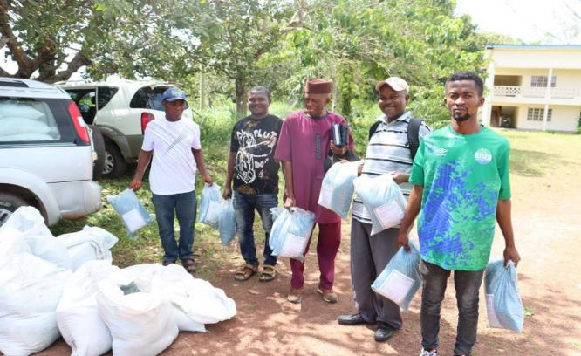
Figure 5. Scientific Exchange Program workshop participants hearing first-hand from farmers in Senegal on Aflasafe application practices, observed benefits, and strong farmer demand—valuable lessons to guide implementation in Sierra Leone
Figure 6. Scientific Exchange Program workshop participants visiting the Aflasafe manufacturing facility in Kaolack, Senegal.
Figure 8. Application of Aflasafe (a) groundnut farmer, (b) maize farmer, and (c) distribution time after training
Figure 7. Group photo of farmers and participants in Moyamba receiving training on aflatoxin mitigation

Slide 22
Table 6. Aflatoxin Management and Aflasafe Application
NAME OF PROJECT | OBJECTIVES | BRIEF SUMMARY | CURRENT STATUS
Assessment of dietary exposure and consumer awareness of major mycotoxins in foods in Sierra Leone (FSRP Adaptive Research Grant) | To raise awareness of mycotoxin-related health, trade, and income risks;. To share preliminary findings from aflatoxin testing in maize, groundnut, and sesame across three agroecological zones; To foster multi-sector collaboration and solicit feedback on study tools and dissemination strategies; To outline a road map for future engagement, policy development, and resource mobilization. | One-day stakeholder Meeting on Mycotoxin Contamination in Sierra Leone organized by SLARI To critical food safety concerns, particularly dietary exposure and consumer awareness of mycotoxins (e.g., aflatoxins, fumonisins, ochratoxins) in Sierra Leone’s food systems | Critical food safety concerns, particularly dietary exposure and consumer awareness of mycotoxins in Sierra Leone’s food systems discussed.

Slide 23
Table 7. Mycotoxins Training and Data Collection
NAME OF PROJECT | OBJECTIVES | BRIEF SUMMARY | CURRENT STATUS
Assessment of dietary exposure and consumer awareness of major mycotoxins in foods in Sierra Leone (FSRP Adaptive Research Grant) | To assess the public health risks of mycotoxins in staple foods like maize, rice, cassava, and groundnuts;. To prepare data collection teams for a nationwide dietary exposure survey supporting Sierra Leone’s “Feed Salone” initiative. | Focused on clarity, neutrality, and accuracy in engaging diverse respondent groups (farmers, traders, health workers, etc.); Participants trained on food intake data and proper weight/height measurement techniques; Teams assigned by region; Participants gained strong understanding of mycotoxins and field survey methods; Training laid the groundwork for reliable national data to inform food safety policies and public health strategies; Next Steps: | Data analysis and reporting; Sample collection and analysis; Media engagement to inform the public on our findings; Development of policy brief

Slide 24
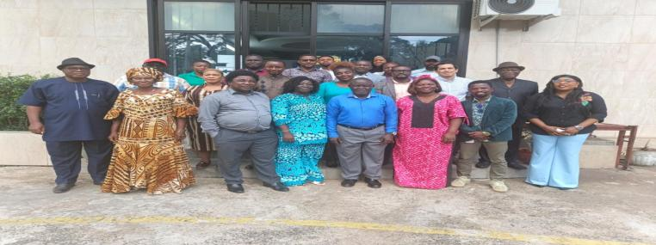
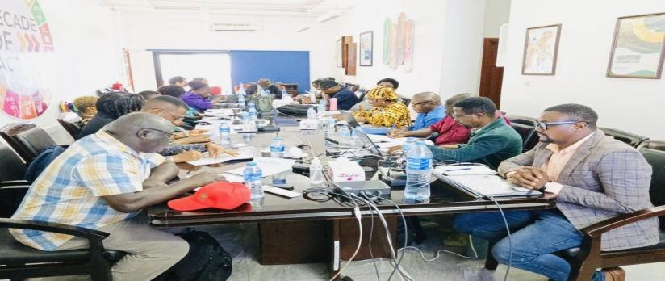
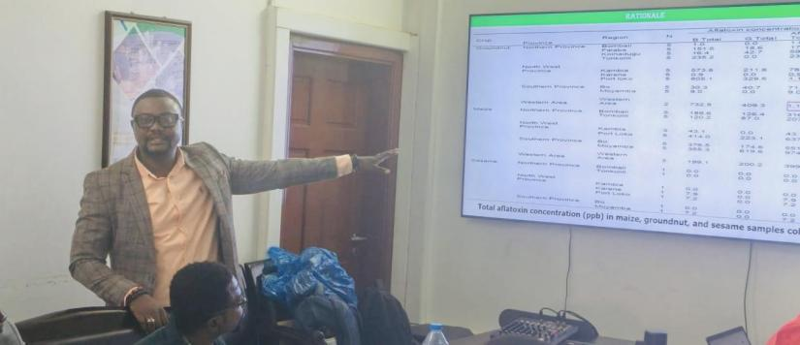
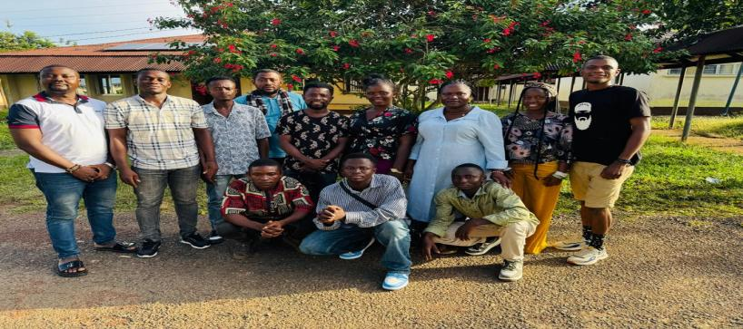
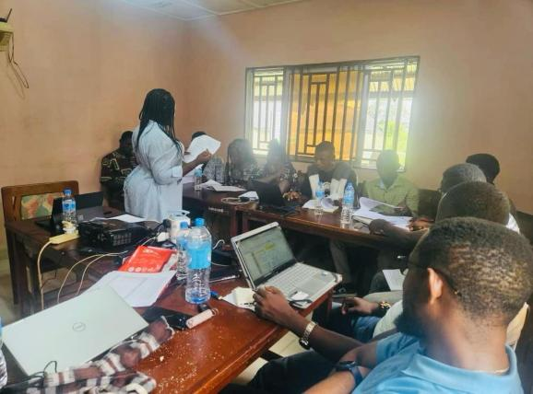
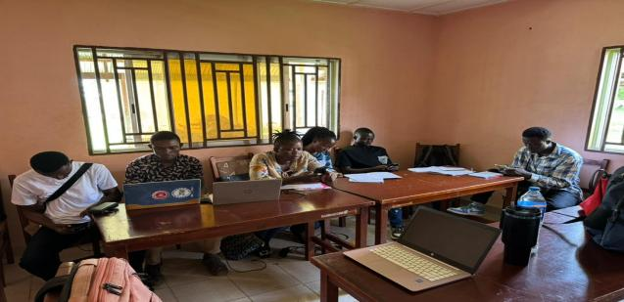
Figure 9. Photographic display of participants on one-day stakeholder meeting on critical food safety, dietary exposure and consumer awareness of mycotoxin contamination in Sierra Leone
Figure 10. Group photo of trainers and data collection team
Figure 11. Trained data collectors rehearsing the updated data collection tool

Slide 25
Table 8. Mycotoxins Training and Data Collection
NAME OF PROJECT | OBJECTIVES | BRIEF SUMMARY | CURRENT STATUS
Comparative Analysis of Economics Performance and Agronomic Practices in Groundnut production. Evidence from Research and small holder systems in Sierra Leone | To estimate and compare the profitability of groundnut production between NARC research station and small holder farmers managed plots;. To identify and assess the key agronomic practices used in groundnut production across the two systems; To determine the socio-economic and agronomic factors influencing profitability among smallholder groundnut producers; To evaluate the level of adoption of improved groundnut production technologies and inputs among smallholder farmers relative to research station practices. | Project proposal fully developed; Complete set of field data collection tools drafted (household questionnaire included in document). Secondary data from SLARI/NARC research station trials identified for comparative analysis; Land preparation Complected at the research station and the five farmers’ fields; Trial establishment: completed at the research station and the five farmers’ fields | Draft research proposal Completed; Survey instruments and methodology framework Documented; Literature review summarizing productivity constraints and adoption gaps in groundnut farming.

Slide 26
Planned Activities for Next Period:
Conduct complete household data collection in Moyamba District (pending funding).
Clean, verify and analyse farmer field data to compare with research station data.
Perform profitability analysis, input-use efficiency analysis, and adoption modelling.
Draft full scientific manuscript and policy brief.
Present preliminary findings to NARC/SLARI and district stakeholders.

Slide 27
Table 9. Update on Flash Dryer Operationalised Grant
NAME OF PROJECT | OBJECTIVES | BRIEF SUMMARY | CURRENT STATUS
Operationalizing cassava flash dryer for high throughput processing of cassava products | To open and clear the designated road corridor from the main access point to the cassava factory building site;. To remove unwanted vegetation, trees, and obstacles obstructing safe passage; To prepare the area for subsequent civil works such as grading, leveling, drainage installation, and surfacing; To strengthen and restore the factory’s structural and functional integrity. | Factory is now fully rehabilitated and suitable for processing cassava into flour, gari, or other value-added products. The rehabilitated space now allows for better workflow, from raw material entry to final product output; | Rehabilitation of the cassava flash drier factory has completed.

Slide 28
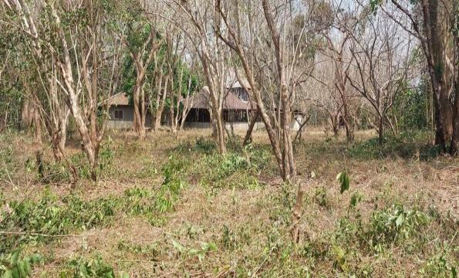
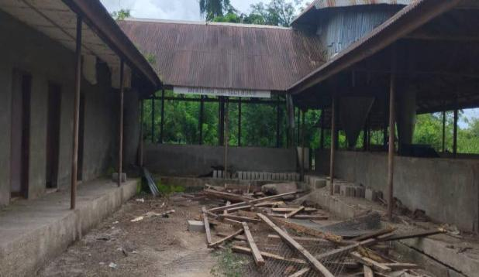







Figure 12. Status of the factory before FSRP intervention
Figure 13. Status of the factory after FSRP intervention

Slide 29
Table 10. Update on Flash Dryer Operationalised Grant
NAME OF PROJECT | OBJECTIVES | BRIEF SUMMARY | CURRENT STATUS
Accelerating sustainable soybean value chain for improved Income, Nutrition, and Health in Sierra Leone (Partner: IITA) | To develop, evaluate and promote different soybean products; To evaluate consumer acceptability and willingness to pay for soybean; To demonstrate cooking and feeding of local complementary foods enriched with soybean and soy milk with mothers and caregivers in selected districts in the country conducted; To organize soybean campaign sessions at schools, hospitals, churches, mosques, and community levels. | A total of 1,000 consumers were engaged; 500 for traditional products and 500 for novel products. A total of 10 districts were included in the study based on stunting prevalence from the Sierra Leone National Nutrition Survey (2021) and previous soybean-related interventions. | Training manual on soybean processing, value addition, and utilization has been developed; Data Management, and analyses; Report writing.

Slide 30








Quantitative trait nucleotides in white yam
a
b
Figure 15: Soybean enriched products
Figure 14: Explaining to the participants on the relevant of the study

Slide 31




KFTCRC
Establishment of Coffea canephora plots at Bambawo, Pendembu and Kpuwabu
1 ha each of C. robusta was established at Pendembu, Bambawo and Kpuwabu in August, 2025.
Brushing, shade management and mulching are ongoing
Figure 16. Field Layout of 1-ha each at Pendembu, Bambawo and Kpuwabu

Slide 32




KFTCRC
IFAD SUPPORT MISSION TEAM
In September, 2025, the OIC of KFTCRC did a presentation on the status of the tree crop component implementation of the AVDP
A total of 700 pods were supplied to the AVDP, equivalent to 24,500 seeds/seedlings.
These have been nursed by the project for next year’s planting season
Below are F₁ generation cocoa hybrid
C67 x C77
C74 x C20
C75 x C25
C68 x C22
Figure 17. F₁ cocoa hybrids

Slide 33

Figure 18. Stolen cocoa pods

Slide 34
TLRC
NAME OF PROJECT | OBJECTIVES | BRIEF SUMMARY | CURRENT STATUS
Stakeholder Engagement on the Design and Construction of a Biodigester Prototype under FSRP Grant to SLARI-TEKO | To refine the biodigester design, ensuring efficient organic waste conversion, optimising biogas production, and establishing safety and sustainability protocols. | A comprehensive assessment of waste availability and site selection done. Livestock manure from cattle and goats, crop residues and market waste were measured. Seasonal variations, feedstock consistency, and current disposal methods were analysed to ensure a dependable biomass supply for the digester | Biodigester Prototype designed and constructed; Post-Construction Training: Organize hands-on maintenance sessions for assigned operators; Monitoring Protocols: Establish weekly check-ins to assess gas yield, consistency of feedstock input, and slurry output; Scale-Up Feasibility: Begin planning for multi-unit deployment targeting farmer cooperatives and agro-processing centres; Impact Documentation: Develop a storytelling toolkit that captures the transformation from waste to resource, emphasizing the roles of women and youth.

Slide 35







Slide 36
TLRC
NAME OF PROJECT | OBJECTIVES | BRIEF SUMMARY | CURRENT STATUS
Design and Construction of a Biodigester Prototype under FSRP Grant to SLARI-TEKO | To efficiently convert organic waste, primarily from livestock manure, into renewable biogas suitable for cooking and heating; To generate a nutrient-rich digestate, which serves as a valuable organic fertilizer for agricultural use. | This dual benefit not only addresses waste management issues but also promotes sustainable farming practices by enhancing soil fertility through the use of the byproduct. The deployment of the biodigester marks a significant step towards sustainability in livestock operations and energy production within the region. | Biodigester Prototype designed and constructed; Post-Construction Training: Organize hands-on maintenance sessions for assigned operators; Monitoring Protocols: Establish weekly check-ins to assess gas yield, consistency of feedstock input, and slurry output; Scale-Up Feasibility: Begin planning for multi-unit deployment targeting farmer cooperatives and agro-processing centres; Impact Documentation: Develop a storytelling toolkit that captures the transformation from waste to resource, emphasizing the roles of women and youth.

Slide 37





Figure 19. Photos of participants involvement in the Design and Construction of a Biodigester Prototype

Slide 38
TLRC
NAME OF PROJECT | OBJECTIVES | BRIEF SUMMARY | CURRENT STATUS
Training of Fifty Farmers on Anaerobic Biodigester Design and Construction under FSRP Grant to SLARI-TEKO | To introduce farmers to the principles and benefits of anaerobic digestion; To build capacity in biodigester design tailored to local agricultural and livestock waste streams; To promote sustainable waste management and renewable energy generation in rural communities; To prepare farmers for the future construction of biodigesters post-rainy season. | Training of 50 Farmers on Anaerobic Biodigester Design and Construction (Tonkolili, Koinadugu, and Falaba). Schedule follow-up practical sessions post-rainy season to reinforce design concepts with hands-on construction. Develop simplified visual manuals in local languages to support farmer-led implementation; Establish district-level farmer cooperatives to facilitate peer learning and resource sharing; Monitor temperature trends and develop adaptive strategies for biodigester operation in fluctuating climates. | Trained 50 farmers in Musaia;

Slide 39


Figure 20. Photos of smallholder farmers, livestock rearers, and community development volunteers

Slide 40
MLWERC
NAME OF PROJECT | OBJECTIVES | BRIEF SUMMARY | CURRENT STATUS
Effect of Lime, Biochar, and Different Levels of Nitrogen Fertilizer on Maize (Zea mays L.) Crop | To determine how lime application influences soil pH and maize performance To evaluate the impact of biochar on soil structure and nutrient availability; To assess maize growth response to four nitrogen fertilizer levels; To identify the best combination of amendments for optimal maize yield. | Treatment structure: Control + N levels (C + N0, C + N1, C + N2 & C + N3); Lime + N levels (L + N0, L + N1, L + N2 & L + N3); Biochar + N levels (B + N0, B + N1, B + N2 & B + N3); Lime + Biochar + N levels (L + B + N0, L + B + N1, L + B + N2 & L + B + N3). B@ 2 t ha⁻¹; L@2 t ha⁻¹ ; N0 = 0 kg N/ha; N1 = 50 kg N/ha; N2 = 100 kg N/ha; N3 = 150 kg N/ha. Biochar-treated plots exhibited improved plant height. Combined application of lime + biochar + higher N levels resulted in visibly larger and greener plants compared to control plots | Vegetative parameters collected; Harvest and post-harvest data ongoing.

Slide 41
MLWERC
NAME OF PROJECT | OBJECTIVES | BRIEF SUMMARY | CURRENT STATUS
Assessing climate smart characteristics of agricultural technologies and innovations in FSRP countries | To identify and list the potential technologies and innovations; To assess the climate-smart characteristics of the technologies and innovations. |  | Vegetative parameters collected; Harvest and post-harvest data ongoing.

Slide 42
Table 11: List of technologies and innovations evaluated
Categories | Name of the technology or innovation | Origin (if applicable) | Status (deployed or to be disseminated
Crop variety | SLINUT 2 | International Crop Research for the Semi- Arid Tropics (ICRISAT) | Deployed
Crop variety | SLICASS 4 | International Institute of Tropical Agriculture (IITA) | Deployed
Crop variety | SLICASS 6 | Njala Agricultural Research Centre/Sierra Leone Agricultural Research Institute (NARC/SLARI) | Deployed
Crop variety | SLICASS 7 | IITA | Deployed
Crop variety | SLICASS 10 | NARC/SLARI | Deployed
Crop variety | SLIPEA 2 | IITA | Deployed
Crop variety | SLIPEA 5 | IITA | Deployed
Crop variety | ROK 34 (Pa Kiamp) | Rokupr Agricultural Research Centre (RARC/SLARI) | Deployed
Crop variety | ROK 5 | RARC/SLARI | Deployed
Crop variety | ROK 10 | RARC/SLARI | Deployed
Crop variety | Nerica L19 | WARDA | Deployed
Crop variety | SLIPOT1 (Kaphulira) | IITA | Deployed
Crop variety | SLIPOT 5 (Mathuthu) | IITA | Deployed
Crop variety | SLIPOT3 (Chipka) | IITA | Deployed
Fertilizers or Pests management product | NPK (15-15-15) | NA | Deployed
$σ^{2}$=variance, and $σ$=standard deviation

Slide 43
Table 11: Cont’d
Fertilizers or Pests management product | DAP | NA | Deployed
Fertilizers or Pests management product | Granular urea | NA | Deployed
Small Equipment | Mechanised peeler for cassava | Fomel Industry and National Industrialization Centre (FINIC) – Sierra Leone (SL) | Deployed
Small Equipment | Cassava grater | FINIC – SL | Deployed
Small Equipment | Hhdraulic press for cassava | FINIC – SL | Deployed
Small Equipment | Tray for cassava | FINIC – SL | Deployed
Small Equipment | Rice thresher | China | Deployed
Small Equipment | Combined mini-harvester | China | Deployed
Small Equipment | Rice miller | China | Deployed
Small Equipment | Solar-powered drip irrigation system for vegetable production | China | Deployed
Small Equipment | Growing in greenhouse | China | Deployed
Agricultural Practice | Intercropping (cassava and groundnut) | NA | Deployed
Agricultural Practice | Intercropping (cassava and cowpea) | NA | Deployed
Agricultural Practice | Crop rotation | NA | Deployed

Slide 44
Figure 21: Climate-smartness of technologies

Slide 45


Category I: Best-bet crop seed varieties or animal breeds
Technology | Comment | Photo
 | P: The variety is high yielding (> 33 t/ha), increasing farmers’ income, and highly nutritious A: Resistant to ACMD and CBB, fairly tolerant to CGM and Mealy Bugs (MB), generally accepted by farmers across the country, has multiple revenue streams, tolerant to drought, and gender sensitive – provides income opportunities for women M: It contributes to soil organic matter, enhancing fertility and reducing erosion, and it utilizes nutrients efficiently

Slide 46


Category I: Best-bet crop seed varieties or animal breeds
Technology | Comment | Photo
 | P: High yielding, increases income, nutritious A: Resistant to ACMD and BB, fairly tolerant to CGM and MB, Improves Soil structure, generally accepted, income diversification, withstands dry spells, gender sensitive M: It contributes to soil organic matter

Slide 47


Category I: Best-bet crop seed varieties or animal breeds
Technology | Comment | Photo
 | P: Yields up to 4 t/ha, more than the country average in the last five years (1.76 t/ha) increases income, nutritious A: Resistant to rice blast, can thrive in various rice ecologies (upland, IVS, bolilands, etc), it is a gender sensitive variety M: Minimizes reliance on synthetic fertilizers, lowering greenhouse gas (ghg) emission

Slide 48


Category I: Best-bet crop seed varieties or animal breeds
Technology | Comment | Photo
 | P: Among the highest yielding (35 – 40 t/ha) cassava varieties in the country, increase income A: Resistant to ACMD and CBB, fairly tolerant to CGM and MB, generally accepted, income diversification, withstands dry spells, and gender sensitive M: Contributes to soil organic matter, improving soil structure.

Slide 49


Category II: Fertilizers or Pests management products
Technology | Comment | Photo
 | P: Boost nutrient supply, increase crop yields by optimizing nutrient availability A: It is a socially accepted agricultural input countrywide. M: N volatilization is reduced when urea is applied in splits, minimizing GHG (N₂O) emissions; N use efficiency increases when urea is applied at optimal rate; it prevents excessive land expansion for agriculture.

Slide 50


Category II: Fertilizers or Pests management products
Technology | Comment | Photo
 | P: NKP 15:15:15 provides a balanced supply of N, P and K, enhancing crop yields and farmers’ income A: Balanced NPK application improves crop resilience against drought and other extreme weather conditions M: NPK 15:15:15 supports carbon sequestration by improving SOM; it reduces land degradation by preventing excessive land expansion for agriculture.

Slide 51


Category II: Fertilizers or Pests management products
Technology | Comment | Photo
 | P: DAP helps farmers achieve higher productivity and income through enhanced root and shoot growth A: It enhances drought tolerance, helping crops withstand erratic rainfall M: Its efficient application enhances soil health, reducing the need for excessive land expansion and deforestation

Slide 52


Category III: Small equipment
Technology | Comment | Photo
 | P: Greenhouse protects crops from unpredictable rainfall, extreme temperatures, and pests, ensuring stable conditions for growth and higher yields and income A: It allows farmers to grow more produce with far less water (up to 86% reduction); it allows farmers to grow high value crops, increasing income potential; protects crops from pests’ attack M: It lowers carbon footprint by optimizing resource use, reducing reliance on deforestation for farmland expansion. | Source: www.bing.com/images/

Slide 53


Category III: Small equipment
Technology | Comment | Photo
 | P: The technology extends the growing season, allows farmers to cultivate vegetables year-round, increasing overall yield and income A: The system lowers the need for manual watering, saving time and resources M: It replaces diesel pumps, cutting GHG emissions and reliance on fossil fuels. | Solar water supply & irrigation project in SL Source: www.bing.com/images/

Slide 54


Category III: Small equipment
Technology | Comment | Photo
 | P: It reduces the drying time of cassava mash, allows for large volumes of cassava to be processed, increasing gari production capacity and reducing post-harvest loss A: It minimizes manual efforts, making processing simpler and efficient. It reduces the risk of losing cassava roots to pests and is accepted nationwide M: It reduces the reliance on fuel-wood | FINIC cassava presser machine

Slide 55


Category III: Small equipment
Technology | Comment | Photo
 | P: It minimizes waste, ensuring higher yields A: It reduces labour time and increases output. It reduces post-harvest losses and is accepted nationwide M: Reducing post-harvest losses ensures more rice is available for consumption and reducing the need for expanded cultivation and land degradation.

Slide 56


Category IV: Practices
Technology | Comment | Photo
 | P: The technology maximizes land productivity; improves overall output and profitability A: It reduces pest and disease pressure and the risk of crop failure; it allows farmers to harvest multiple crops from the same plot, ensuring diverse income sources M: It enhances soil organic carbon stock, supporting sustainable land management

Slide 57


Category IV: Practices
Technology | Comment | Photo
 | P: It improves overall farm output and profitability A: M: It enhances the soil organic carbon stock

Slide 58


Category IV: Practices
Technology | Comment | Photo
 | P: It increases overall farm output and profitability A: It helps replenish essential nutrients, disrupts pest cycles, reduces the need for synthetic fertilizers M: It enhances soil organic carbon sequestration

Slide 59
OCP AFRICA
NAME OF PROJECT | OBJECTIVES | BRIEF SUMMARY | CURRENT STATUS
OCP Africa Agronomic Demonstration Trials in Sierra Leone | To improve soil fertility and productivity for increased crop productivity. | The OCP Africa agronomic demonstration trials were established in 49 locations of Sierra Leone. Of the 49 sites, 17 were IVS rice, 14 maize, 13 cassava and 5 sites were groundnut; The potential impact of OCP Africa's initiatives is aimed at creating a resilient, productive, and sustainable agricultural sector in Sierra Leone | Data collection is ongoing; IVS Rice harvesting has begun at some sites

Slide 60












Slide 61
Monographs and related assignments
A couple of monographs have been drafted
The yam monograph has been completed
The coffee monograph is about 90% complete.
The remaining monographs on the other value chains are in progress.
The first Annual Report for 2025 will be completed by end of January 2026.

Slide 62

































ACKNOWLEDGMENTS
RESADE-SL
HELD AT RARC CONFERENCE ROOM, 17th DECEMBER, 2025.
8

