Slide 1



Report to SLARI Council by
Acting Director-General - Dr Abdul Rahman Conteh
Wednesday, July 31, 2024

Slide 2
THE 19TH REGULAR SLARI COUNCIL MEETING – JULY 31, 2024 AT 10AM
AGENDA
Opening Prayers
Individual Introduction of members present
Chairman’s Opening Remarks – Dr. Alfred G. O. Dixon
Minutes of 18TH Regular Council Meeting
Matters arising from the Minutes (Action points)
Report of the Appointments, Promotions and Performance Committee
Acting Director-General’s Report – Dr. Abdul Rahman Conteh
Research Report – Dr Prince Norman
Commercialization Report – Dr Isata Kamanda
Any other business

Slide 3
Recommendations from the 18th SLARI Council meeting
The following were the recommendations:
HR manual and Conditions of Service should be reviewed and in line with the new Act and the Sierra Leone labour laws.
All centres will be visited by council members and council meetings will be rotated.
Chairman encouraged the Ag. DG to complete the work he had started.
A consultant should be hired on short term to carry out an assessment of SLARI to complement the Self-Assessment done by SLARI.
It was recommended that the Ag. DG should put together his plans, funds needed, and what he wants to achieve within a time frame.
It was recommended that a lobbying team be set up to help SLARI management source funds for the Institute. The Chairman suggested Senior Permanent Secretary and the Chief Agriculture Officer of the Ministry of Agriculture to be in that group.

Slide 4
The Senior Permanent Secretary advised the Council to book an appointment and meet with the Minister of Agriculture to make a case for SLARI conditions.
It was advised that all new recruitment be freezed so that the money could be used to increase the personnel emolument.
The finance unit should be involved in all project development.
An appeal was made to the Senior Permanent Secretary to help SLARI recover some of the land lost at John Obey; if it cannot be recovered to enable the Ministry of Lands to allocated another plot of land to SLARI.
Finally, the representative of NaFFSL appeal that all that have been said should not be just a mere talk it should be implemented.
It was that there should be a team for project writing in the manner that will attract donor funding and the representative for SLeCAD promised to help in that direction.
It was recommended that a weekly or monthly seminars should be organized at centre level for all Researchers.

Slide 5
Creating a conducive environment for research coordination at the headquarter
Financial controls
Internal Auditors must check and verify every request before approval
Institutional Audit at least three times a year
Three Packed vehicles have been repaired and in current use
Strengthening communication
Involvement of Finance in Project Development
Deputies and Assistants to be made more relevant
Appointment of two Deputy Director-Generals;
    Research, Technology and Innovation
    Commercialization and Agribusiness Development

Slide 6


Slide 7
Ensuring that the SLARI Act of 2023 is activated
The minimum terms and conditions of service of the Institute shall be determined by Council and be made equivalent to or better than those of Vice-Chancellors and Principals of Njala University, University of Sierra Leone or other public universities in Sierra Leone.

Slide 8
Issues
Harmonize Salaries in line with universities
Retirement age for Senior Staff
Staff replacement

Slide 9
Reactivate the Annual Work Planning and Performance Conference (Food Systems Research Platform) of 2024.
The object for which the Institute is established is to serve as the national agricultural technological research body of institute responsible to:
conduct, facilitate, promote, coordinate and regulate a national food system through the Food Systems Research Platform; participate in agricultural innovations and technology transfer processes.

Slide 10
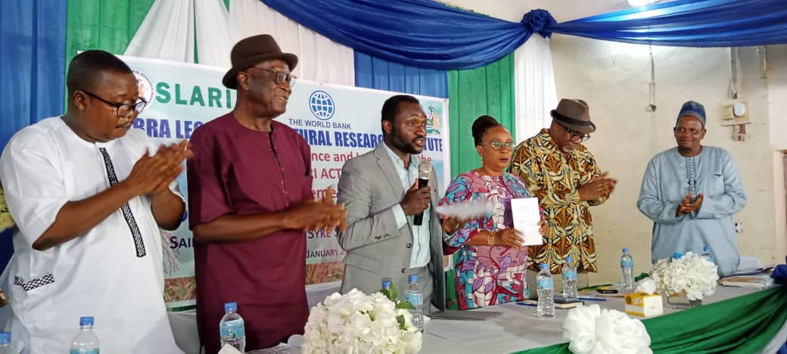

Slide 11
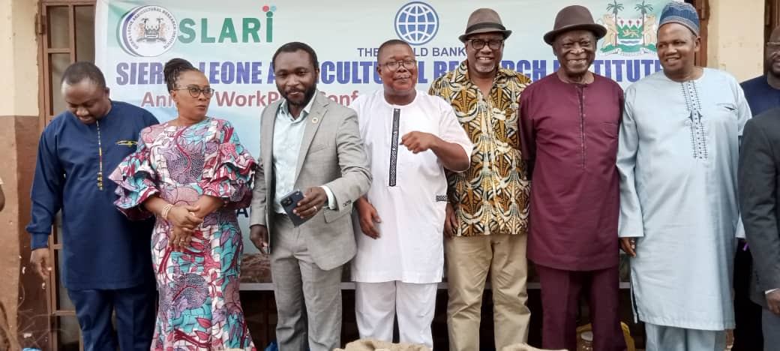

Slide 12
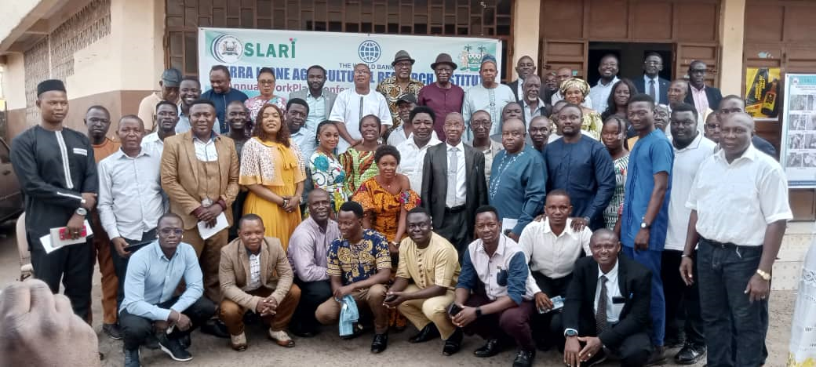

Slide 13
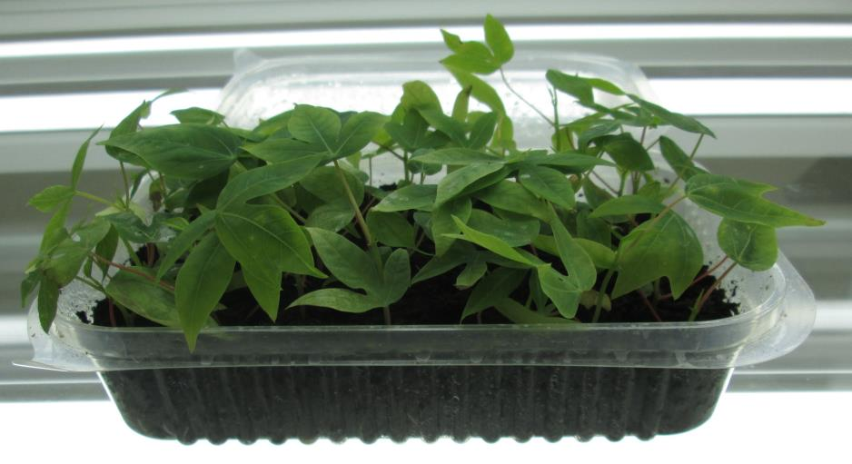
Semi-Autotrophic Hydroponics (SAH)
Cassava Propagation System
“A novel, low-cost method for rapid propagation of true-to-type, virus-free cassava planting material”

Slide 14
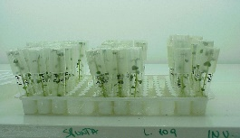
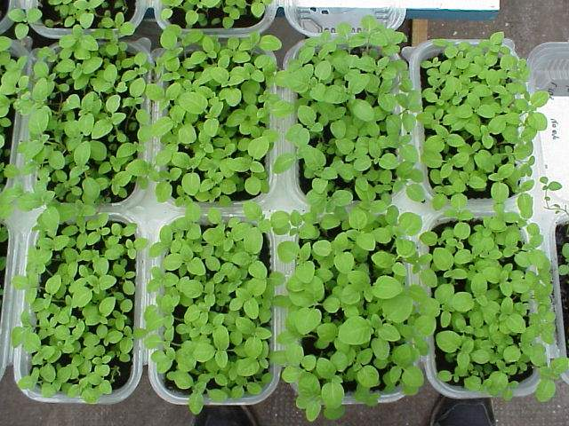
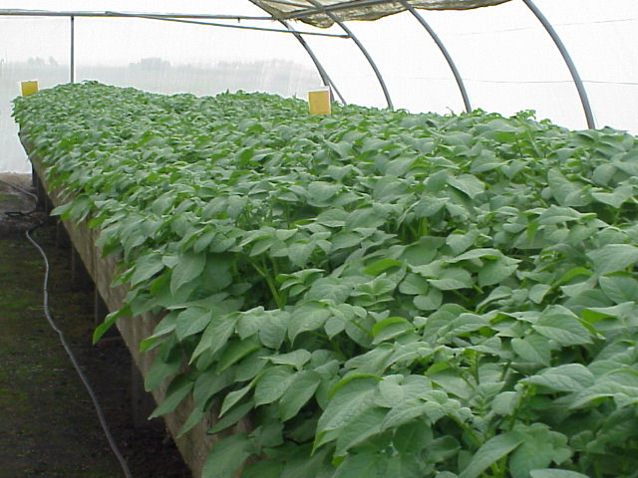
SAH is a licensed technology developed in Argentina transferred to Nigeria
A few virus-free mother plants
SAH Lab
SAH plants
Greenhouse or
Field
Tubers, roots or plants

Slide 15
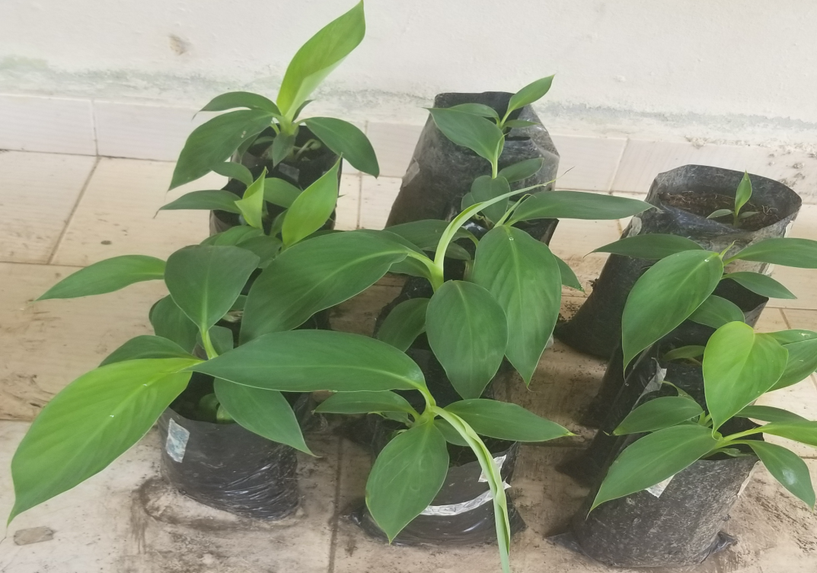
Full nursery establishment plantain plantlets ready for field

Slide 16
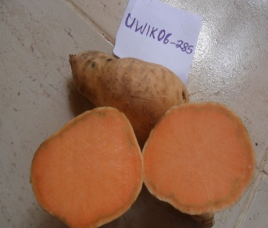
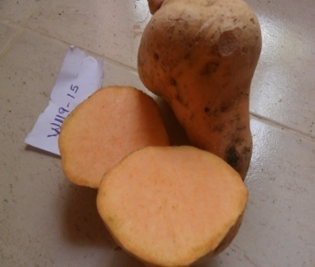
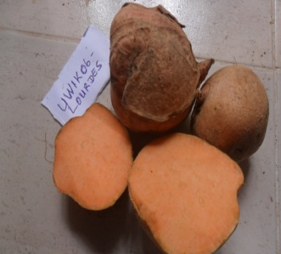
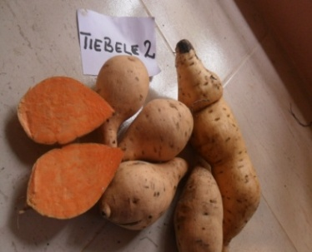

Slide 17
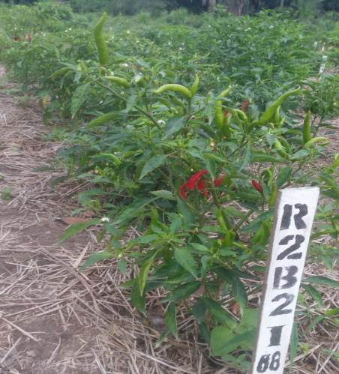
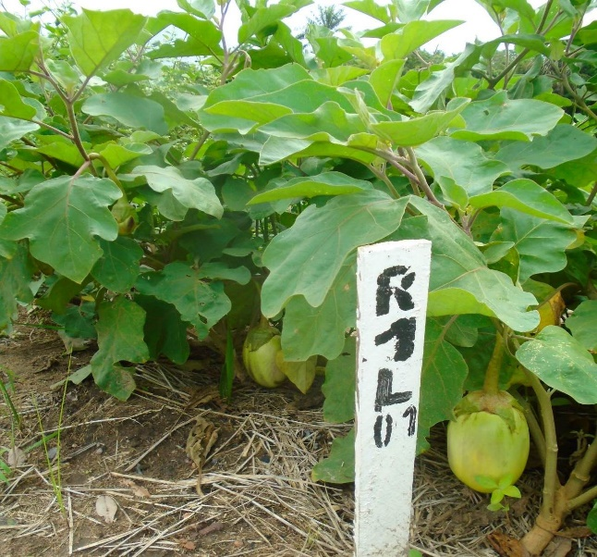
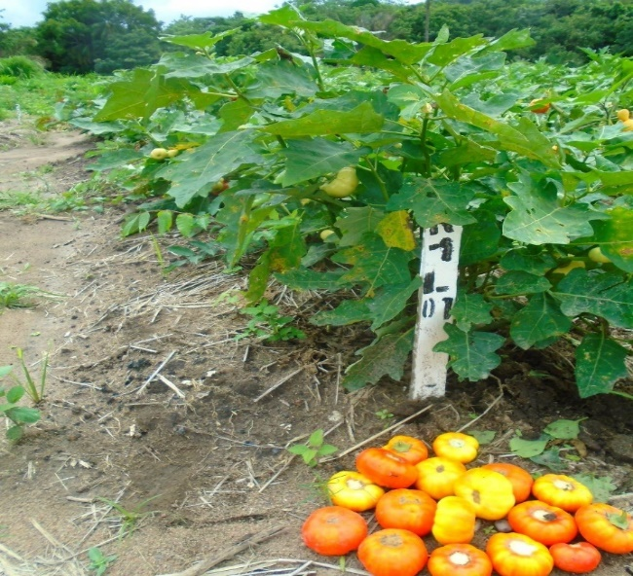
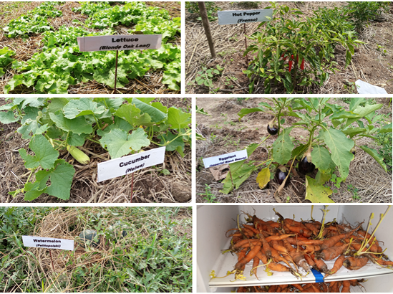

Slide 18
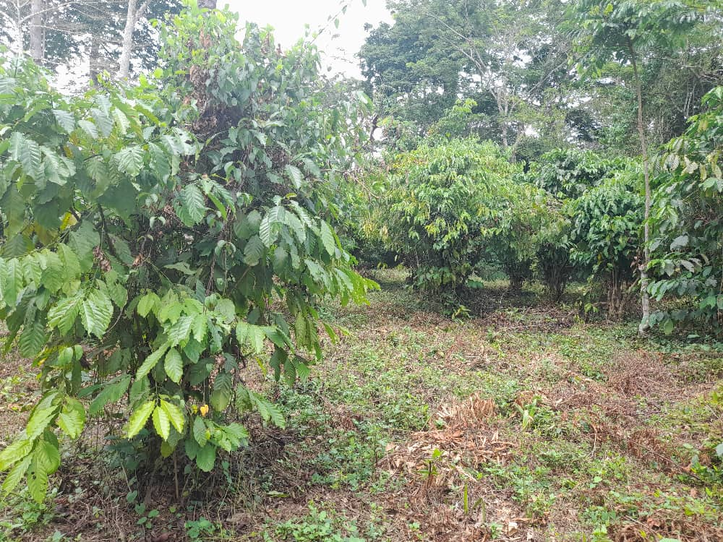
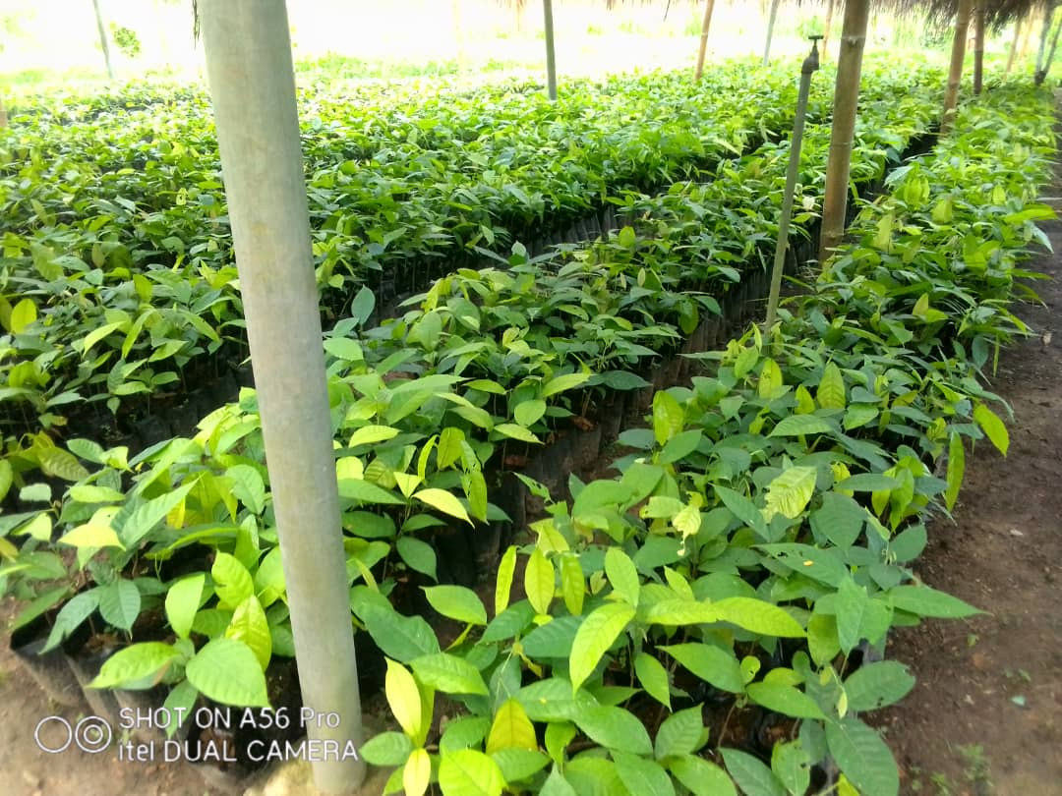
Generation and Development of Cocoa Hybrids
High Yielding Coffea canephora

Slide 19
Organize scoring committee for assessment of scientific staff for promotions
Research – University Equivalencies
University | Research (SLARI)
Lecturer II | Research Officer II
Lecturer I | Research Officer I
Senior Lecturer | Senior Research Officer
Associate Professor | Principal Research Officer
Professor | Chief Research Officer

Slide 20
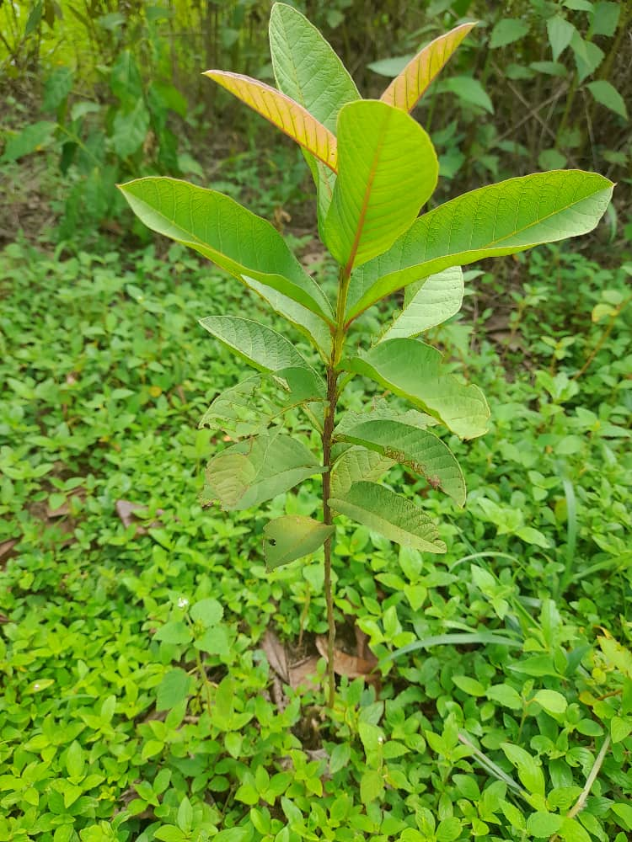
REPORT OF THE SCORING COMMITTEE
The committee was made up as follows:
Prof. Abdul Babatunde Karim – USL
Prof. Abdul Rahman Sesay, Dean of Postgraduate Studies, N.U.
Prof. Alieu M. Bah, Deputy Vice Chancellor, N.U.
Prof. Adolphus Johnson, School of Agriculture, N.U.
The committee was chaired by Prof. Abdul Babatunde Karim
The scoring was done using the old guidelines of the university scoring and the SLARI Summary Scoring Sheet detailing the Minimum Scores for Categories for Promotion.
C D
Plates A, B, C and D: Pawpaw, Avocado, Mango and Guava respectively

Slide 21
The committee was also guided by the following:
TO BE APPOINTED/PROMOTED TO THE POSITION OF CHIEF RESEARCH OFFICER, YOU MUST HAVE SERVED IN THE POSITION OF PRINCIPAL RESEARCH OFFICER
TO BE APPOINTED/PROMOTED TO THE POSITION OF PRINCIPAL RESEARCH OFFICER, YOU MUST HAVE SERVED IN THE POSITION OF SENIOR RESEARCH OFFICER
TO BE APPOINTED/PROMOTED TO THE POSITION OF SENIOR RESEARCH OFFICER, YOU MUST HAVE SERVED IN THE POSITION OF RESEARCH OFFICER I
TO BE APPOINTED/PROMOTED TO THE POSITION OF RESEARCH OFFICER I, NORMALLY A PhD IS REQUIRED AND YOU MUST HAVE SERVED IN THE POSITION OF RESEARCH OFFICER II
C D
Plates A, B, C and D: Pawpaw, Avocado, Mango and Guava respectively

Slide 22
 | Chief Research Officer | Principal Research Officer | Senior Research Officer | Research Officer I
AREAS FOR SCORING | MINIMUM POINTS SCORABLE | MINIMUM POINTS SCORABLE | MINIMUM POINTS SCORABLE | MINIMUM POINTS SCORABLE
QUALIFICATIONS | 10.0 | 10.0 | 10.0 | 6.0
RESEARCH/PROFESSIONAL EXPERIENCE | 10.0 | 8.0 | 5.0 | -
RESEARCH AND PUBLICATIONS | 65.0 | 50.0 | 20 | 6
PROFESSIONAL ACTIVITIES | 6.0 | 5.0 | 2.0 | -
PUBLIC ACTIVITIES | 6.0 | 5.0 | 2.0 | -
ADMINISTRATIVE EXPERIENCE | 4.0 | 3.0 | - | -
TOTAL MINIMUM QUALIFYING SCORE | 110 | 90 | 40 | 10
C D
Plates A, B, C and D: Pawpaw, Avocado, Mango and Guava respectively

Slide 23
It was noted that there has not been any scoring for promotion/placement for over 10 years.
As a results staff has stagnated and therefore disadvantaged.
It is therefore strongly recommended that candidates who have served in the same position for more than ten years and have the minimum for R&D for a higher level be considered for upward mobility
Based on the recommendations of the Scoring Committee and the deliberations of the Appointment and Promotions Committee:
Two staff promoted to Chief Research Officer
One promoted to Principal Research Officer
Two staff promoted to Senior Research Officer
Eight staff promoted from Research Officer II to Research Officer I.
Two staff did not meet the requirement for promotion above the current level
Seven staff promoted to Research Officer I s a result of obtaining their Ph.Ds.
Eleven were stepped down due to incomplete documents.
C D
Plates A, B, C and D: Pawpaw, Avocado, Mango and Guava respectively

Slide 24
Visit to all SLARI research Centres
Date | Activity | Comment
Thursday, 14/03/24 | Travel to Rokupr (RARC), Kambia | Overnight in Rokupr
Friday, 15/03/24 | Meet staff of Rokupr, tour the facilities, Lunch and depart for Makeni (Teko). | Overnight in Makeni
Saturday, 16/03/24 | Travel to Kabala, meet staff at KHCRC, visit Musaia, return to Makeni | Overnight in Makeni
Sunday, 17/03/24 | Meet staff at Teko, tour the facilities, depart for Njala (NARC) | Overnight in Njala
Monday, 18/03/24 | Meet staff at Magbosi, tour the facilities, return back to Njala. | Overnight in Njala
Tuesday, 19/03/24 | Meet staff at NARC, tour the facilities, depart for Kenema. | Overnight in Kenema
Wednesday, 20/03/24 | Travel to Pendembu, tour the facilities and crop sites, meet the staff, depart back to Kenema. | Overnight in Kenema
Thursday, 21/03/24 | Meet the staff in Kenema, travel to Bambawo and return back to Kenema. | Overnight in Kenema
Friday, 22/03/24 | Travel to Kpuwabu, meet the staff and inspect the facilities. Depart to Freetown.

Slide 25
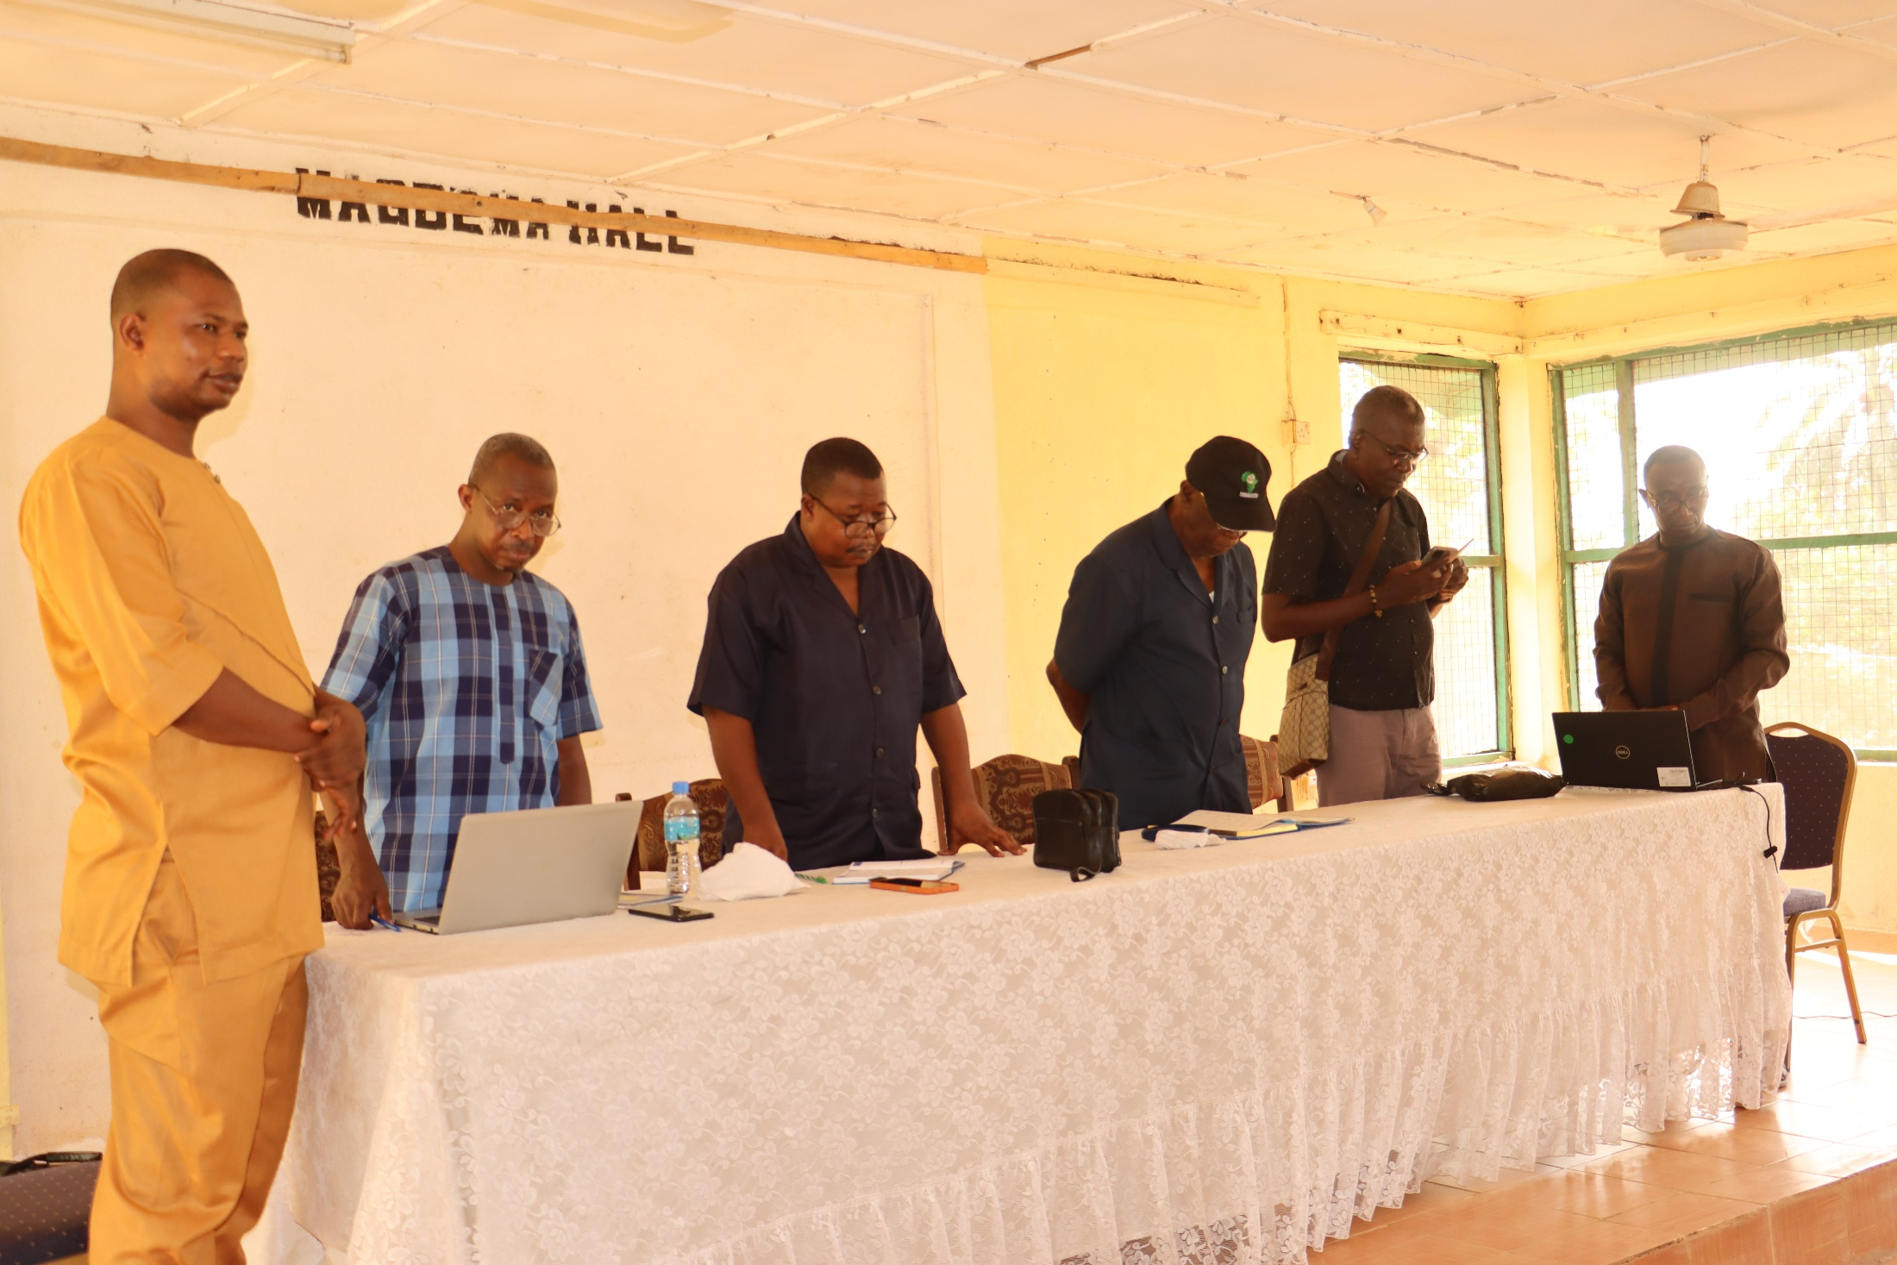
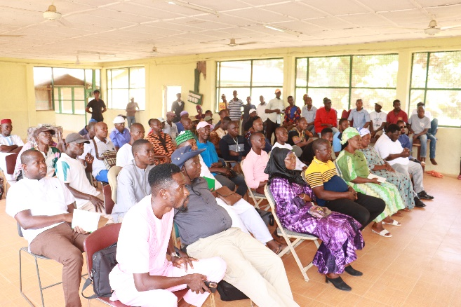

Slide 26
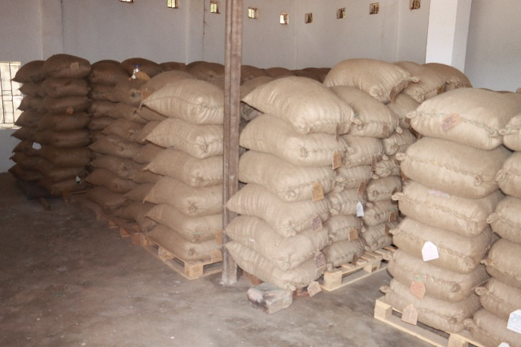

Slide 27
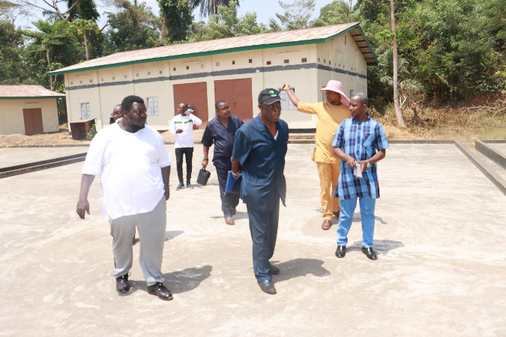

Slide 28
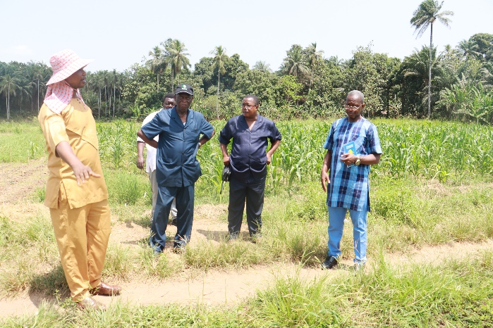

Slide 29
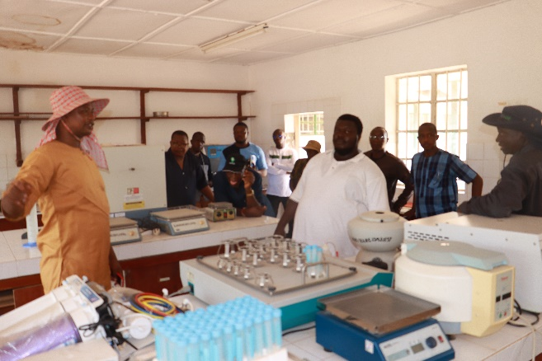

Slide 30
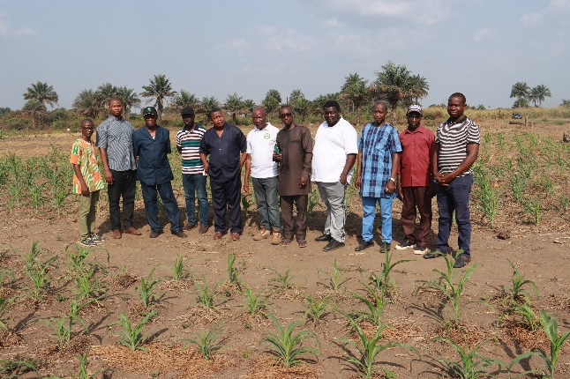

Slide 31
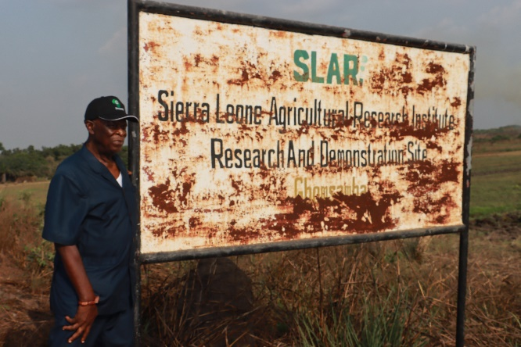

Slide 32
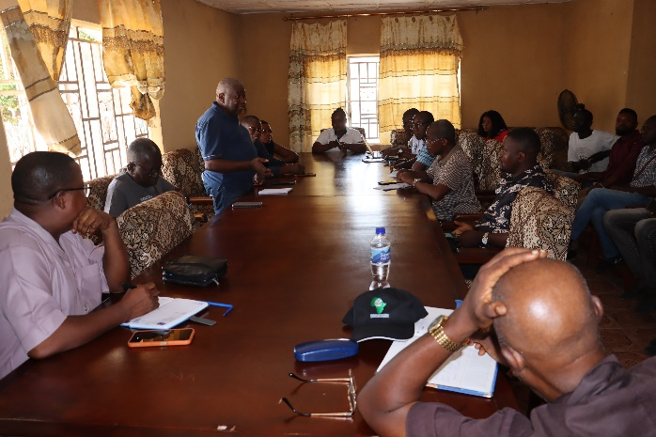

Slide 33
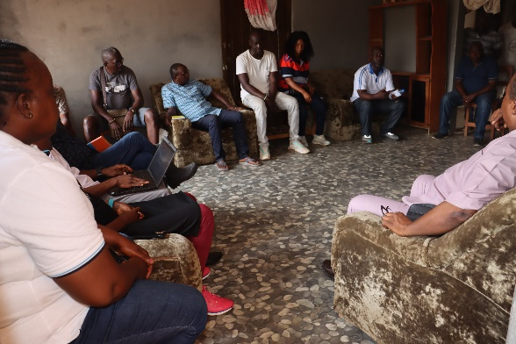

Slide 34
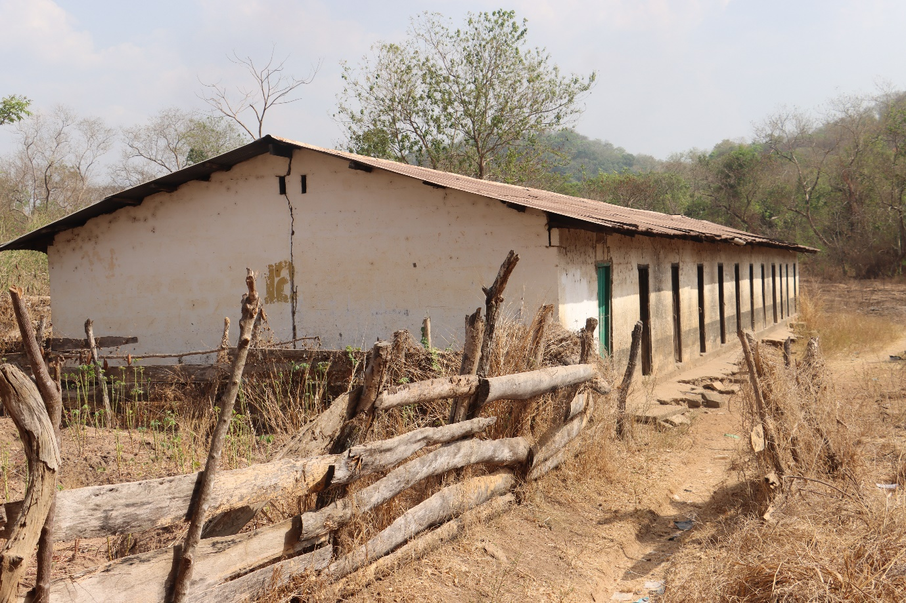

Slide 35
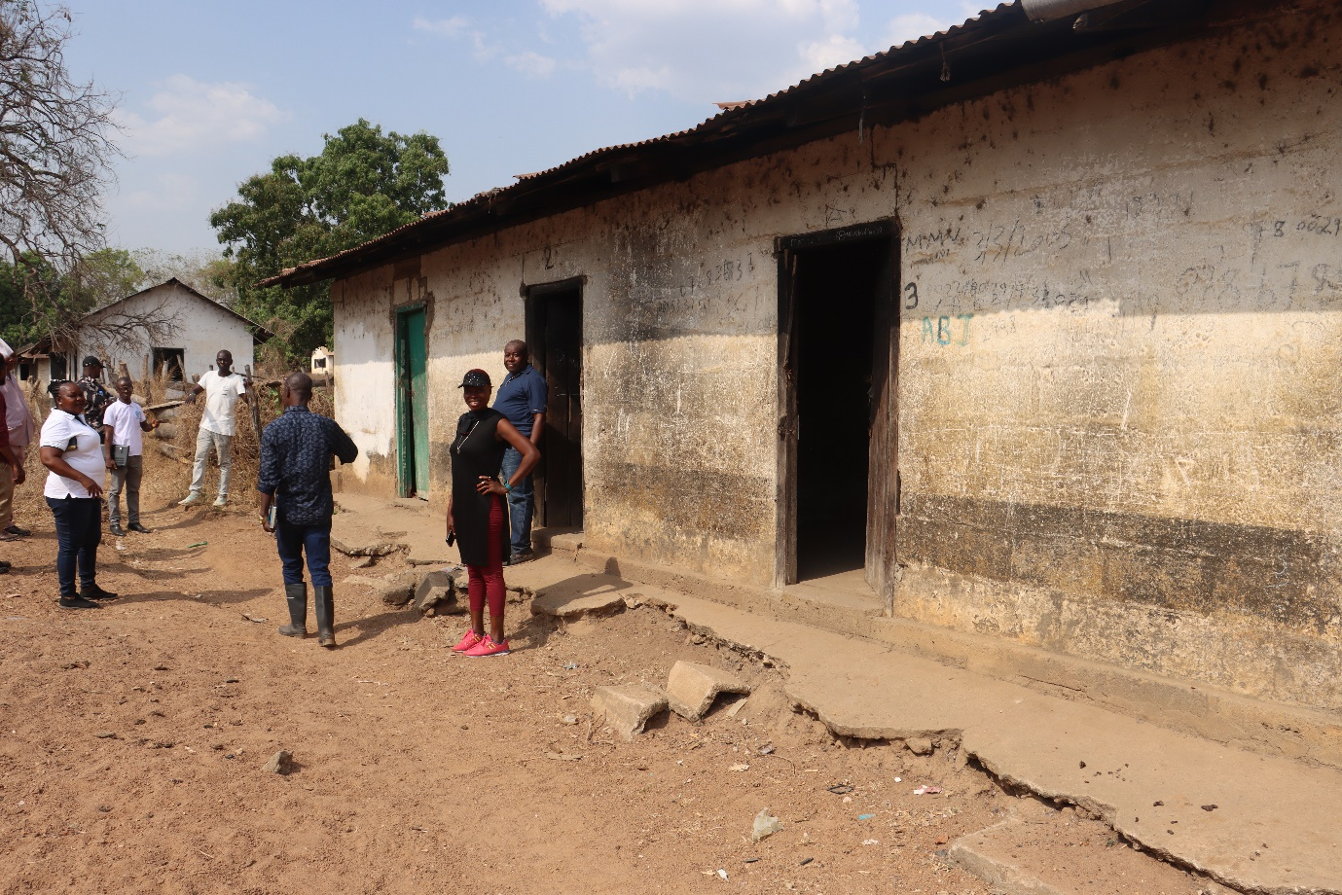

Slide 36
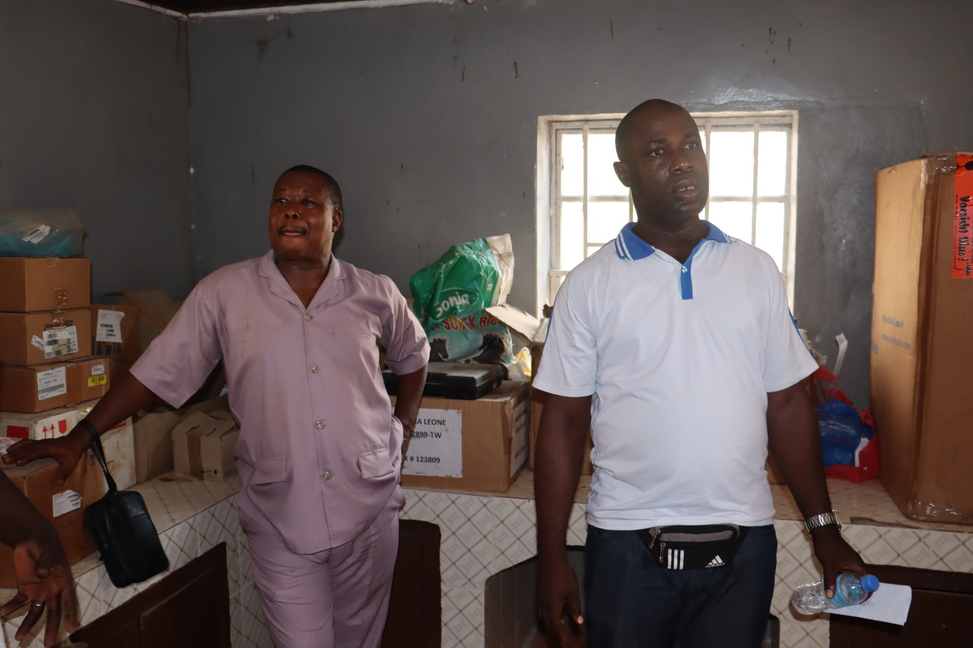

Slide 37
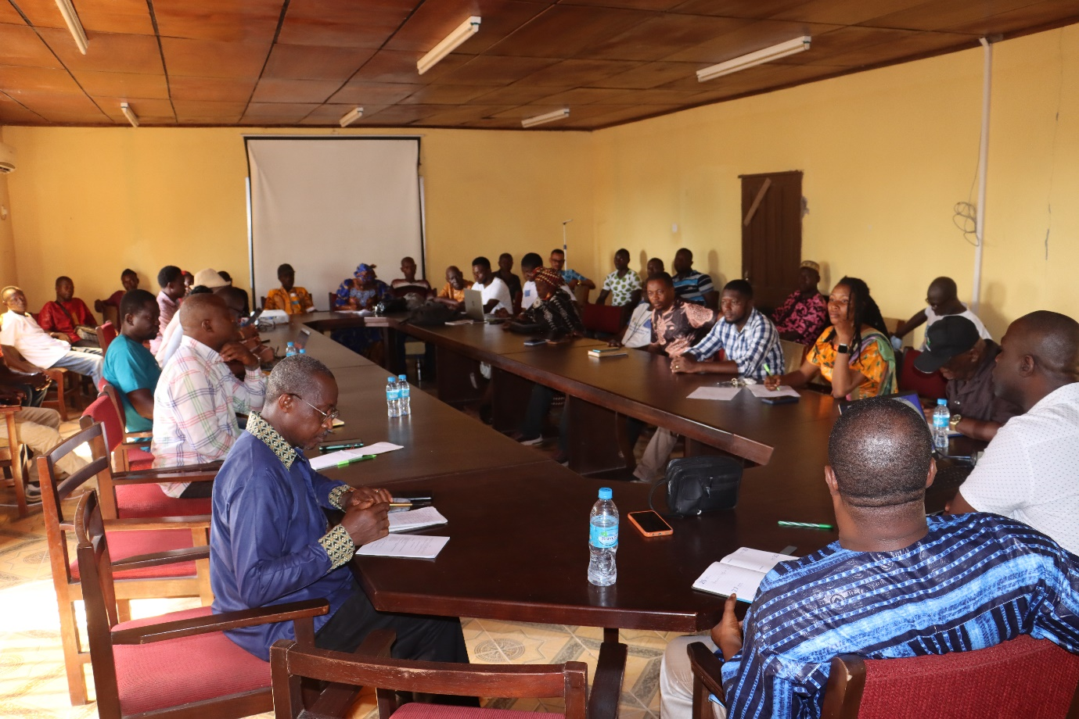

Slide 38
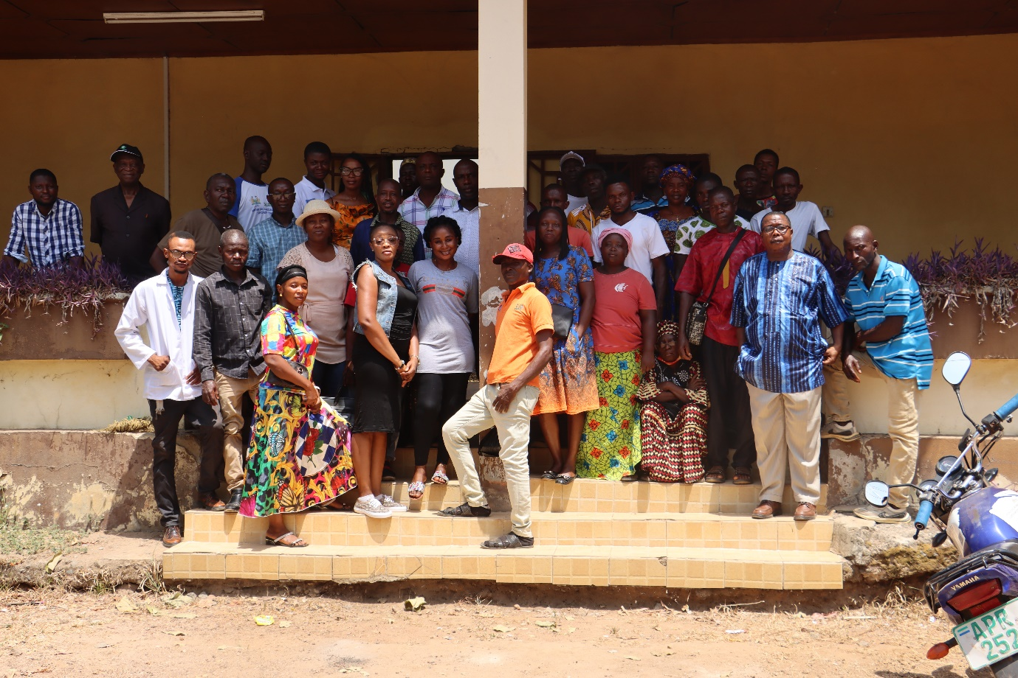

Slide 39
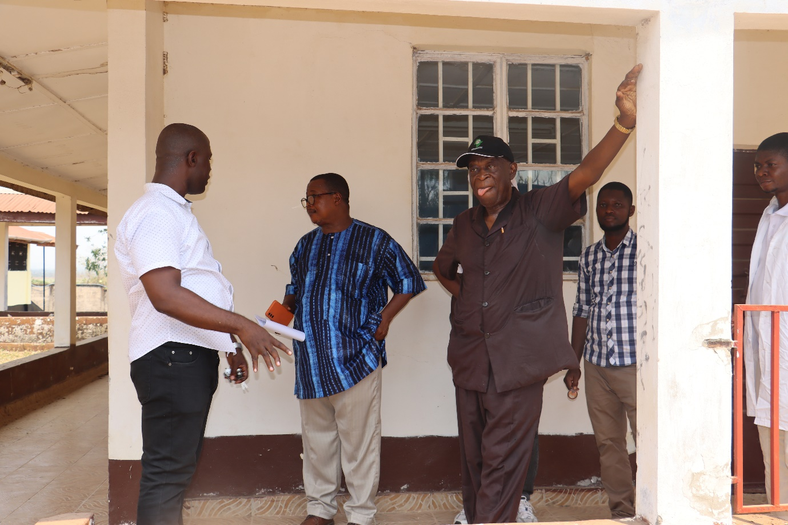

Slide 40
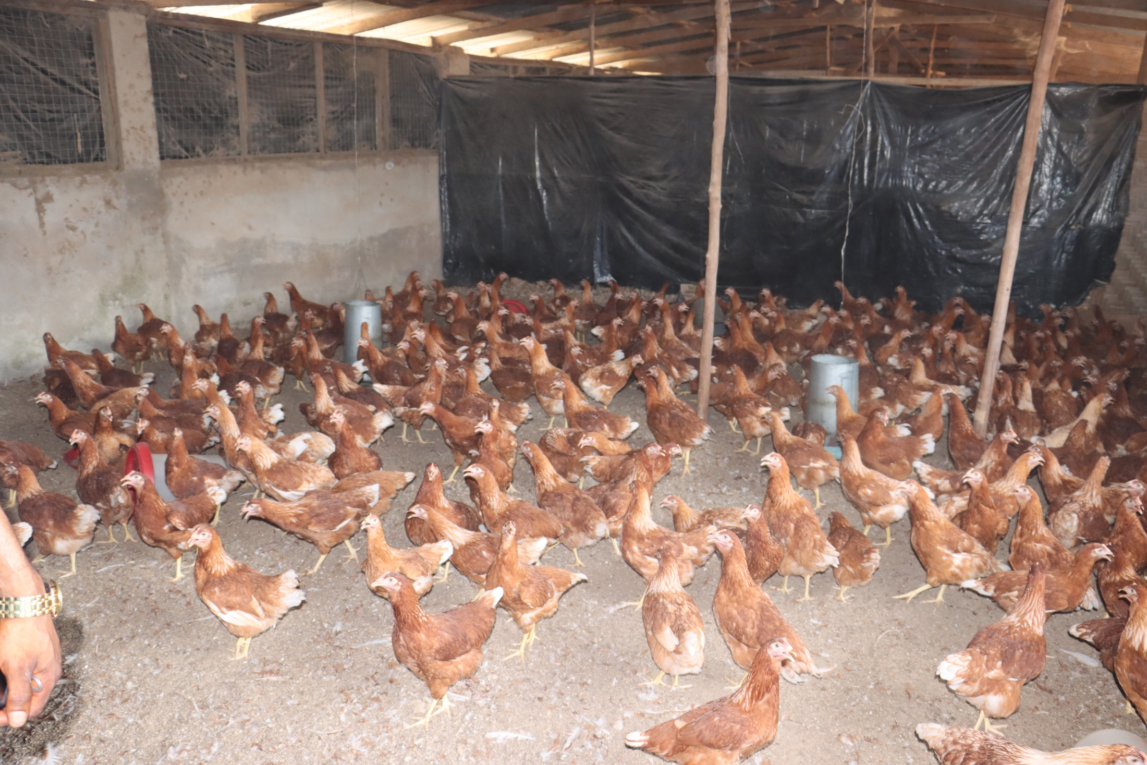

Slide 41
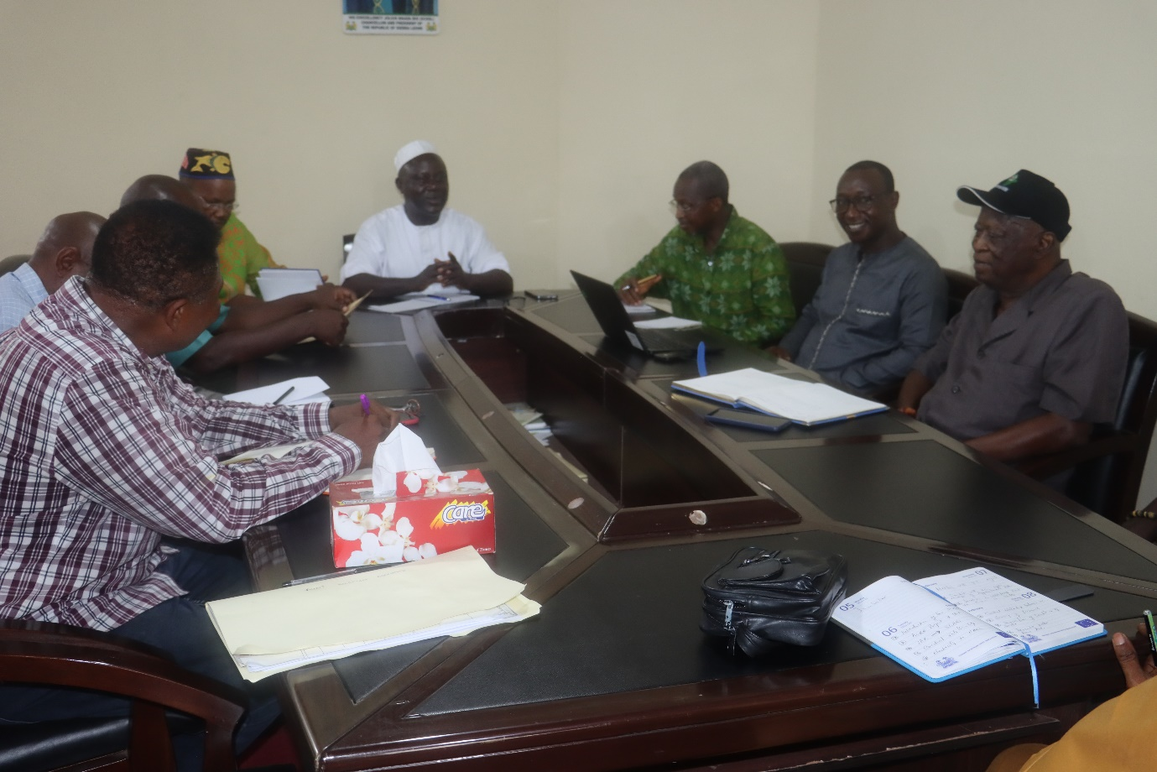

Slide 42
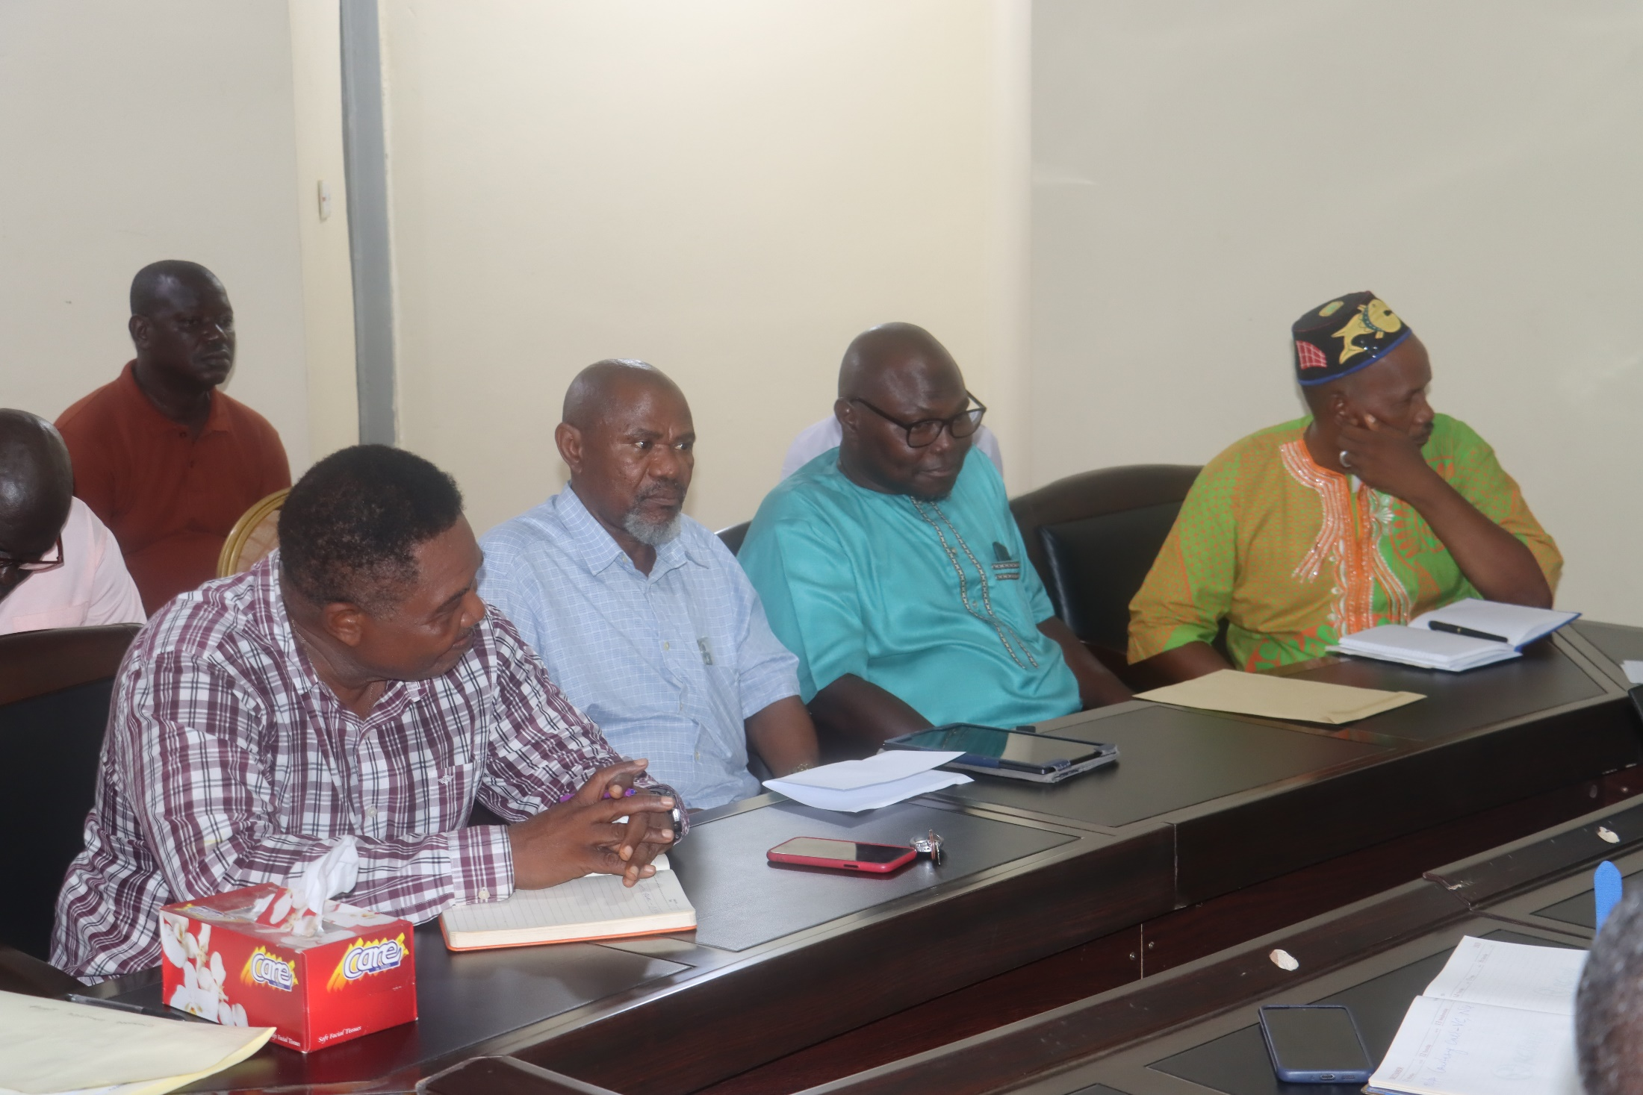

Slide 43
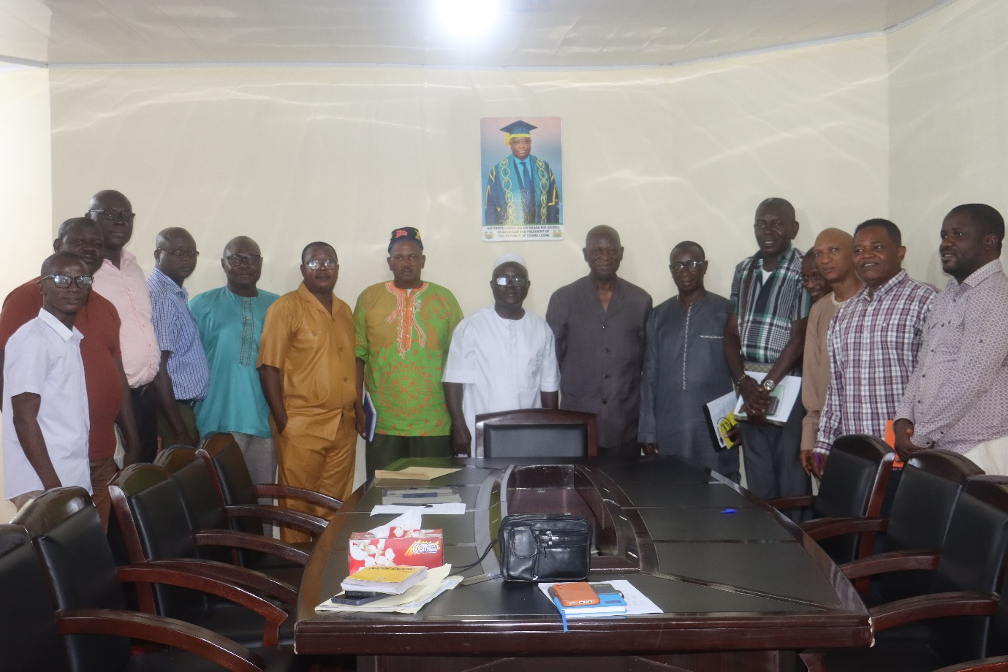

Slide 44
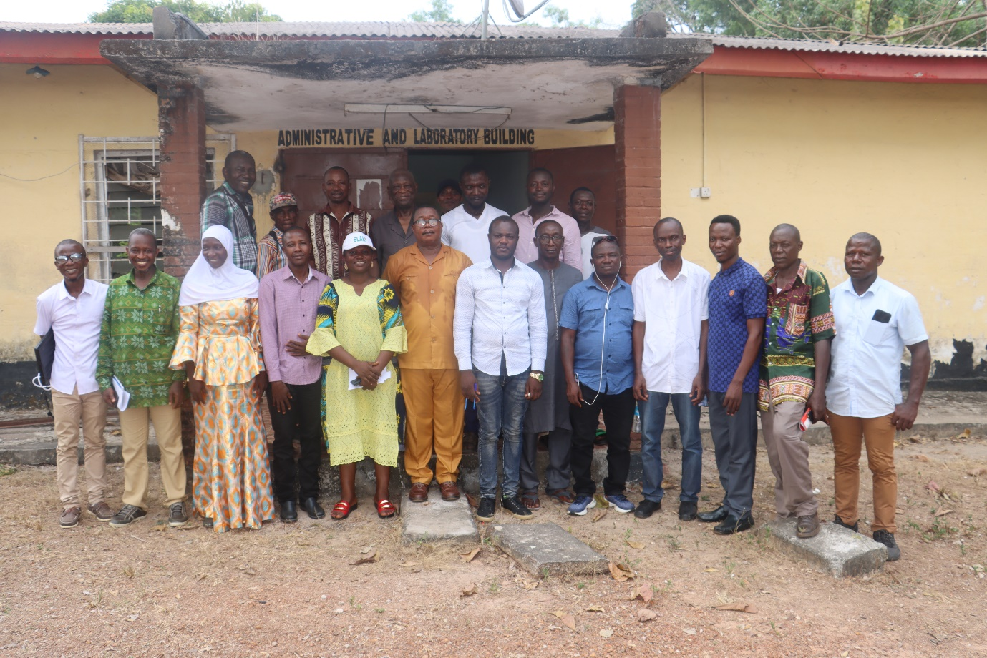

Slide 45
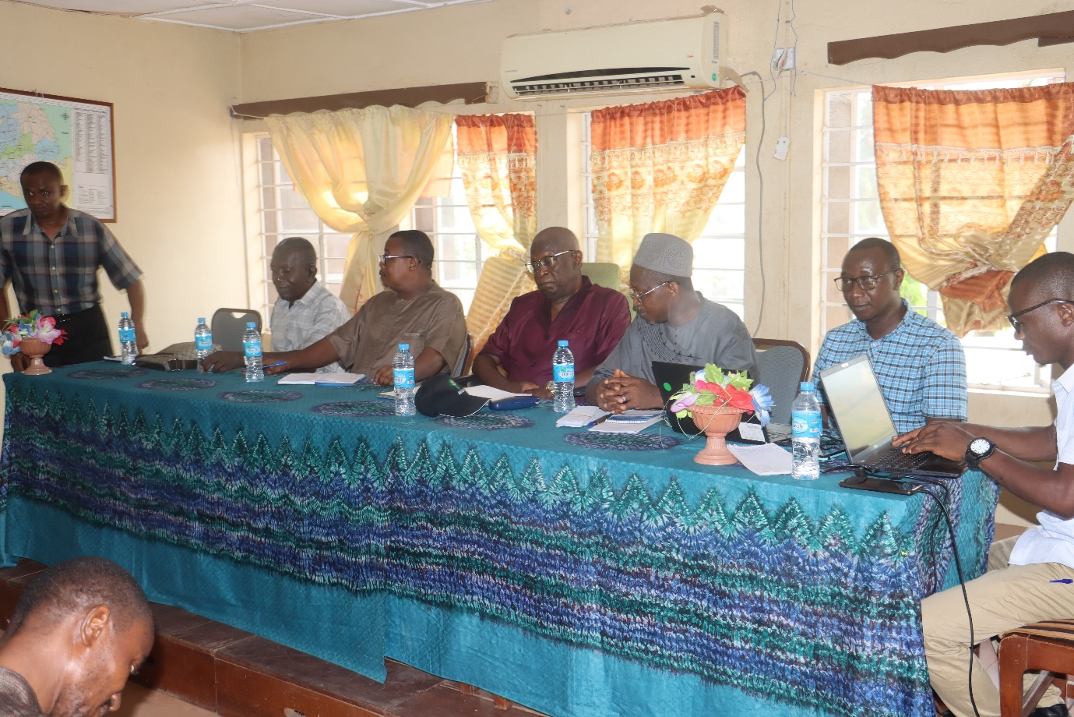

Slide 46
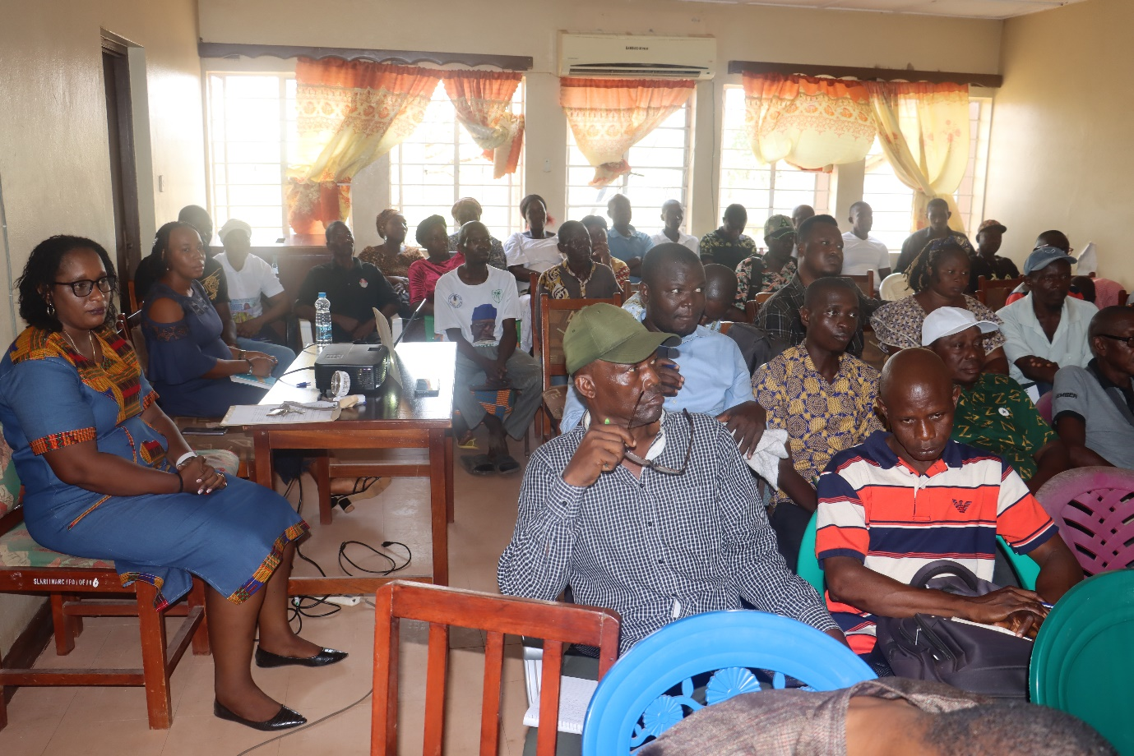

Slide 47
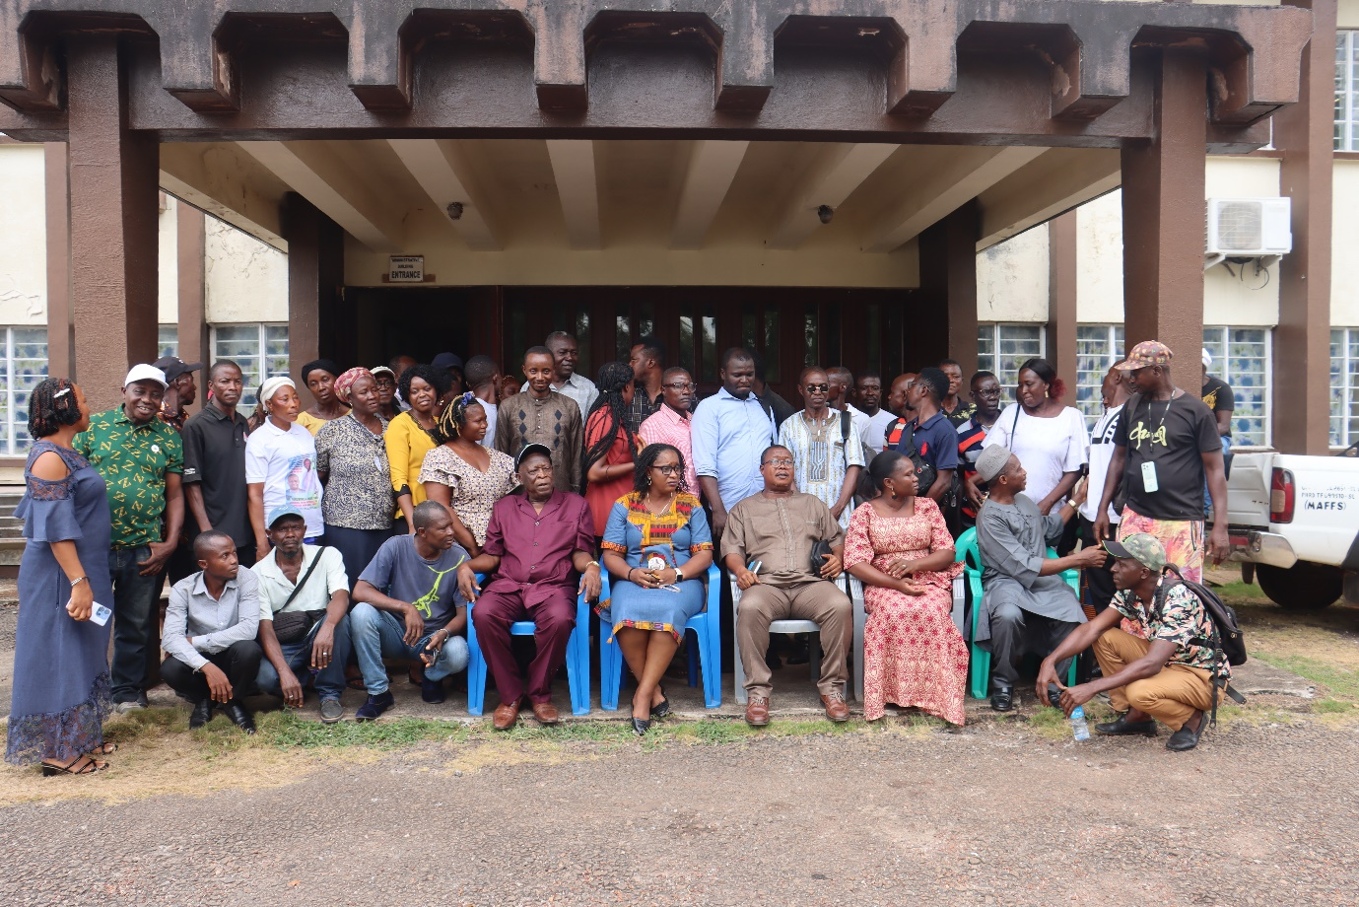

Slide 48
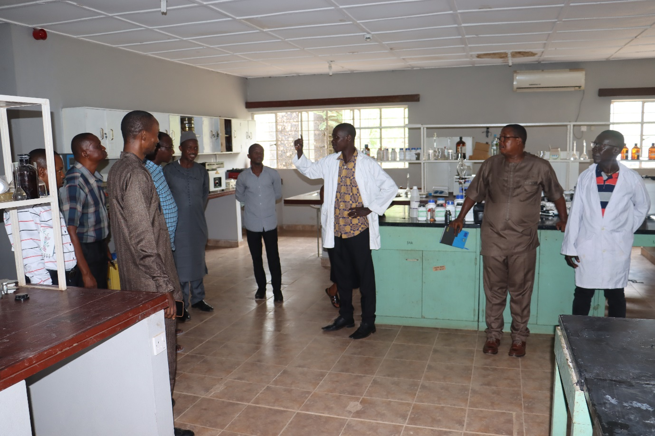

Slide 49
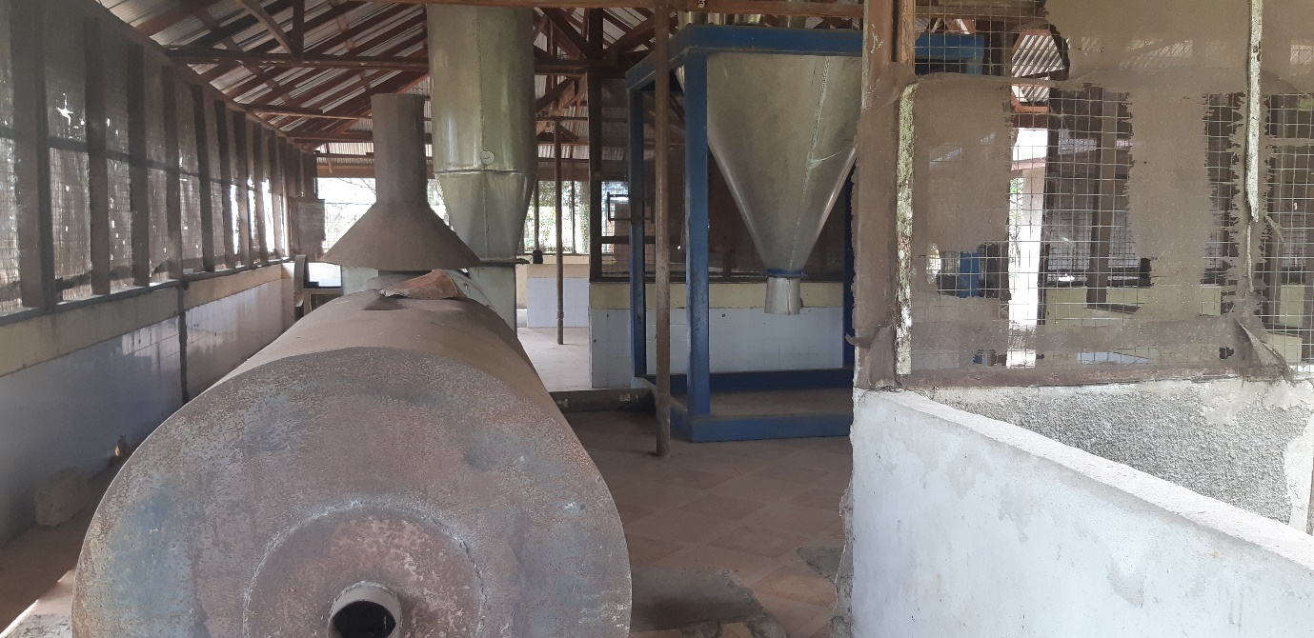

Slide 50
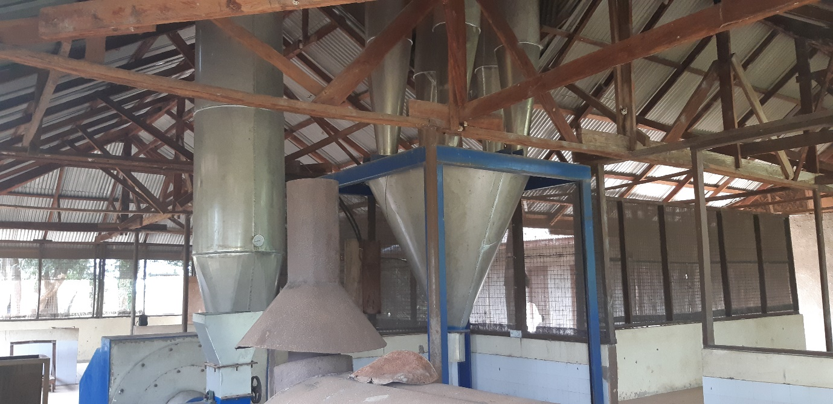

Slide 51
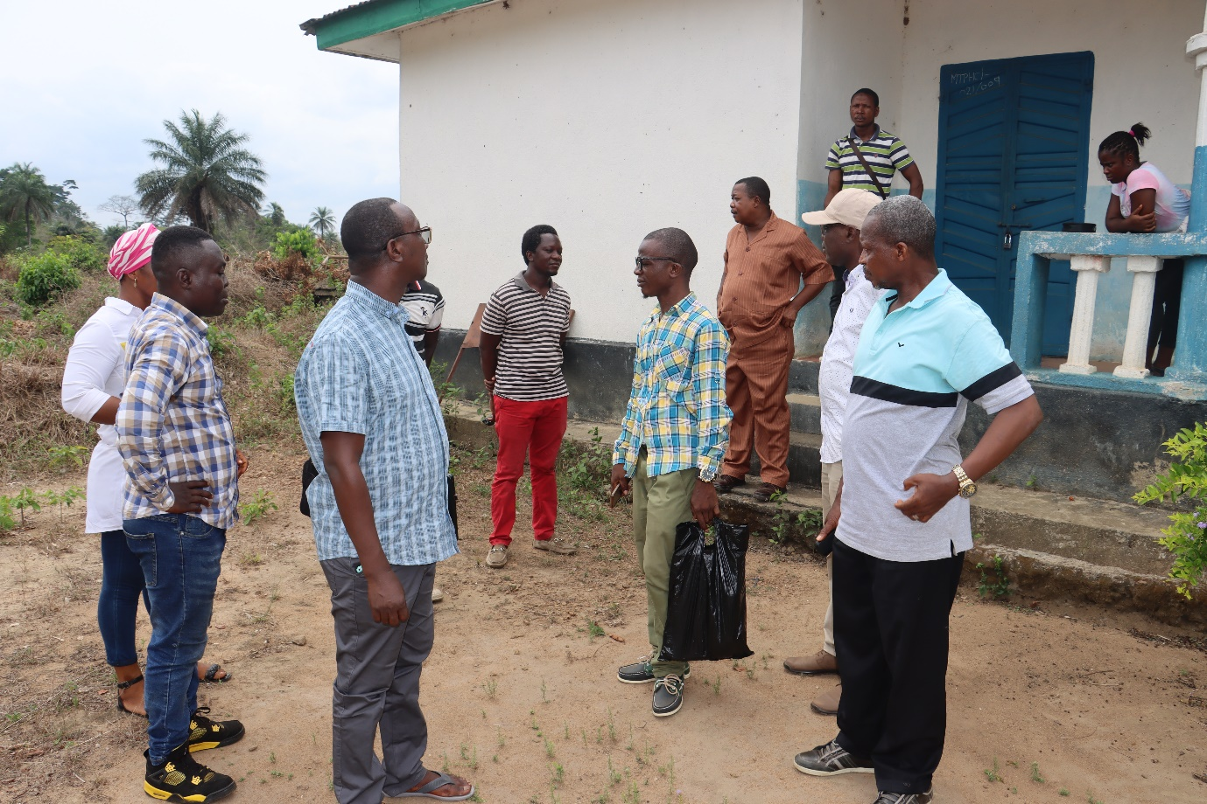

Slide 52
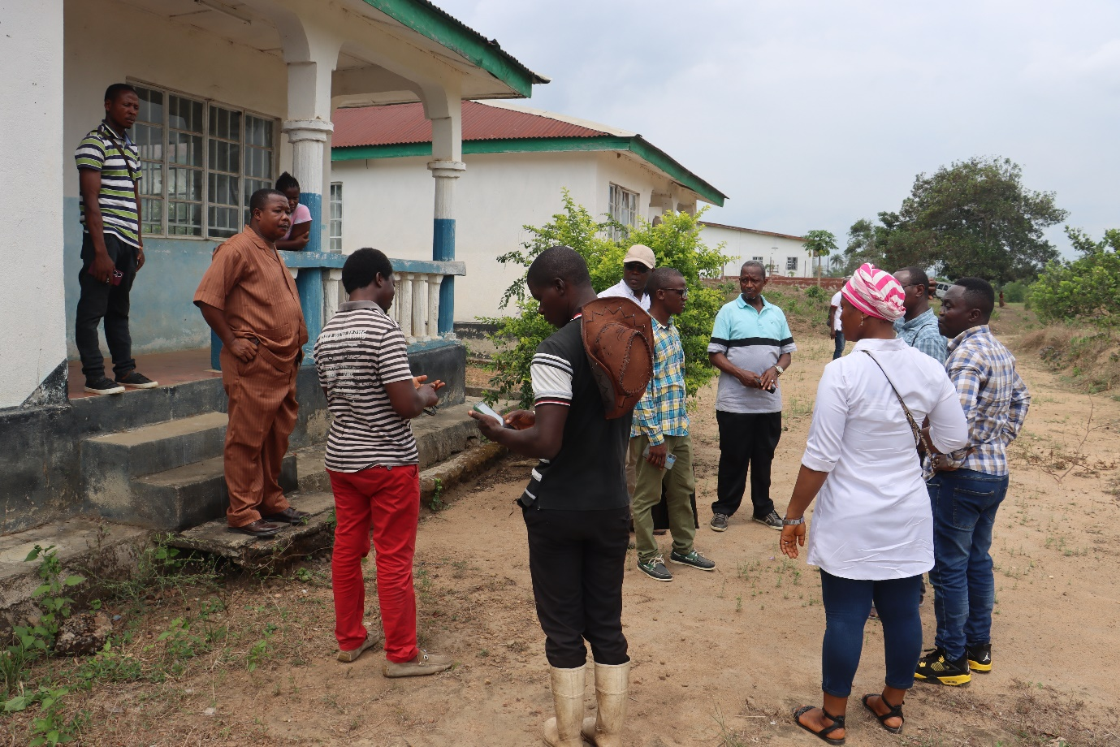

Slide 53
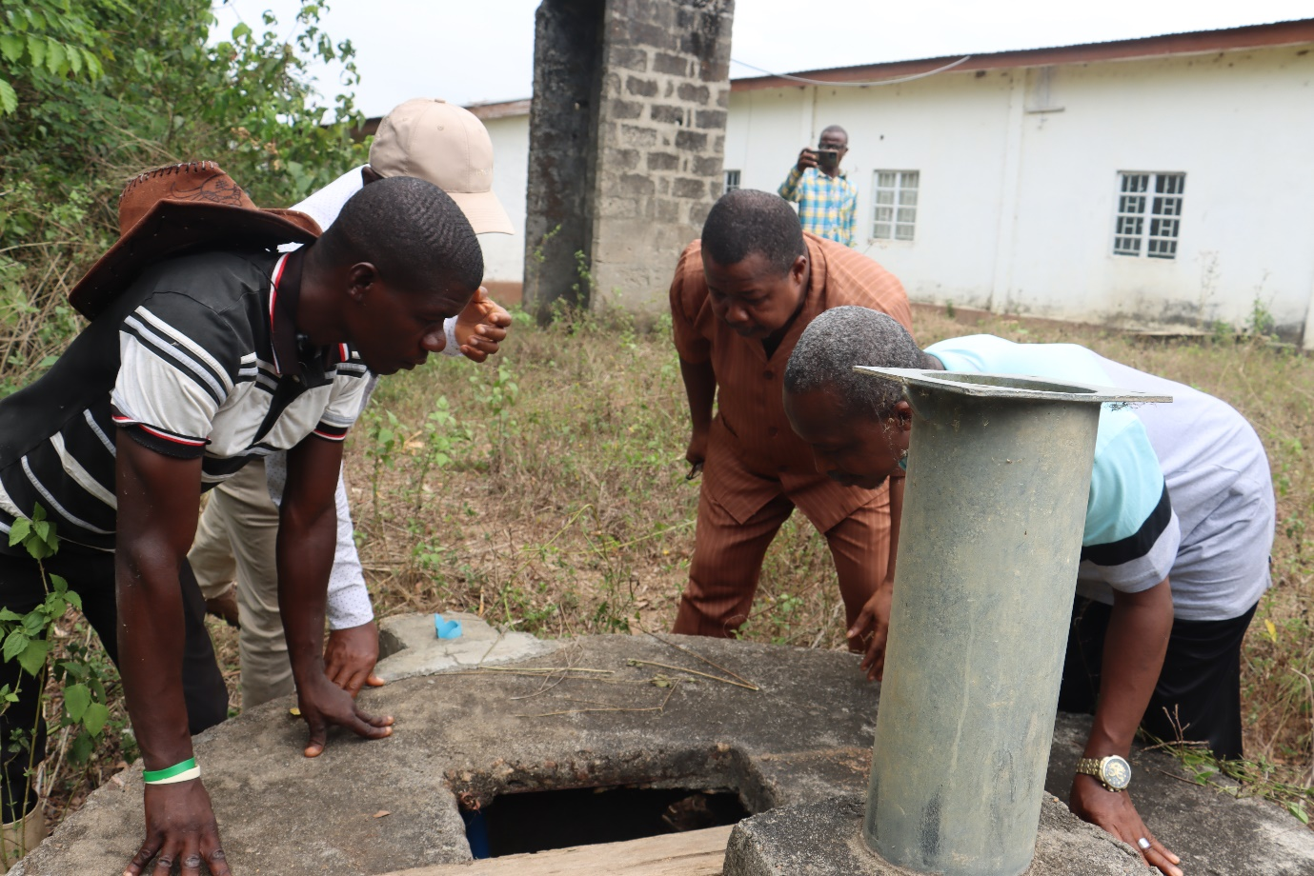

Slide 54
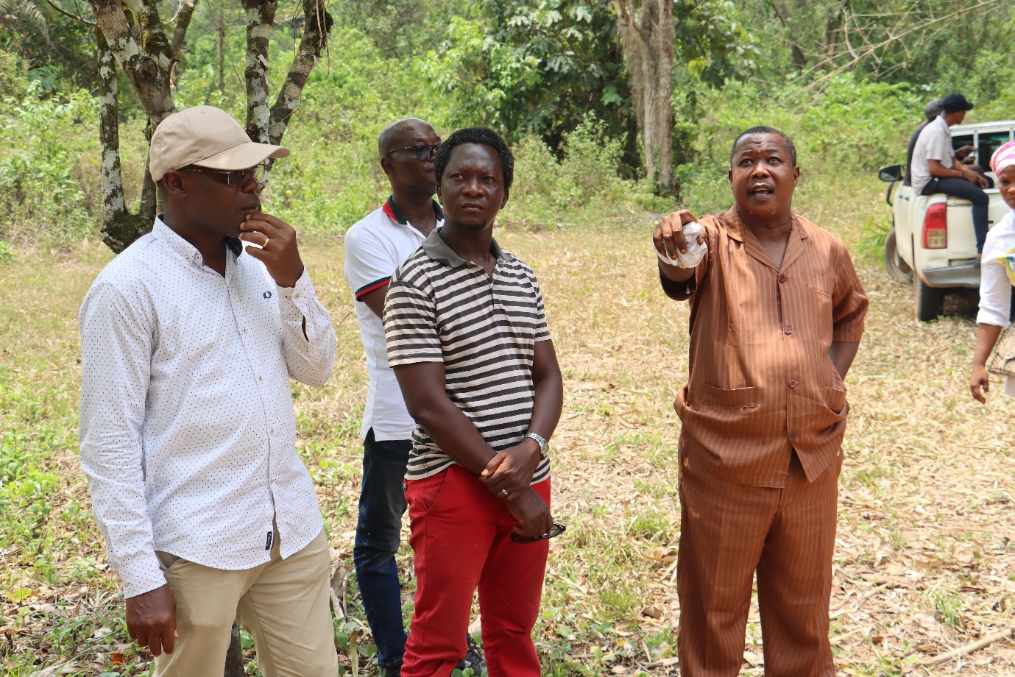

Slide 55


Slide 56


Slide 57
Total Staff in SLARI disaggregated by gender and by rank
 | HQ | RARC | NARC | KHCRC | KFTCRC | MLWERC | TLRC | TOTAL
JS-F | 8 | 7 | 8 | 0 | 1 | 0 | 2 | 26
JS-M | 21 | 58 | 58 | 6 | 22 | 5 | 25 | 195
SS-F | 8 | 6 | 12 | 4 | 2 | 2 | 8 | 42
SS-M | 23 | 31 | 18 | 6 | 18 | 9 | 12 | 117
TOTAL | 60 | 102 | 96 | 16 | 43 | 16 | 47 | 380
JS-F = Junior Staff Female, JS-M = Junior Staff Male, SS-F = Senior Staff Male, SS-F = Senior Staff Female

Slide 59
Staff distribution at the Headquarter by age, by gender and by rank
HQ
Age (yrs) | < 40 | 40 - 55 | > 55 | TOTAL
JS-F | 6 | 2 | 0 | 8
JS-M | 6 | 14 | 1 | 21
SS-F | 4 | 4 | 0 | 8
SS-M | 10 | 11 | 2 | 23
TOTAL | 26 | 31 | 3 | 60
JS-F = Junior Staff Female, JS-M = Junior Staff Male, SS-F = Senior Staff Male, SS-F = Senior Staff Female

Slide 60
Staff distribution at the centres by age, by gender and by rank
RARC |  |  |  |  |  | NARC
Age (yrs) | < 40 | 40 – 55 | > 55 | TOTAL |  | Age (yrs) | < 40 | 40–55 | > 55 | TOTAL
JS-F | 1 | 6 | 0 | 7 |  | JS-F | 2 | 3 | 3 | 8
JS-M | 5 | 38 | 15 | 58 |  | JS-M | 0 | 39 | 19 | 58
SS-F | 0 | 3 | 3 | 6 |  | SS-F | 4 | 6 | 2 | 12
SS-M | 11 | 16 | 4 | 31 |  | SS-M | 4 | 10 | 4 | 18
TOTAL | 17 | 63 | 22 | 102 |  | TOTAL | 10 | 58 | 28 | 96

Slide 61
Staff distribution at the centres by age, by gender and by rank
TLRC |  |  |  |  |  | MLWERC
Age (yrs) | <40 | 40-55 | >55 | TOTAL |  | Age (yrs) | <40 | 40-55 | >55 | TOTAL
JS-F | 0 | 1 | 1 | 2 |  | JS-F | 0 | 0 | 0 | 0
JS-M | 10 | 14 | 1 | 25 |  | JS-M | 1 | 4 | 0 | 5
SS-F | 5 | 2 | 1 | 8 |  | SS-F | 2 | 0 | 0 | 2
SS-M | 4 | 8 | 0 | 12 |  | SS-M | 5 | 4 | 0 | 9
TOTAL | 19 | 25 | 3 | 47 |  | TOTAL | 8 | 8 | 0 | 16

Slide 62
Staff distribution at the centres by age, by gender and by rank
KFTCRC |  |  |  |  |  | KHCRC
Age (yrs) | <40 | 40-55 | >55 | TOTAL |  | Age (yrs) | <40 | 40-55 | >55 | TOTAL
JS-F | 1 | 0 | 0 | 1 |  | JS-F | 0 | 0 | 0 | 0
JS-M | 3 | 14 | 5 | 22 |  | JS-M | 5 | 1 | 0 | 6
SS-F | 2 | 0 | 0 | 2 |  | SS-F | 2 | 2 | 0 | 4
SS-M | 4 | 12 | 2 | 18 |  | SS-M | 2 | 4 | 0 | 6
TOTAL | 10 | 26 | 7 | 43 |  | TOTAL | 9 | 7 | 0 | 16

Slide 63
WFP Training
To enhance food security and empower smallholder farmers, particularly youth and women, Sierra Leone Agricultural Research Institute (SLARI) collaborated with the World Food Programme (WFP), to provided training to MAFS district-level extension staff and community youth contractors (CYCs) on soil management, and the multiplication of rice and specific nutritious vegetables and legumes.
Modules and topics covered during the training
The modules and lessons covered during the training were:
Module 1: Sustainable Soil fertility management
Module 2: Quality seed rice production and maintenance
Module 3: Vegetable production
Module 4: Root and tuber and grain legume production

Slide 64
Trainings were conducted at the cluster level for MAFS extension staff and community youth contractors from seven districts, organized into six clusters:
Cluster 1: Falaba, and Koinadugu.
Cluster 2: Kambia and Tonkolili
Cluster 3: Pujehun (Malen). 2
Cluster 4 : Pujehun (Makpele, Barri, Peje).
Cluster 5: Moyamba.
Cluster 6: Kenema.
The training was facilitated by SLARI in close coordination with MAFS District staff and WFP staff.
A total of 202 participants benefitted from this training

Slide 65
demonstration of climate-smart practices: A (Raised bed versus sunken bed) and B (mulching)
Contracts/MOU signed

Slide 66
Agrodealers and extension Training
Transition Support Facility (TSF) Capacity-Building and Sensitization Workshop to Empowers agrodealers in Sierra Leone
Acting Director General of the SLARI chaired the workshop, ensuring smooth proceedings and active participation from all trainees.
Training of Trainers and Development of Work Plans on Good Agronomic Practices
GAP contribute significantly to the overall sustainability, productivity, and economic viability of agricultural operations

Slide 67





Slide 68
LOOKING FORWARD
Activate the Commercialization and Business Development Committee
Create SLARI Documentary
Review SLARI Strategic Plan
Review SLARI Conditions of Service
Expand Radio and TV appearances
Acting positions in SLARI
Expand Technology Park for outscaling technologies

Slide 69
THANK YOU FOR YOUR ATTENTION

