Slide 1



Report to SLARI Council by
Acting Director-General - Dr Abdul Rahman Conteh
Wednesday, December 17, 2025

Slide 2
Recommendations from the 21st SLARI Council meeting
Recommendation | Status | Remark
It was recommended that training for farmers on agribusiness be done and also connections should be established between the farmers and the buyers. | This is well noted and will be implemented in the next year | Training of NaFFSL is part of our activities next year
More financial support to the commercialization directorate was required for it to be more productive and successful. | This is noted and will be implemented when funds become available | Depends on fund availability
There should be a clear-cut difference between the M&E and outreach activities of SLARI | There is already a difference between M&E and outreach | M&E is not outreach

Slide 3
Recommendations from the 21st SLARI Council meeting
Recommendation | Status | Remarks
The Commercialization and Agribusiness Directorate to focus more on breeder and foundation seeds in order to prevent direct competition with the private sector. | To be implemented | Already discussed and agreed
It was recommended that all project proposals must be aligned with SLARI’s strategic plan. | Already aligned | Strategic Plan is almost completed
It was recommended that a holistic financial report should be presented to Council Members with explicit breakdown of incomes and expenditures. | To be presented by Finance Director | Well noted

Slide 4
Recommendations from the 21st SLARI Council meeting
Recommendation | Status | Remarks
All donor projects must include 10% administrative cost into their budget during proposal development. | Already acted upon | Done

Slide 5
Action Points from the 21st SLARI Council meeting
Action Point | Status | Remarks
A proper breakdown of financial report should be prepared and submitted to Council Finance Committee for endorsement and onwards submission to Council for approval. | To be presented by Finance Director
The Commercialization and Agribusiness Directorate should contact the mining companies to discuss about the tree crops that they may want to use for land reclamation. | To be presented by Director of Commercialization
All donor projects must include into their budget 10% administrative cost. | Already included in all projects

Slide 6
Action Points from the 21st SLARI Council meeting
Action Point | Status | Remarks
SLARI management to look at the work programme of FSRP for 2025 and forward the concept note to the CAO MAFS, and then copy the chair and Minister of Agriculture and Food Security for necessary action. | This was done and a meeting was held between CAO, Chairman and Management | Done
OIC allowance to be paid to all serving OICs without backlog. | This was already made known to all OICs | Depends on Funds availability
A commercialization and Agric business policy should be developed after the completion of the strategic & operational plan | Strategic Plan is almost completed | On track

Slide 7
Action Points from the 21st SLARI Council meeting
Action Point | Status | Remarks
The CAO MAFS to meet the Minister of Agriculture on behalf of council to lobby FSRP to make available all resources that are allocated to SLARI, so that urgent actions could be taken in order to move SLARI to the Regional Centre of Excellence. | CAO can explain

Slide 8
ORDER OF PRESENTATION
ADDRESSING THE PROBLEM OF SOIL ACIDITY IN SIERRA LEONE
OCP FOUNDATION INTERVENTION
INAUGURATION OF THE SLARI TRAINING ROOM
HANDING OVER OF CONSTRUCTION SITE AT NJALA
STAKEHOLDER ENGAGEMENT ON IMPLEMENTATION OF FIELD TRIALS IN SIERRA LEONE
EXPLORATION OF SOURCES AND KINDS OF LIMING MATERIALS THAT CAN BE SUSTAINABLY PRODUCED IN SIERRA LEONE.
TRAINING ON SOIL FERTILITY AND MANAGEMENT SHORT COURSE ORGANIZED BY OCP FOUNDATION AND SLARI IN MOROCCO

Slide 9
ORDER OF PRESENTATION
SLARI ORGANIZES THE SIERRA LEONE SOIL INFORMATION SYSTEMS ROADMAP-DEVELOPMENT
DEPUTY DIRECTOR GENERAL OF IITA VISITS SLARI AND PLEDGES SUPPORT FOR MAKING SLARI A CENTRE OF EXCELLENCE
SLARI JOINS THE PRESIDENT TO COMMEMORATE THE 2025 WORLD FOOD DAY IN KAMBIA DISTRICT
H.E. PRESIDENT BIO VISITS SLARI ROKUPR
SLARI VALIDATES ITS REVIEWED STRATEGIC AND OPERATIONAL PLANS TO GUIDE AGRICULTURAL RESEARCH FOR THE NEXT DECADE
SLARI JOINS CAASTIA AT THE GENERAL ASSEMBLY HELD IN ADDIS ABABA, ETHIOPIA, ON OCTOBER 26 – 29, 2025.

Slide 10
ADDRESSING THE PROBLEM OF SOIL ACIDITY IN SIERRA LEONE
Since June 2025, SLARI has been involved in implementing an agreement signed with the OCP Foundation in Morocco to address the problem of Soil Acidity in Sierra Leone in support of the Feed Salone strategy.
Soil acidity is one of the most important soil factors affecting crop growth and ultimately, yield and profitability
A substantial proportion of agricultural soils nationwide are currently ranging from very slightly to extremely acidic. National crop yields on farmers’ fields in Sierra Leone have been very low.
Therefore, soil acidity must be addressed for farmers to receive the greatest benefits from their investments in seed and fertilizer

Slide 11
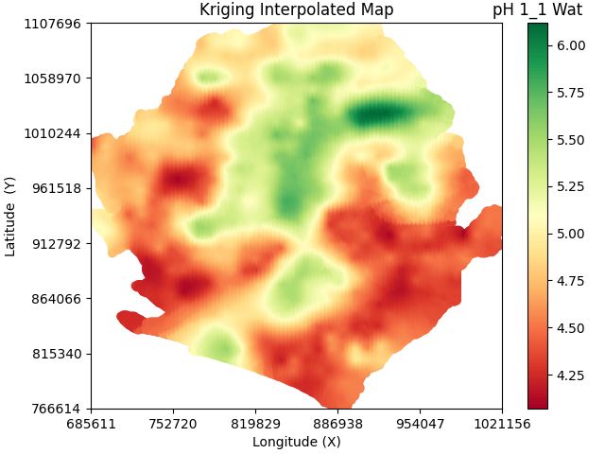
ADDRESSING THE PROBLEM OF SOIL ACIDITY IN SIERRA LEONE

Slide 12
ADDRESSING THE PROBLEM OF SOIL ACIDITY IN SIERRA LEONE
Gaps in knowledge or experience on the effective use of liming materials exist.
The filling of these gaps in the short and medium term are matters of high priority in addressing soil acidity in Sierra Leone.
Specifically, we aim to find answers to questions such as:
What liming materials can be sustainably accessible in Sierra Leone?
How can lime requirement be determined rapidly from laboratory analysis?
What is the rate of change in pH for each amount of lime applied?
How frequently should these liming materials be applied?

Slide 13
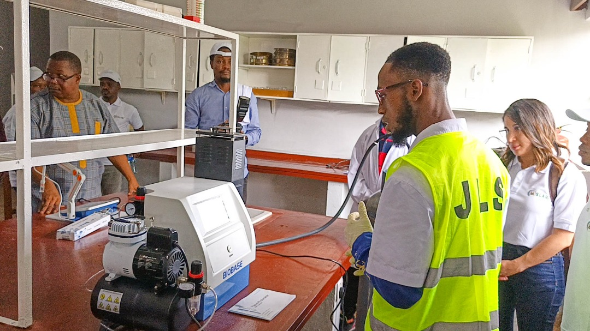
2. OCP FOUNDATION INTERVENTION
Freetown, Sierra Leone – July 15, 2025 – The Sierra Leone Agricultural Research Institute (SLARI) and OCP Foundation outlined major milestones in the Soil Acidity Reduction Project (SARP), a strategic initiative aimed at restoring soil health and enhancing agricultural productivity in Sierra Leone.

Slide 14
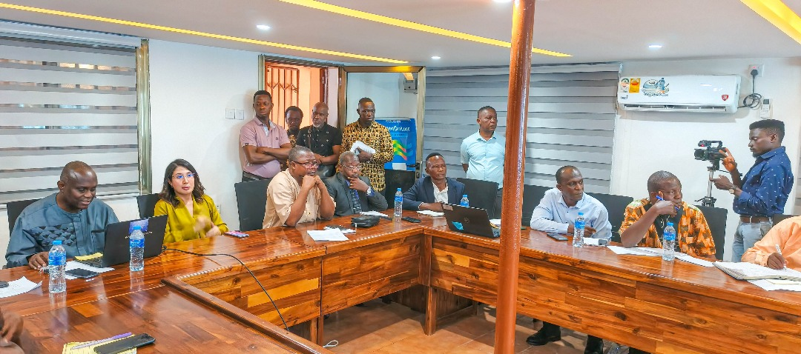
3. INAUGURATION OF THE SLARI TRAINING ROOM
The Sierra Leone Agricultural Research Institute (SLARI), in partnership with the OCP Foundation, officially launched a modern training room at SLARI Headquarters, Tower Hill, Freetown.

Slide 15
3. INAUGURATION OF THE SLARI TRAINING ROOM
Following the opening ceremony, Ms. Hamdi appeared on a live radio broadcast on 98.1 FM’s Mid-Day Show, where she highlighted the goals of the partnership, the importance of knowledge transfer, and the role of innovation in transforming soil fertility management in Sierra Leone.

Slide 16
2. OCP FOUNDATION INTERVENTION
One of the key achievements of the project so far has been the complete rehabilitation and re-equipping of the Soil Analysis Laboratory at the Njala Agricultural Research Centre (NARC).
The laboratory serves now as a national hub of soil science, equipped with advanced instruments capable of analysing the soil acidity and nutrient levels with high precision.
In parallel, field trials are being conducted across selected regions to assess the effectiveness of soil amendments, including lime, in reducing acidity and improving crop performance.
Findings are expected to inform evidence-based recommendations for farmers and policymakers and to support the broader adoption of sustainable soil management practices in Sierra Leone

Slide 17
2. OCP FOUNDATION INTERVENTION
Recently installed Nitrogen Analyzer at the Njala Agricultural Research Centre

Slide 18
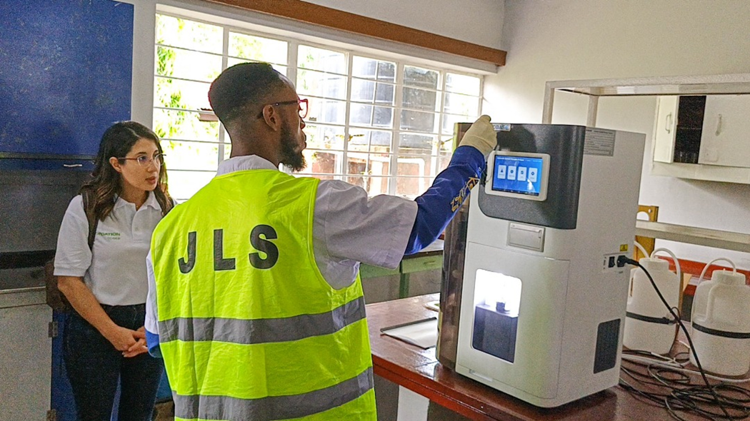
4. HANDING OVER OF CONSTRUCTION SITE AT NJALA
Newly installed Nitrogen Analyzer in the SLARI Soils Laboratory at the Njala Agricultural Research Centre.

Slide 19
3. INAUGURATION OF THE SLARI TRAINING ROOM
In the framework of its institutional capacity-building component, the project has also provided a specific training course in Soil Fertility and Management to SLARI researchers and technicians.
This investment in local expertise will help ensure the long-term sustainability and scalability of the project’s outcomes.
These efforts align with the Feed Salone 2028 Strategy, promoting food sovereignty and sustainable agriculture in Sierra Leone.
Dr. Abdul R. Conteh, Acting Director General of SLARI, emphasized the ongoing advancements that will significantly benefit farmers and the agricultural sector.

Slide 20
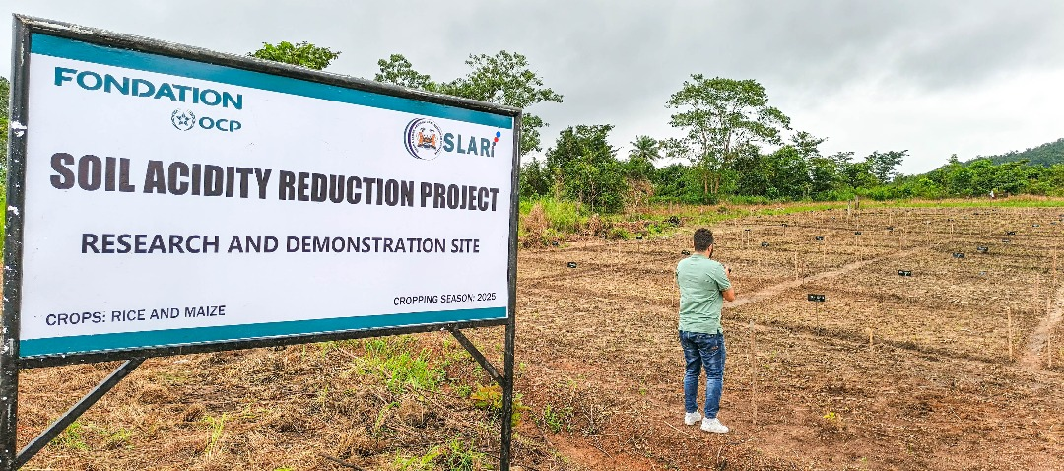
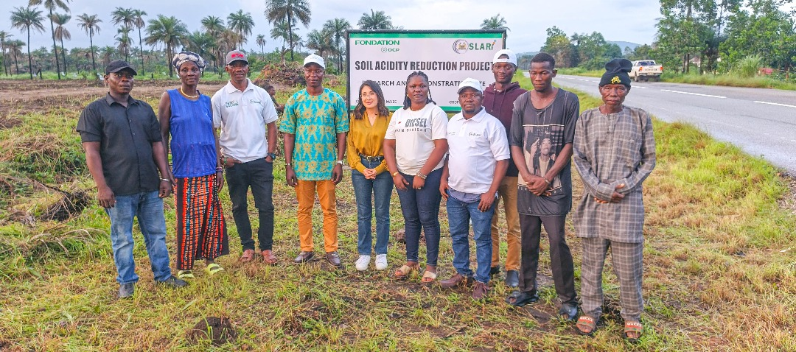
3. INAUGURATION OF THE SLARI TRAINING ROOM
Establishment of Field Trials addressing the soil acidity problem

Slide 21
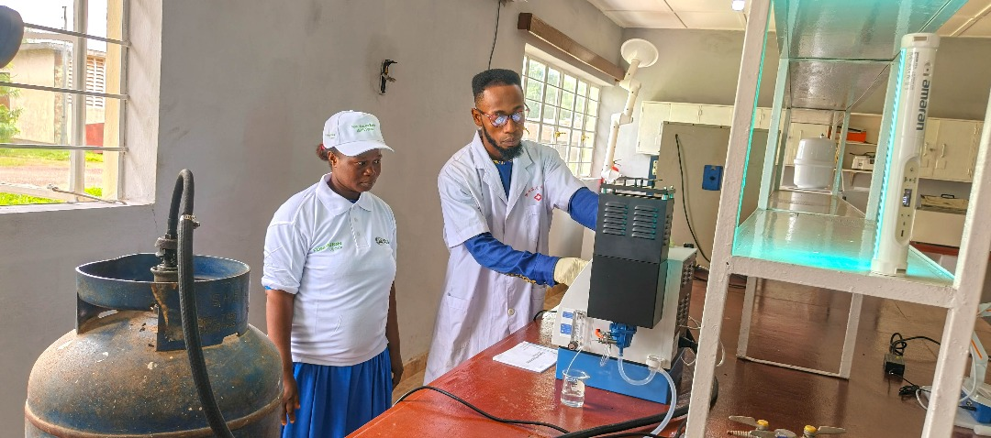
4. HANDING OVER OF CONSTRUCTION SITE AT NJALA
Testing the newly installed Flame Photometer

Slide 22
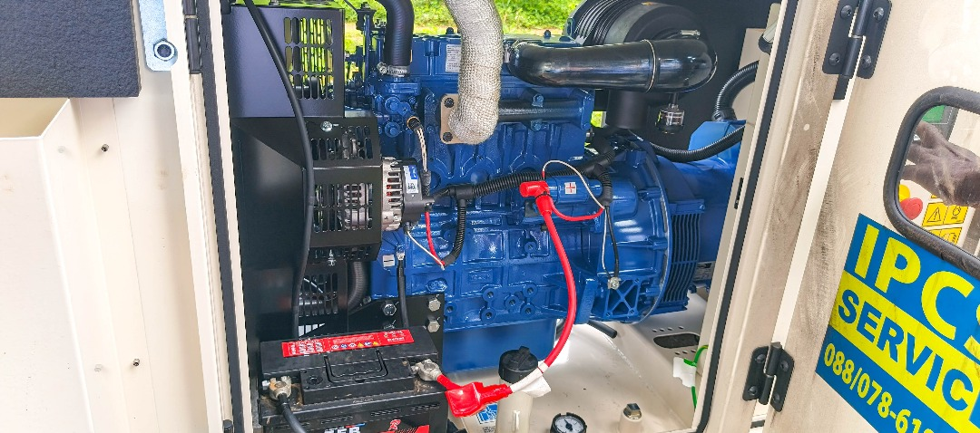
4. HANDING OVER OF CONSTRUCTION SITE AT NJALA
A new 20 kVA generator installed at the Soils Laboratory

Slide 23
5. STAKEHOLDER ENGAGEMENT ON IMPLEMENTATION OF FIELD TRIALS IN SIERRA LEONE
On Thursday May 29th, 2025, staff at the Sierra Leone Agricultural Research Institute (SLARI), held a planning meeting in preparation for the commencement of field activities for Soil Acidity Reduction Project.
The meeting created a platform for SLARI researchers in various disciplines to plan and share ideas on the necessary processes for the implementation of the Soil Acidity Reduction project.
The meeting focused on the preparation of land and the application of the required treatments to the soil, the time interval for the application of the lime and fertilizer, and the data collection processes.
While addressing the team of researchers, Director General of SLARI emphasized the need for thorough research that will come out with results that reflect integrity.

Slide 24
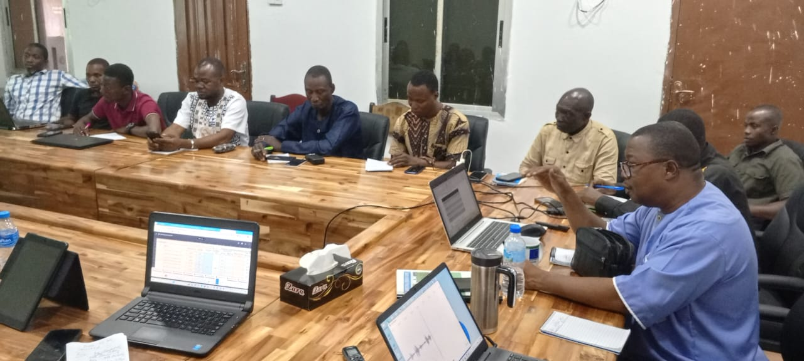
5. STAKEHOLDER ENGAGEMENT ON IMPLEMENTATION OF FIELD TRIALS IN SIERRA LEONE
Director General (Dr. AR Conteh) presenting the project protocols

Slide 25
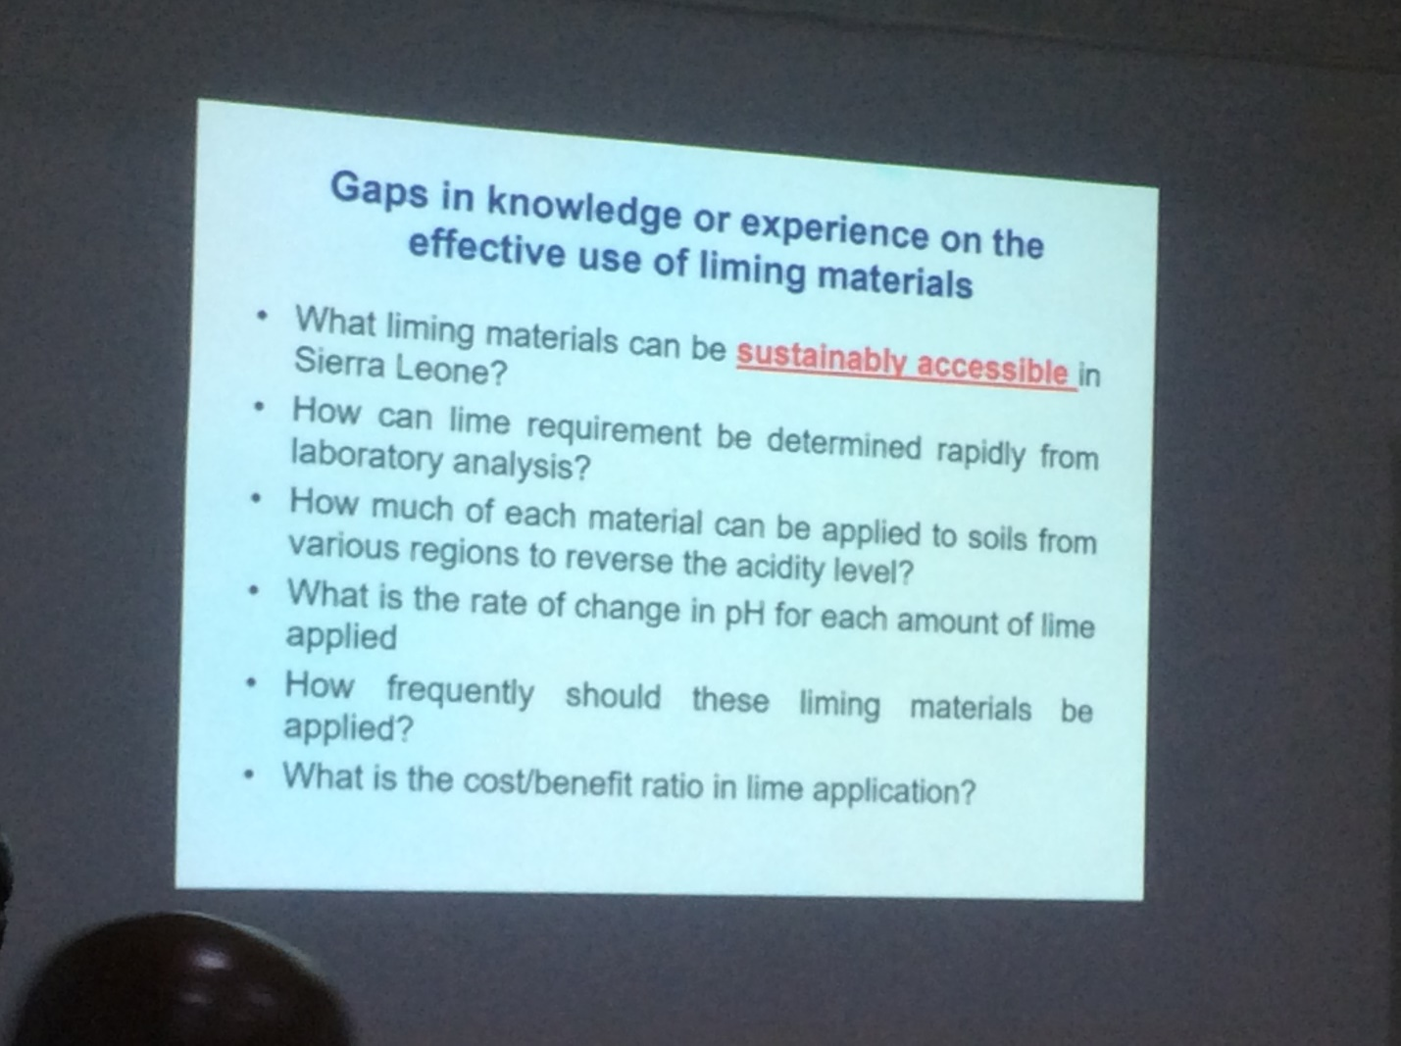
5. STAKEHOLDER ENGAGEMENT ON IMPLEMENTATION OF FIELD TRIALS IN SIERRA LEONE

Slide 26
5. STAKEHOLDER ENGAGEMENT ON IMPLEMENTATION OF FIELD TRIALS IN SIERRA LEONE

Slide 27
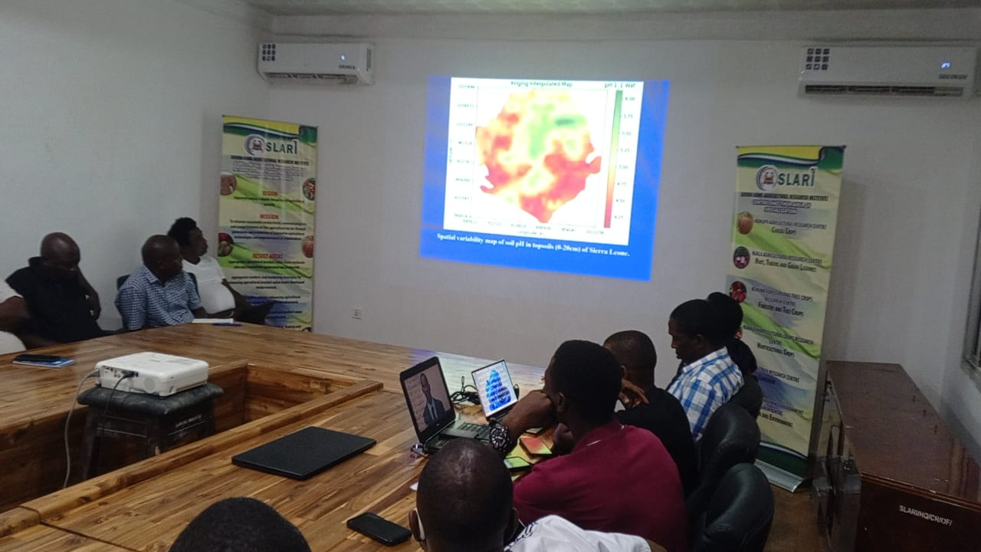
5. STAKEHOLDER ENGAGEMENT ON IMPLEMENTATION OF FIELD TRIALS IN SIERRA LEONE

Slide 28
7. TRAINING ON SOIL FERTILITY AND MANAGEMENT SHORT COURSE IN MOROCCO
Among the activities completed in this project is a study visit of some of our scientists to University of Mohamed VI in Morocco. The following staff took part in this exchange visit and covered the list of courses below.
Foday Sumah, Soil Scientist, Rokupr Agricultural Research Center (RARC), Tel: +23276836429, Email: fodsum@gmail.com
Sidique Kutubu, Soil Scientist, Kenema Forestry and Tree Crop Research Center (KFTCRC), Tel: +23279961611, Email: sidiquekutubu2023@gmail.com
Hindolo Andrew Bebeley, Soil and Water Engineer, Magbosie Land Water and Environment Research Center (MLWERC), Tel: +23276677826, Email: bebeleyh@gmail.com
Raymond Massaquoi, Soil and Water Engineer, Magbosie Land Water and Environment Research Center (MLWERC), Tel: +23278233445, Email: raymondmassaqui93@gmail.com
Mohamed Lamin Sesay, Soil and Water Engineer, Magbosie Land Water and Environment Research Center (MLWERC), Tel: +23273312315, Email: amadumenday@yahoo.com

Slide 29
7. TRAINING ON SOIL FERTILITY AND MANAGEMENT SHORT COURSE IN MOROCCO
Soil Sampling and Geostatistics (3 hours). This course covers the principles of soil sampling, considering the topographic features and management factors that produce variation in soil properties.
GIS-based Soil Mapping (3 hours). During the field trip, participants will gain hands-on experience in collecting a georeferenced soil sample, which is assigned a unique barcode/ QR code for traceability.
Soil Methods of Analysis (3 hours). The course discusses the standard methods of analysis that are used in wet chemistry laboratories.
Test Methods for Lime and Fertilizer Recommendations (3 hours). Participants will have a tour of the Soil Testing Laboratory, to see the safety, organization and operation of technically advanced laboratory instruments.
Principles of Soil Spectroscopy (3 hours). Introduction to the spectral methods to analyze soil for soil organic matter and total elements.

Slide 30
7. TRAINING ON SOIL FERTILITY AND MANAGEMENT SHORT COURSE IN MOROCCO
Soil Spectroscopy Demonstration (3 hours). Participants will have the opportunity to prepare and analyze soil samples with hands-on use of the spectral analyzer and software.
Fundamentals of Proximal Soil Sensing (3 hours). Fundamentals of the methods followed to acquire proximal/ remote sensing data..
Sensors and Drones Demonstration (3 hours). Participants will be introduced to the latest technology in soil sensors for measuring and monitoring soil water potential, soil temperature, soil salinity and other soil properties.
Machine Learning tools for Lime and Fertilizer Recommendations (3 hours). Model algorithms for calculating the lime requirement and fertilizer recommendations will be reviewed and compared to machine learning tools.
Machine Learning Model Demonstration (3 hours). Through a hands-on exercise, participants will learn how machine learning is coupled with soil testing and analysis data, along with sensor/ drone inputs, to evaluate soil pH and fertility in relation to agricultural production and yield targets.

Slide 31
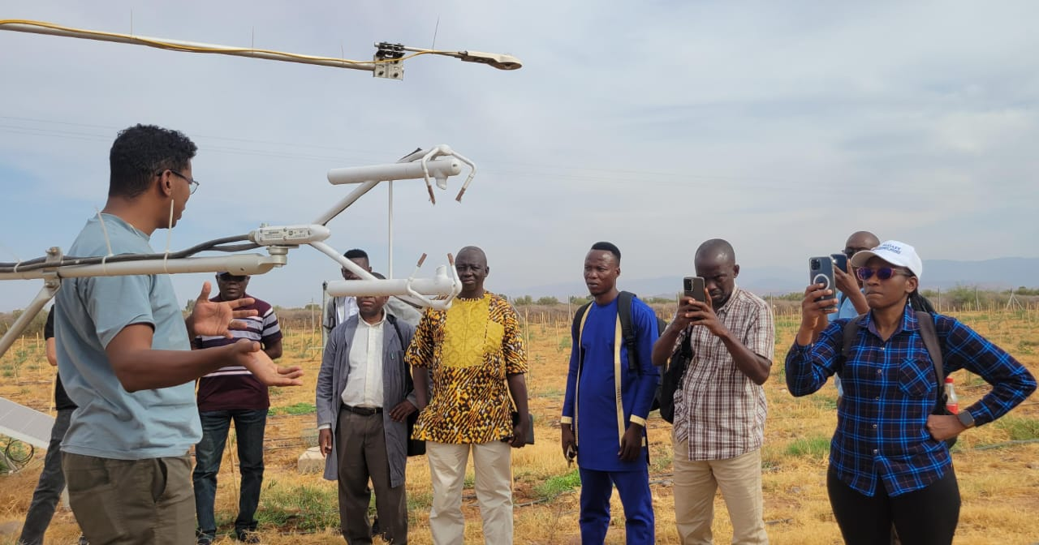
7. TRAINING ON SOIL FERTILITY AND MANAGEMENT SHORT COURSE IN MOROCCO
SLARI Staff receiving training on remote sensing

Slide 32
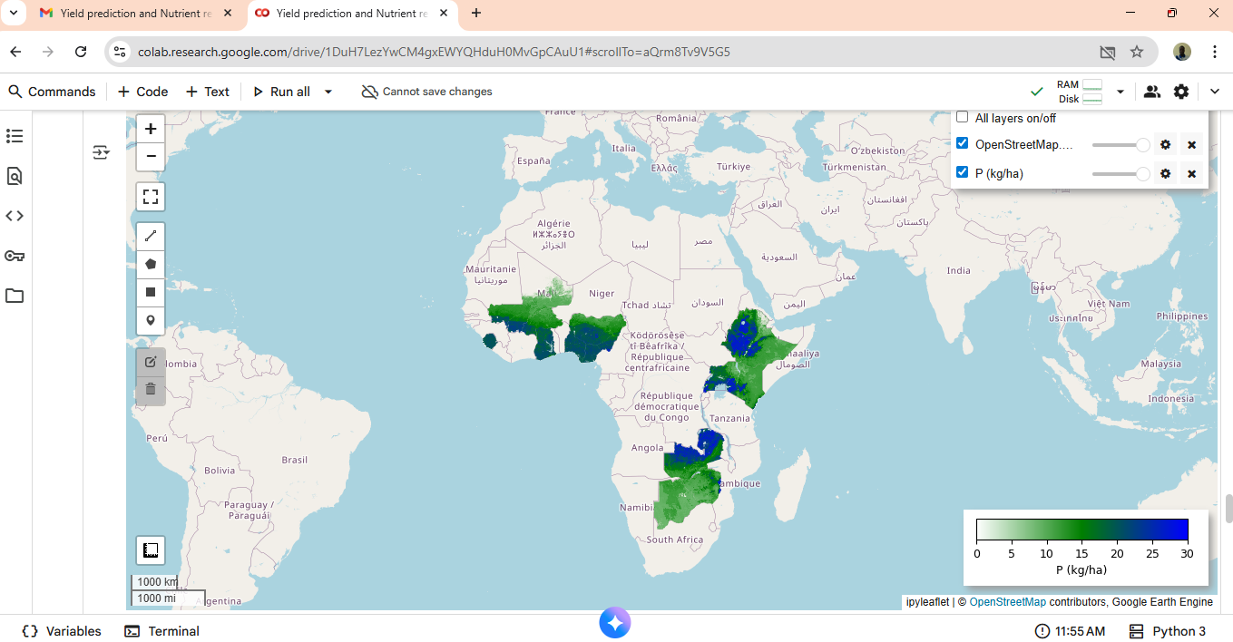
7. TRAINING ON SOIL FERTILITY AND MANAGEMENT SHORT COURSE IN MOROCCO
Screenshot showing prediction of phosphorus recommendation for selected Africa countries

Slide 33
8. SLARI ORGANIZES THE SIERRA LEONE SOIL INFORMATION SYSTEMS ROADMAP WORKSHOP
This strategic workshop brought together key stakeholders, scientists, and policy actors to chart a national roadmap for soil information management, which is crucial for guiding sustainable agricultural practices and supporting the government’s Feed Salone Initiative.
The Sierra Leone Soil Information Systems Roadmap-Development Workshop outlines the strategic steps for building and strengthening Sierra Leone’s Soil Information System (NaSIS) to enhance agricultural productivity, soil health, and informed decision-making for sustainable soil management.

Slide 34
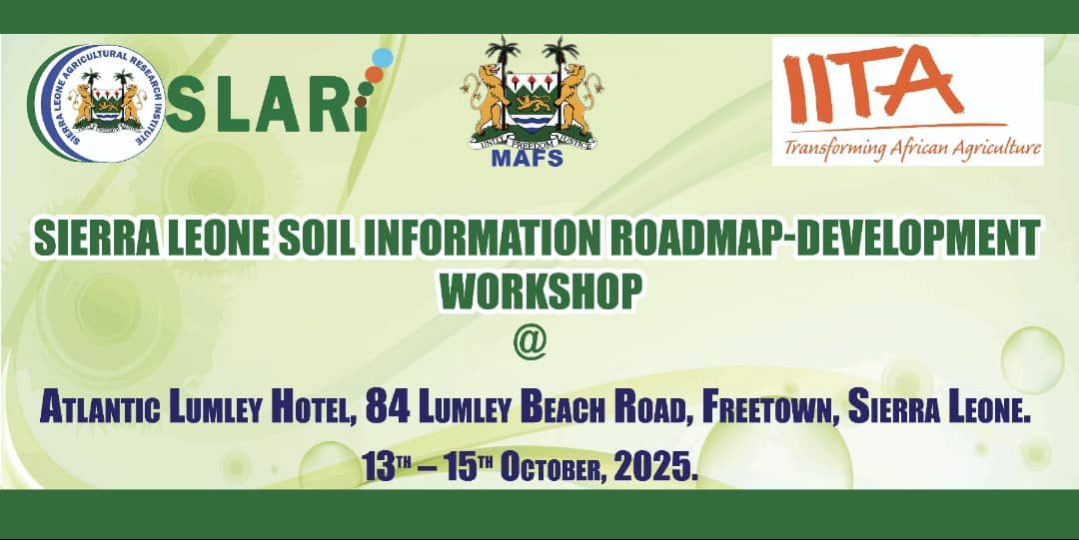
8. SLARI ORGANIZES THE SIERRA LEONE SOIL INFORMATION SYSTEMS ROADMAP WORKSHOP

Slide 35
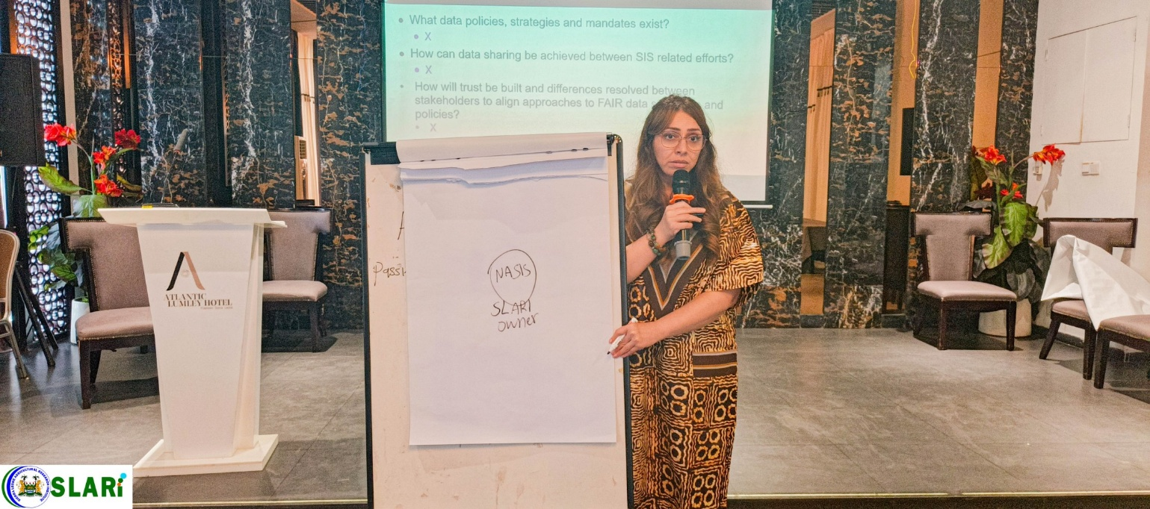
8. SLARI ORGANIZES THE SIERRA LEONE SOIL INFORMATION SYSTEMS ROADMAP WORKSHOP
The three-day workshop, held from 13th to 15th October 2025, brought together leading soil scientists, agricultural researchers, policymakers, and international experts from ISRIC – World Soil Information, Netherlands.
To develop a comprehensive national roadmap for the collection, management, and application of soil data to guide sustainable land use and enhance agricultural productivity across Sierra Leone.

Slide 36
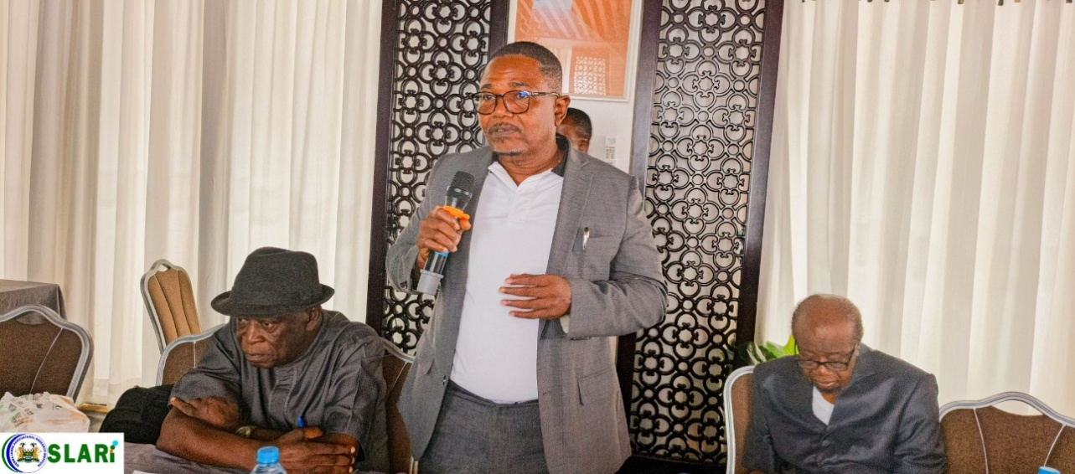
8. SLARI ORGANIZES THE SIERRA LEONE SOIL INFORMATION SYSTEMS ROADMAP WORKSHOP
The Soil Information Roadmap is expected to serve as a guiding framework for policy, and investment decisions, ensuring that every agricultural intervention under Feed Salone is based on solid scientific evidence about the land and soils that sustain it.
“This effort marks a major milestone in Sierra Leone’s journey toward evidence-based agricultural transformation. With robust soil data, policymakers and farmers alike can make smarter, climate-resilient decisions,” Professor Patrick Andrew Sawyerr stated.
The workshop featured technical sessions led by ISRIC experts from the Netherlands, who guided participants through modern soil information systems and digital tools.
Professor Patrick Andrew Sawyerr

Slide 37
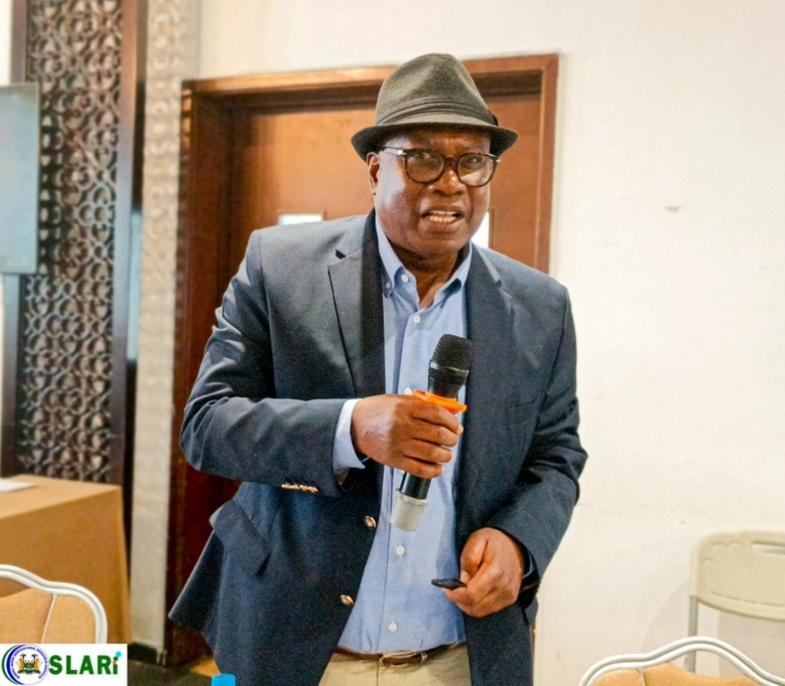
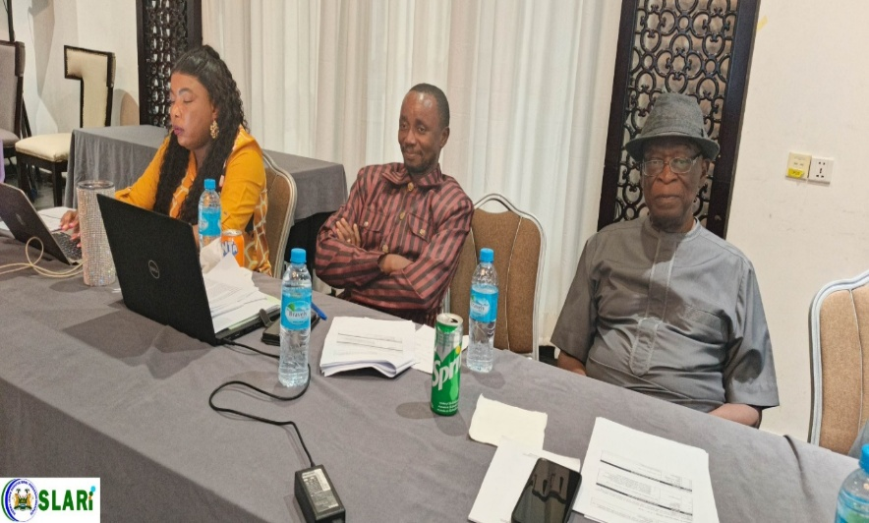
8. SLARI ORGANIZES THE SIERRA LEONE SOIL INFORMATION SYSTEMS ROADMAP WORKSHOP
Professor Jalloh, CAO, noted that the roadmap will complement the government’s broader Feed Salone agenda by supporting site-specific fertilizer recommendations, promoting sustainable soil management, and ensuring that farmers have access to technologies that improve productivity while conserving natural resources.
Dr. Alfred O. Dixon, IITA’s country representative and Chairman of SLARI Council, commended the collaborative spirit shown by Sierra Leonean institutions and reaffirmed IITA’s commitment to strengthening national research capacities.

Slide 38
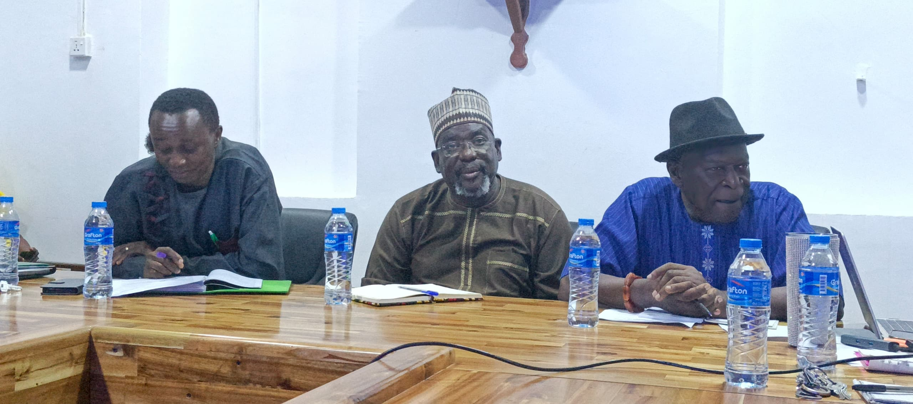
DEPUTY DIRECTOR GENERAL OF IITA VISITS SLARI AND PLEDGES SUPPORT FOR SLARI TO BE A CENTRE OF EXCELLENCE
Freetown, 27th October 2025. The Sierra Leone Agricultural Research Institute (SLARI) has received a strong endorsement of support from the International Institute of Tropical Agriculture (IITA) toward its vision of becoming a Centre of Excellence in agricultural research and development
Dr. Tahirou Abdoulaye, Deputy Director General for Partnerships Delivery at IITA, flanked by SLARI Chairman Dr Alfred Dixon and SLARI DDG Dr Prince Emmanuel Norman.

Slide 39
DEPUTY DIRECTOR GENERAL OF IITA VISITS SLARI AND PLEDGES SUPPORT FOR SLARI TO BE A CENTRE OF EXCELLENCE
Dr. Abdoulaye commended SLARI for its ongoing contributions to agricultural research and reaffirmed IITA’s readiness to support the institute’s institutional growth. “SLARI has the potential to become a true Centre of Excellence,” he remarked, “but this requires strengthening key areas, particularly infrastructure development and establishing a high-quality database for research publications.”
Dr. Tahirou Abdoulaye, Deputy Director General for Partnerships Delivery at IITA, reaffirmed this commitment during a high-level courtesy visit to SLARI headquarters. The visit aimed to assess SLARI’s status, engage with its management, and explore practical pathways to elevate the institute’s role in driving agricultural transformation in Sierra Leone.

Slide 40
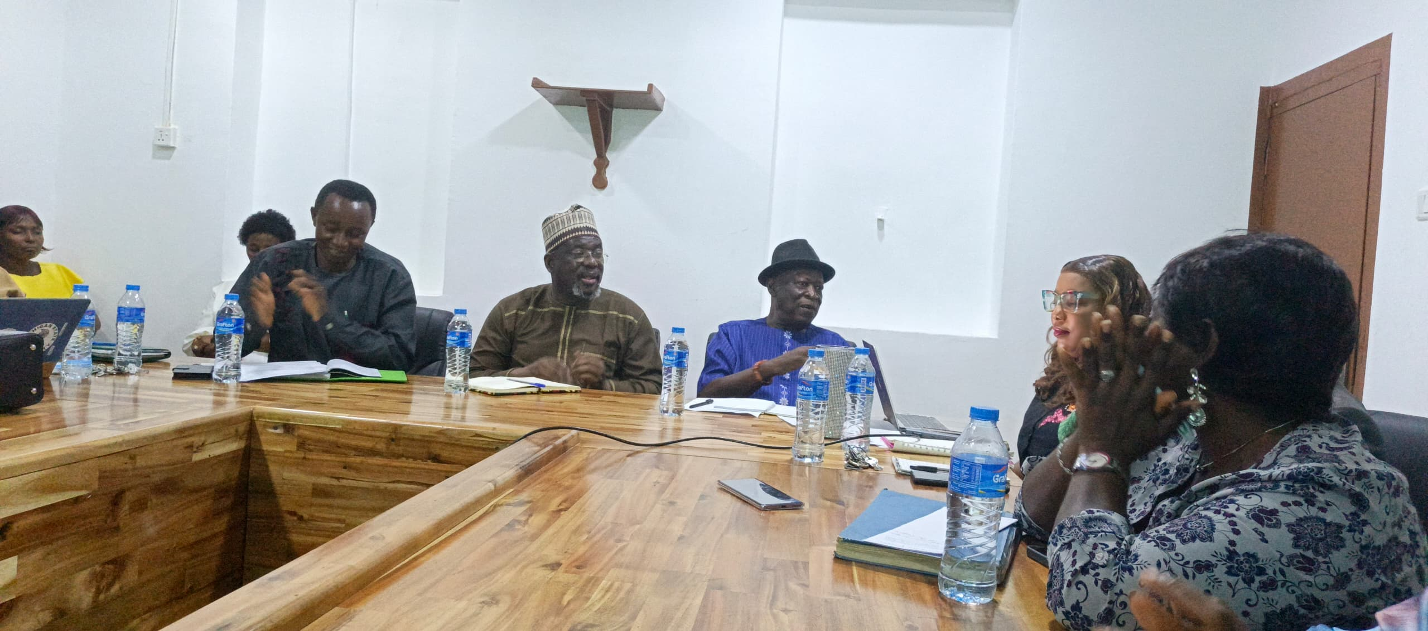
DEPUTY DIRECTOR GENERAL OF IITA VISITS SLARI AND PLEDGES SUPPORT FOR SLARI TO BE A CENTRE OF EXCELLENCE
Meeting with staff at the SLARI Conference Hall.

Slide 41
11. H.E. PRESIDENT BIO VISITS SLARI ROKUPR
In a historic move to accelerate Sierra Leone’s agricultural transformation under the Feed Salone Initiative, His Excellency President Dr. Julius Maada Bio has officially released 30 new and improved varieties of rice, cassava, and maize, developed by the SLARI on October 10th, 2025.
"The release of these new varieties marks a turning point in our Feed Salone vision. Through research and innovation, we are giving farmers access to seeds that will increase yields, improve resilience, and ensure food security," President Bio stated.

Slide 42
11. H.E. PRESIDENT BIO VISITS SLARI ROKUPR
In his keynote address, President Bio described the release as a scientific breakthrough and a powerful demonstration of his government’s commitment to empowering farmers and strengthening national food systems.
Among the newly released varieties are high-yielding rice strains capable of producing 7—8 tons per hectare, a major leap from the national average of 2—3 tons. These varieties, together with improved maize and cassava lines, were developed through years of dedicated research, field trials, and multi-location testing
He emphasized that agricultural transformation must be rooted in science and evidence-based practices, reaffirming that “Agriculture is a science.”

Slide 43
11. H.E. PRESIDENT BIO VISITS SLARI ROKUPR
In recognition of the President’s visionary leadership and commitment to food security, one of the newly released cassava varieties was named “Maada Cassava
Displaying the new improved varieties of rice, maize and cassava

Slide 44
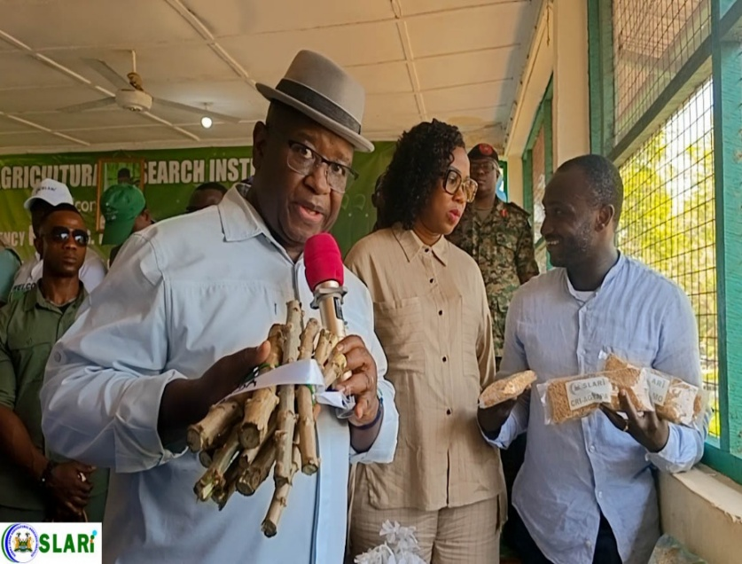
11. H.E. PRESIDENT BIO VISITS SLARI ROKUPR
President Bio and Minister Kpaka are joined by the First Lady, Madam Dr Fatima Bio in inspecting samples of the new varieties
Minister of Agriculture and Food Security, Dr. Henry Musa Kpaka, reaffirmed the government’s unwavering commitment to ensuring that the improved seeds reach farmers nationwide.

Slide 45
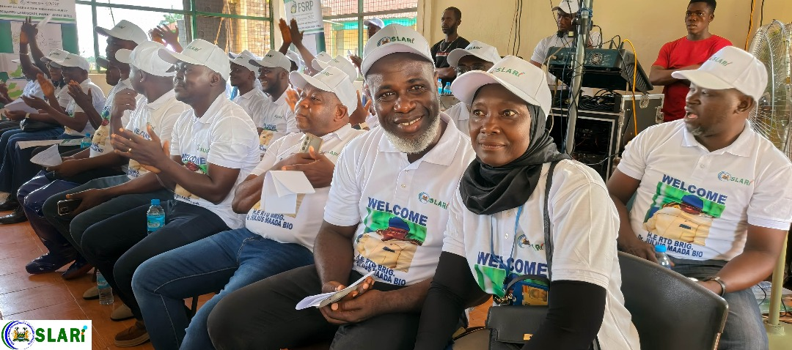
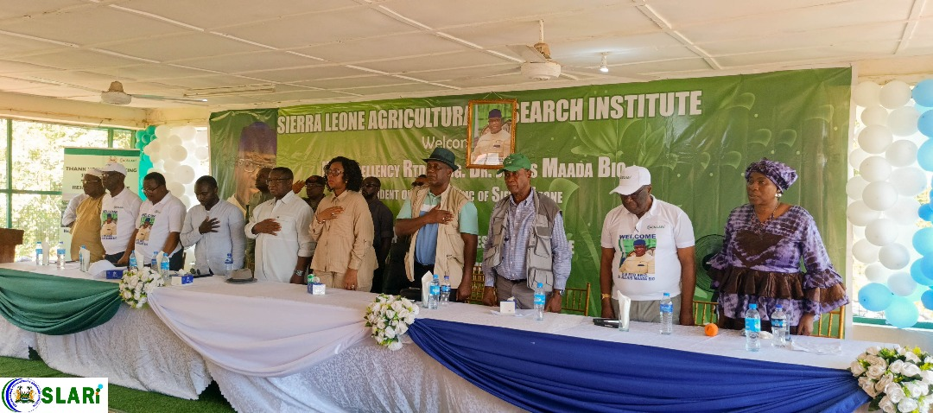
11. H.E. PRESIDENT BIO VISITS SLARI ROKUPR

Slide 46
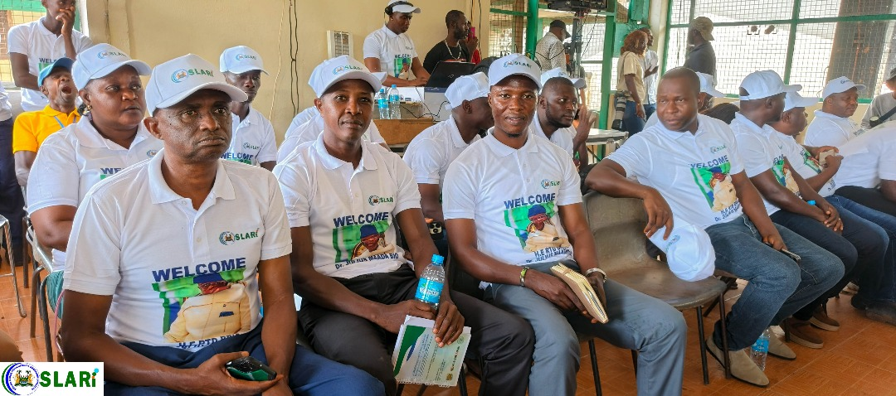
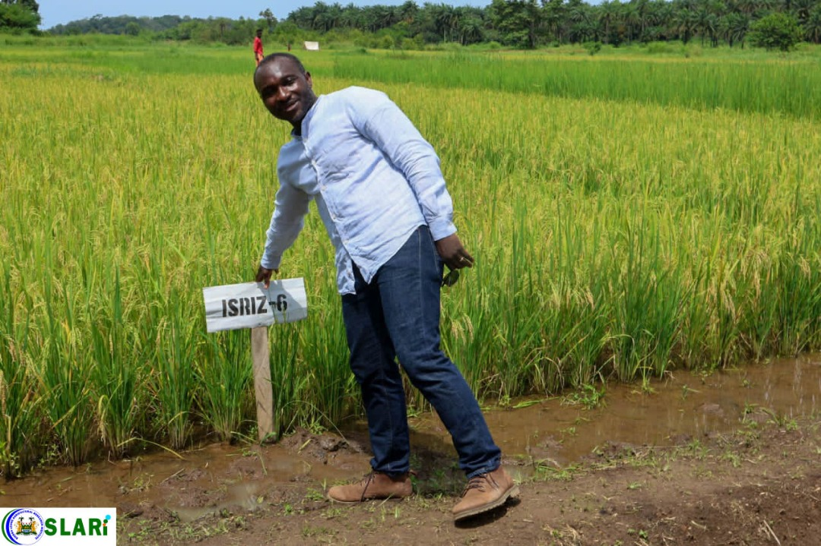
11. H.E. PRESIDENT BIO VISITS SLARI ROKUPR

Slide 47
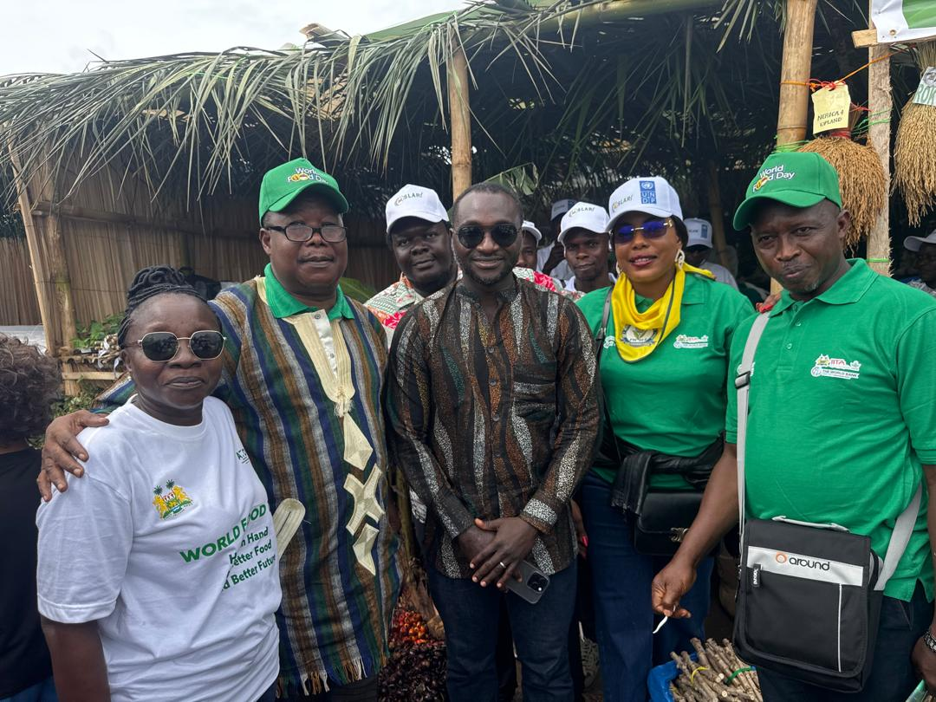
10. SLARI JOINS THE PRESIDENT TO COMMEMORATE THE 2025 WORLD FOOD DAY IN KAMBIA DISTRICT
The Sierra Leone Agricultural Research Institute (SLARI) successfully participated in the commemoration of World Food Day 2025, held in Kambia District from October 31 to November 1, 2025. Initiative.
Hon Minister—MAFS, Posing with SLARI Staff at the World Food Day Celebrations

Slide 48
11. H.E. PRESIDENT BIO VISITS SLARI ROKUPR
10. SLARI JOINS THE PRESIDENT TO COMMEMORATE THE 2025 WORLD FOOD DAY IN KAMBIA DISTRICT
A defining moment of the event was the visit of His Excellency, the President, Rtd. Brig. Dr. Julius Maada Bio, to the SLARI exhibition booth. The diverse range of research innovations, improved crop varieties, and technologies on display visibly impressed the President.
During his speech, the President made a remarkable statement expressing his appreciation for SLARI’s efforts: “I have special thanks to SLARI,” he said. During his speech, he went on asking the audience to applaud, adding, “Clap for SLARI, they have done well.”

Slide 49
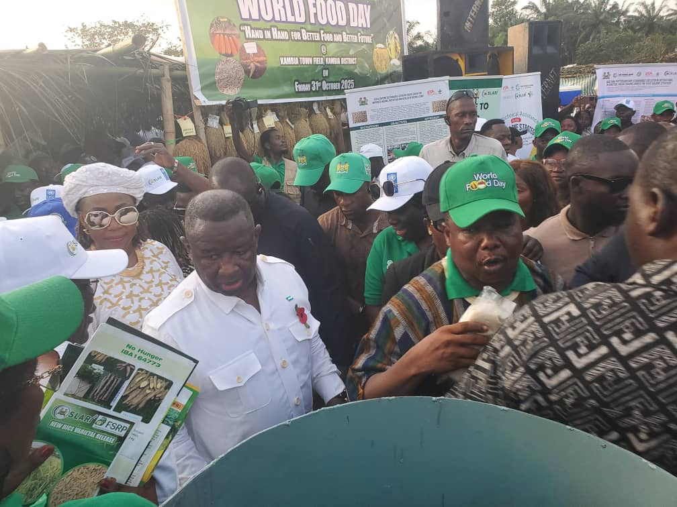
10. SLARI JOINS THE PRESIDENT TO COMMEMORATE THE 2025 WORLD FOOD DAY IN KAMBIA DISTRICT

Slide 50
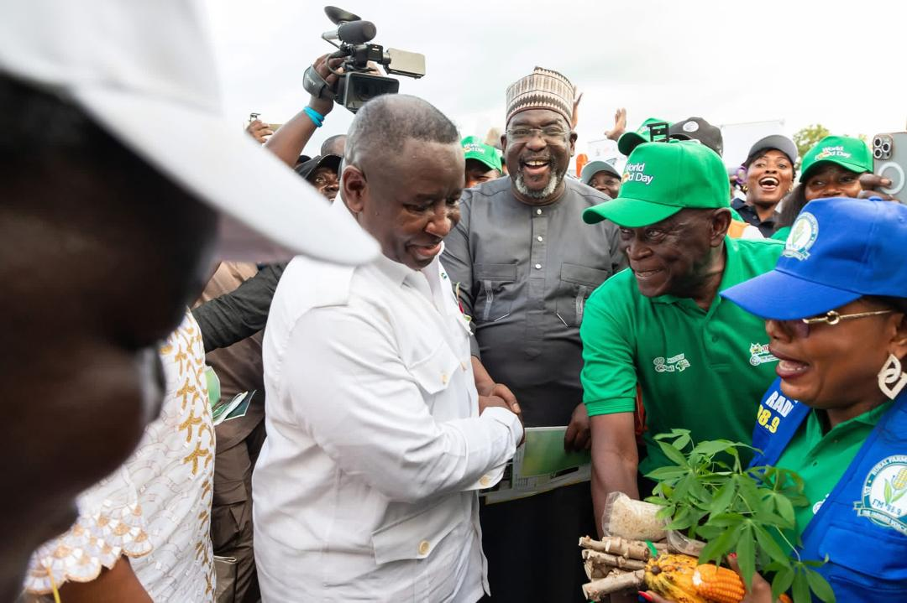
11. H.E. PRESIDENT BIO VISITS SLARI ROKUPR
10. SLARI JOINS THE PRESIDENT TO COMMEMORATE THE 2025 WORLD FOOD DAY IN KAMBIA DISTRICT
SLARI’s participation was strengthened through technical and logistical support from IITA. Dr. Tahirou Abdoulaye, the newly appointed Deputy Director General for Partnership, Delivery, and Scaling, led the IITA team from Ibadan, Nigeria.
This gesture of recognition from the Head of State symbolized national appreciation for the Institute’s consistent contributions to food system resilience and agricultural transformation in Sierra Leone.

Slide 51
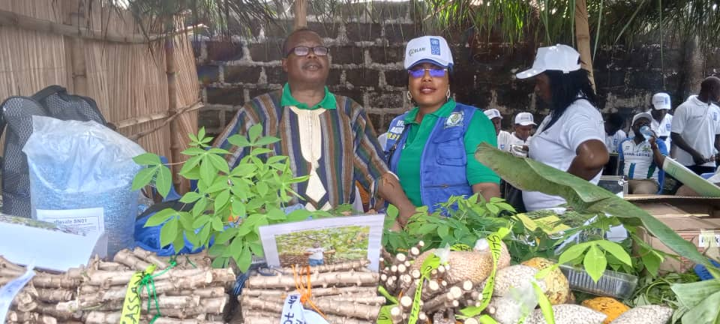
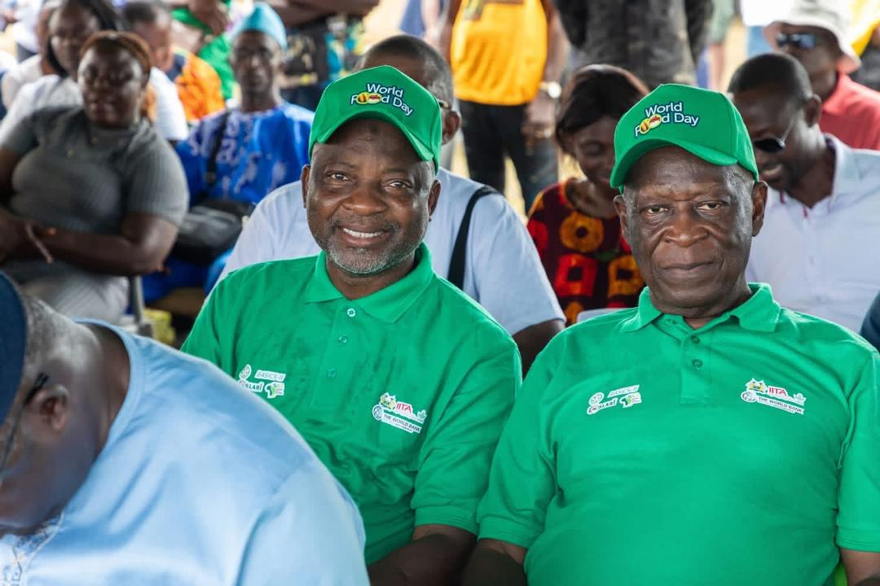
10. SLARI JOINS THE PRESIDENT TO COMMEMORATE THE 2025 WORLD FOOD DAY IN KAMBIA DISTRICT

Slide 52
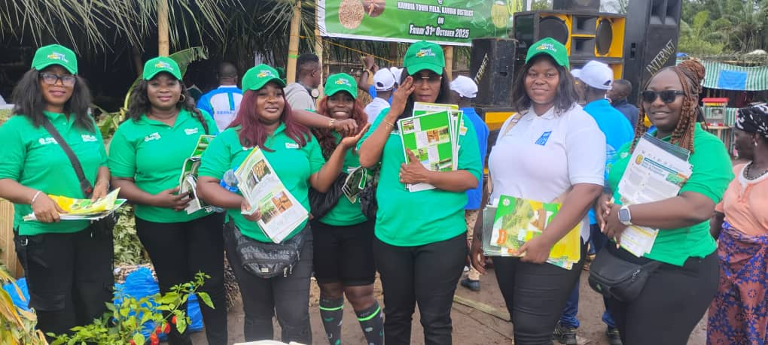
SLARI Staff sharing flyers of our release technologies at the World Food Day Celebrations

Slide 53
10. SLARI JOINS THE PRESIDENT TO COMMEMORATE THE 2025 WORLD FOOD DAY IN KAMBIA DISTRICT
The 2025 World Food Day commemoration in Kambia was a resounding success.
With the active participation of the Commercialization Wing and the unwavering support from partners, including IITA, FSRP, and UNDP, SLARI’s contribution stood out as one of the most impactful and memorable aspects of the event.
The recognition from His Excellency the President affirmed SLARI’s pivotal role in supporting the national Feed Salone Initiative and advancing agricultural research, innovation, and commercialization for sustainable food security.

Slide 54
12. SLARI VALIDATES ITS STRATEGIC AND OPERATIONAL PLANS TO GUIDE AGRICULTURAL RESEARCH FOR THE NEXT DECADE
November 6, 2025. SLARI successfully concluded a two-day national validation workshop on its Reviewed Strategic and Operational Plans (2025–2034), reaffirming its commitment to driving innovation, research excellence, and agricultural transformation in Sierra Leone.
The validation of SLARI’s Reviewed Strategic and Operational Plans (2025–2034) represents a major milestone in strengthening the institute’s institutional capacity and reaffirming its relevance in national development.
In his contribution, Dr. Dixon, Chairman of the SLARI Council, commended the collaborative approach used to prepare the documents and underscored that the plans will serve as a ten-year roadmap guiding SLARI’s research focus, resource mobilization, and operational framework.

Slide 55
13. SLARI JOINS CAASTIA AT THE GENERAL ASSEMBLY HELD IN ADDIS ABABA, ETHIOPIA, ON OCTOBER 26 – 29, 2025
CAASTIA’s membership is inclusive of all institutions working on agriculture (e.g., universities, national research institutes and councils in Africa and China, etc.). We are all therefore Players and Actors in CAASTIA’s Implementation plan.
In his Keynote speech at the Summit of the 2024 Forum on China-Africa Cooperation (FOCAC), President Xi Jinping proposed the establishment of China-Africa Agricultural Science and Technology Innovation Alliance (CAASTIA), as one of Ten Partnership Initiatives of the FOCAC Beijing Action Plan (2025-2027), with the Chinese Academy of Agricultural Sciences (CAAS) and the African Academy of Sciences (AAS) as the implementing institutions.
The first General Assembly of the China-Africa Agricultural Science and Technology Innovation Alliance (CAASTIA) took place from 26-29 October 2025 in Addis Ababa, Ethiopia

Slide 56
13. SLARI JOINS CAASTIA AT THE GENERAL ASSEMBLY HELD IN ADDIS ABABA, ETHIOPIA, ON OCTOBER 26 – 29, 2025
Under the Beijing Action Plan (2025–2027), CAASTIA is mandated to promote:
germplasm exchange between China and Africa for research and food security in Africa,
continued joint training of young African scientists and PhD students at the National Nanfan Research Institute in Sanya, China, to ensure the development of future generation of agricultural scientists.
collaborative research on agricultural technologies that are adapted to local conditions for increased food production and sustainable agricultural development in Africa,
the building of digital, AI, and other platforms for agricultural technology cooperation and exchanges, and
a coordinated of agricultural technology and industry in China and Africa, and

Slide 57
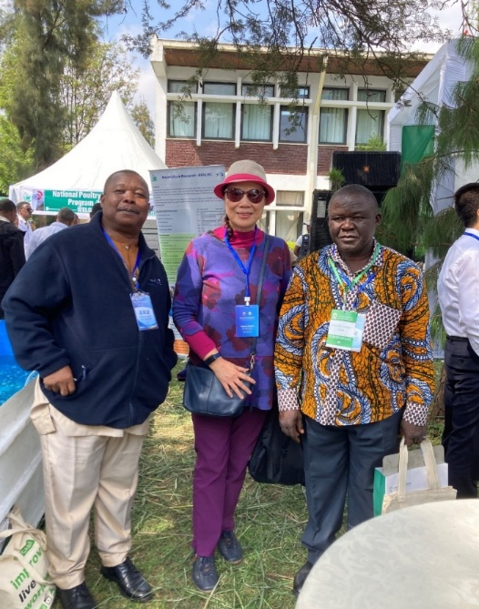
13. SLARI JOINS CAASTIA AT THE GENERAL ASSEMBLY HELD IN ADDIS ABABA, ETHIOPIA, ON OCTOBER 26 – 29, 2025
The first General Assembly of the China-Africa Agricultural Science and Technology Innovation Alliance (CAASTIA) took place from 26-29 October 2025 in Addis Ababa, Ethiopia.
CAASTIA’s membership is inclusive of all institutions working on agriculture (e.g., universities, national research institutes and councils in Africa and China, etc.).
Participants included senior researchers from most countries in Africa and senior representatives of the Chinese government, most of whom were professors from Chinese Universities and leaders of Chinese agricultural research institutions.

Slide 58
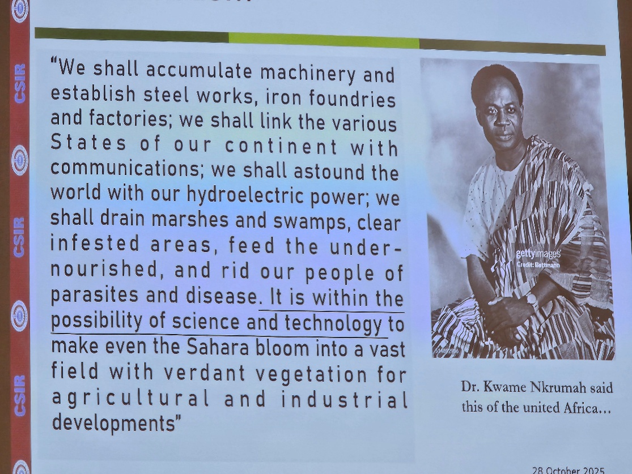
A slide from a presentation by the Director-General of the CSIR in Ghana illustrating the dream of the late Dr Kwame Nkrumah of Ghana.

Slide 59

SLARI ACHIEVEMENTS (2024–2025)
Between 2024 and 2025, SLARI made transformative contributions to Sierra Leone’s agriculture sector, from releasing improved varieties to training tens of thousands of farmers and establishing innovation parks that will shape the future of farming.
These achievements reinforce SLARI’s role as the nation’s leading agricultural research institution and a key driver of the Feed Salone Initiative.

Slide 60
Strengthening Seed Systems and Value Chain Development
Supported 20 commercial seed producers with advanced training in soybean management and cassava value chain, improving access to quality planting materials.
Introduced and tested the first-ever Aflasafe product in Sierra Leone, designed to reduce aflatoxin contamination in groundnut, maize, and sesame value chains.
Released 14 new climate-resilient rice varieties suitable for diverse ecologies across Sierra Leone.
Released 8 new maize varieties, including 4 high-yielding hybrids, to boost national maize production.
Released 6 improved cassava varieties, including one bio-fortified variety aimed at enhancing national nutrition outcomes.

Slide 61
Expanding Farmer Training and Extension Support
Trained 30,000 farmers nationwide on the Six Steps to Effective Weed Management, significantly improving weed control practices.
Trained 100 agricultural extension agents on Good Agronomic Practices (GAP) to support continuous farmer outreach.
Provided resilience and climate-smart agriculture training to over 1,000 farmers across multiple value chains.
Trained over 250 youths on the use of herbicide calculators to promote responsible and efficient herbicide application.

Slide 62
Advancing Research, Technology, and Innovation
Trained 10 national experts to generate a robust Food Consumption and Micronutrient Database, supporting better nutrition planning and policy development.
Established Nutrient Omission and Nutrient-Specific Trials across key ecological zones to strengthen soil fertility management and promote soil health programmes.
Introduced the first-ever Semi-Autotrophic Hydroponic (SAH) technology for rapid cassava multiplication.
30,000 plantlets have already been produced and distributed to support large-scale cassava cultivation.

Slide 63
Establishment of Technology and Innovation Parks
SLARI successfully established three Technology and Innovation Parks in the Northern, Southern, and Eastern Regions of Sierra Leone. These parks serve as hubs for:
Hands-on training for farmers, youth, and extension agents.
Demonstration and adoption of improved technologies from SLARI’s six research centres.
Field days enabling farmers to observe, select, and adopt proven technologies.
Promoting youth engagement, agriprenuers, and employment in agriculture.
Strengthening partnerships with agricultural stakeholders, development partners, and the private sector.

Slide 64
THANK YOU FOR YOUR ATTENTION

