Slide 1



Director-General’s Report for Council 2026 by
Director-General - Dr Abdul Rahman Conteh
Tuesday, June 16, 2026

Slide 2
ORDER OF PRESENTATION
FLASH BACK
PREVIOUS ACTION POINTS
ACTIVITIES IN 2026
ANNUAL WORK PROGRAM CONFERENCE
COLLABORATION WITH IITA
TRAINING OF LAB TECHNICIANS
4. OVERVIEW OF STAFF SITUATION

Slide 3
Proposal to Co-opt two Centre Leaders on a rotational basis
Dr Adam Sheka Kanu
Rokupr
2. Dr Dauda Sheku Yillah
Teko

Slide 4
FLASH BACK
Major Successes of SLARI
Reactivation of the Annual Work Program Conference
Compilation of Annual Reports
Scoring of Scientists for Promotion
Enhanced Visibility of SLARI
Visit to Rokupr by H.E. Dr (Rtd. Brig.) Julius Maada Bio
Strategic Plan
Website Completed https://slari.gov.sl

Slide 5
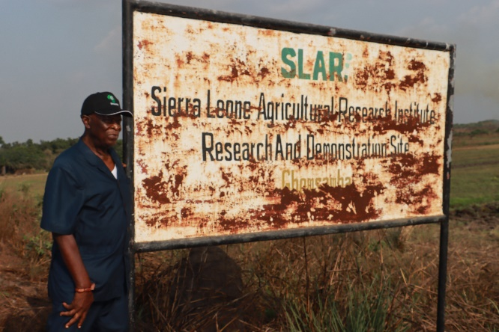

Slide 6
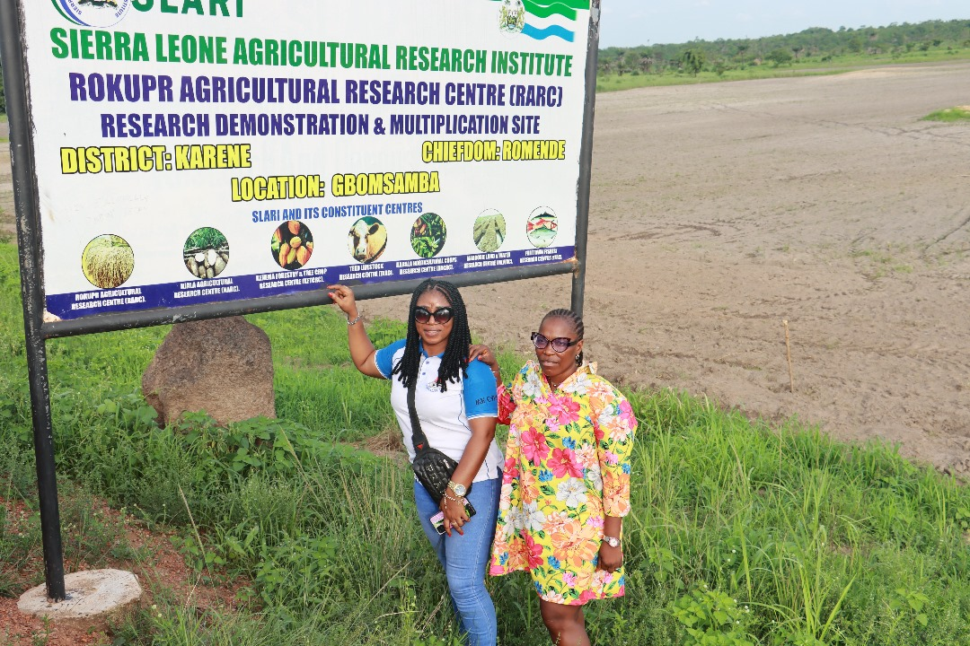
Enhanced Visibility of SLARI

Slide 7
H.E. PRESIDENT BIO VISITS SLARI ROKUPR
In a historic move to accelerate Sierra Leone’s agricultural transformation under the Feed Salone Initiative, His Excellency President Dr. Julius Maada Bio has officially released 30 new and improved varieties of rice, cassava, and maize, developed by the SLARI on October 10th, 2025.
"The release of these new varieties marks a turning point in our Feed Salone vision. Through research and innovation, we are giving farmers access to seeds that will increase yields, improve resilience, and ensure food security," President Bio stated.

Slide 8
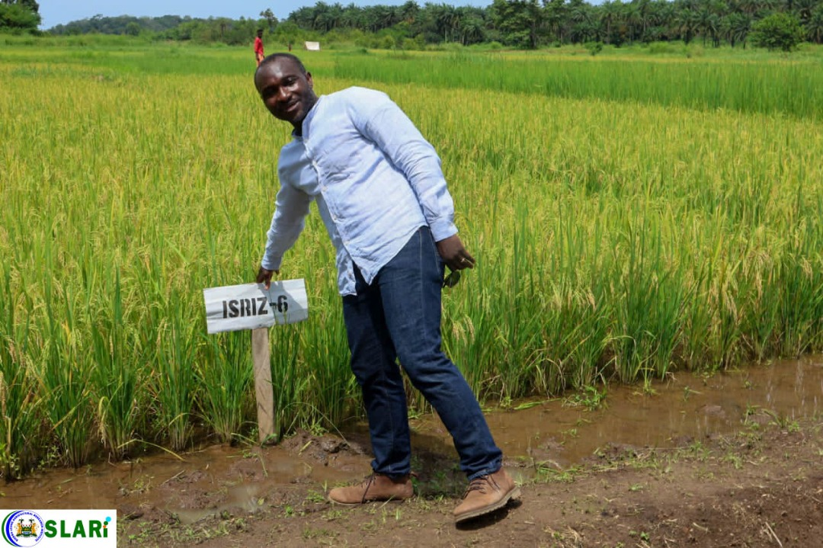
H.E. PRESIDENT BIO VISITS SLARI ROKUPR

Slide 9
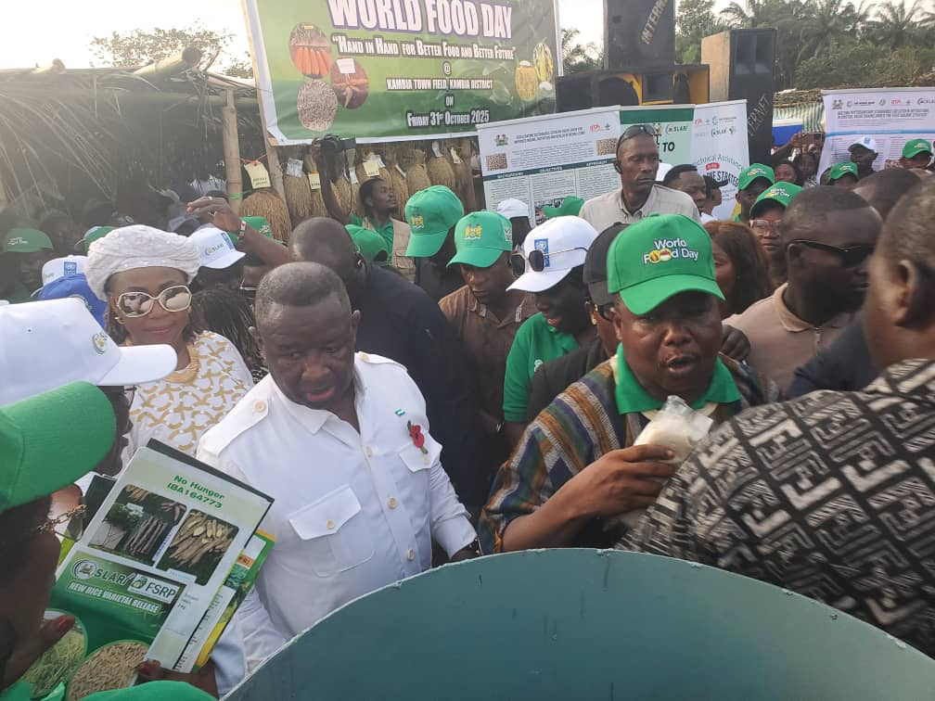
10. SLARI JOINS THE PRESIDENT TO COMMEMORATE THE 2025 WORLD FOOD DAY IN KAMBIA DISTRICT

Slide 10
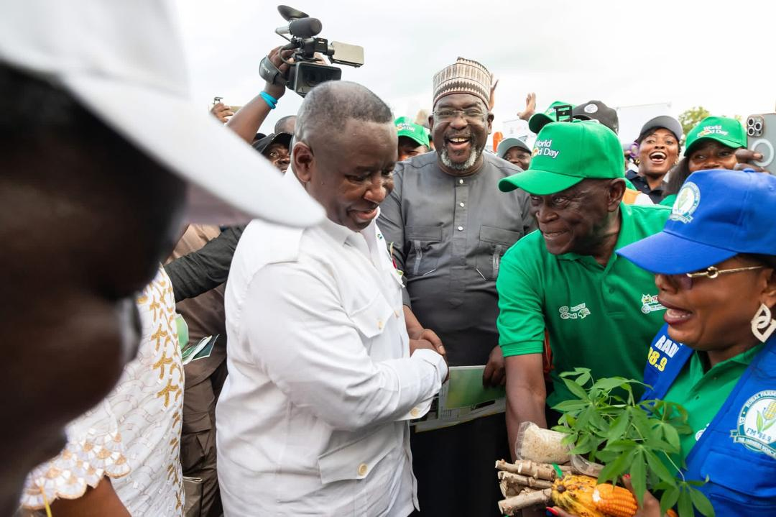
11. H.E. PRESIDENT BIO VISITS SLARI ROKUPR
SLARI JOINS THE PRESIDENT TO COMMEMORATE THE 2025 WORLD FOOD DAY IN KAMBIA DISTRICT
SLARI’s participation was strengthened through technical and logistical support from IITA. Dr. Tahirou Abdoulaye, the newly appointed Deputy Director General for Partnership, Delivery, and Scaling, led the IITA team from Ibadan, Nigeria.
This gesture of recognition from the Head of State symbolized national appreciation for the Institute’s consistent contributions to food system resilience and agricultural transformation in Sierra Leone.

Slide 11
Action Points from the 22nd SLARI Council meeting
Action Point | Status | Remarks
SLARI should plant the newly released varieties in their demonstration sites which should be visible and accessible to farmers and government officials so that farmers can adopt these varieties quickly. | New varieties currently under multiplication | Private sector involved
Council members agreed that scientists who fail to submit Technical and Financial reports on time should have their salaries withheld by management. | This was noted and will be implemented | Warnings sent to staff
Council members should approve the budget every year before it is submitted to the Ministry of Finance. | This was noted and will be implemented | Not yet time for budget submission

Slide 12
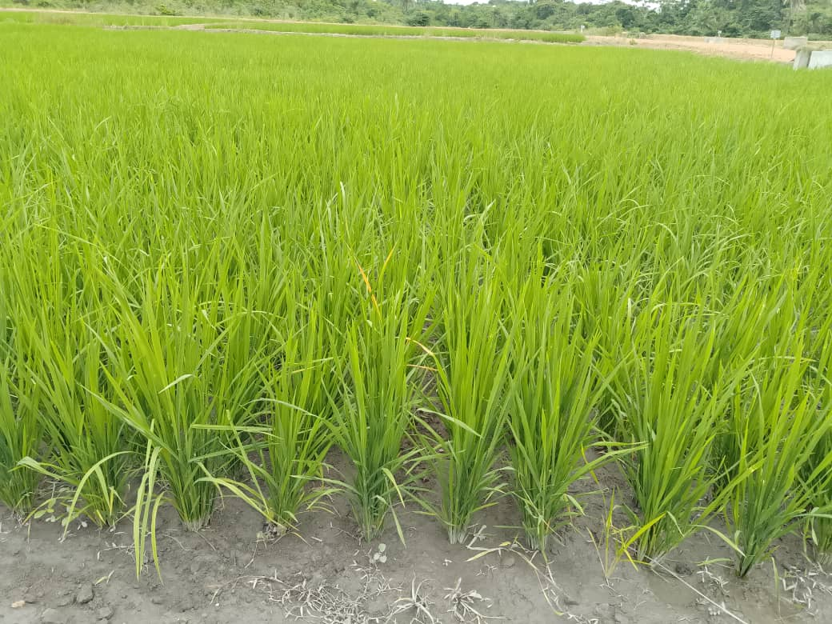
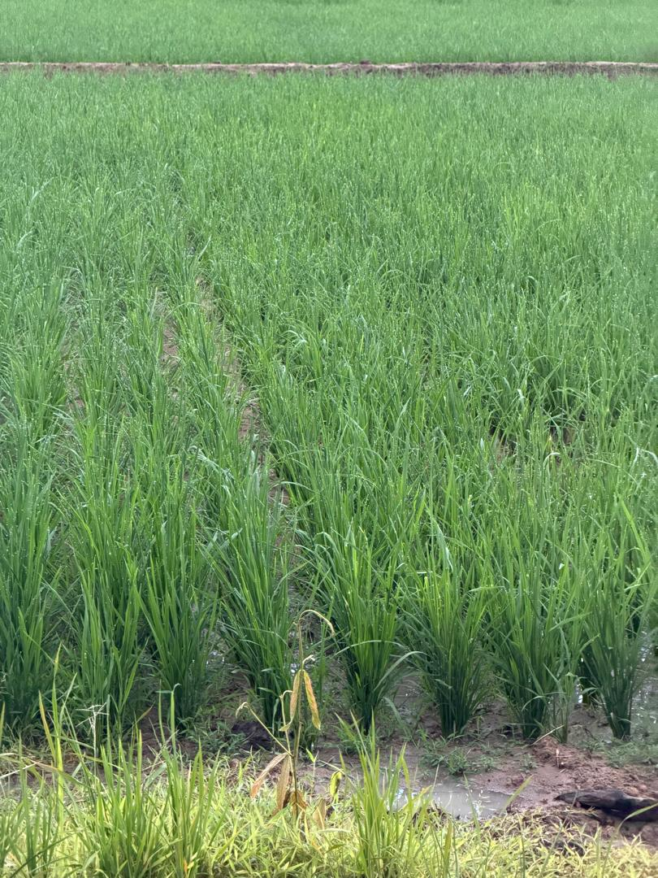
Smart Farms
48 Robert Street, Freetown
www.smartfarmssl.com

Slide 13
Action Points from the 21st SLARI Council meeting
Action Point | Status | Remarks
A Search Committee consisting of the following people to be set-up to initiate the recruitment process for the position of DG and Directors of Centres: | This was done. | This is on hold.
CAO, MAFS President, NaFFSL Executive Secretary, SLeCAD Prof. Abdul B. Karim – FBC, University of Sierra Leone Dr. Alpha Yaya Kamara – IITA, Nigeria DVC – Njala University

Slide 14
Action Points from the 21st SLARI Council meeting
Action Point | Status | Remarks
It was agreed that the advertisement for the position of Director General and Centre Directors should be done following international standards and should be done early January 2026. | This was noted and will be implemented | This is on hold.
The arrears for OIC allowances must be paid from the Other Charges or other funds received by SLARI. The Acting DG to write a letter to the FSRP Project Manager on the status of SLARI’s activities and then copy the CAO MAFS, SLARI Council Chairman and Minister of Agriculture on or before 19th December 2025. | This was noted and will be implemented Letter was written and sent as instructed.

Slide 15
Action Points from the 21st SLARI Council meeting
Action Point | Status | Remarks
The Acting DG is expected to take serious action against scientists who are engaged on a second job and neglecting the work at SLARI. | This was noted and will be implemented

Slide 16
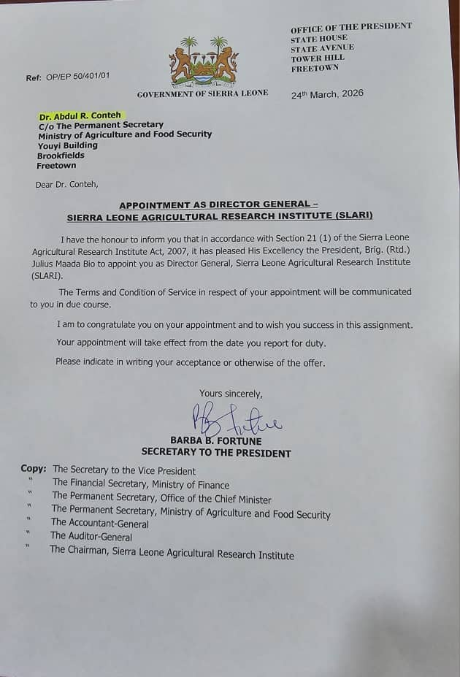

Slide 17
Sierra Leone Agricultural Research Institute (SLARI) held its Annual Work Program Conference on March 10 – 11, 2026, at the Rokupr Agricultural Research Centre (RARC), Kambia District. The primary objective of the conference was to:
Critically review research and development (R&D) activities implemented in 2025
Document key achievements and lessons learned
Identify major challenges encountered
Examine, validate, and align proposed action plans and research priorities for 2026
Welcome Address – Dr. Adam Sheka Kanu (Officer-in-Charge, RARC)
Dr. Kanu warmly welcomed all participants and encouraged active participation from all delegates, noting that the outcomes of the deliberations would significantly shape SLARI’s contribution to national food security.

Slide 18
Professor Roland Suluku (Chairman)
Professor Suluku highlighted that the Government’s “Feed Salone” initiative aims to transform the food system, increase agricultural productivity, and reduce dependence on food imports.
He noted that the Annual Work Program Conference serves as a vital platform for reflection, knowledge sharing, and strategic planning.
He concluded by emphasizing the importance of collaboration among government institutions, universities, farmers, private sector actors, and development partners in driving agricultural transformation.

Slide 19
Eastern Technical University – Dr. Bernadette Lahai
Dr. Lahai emphasized the triple mandate of universities: teaching, research, and outreach..
She advocated for:
Increased funding for SLARI
Stronger engagement with Parliament for effective policy advocacy
Enhanced research-extension linkages
Ernest Bai Koroma University – Prof. Edwin Momoh
Prof. Momoh stressed that research should remain the foundation of development interventions. He highlighted the importance of:
Demand-driven and community-based research
Institutional collaboration
Student involvement in applied research

Slide 20
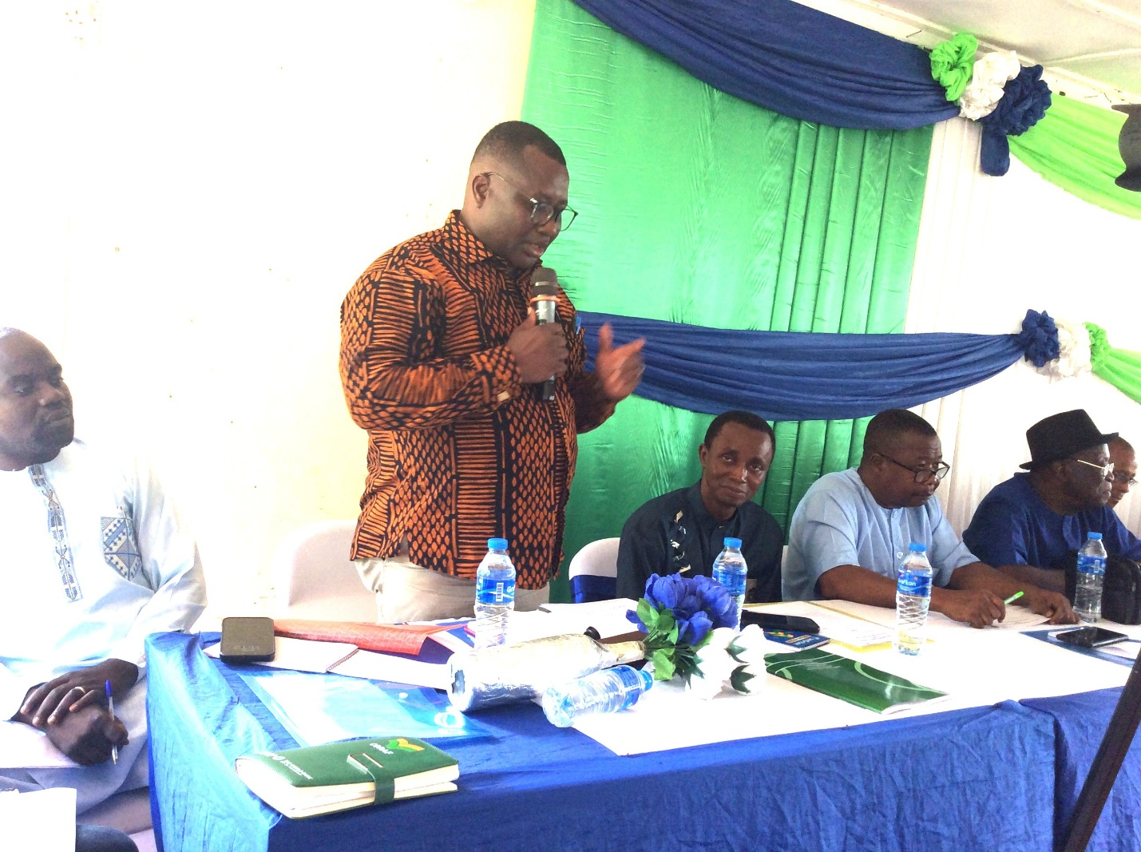

Slide 21
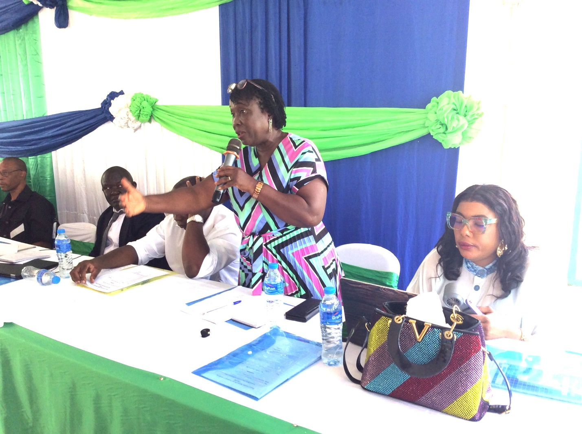

Slide 22
Food and Agriculture Organization (FAO)
The FAO representative highlighted ongoing and planned support to SLARI, stressed the importance of increased domestic investment in agriculture, noting that over-reliance on donor funding poses sustainability risks.
National Farmers Radio – Prof. Adolphus Johnson
Prof. Johnson emphasized the importance of communication and knowledge dissemination. Strengthening professional research networks
Ministry of Agriculture and Food Security (MAFS)
The Ministry reaffirmed its commitment to supporting SLARI and strengthening its role as a center of excellence in agricultural research.
Parliamentary Engagement
A representative from Parliament emphasized the importance of strengthening collaboration between SLARI and legislators.

Slide 23
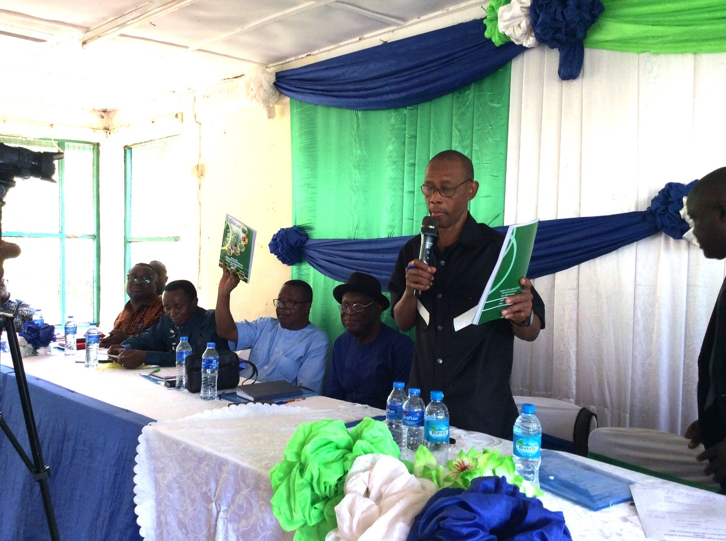

Slide 24
Dr. Abdul R. Conteh (SLARI Director General) delivered a comprehensive institutional overview, highlighting both achievements and constraints experienced during the 2025 implementation period.
Dr. Conteh further emphasized SLARI’s growing international profile through the establishment and strengthening of strategic partnerships signed with prominent regional and international organizations such as IITA, CORAF, FSRP, and OCP Africa.
Technical session
Dr. Prince Norman (Deputy Director General, SLARI Headquarters) provided an in-depth overview of FSRP Adaptive Research Grants. He emphasized that the grants have played a catalytic role thereby strengthening the linkage between research outputs and field-level impact.

Slide 25
Technical Session 1: Research Highlights from 2025
Addressing critical challenges within the agricultural sector.
Dr. Nabieu Kamara (RARC) presented on the collection and characterization of mangrove rice germplasm.
Dr. Patrick Maada Ngegba (NARC) shared findings from a national assessment of dietary exposure and consumer awareness of mycotoxins.
Dr. Kemoh Bangura (RARC) discussed interventions to promote improved rice parboiling technologies among mangrove rice processors.
Mr. Suffian Mansaray (NARC) presented on the operationalization of a cassava flash dryer, highlighting its potential to revolutionize cassava processing.
Hindolo A. Bebeley (MLWERC) shared research findings on the application of biochar for soil fertility improvement.
Mohamed Tejan Jalloh (TLRC) presented an innovative project on biogas production from livestock waste.
Collectively, these presentations demonstrated the breadth of SLARI’s research portfolio and its alignment with national priorities on food security, climate resilience, and value chain development.

Slide 26
FSRP/IITA Technical Backstopping Session
Component leads presented progress across key thematic areas:
Component 1 (Dr. Patrick Maada Ngegba): Focused on phytosanitary compliance, particularly aflatoxin mitigation in priority value chains, contributing to improved food safety and market access.
Component 2.1 (Dr. Jebeh Samba Barka): Highlighted progress in developing a commercially viable cassava seed system through private sector engagement and seed certification mechanisms.
Component 2.2 (Mr. Keiwoma Mark Yila & Dr. Martha S.E. Williams-Ngegba): Covered soybean value chain development and the establishment of food consumption and micronutrient databases to inform nutrition-sensitive agriculture.
Component 3 (Dr. Frederick Kobba): Focused on farmer empowerment through training, extension services, and capacity-building initiatives aimed at improving productivity and adoption of technologies.
Soils Research Team (Dr. Conteh): Presented findings from fertilizer trials and liming studies, providing evidence-based recommendations for soil fertility management.

Slide 27
Key Outcomes
The conference achieved several significant outcomes:
Stakeholders identified high-potential initiatives for scaling and funding, including:
  Expansion of biogas technologies
  Strengthening mycotoxin mitigation efforts
  Commercialization of cassava seed systems
Dr. Adam Sheka Kanu delivered the closing remarks on behalf of SLARI management.

Slide 28
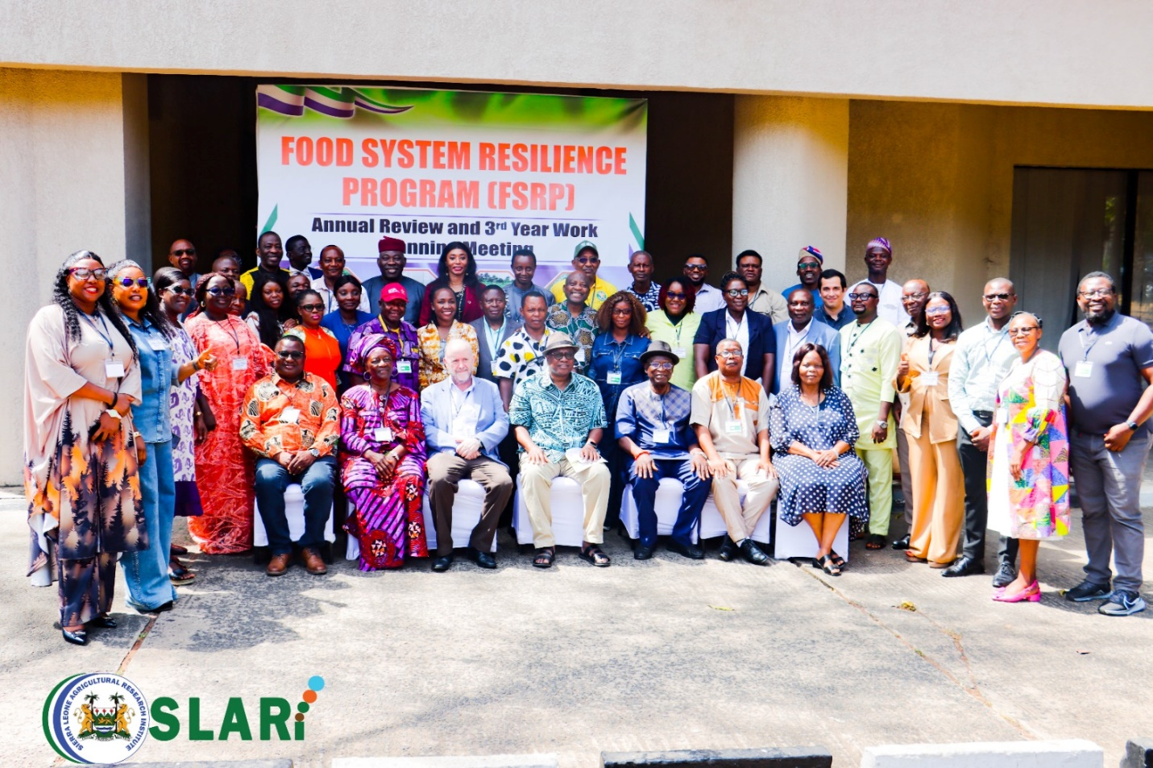

Slide 29
World Bank Mission Expresses Satisfaction with SLARI/IITA/FSRP Project Implementation
On Saturday 17 January 2026, at Njala Agricultural Research Centre (NARC) conference hall, the World Bank team, headed by Dr Tunji Oredipe, expressed strong satisfaction with the progress and outcomes of the Food Systems Resilience Programme (FSRP) project implemented by Sierra Leone Agricultural Research Institute (SLARI) in collaboration with the International Institute of Tropical Agriculture (IITA).

Slide 30
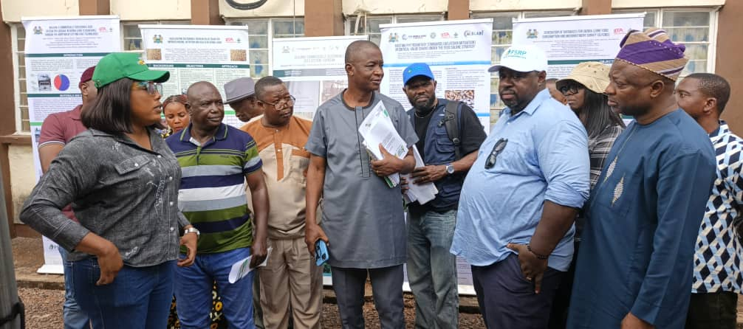
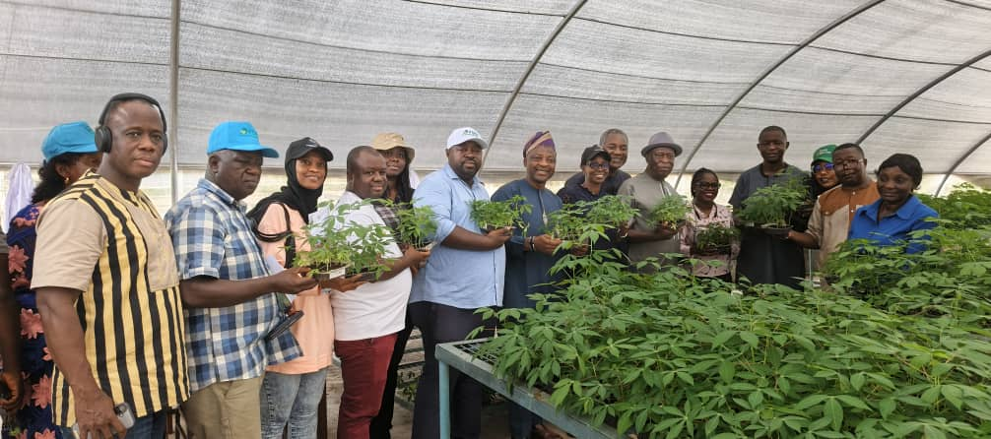
From the Ministry of Finance, Mr. Samuel Yankuba also expressed satisfaction with the overall implementation of the FSRP/IITA/SLARI projects, highlighting the transparency, coordination, and visible impact achieved within a relatively short period
.

Slide 31
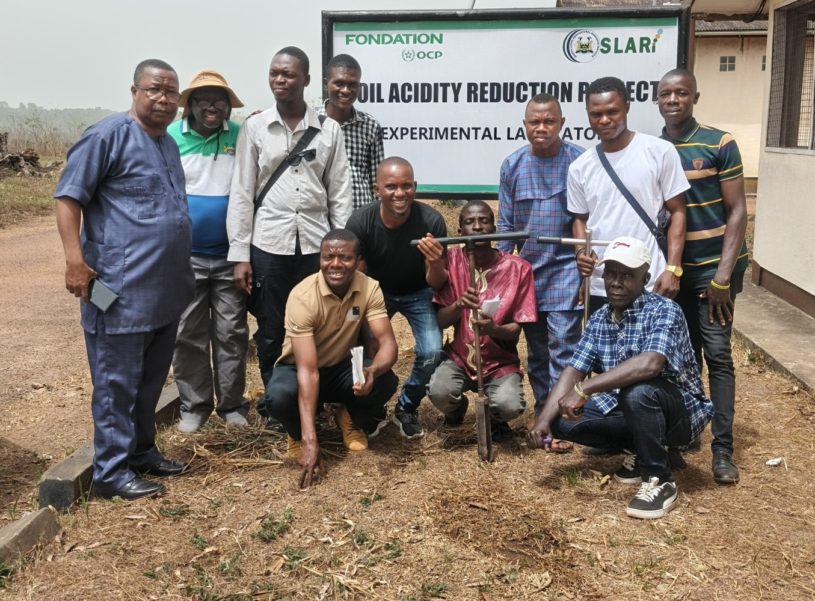
Strengthening Soil Laboratory Capacity in Sierra Leone
SLARI, in partnership with Njala University, concluded a technical training at NARC from 16th to 20th February 2026,
The training aimed at strengthening soil laboratory capacity to support national agricultural transformation under the Feed Salone Strategy.
The training focused on basic laboratory operations, analytical efficiency principles, and the professional do’s and don’ts of soil laboratory management.

Slide 32
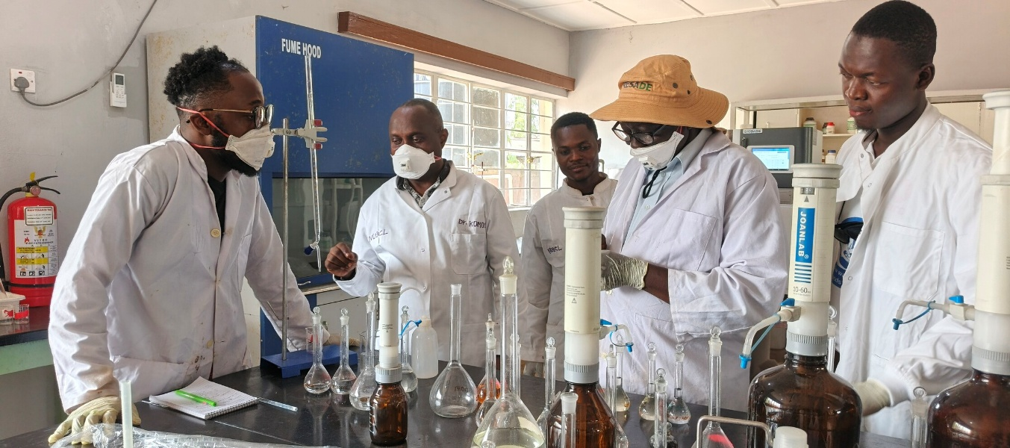
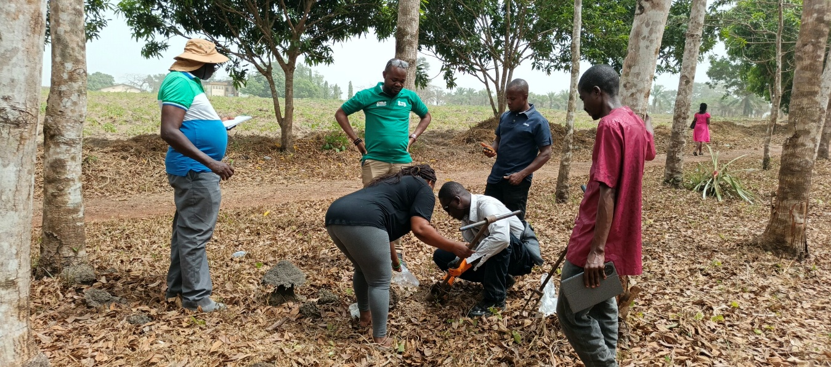
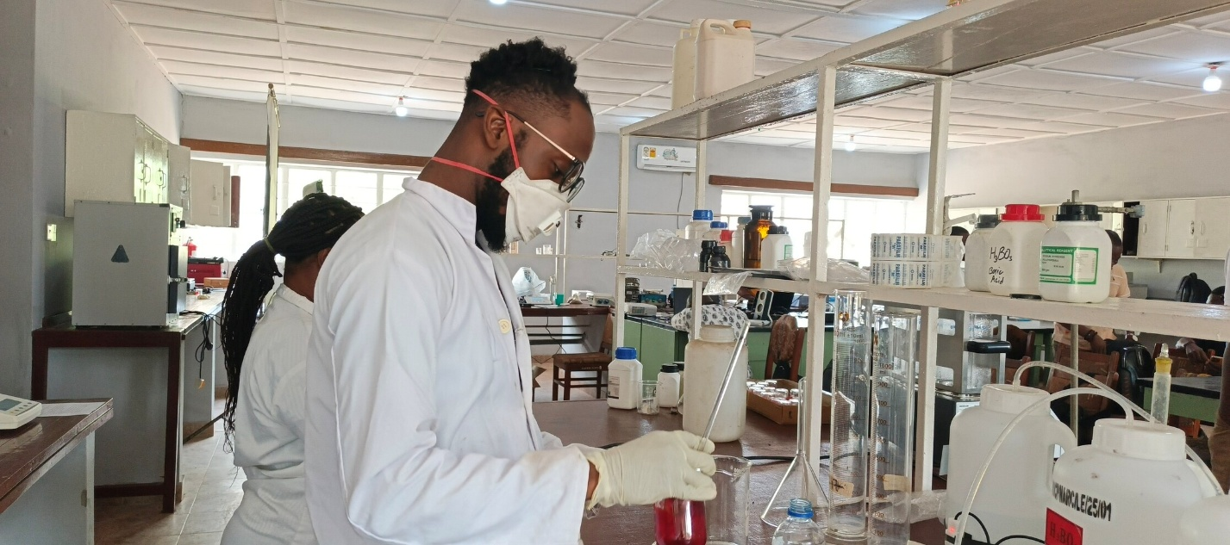
Reliable soil analysis supports better fertilizer management, soil acidity correction, and sustainable land use practices —
With enhanced laboratory capacity, Sierra Leone’s agricultural research system is better positioned to contribute meaningfully to improved soil fertility and sustainable food production for the nation.

Slide 33
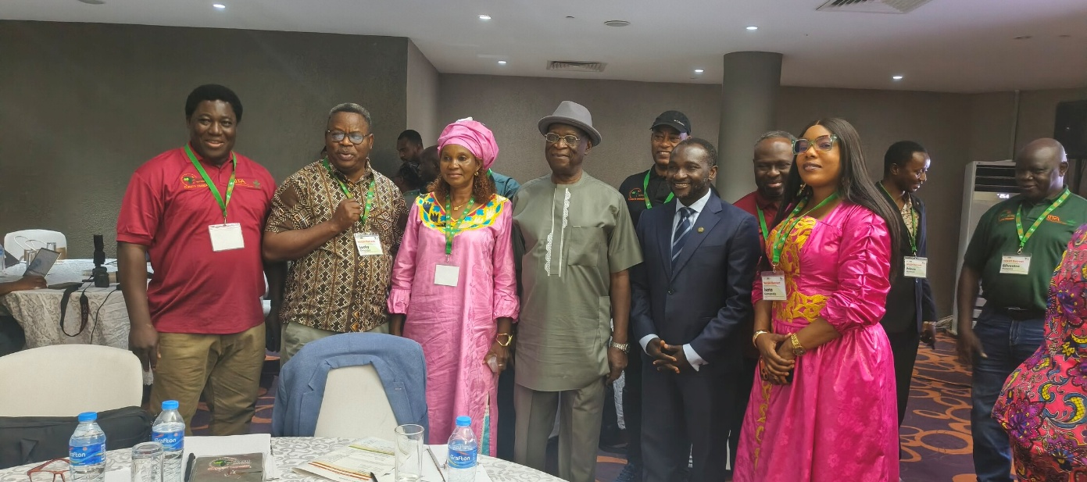
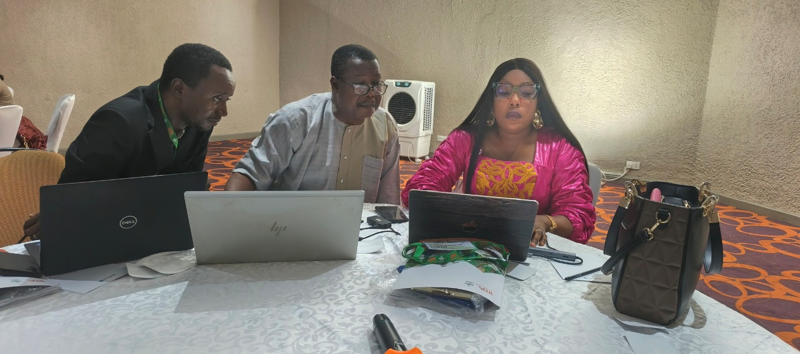
SLARI joined IITA Conclude a Three-Day WASH Retreat in Freetown
March 27, 2026. Freetown, Sierra Leone –SLARI joined the International Institute of Tropical Agriculture in successfully concluding its three-day West Africa and Sahel Hub (WASH) Retreat at the Radisson Blu Mammy Yoko Hotel, bringing together leading scientists, policymakers, and development partners under the theme “Climate Change.”
A major highlight of the opening ceremony was the keynote address delivered by Dr. Henry Musa Kpaka, Honourable Minister of Agriculture and Food Security. In his statement, the Minister emphasized that the retreat reflects His Excellency the President’s strong desire to deepen collaboration with IITA in the implementation of the Feed Salone Strategy.

Slide 34
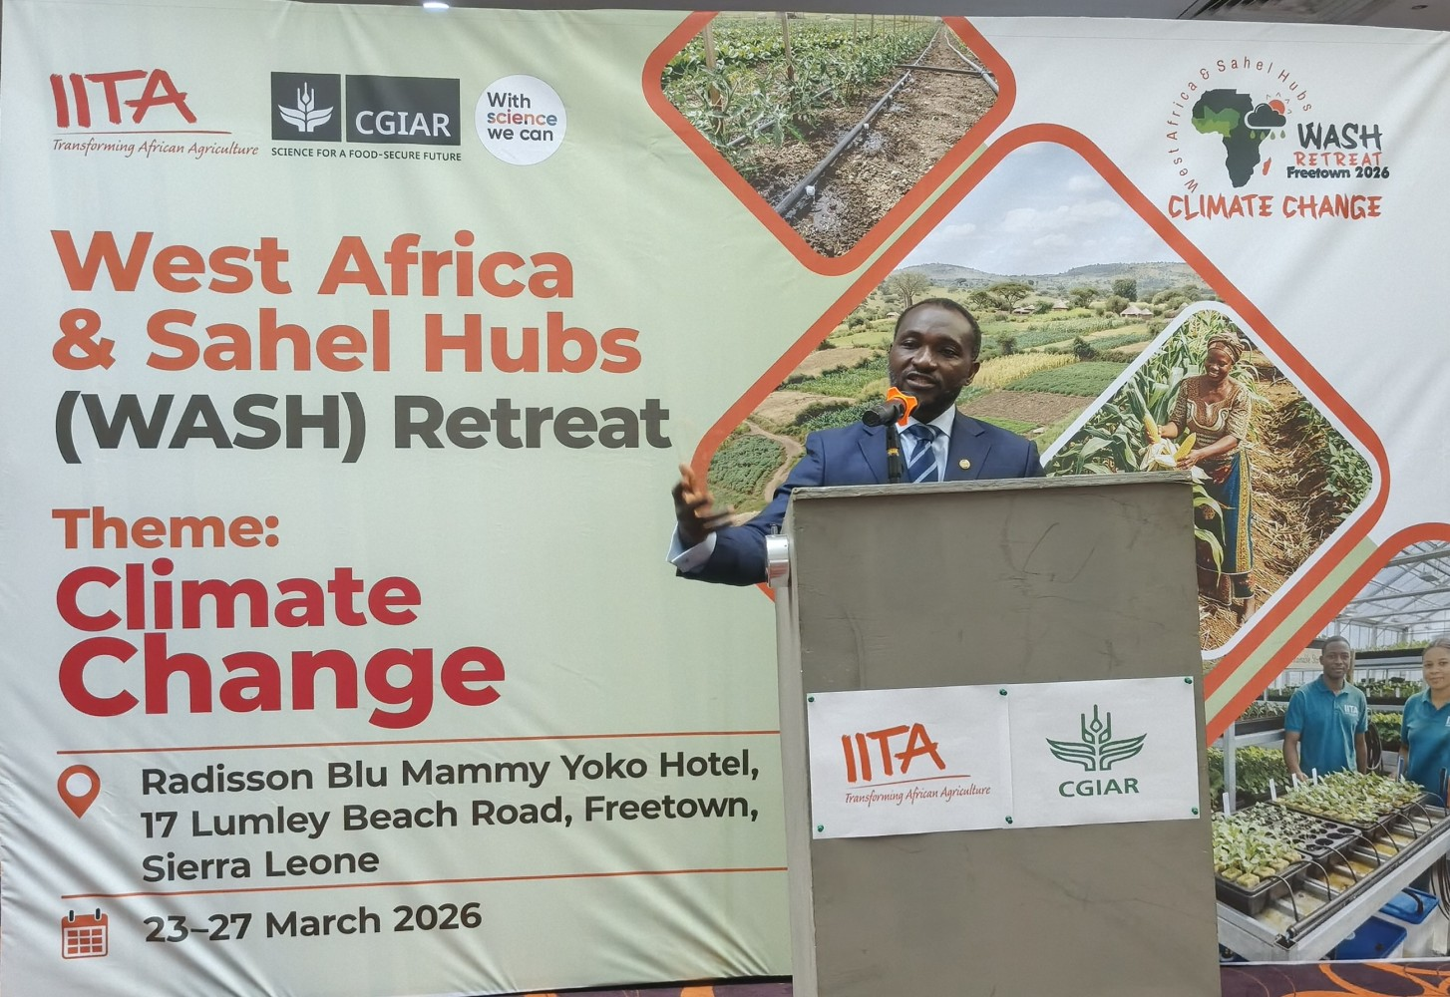
President is highly satisfied with progress made by IITA in partnership with SLARI and other key institutions within the agricultural sector.
Such collaborations are critical to transforming Sierra Leone’s food systems.

Slide 35
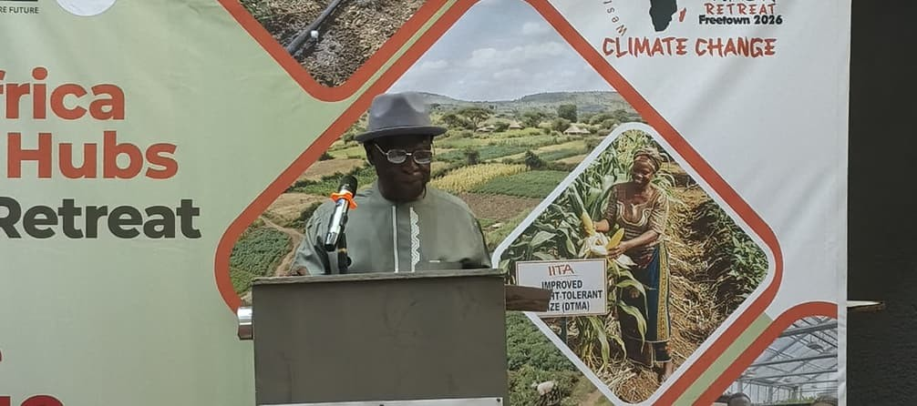
Dr. Alfred Dixon underscored that the overarching goal of IITA is to improve the livelihoods of people through agricultural innovation.
Dr. Dixon noted that the retreat provides a unique opportunity to accelerate action and ensure that research outputs translate into tangible benefits for farmers

Slide 36
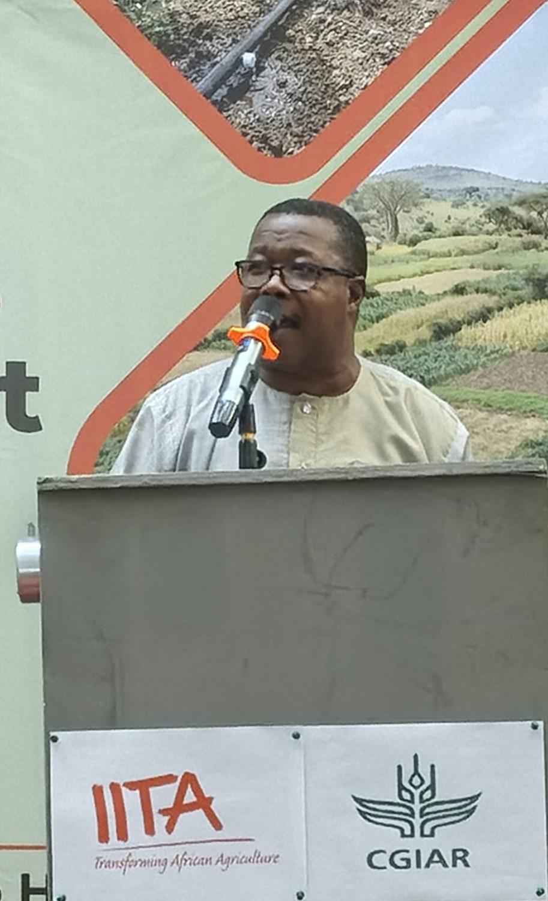
Dr. Abdul Rahman Conteh, Director General of SLARI, expressed profound appreciation to IITA for selecting Sierra Leone as the host of this year’s WASH Retreat.
He described the event as a significant milestone under the IITA Technical Assistance to the Feed Salone Strategy and a testament to the country’s growing role in regional agricultural research and development.

Slide 37
AN OVERVIEW OF SLARI STAFF ATTRITION BETWEEN 2020 AND 2026
SLARI has been losing staff without replacement since 2020.
Between 2020 and 2026, a total of 173 staff were separated from SLARI by retirement, resignation, death, and abandonment resulting in dismissal.
At least 20 staff have been lost by SLARI every year since 2020 without replacement.
The highest staff attrition occurred in 2020 when SLARI had the highest migration of staff to the universities.
In the first two quarters of 2026, SLARI lost 9 staff, mostly due to retirement and death. These staff have still not been replaced.
For an institution whose total staff strength originally hovers around 500, a loss of 173 staff is highly significant.
This is creating a serious constraint to the institution in meeting its objectives.

Slide 38
SLARI staff Attrition by year between 2020 and 2026

Slide 39
Causes of Staff Attrition

Slide 40
Some staff simply abandoned their work and never reported. They are presented under dismissal.
The highest staff attrition between 2020 and 2026 occurred as a result of retirement.
The total number of staff separated from the institution due to retirement was more than the sum of those who separated as a result of resignation and those who separated as a result of death.
When these figures are examined on a yearly basis, it can be seen that retirement far outnumbers the other causes of staff attrition, with resignations making a distant second place.
The greatest attrition as a result of retirement occurred in 2020 and 2024. In 2020, as many as 15 staff resigned from SLARI.
That was a time when as many as 10 staff holding PhDs together with many of SLARI’s skilled field technicians resigned from SLARI. Resignations and retirements continue up to 2026.
All these staff losses have not been replaced.

Slide 41
Causes of Staff Attrition by year

Slide 42
Staff attrition by categories

Slide 43
Looking closely at the categories of staff, it can be seen that the greatest staff attrition occurred with the junior staff category.
This category includes many of the staff who handle the manual and skilled field and laboratory work for the institution.
This has severely hampered SLARI’s field and laboratory capacity.
Replacement of these staff is necessary for SLARI to improve in its capacity to deliver results of its mandates.
The research centres in Rokupr and Njala had suffered the greatest from staff attrition, together with the Headquarter in Freetown.
The losses of staff in these centres have created considerable constraint in the execution of their duties.
As many as 64 staff and 57 staff have been lost in Njala and Rokupr over the period 2020 to 2026. The other centres were already severely understaffed prior to 2020.

Slide 44
Total SLARI staff Attrition by center between 2020 and 2026

Slide 45
SLARI staff Attrition by Categories in 2020 - 2026

Slide 46
Total SLARI staff Attrition by center by year

Slide 47
Current Staffing Situation
SLARI currently has a total of 335 staff, of whom 273 are male and 62 are female.
This 335 includes the junior staff and senior staff. There are 192 junior staff SLARI-wide and 138 senior staff all over SLARI.
The bulk of the existing junior staff are in Njala and Rokupr, with Kenema and Teko holding a handsome share.
In all centres, the female staff are far less than the male staff. A serious shortage of female staff can be seen, especially in the junior staff category.
Centres like those in Kabala and Magbosi are critically short of junior staff. There is no female among the junior staff in Kabala and Magbosi.
This will pose a severe challenge in getting activities carried out in these centres without casual workers.

Slide 48
Total Number of Staff in SLARI by Categories
Centre | Junior Staff |  | Senior Staff |  | Total |  | Grand Total
 | Male | Female | Male | Female | Male | Female
HQ | 18 | 5 | 23 | 9 | 41 | 14 | 55
ROKUPR | 46 | 6 | 25 | 4 | 71 | 10 | 81
NJALA | 48 | 12 | 16 | 7 | 64 | 19 | 83
KENEMA | 23 | 1 | 13 | 3 | 36 | 4 | 40
KABALA | 8 | 0 | 4 | 4 | 12 | 4 | 16
MAGBOSI | 4 | 0 | 9 | 2 | 13 | 2 | 15
TEKO | 23 | 3 | 13 | 6 | 36 | 9 | 45
TOTAL | 170 | 27 | 103 | 35 | 273 | 62 | 335

Slide 49
When the current number of staff in SLARI is compared to the optimum prescribed in SLARI staff assessment report prepared by the Forum for Agricultural Research in Africa (FARA) in MARCH 2012, the current staff capacity is by far below the optimal (Figure 15).
In the SLARI capacity assessment report of FARA, it was recommended that for optimum output of SLARI, a total staff strength of not less than 1400 is required.
The significant loss of staff described earlier in this report therefore occurred within the context of an already insufficient staff for optimum performance.
This situation definitely needs to be addressed.

Slide 50
Current Staff of SLARI as a Whole and the Anticipated Optimum Number

Slide 51
SLARI Staff with academic qualifications

Slide 52
SLARI staff with academic qualifications by centres

Slide 53
Staff with MSc

Slide 54
Staff with PhD

Slide 55
Age Ranges of Current SLARI Staff
Staff by Age
Centre | < 30 yrs |  | 30 - 40 yrs |  | 40 - 55 yrs |  | > 55 yrs |  | Total |  | Grand Total
 | Male | Female | Male | Female | Male | Female | Male | Female | Male | Female
HQ | 0 | 0 | 10 | 8 | 30 | 6 | 1 | 0 | 41 | 14 | 55
ROKUPR | 0 | 0 | 11 | 0 | 44 | 6 | 16 | 4 | 71 | 10 | 81
NJALA | 0 | 1 | 5 | 4 | 39 | 9 | 20 | 5 | 64 | 19 | 83
KENEMA | 0 | 0 | 5 | 3 | 24 | 1 | 7 | 0 | 36 | 4 | 40
KABALA | 0 | 0 | 3 | 2 | 8 | 2 | 1 | 0 | 12 | 4 | 16
MAGBOSI | 0 | 0 | 5 | 2 | 7 | 0 | 1 | 0 | 13 | 2 | 15
TEKO | 0 | 0 | 10 | 4 | 22 | 5 | 4 | 0 | 36 | 9 | 45
TOTAL | 0 | 1 | 49 | 23 | 174 | 29 | 50 | 9 | 273 | 62 | 335

Slide 56
Discipline | HQ | NARC Njala | RARC Rokupr | TLRC Teko | MLWERC Magbosi | KFTCRC Kenema | KHCRC Kabala | TOTAL
Soil Science | 1 | 1 | 2 |  |  | 1 |  | 5
Agronomist/Crop Physiologist |  |  | 1 | 2 |  |  | 2 | 5
Nutrition/Health |  | 1 |  | 3 |  |  |  | 4
Food Science/Food Technology |  |  | 2 | 1 |  |  | 1 | 4
Breeding | 2 | 1 | 7 |  |  | 2 | 1 | 13
Microbiology |  |  |  | 1 |  |  |  | 1
Non-Ruminant Production |  |  |  | 1 |  |  |  | 1
Ruminant Production |  |  |  | 3 |  |  |  | 3
Agroforestry |  |  |  |  |  | 1 |  | 1
Mechanization/Agric Engineering |  |  | 1 | 1 |  |  |  | 2
Horticulture |  |  |  |  |  |  | 1 | 1
Weed Science |  |  | 1 |  |  |  |  | 1
Tissue Culture |  | 1 |  |  |  |  |  | 1
Seed System |  | 1 |  |  |  |  |  | 1
Plant Pathology |  | 2 | 1 |  |  | 1 |  | 4
Entomology |  | 1 | 1 | 1 |  |  |  | 3

Slide 57
Discipline | HQ | NARC Njala | RARC Rokupr | TLRC Teko | MLWERC Magbosi | KFTCRC Kenema | KHCRC Kabala | TOTAL
Environment & Hydrology |  |  |  |  | 1 |  |  | 1
Agricultural Extension |  | 4 | 1 | 1 |  |  |  | 6
Post-Harvest Technology |  | 1 | 1 |  |  | 1 |  | 3
Farm Management |  |  | 1 |  | 1 | 2 | 1 | 5
Forestry |  |  |  |  |  | 1 |  | 1
Socio-Economics & Policy |  | 2 | 1 | 1 | 1 | 1 |  | 6
Soil & Water Engineering |  |  |  |  | 2 |  |  | 2
Agricultural Meteorology |  |  |  |  | 1 |  | 1 | 2
Environmental Sciences |  |  |  |  | 2 |  |  | 2
TOTAL | 3 | 15 | 20 | 15 | 8 | 10 | 7 | 78

Slide 58
Current Research Support Staff in SLARI Headquarter
Centre | Junior Staff |  | Senior/Senior Supporting |  | Total |  | Grand Total
 | Male | Female | Male | Female | Male | Female
Estate | 11 | 0 | 2 | 0 | 13 | 0 | 13
Administration | 6 | 5 | 1 | 2 | 7 | 7 | 14
Finance | 0 | 0 | 2 | 4 | 2 | 4 | 6
Procurement | 1 | 0 | 1 | 1 | 2 | 1 | 3
Communications | 0 | 0 | 6 | 0 | 6 | 0 | 6
Logistics | 0 | 0 | 2 | 0 | 2 | 0 | 2
M & E | 0 | 0 | 2 | 0 | 2 | 0 | 2
Internal Audit | 0 | 0 | 2 | 1 | 2 | 1 | 3
Asset Management | 0 | 1 | 2 | 0 | 2 | 1 | 3
Researchers | 0 | 0 | 3 | 1 | 3 | 1 | 4
Total | 18 | 6 | 23 | 9 | 41 | 15 | 56

Slide 59
THANK YOU FOR YOUR ATTENTION

Slide 60
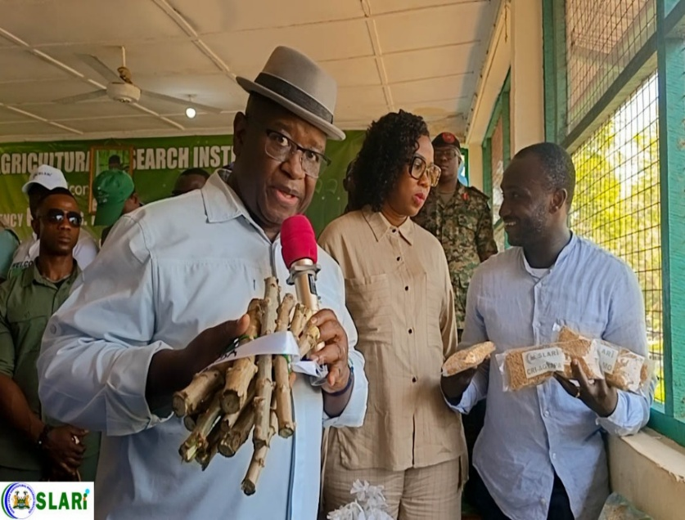
H.E. PRESIDENT BIO VISITS SLARI ROKUPR
President Bio and Minister Kpaka are joined by the First Lady, Madam Dr Fatima Bio in inspecting samples of the new varieties
Minister of Agriculture and Food Security, Dr. Henry Musa Kpaka, reaffirmed the government’s unwavering commitment to ensuring that the improved seeds reach farmers nationwide.

Slide 61
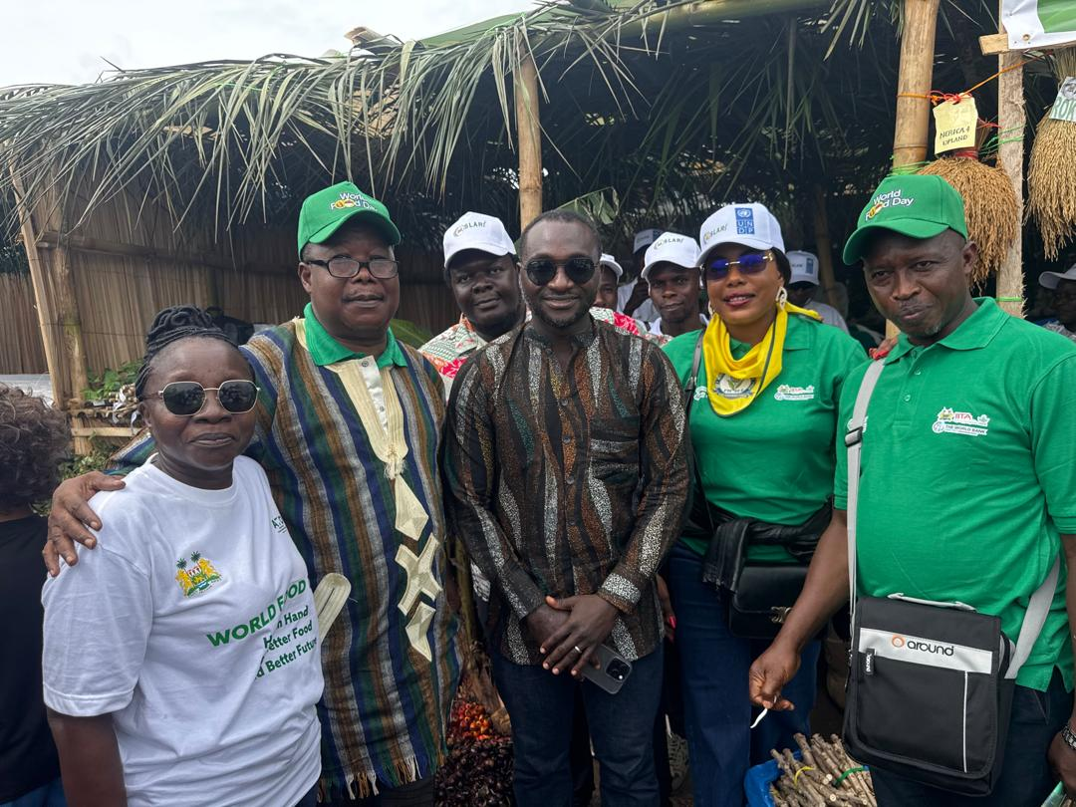
SLARI JOINS THE PRESIDENT TO COMMEMORATE THE 2025 WORLD FOOD DAY IN KAMBIA DISTRICT
The Sierra Leone Agricultural Research Institute (SLARI) successfully participated in the commemoration of World Food Day 2025, held in Kambia District from October 31 to November 1, 2025. Initiative.
Hon Minister—MAFS, Posing with SLARI Staff at the World Food Day Celebrations

Slide 62
SLARI staff Attrition by center

Slide 63
SLARI Staff Attrition by center

