Slide 1


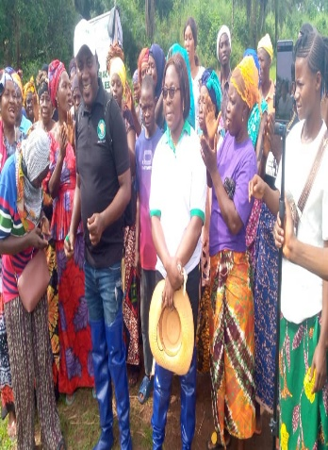
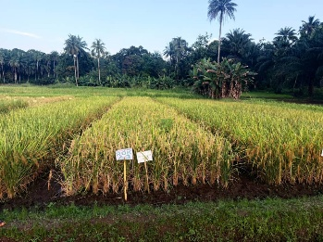
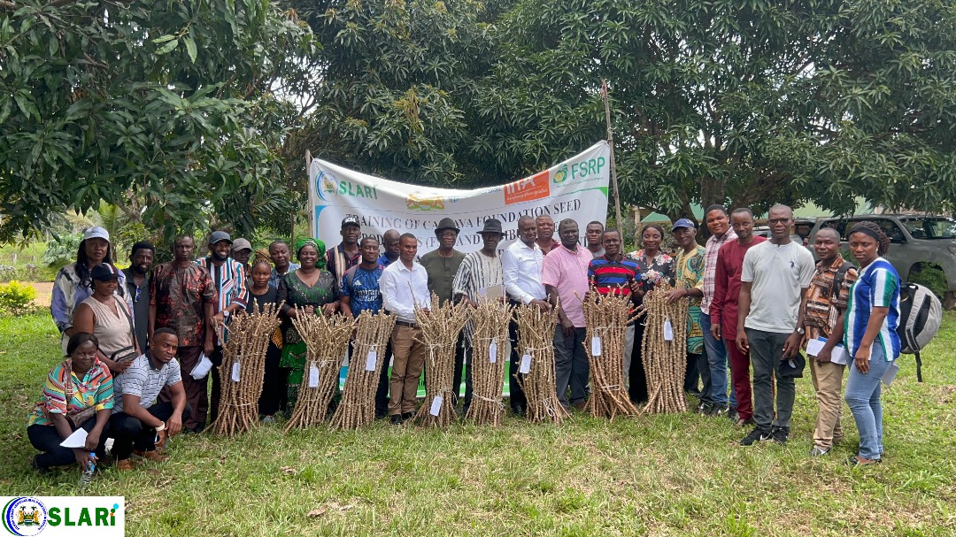
SIERRA LEONE AGRICULTURAL RESEARCH INSTITUTE
22nd REGULAR MEETING OF SLARI COUNCIL
OVERVIEW OF RESEARCH, TECHNOLOGY AND INNOVATION DEVELOPMENT ACTIVITIES IN SLARI
Prince E. Norman (PhD)
DDG, Res., Technol., and Innov Devt, SLARI
Source: RARC Annual Report, 2025
Source: NARC Annual Report, 2025
Held at SLARI HQs Conference Room, 16th-17th June, 2026.

Slide 2
Presentation Outline
Introduction
Status of research activities
Lessons learnt
Monograph & related assignments
Acknowledgement

Slide 3
Introduction
SLARI’s research agenda is increasingly focused on resilience and sustainability, particularly in the context of climate change and shifting food systems.
SLARI’s methodology involves a multi-stakeholder approach.
technologies developed are not only scientifically sound but also economically viable for local production systems.
Vision. A resilient, innovation‑driven agricultural research system that measurably improves agricultural productivity, incomes, and nutrition while preserving the natural resource base and taking advantage of technological advancements.
Mission. To generate, adapt, validate and broker demand‑led, climate‑smart agricultural knowledge and technologies; commercialize responsibly under clear public‑interest guardrails; provide timely evidence for agricultural policy; and build national research capacity in line with Sierra Leone’s development priorities.

Slide 4
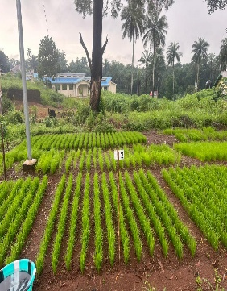
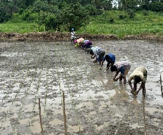
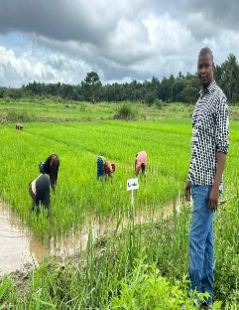
RARC
NAME OF PROJECT | OBJECTIVES | BRIEF SUMMARY | CURRENT STATUS
Regional Rice Value Chain Support Project (RRVCP) Dr. Nabieu | To produce 3 t of breeder seed and 10 t of foundation seed of improved rice varieties | High quality foundation seed to boost food security and agricultural development | Harvested and processed
FSRP | To expand the genetic base of mangrove rice for breeding programs. To develop and release resilient rice varieties suitable to salinity, pests and diseases stresses | Genetic enhancement of mangrove rice germplasm. | Other aspects of the study are yet to be completed due to incomplete support by FSRP.
Kanu et al., 2025

Slide 5
RARC cont’d
NAME OF PROJECT | OBJECTIVES | BRIEF SUMMARY | CURRENT STATUS
KAFACI | To improve rice productivity and good grain quality; To release commercial varieties to increase rice production. | On-station multi-environment evaluation and identification of high-yielding, stable, widely adapted, and climate resilient rice genotypes; 21 cross combinations made. | Post-harvest data collection ongoing
AGRA | To contribute to improved food, nutrition, and income security for smallholder farmers by release and commercialization of climate-resilient and high yielding rice and hybrid maize varieties | Released 4 rice varieties; Registered 4 hybrid maize varieties | Foundation seed Production

Slide 6
RARC cont’d
NAME OF PROJECT | OBJECTIVES | BRIEF SUMMARY | CURRENT STATUS
Mr. Coolson (AfricaRice) | Evaluate and identify rice breeding lines in the various agro ecologies in Sierra Leone that are high yielding, tolerance to major abiotic stresses and resistant to biotic stresses, with good phenotypic and market acceptability and high nutritional value. to accelerate the release of new varieties that promote income generation and good health; Develop climate-resilient rice varieties, for tolerance to Flooding, Iron toxicity and salinity | (1) Multi Environmental Trial (Rainfed upland) Evaluation of 60 upland genotype – in one location Rokupr On-farm trials involving 50 farmers in the upland and lowland ecologies Evaluate rice genotype for tolerance to salinity, flooding and iron toxicity for climatic variability adaption in Sierra Leone. | Trials are ongoing

Slide 7
RARC cont’d
NAME OF PROJECT | OBJECTIVES | BRIEF SUMMARY | CURRENT STATUS
Development of Pest Monitoring and Eco-Friend Control Technologies in Africa (Sierra Leone) (Monitoring the Occurrence of Maize FAW, Spodopters frugiperda and Development of Eco-Friendly Control Technologies in Sierra Leone) Mr. Swaray (KAFACI) Dr. Abdulai (KAFACI) | To enhance biological information on the target pest by monitoring occurrence, density and damage for sustainable agriculture in Africa. To develop pest management and prediction systems for sustainable control | In maize, FAW attacks all crop stages from seedling emergence to ear development. Investigating the occurrence, damage and density of the pest and developing an eco-friendly control technologies for sustainable control is a prerequisite of this work | Completed Report has been submitted.
Improving agricultural resilience to salinity through development and promotion of pro-poor technologies (RESADE) project | The objective of this study was to increase the production and productivity of marginal saline areas thereby mitigating the problems using climate-smart and salinity-resilient agricultural models and approaches. | Generally, application of biochar @ 2 t ha⁻¹ in combination with blended mineral fertilizer NPK produced the highest yields in both sorghum and rice | Completed Report has been submitted.

Slide 8
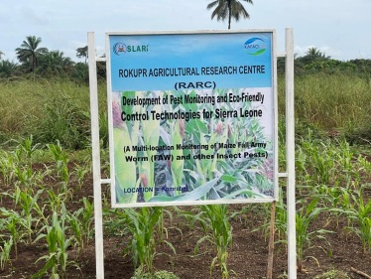
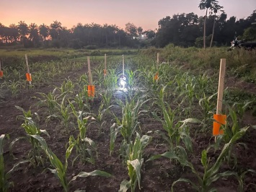
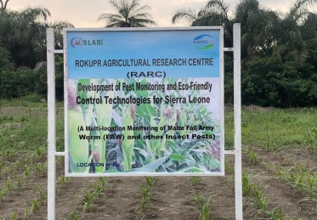
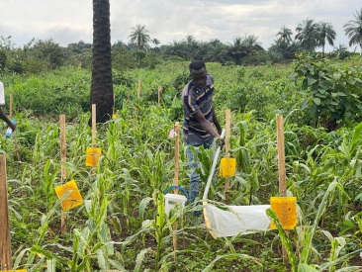
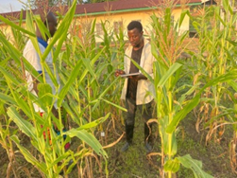
RARC cont’d

Slide 9
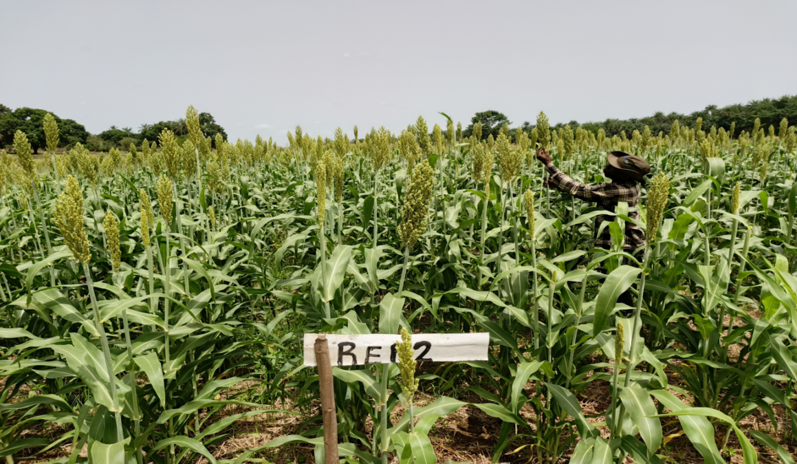
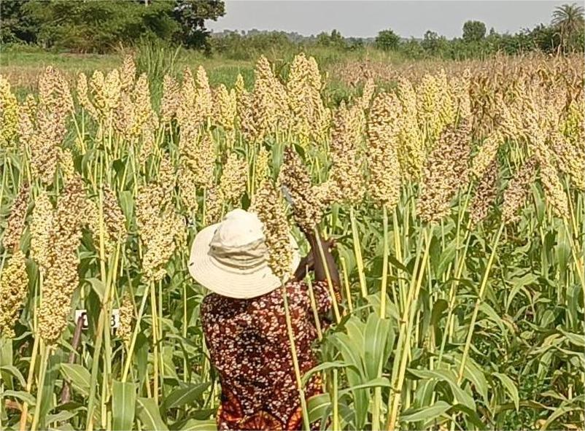
RARC cont’d
Improving agricultural resilience to salinity through development and promotion of pro-poor technologies (RESADE) project
Soil salinity is high during the dry season (> 10 dSm⁻¹), while low values are observed during the rainy season (< 4 dSm⁻¹).
The objective was to increase the production and productivity of marginal saline areas thereby mitigating the problems using climate-smart and salinity-resilient agricultural models and approaches.
Figure 2. Sorghum grain yield under biochar and mineral fertilizer application at the Mawirr IVS. Fertilizer treatments 1= non-fertilizer amended control; 2= Biochar@ 2 t ha⁻¹; 3= NPK @ 60: 40: 40 kg ha⁻¹; and 4= Biochar@ 2 t ha⁻¹ + 10:10:10 kg ha⁻¹NPK
Figure 1. Sorghum grain yield under biochar and mineral fertilizer application at the Mawirr IVS. Fertilizer treatments F0= non-fertilizer amended control; F1= Biochar@ 2 t ha⁻¹; F2= NPK @ 60: 40: 40 kg ha⁻¹; and F3= Biochar@ 2 t ha⁻¹ + 10:10:10 kg ha⁻¹NPK; V1=BRRI dhan 61; and V2=BRRI dban 78

Slide 10
NARC
NAME OF PROJECT | OBJECTIVES | BRIEF SUMMARY | CURRENT STATUS
Effects of phosphorus fertilizer and lime application on the growth, yield, and seed quality of groundnut on the upland soil of Njala: Experiment 1 | To determine optimum rate for phosphorus application on groundnut To determine the effects of different application levels of phosphorus on the growth, yield and seed quality of the two groundnut genotypes. | (1) Trial was laid out in a 2 × 4 factorial arrangement in a RCBD with three replicates (2) Two groundnut genotypes (SLINUT 2 and a Local variety) + four levels of P (0kgP₂O₅/ha, 20kgP₂O₅/ha, 40kg P₂O₅/ha and 60kg P₂O₅/ha) (3) Improved 62.9% higher pod yield relative to the local check. | Report has been submitted.

Slide 11
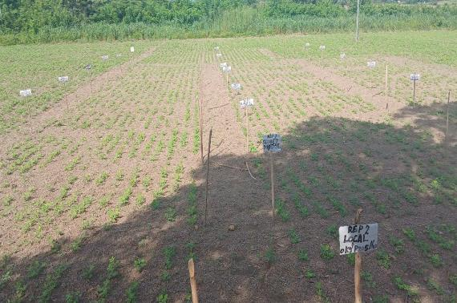
Table 1: Influence of ground variety on number of filled pods, 100 seed weight and yield
Variety | Filled pod | 100 seed wt (g) | Plot yield (kg/ha)
SLINUT 2 | 39.0 (56.9%) | 37.6 (63.7%) | 939 (62.9%)
Local variety | 29.5 | 26.06 | 553
Mean | 34.4 | 31.8 | 746
LSD(0.05) | 17.16 | 2.95 | 222.8
CV (%) | 28.5 | 10 | 34.1
Table 2: Effect of Phosphorus level on shelling percentage of the two groundnut varieties
Phosphorus level ( P₂O₅ ) | Shelling percentage ( %)
0 kg/ha | 58.0
20kg/ha | 66.89 (53.6%)
40kg/ha | 59.89
60kg/ha | 65.45
Mean | 62.58
LSD (0.05) | 5.97
CV (%) | 7.7
Groundnut trial

Slide 12
NARC
NAME OF PROJECT | OBJECTIVES | BRIEF SUMMARY | CURRENT STATUS
Effects of phosphorus fertilizer and lime application on the growth, yield, and seed quality of groundnut on the upland soil of Njala | To determine the appropriate liming rate for increased groundnut productivity; To determine the effect of liming on soil acidity (pH); To assess combined effects of phosphatic fertilizer with different liming rates on the growth and yield of groundnut | Design: RCBD in 3 reps Two groundnut varieties T1=0 t ha⁻¹ lime (Dolomite) + P fertilizer; T2=2 t ha⁻¹ lime +P fertilizer; T3=4 t ha⁻¹ +P fertilizer; Plot size – 4.8 m × 3 m. Data collected Preliminary analysis done | Data analysis and report writing are ongoing

Slide 13
Table 5. Aflatoxin Management and Aflasafe Application
NAME OF PROJECT | OBJECTIVES | BRIEF SUMMARY | CURRENT STATUS
Meeting phytosanitary standards (Aflatoxin Mitigation) in critical value chains under the feed Salone strategy | To raise awareness of aflatoxin contamination in maize and groundnut;. To demonstrate the use and benefits of Aflasafe biocontrol technology; To Distribute Aflasafe samples for field-level adoption; Strengthen knowledge among lead farmers and agricultural officers on safe, sustainable crop production practices. | A total of 180 farmers (90 maize and 90 groundnut) participated across three provinces Application rate: 10 kg/ha (maize or groundnut) Storage: Proper drying and aeration to prevent contamination; Testing: Importance of aflatoxin testing for trade compliance; Field Demonstrations and Product Distribution; Evaluation and Follow-Up; Next Steps: Aflasafe Research and Manufacturing Facility at the Njala Agricultural Research Center (NARC) | Beneficiaries trained

Slide 14
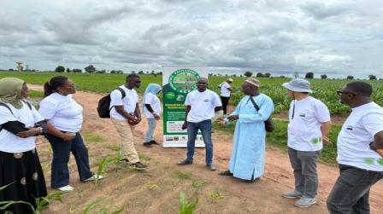
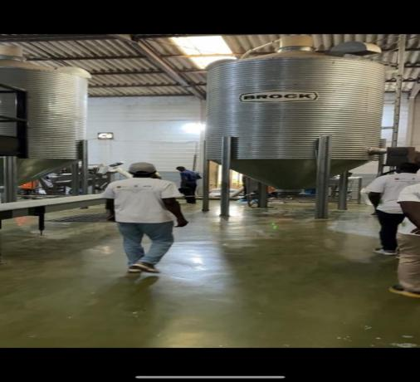
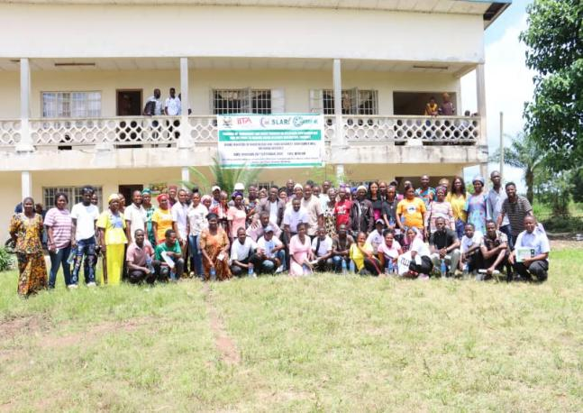
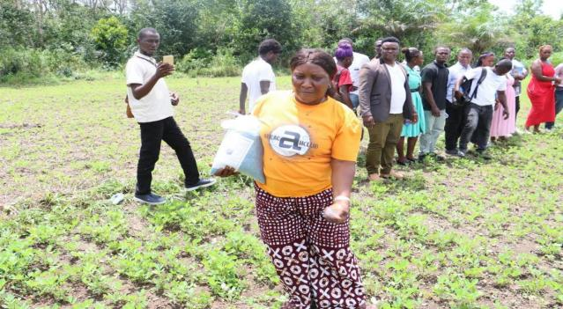
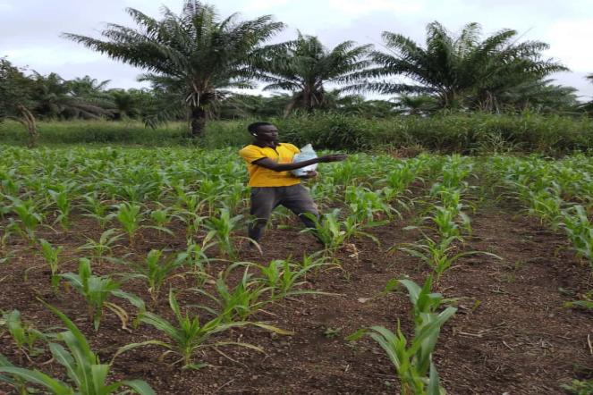
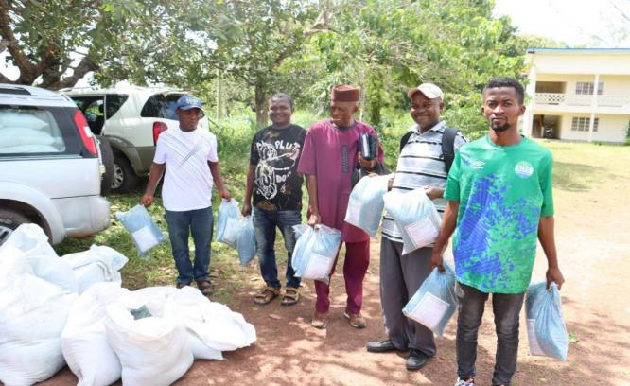
Figure 5. Scientific Exchange Program workshop participants hearing first-hand from farmers in Senegal on Aflasafe application practices, observed benefits, and strong farmer demand—valuable lessons to guide implementation in Sierra Leone
Figure 6. Scientific Exchange Program workshop participants visiting the Aflasafe manufacturing facility in Kaolack, Senegal.
Figure 8. Application of Aflasafe (a) groundnut farmer, (b) maize farmer, and (c) distribution time after training
Figure 7. Group photo of farmers and participants in Moyamba receiving training on aflatoxin mitigation

Slide 15
Table 6. Aflatoxin Management and Aflasafe Application
NAME OF PROJECT | OBJECTIVES | BRIEF SUMMARY | CURRENT STATUS
Assessment of dietary exposure and consumer awareness of major mycotoxins in foods in Sierra Leone (FSRP Adaptive Research Grant) | To raise awareness of mycotoxin-related health, trade, and income risks;. To share preliminary findings from aflatoxin testing in maize, groundnut, and sesame across three agroecological zones; To foster multi-sector collaboration and solicit feedback on study tools and dissemination strategies; To outline a road map for future engagement, policy development, and resource mobilization. | One-day stakeholder Meeting on Mycotoxin Contamination in Sierra Leone organized by SLARI To discuss critical food safety concerns, particularly dietary exposure and consumer awareness of mycotoxins (e.g., aflatoxins, fumonisins, ochratoxins) in Sierra Leone’s food systems | Critical food safety concerns, particularly dietary exposure and consumer awareness of mycotoxins in Sierra Leone’s food systems discussed.

Slide 16
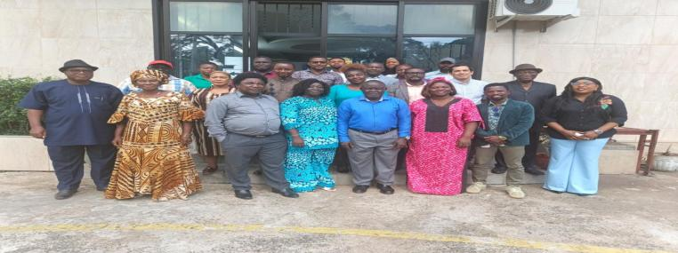
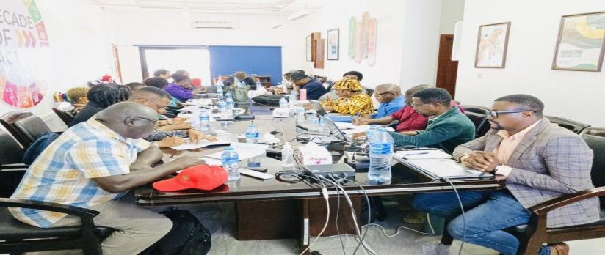
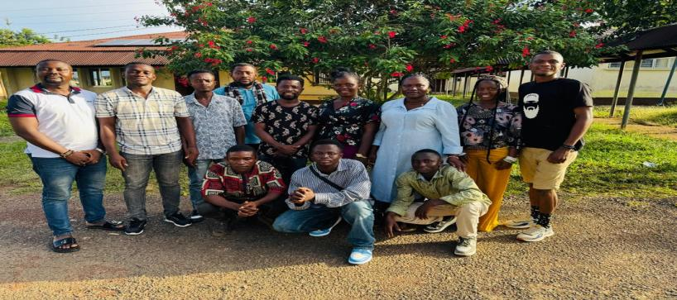
Table 7. Mycotoxins Training and Data Collection
NAME OF PROJECT | OBJECTIVES | BRIEF SUMMARY | CURRENT STATUS
Assessment of dietary exposure and consumer awareness of major mycotoxins in foods in Sierra Leone (FSRP Adaptive Research Grant) | To assess the public health risks of mycotoxins in staple foods like maize, rice, cassava, and groundnuts;. To prepare data collection teams for a nationwide dietary exposure survey supporting Sierra Leone’s “Feed Salone” initiative. | Focused on clarity, neutrality, and accuracy in engaging diverse respondent groups; Participants trained on food intake and proper weight/height measurement techniques; Teams assigned by region; Participants gained strong understanding of mycotoxins and field survey methods; 180 farmers (90 maize farmers and 90 groundnut farmers) | Other aspects of the study are yet to be completed due to incomplete support by FSRP.

Slide 17
Table 8. Mycotoxins Training and Data Collection
NAME OF PROJECT | OBJECTIVES | BRIEF SUMMARY | CURRENT STATUS
Comparative Analysis of Economic Performance and Agronomic Practices in Groundnut production. Evidence from Research and small holder systems in Sierra Leone | To estimate and compare the profitability of groundnut production between NARC research station and small holder farmers managed plots;. To identify and assess the key agronomic practices used in groundnut production across the two systems; To determine the socio-economic and agronomic factors influencing profitability among smallholder groundnut producers; To evaluate the level of adoption of improved groundnut production technologies and inputs among smallholder farmers relative to research station practices. | Project proposal fully developed; Complete set of field data collection tools drafted. Secondary data from SLARI/NARC research station trials identified for comparative analysis; Land preparation complected at the research station and the five farmers’ fields; Trial establishment: completed at the research station and the five farmers’ fields | Conduct complete household data collection in Moyamba District (pending funding).

Slide 18
Table 9. Update on Flash Dryer Operationalised Grant
NAME OF PROJECT | OBJECTIVES | BRIEF SUMMARY | CURRENT STATUS
Operationalizing cassava flash dryer for high throughput processing of cassava products | To enhance the quality and shelf life of cassava products through improved drying technique; To develop and evaluate different bread and other confectioneries substituted with cassava flour for nutritional and sensory parameters; To train processors on the inclusion of cassava flour into bread and other confectioneries; To recommend for policy action on substituting cassava flour into bread and other confectioneries; | Factory is now fully rehabilitated and suitable for processing cassava into flour, gari, or other value-added products. Wet hammermill, hydraulic presser, automated roster, electronic sieve, dry hammermill installed and tested. | Rehabilitation completed; Equipment installed and tested. The 40% balance tranche payment from FSRP needed.
IITA provided two technical experts and the following equipment: 5 Hermetic drums, Improved Smoking Kiln, Multi-crop dryer, Parabolic Shaped Solar Dryer (PSSD), Inert Atmosphere Silo

Slide 19
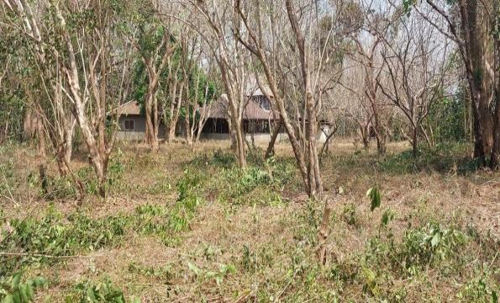
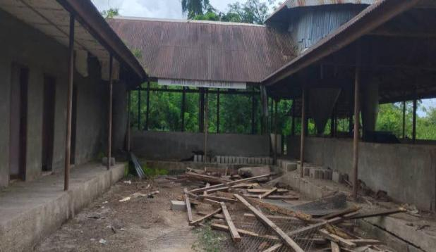
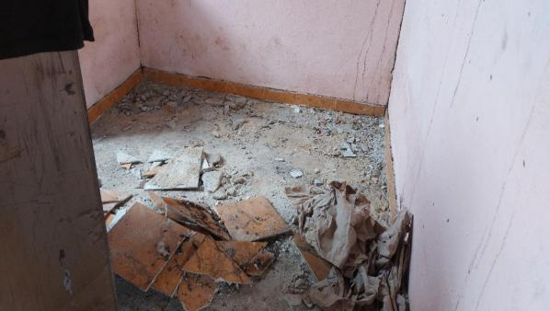
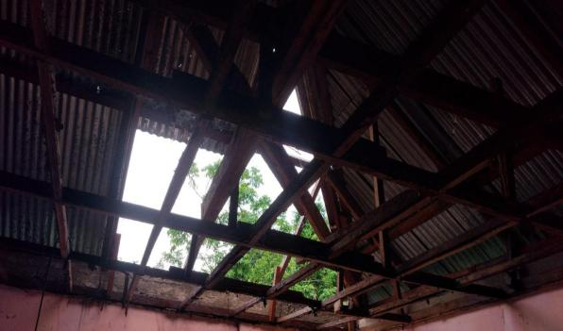
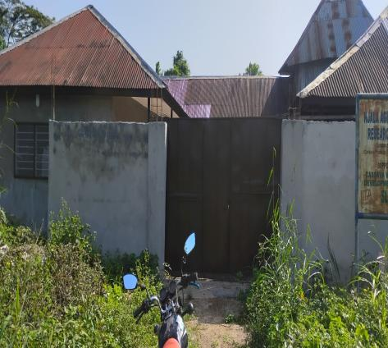
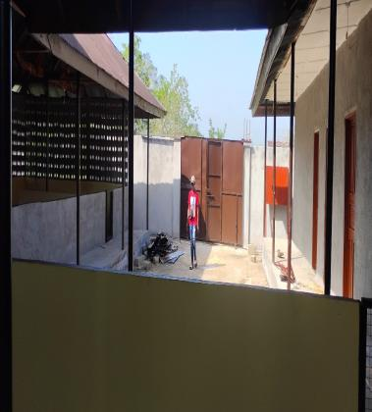
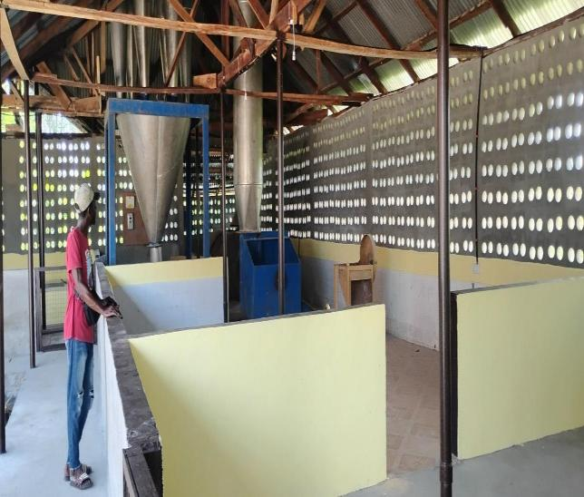

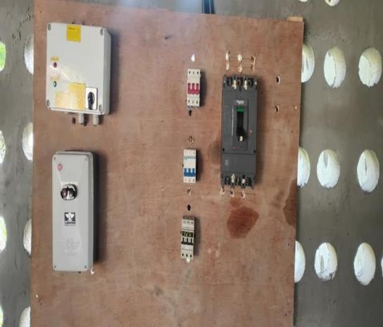
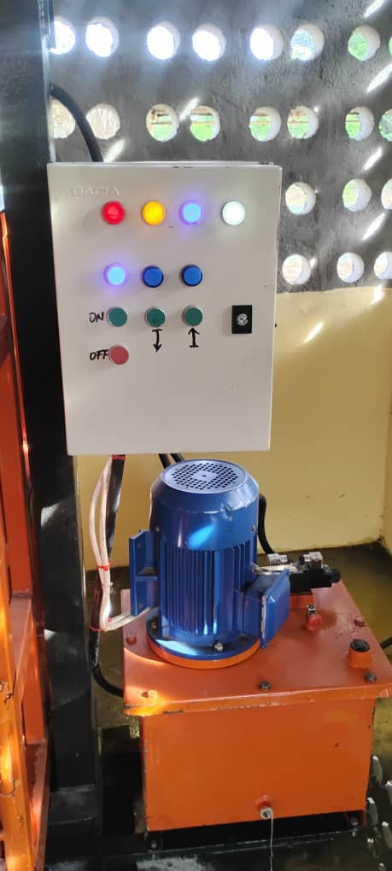
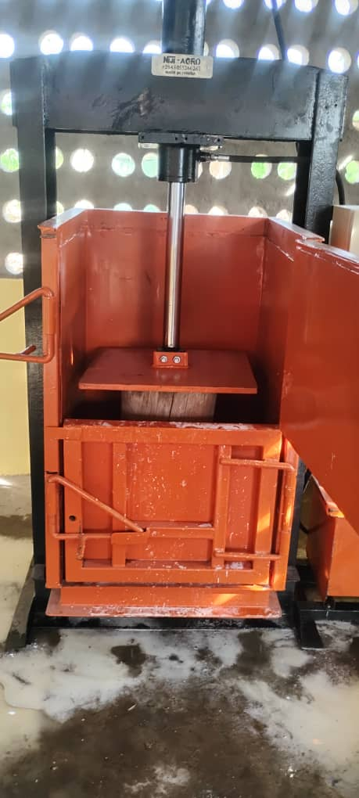
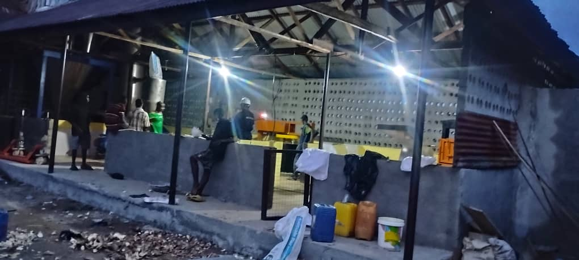
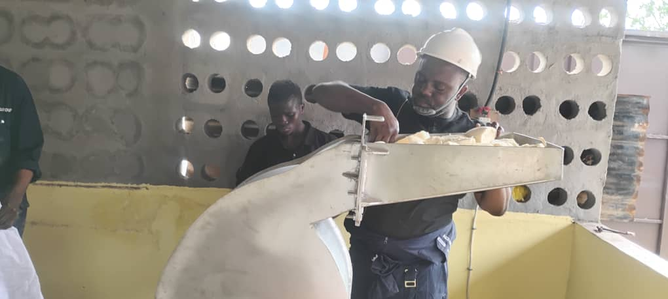
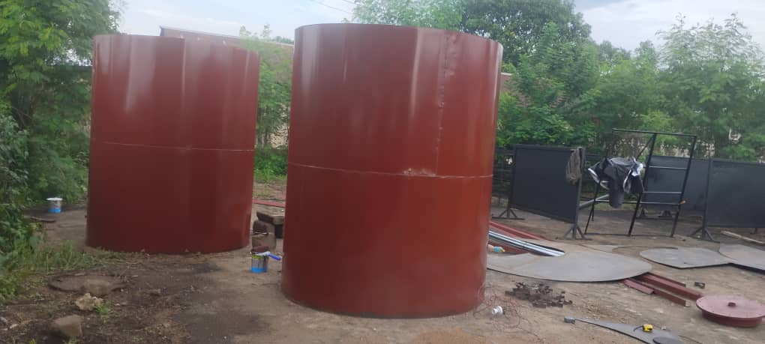
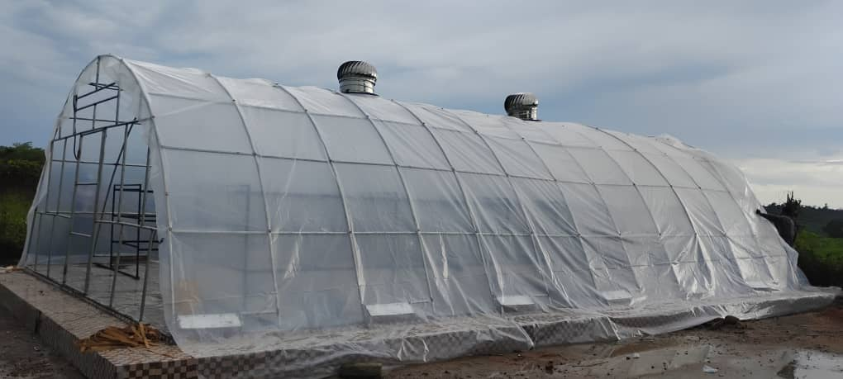
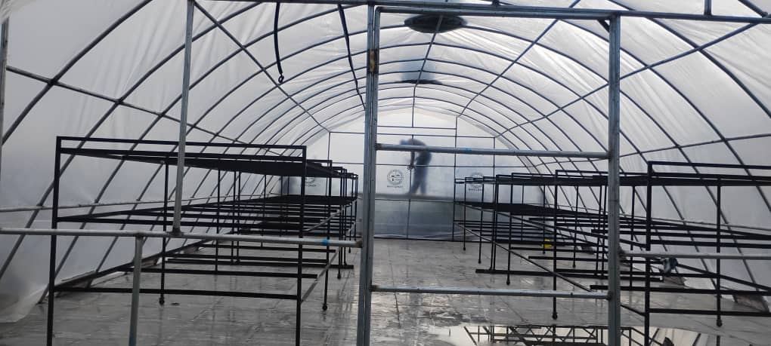
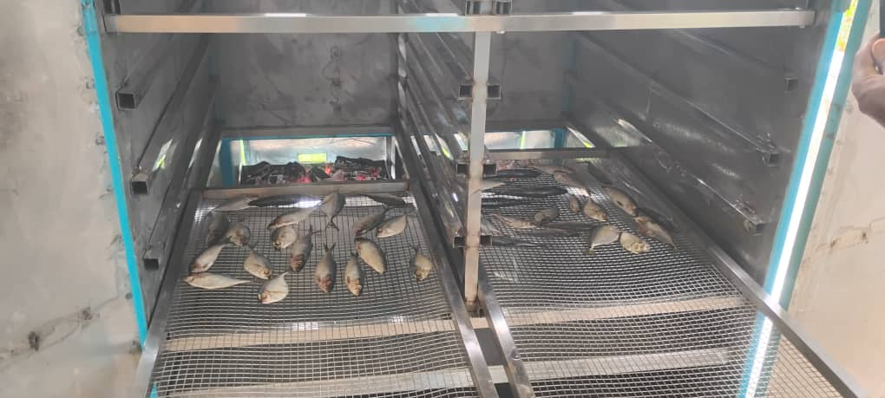
Figure 12. Status of the factory before FSRP intervention
Installation of equipment
Testing of equipment
2 inert atm silos of 5 t capacity each. It uses H₂ gas to lower the temp to below 5ºC with 14 months storage period
Parabolic solar dryer for drying crops and products
Smoking Kiln uses gas and charcoal
Figure 13. Status of the factory after FSRP intervention

Slide 20
Table 10. Component 2.3: Accelerating sustainable soybean value chain for improved income, nutrition, and health in Sierra Leone
NAME OF PROJECT | OBJECTIVES | BRIEF SUMMARY | CURRENT STATUS
Accelerating sustainable soybean value chain for improved Income, Nutrition, and health in Sierra Leone (Partner: IITA) | To develop, evaluate and promote different soybean products; To evaluate consumer acceptability and willingness to pay for soybean; To demonstrate cooking and feeding of local complementary foods enriched with soybean and soy milk with mothers and caregivers in selected districts in the country conducted; To organize soybean campaign sessions at schools, hospitals, churches, mosques, and community levels. | A total of 1,000 consumers were engaged; 500 for traditional products and 500 for novel products. A total of 10 districts were included in the study based on stunting prevalence (Sierra Leone National Nutrition Survey, 2021) and previous soybean-related interventions. | Training manual on soybean processing, value addition, and utilization developed; Consumer acceptability and willingness to pay report submitted.

Slide 21
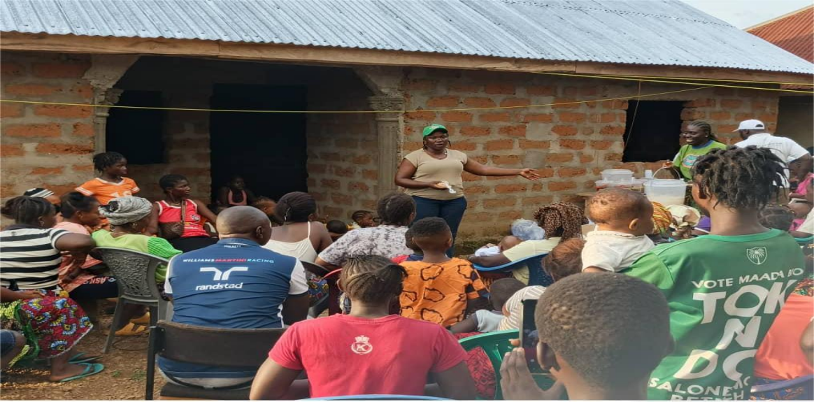
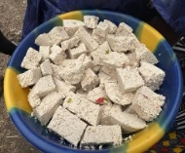
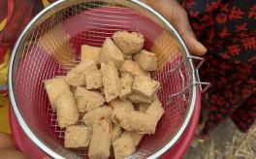
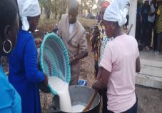
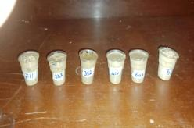
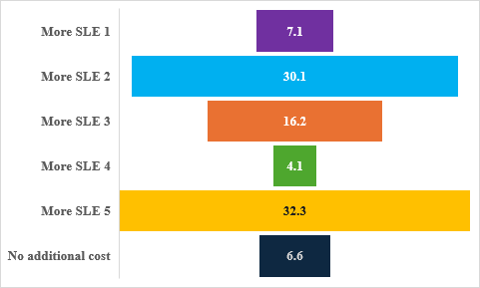
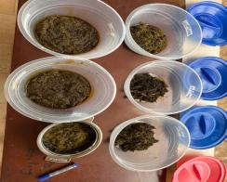
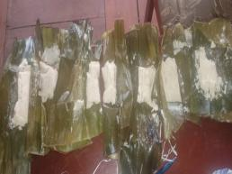
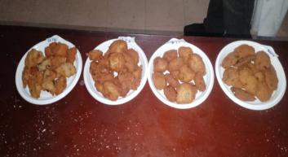
Figure Regional distribution of surveyed consumers
Figure Pie chart showing the price premium over fresh milk for soymilk
Table Mean hedonic ratings and acceptance rates for soybean-supplemented products (n= 439 respondents)
Figure 14: Explaining to the participants the relevance of the study
Product (coded sample) | Mean Hedonic Score (1–5) | Acceptance Rate (%)
Tofu (seasoned fresh) | 2.21 (±1.36) | 17.8
Tofu (seasoned fried) | 3.51 (±1.60) | 63.1
Soymilk (cold extraction) | 3.08 (±1.66) | 50.3
Soymilk (hot extraction) | 3.51 (±1.63) | 62.4
a
b
Figure 15: Soybean enriched products
Funnel chart showing price premium over the same size cherreh for tofu

Slide 22
KFTCRC
Established 1 ha each of C. robusta at Pendembu, Bambawo and Kpuwabu in August, 2025. Moreover, some seedlings of robusta coffee, cashew and citrus were established in-field.
The seed germinator in the seed laboratory of SLARI headquarters has been relocated to the KFTCRC’s regional office in Kenema.
A total of 700 pods, equivalent to 24,500 seeds, were supplied to the AVDP for establishment of seedling nursery at the beneficiary sites.
The seedlings will be transplanted in-field during 2026 planting season.
The joint proposal development with other institutions include:
Establishment of climate smart oil palm model farms around the country – Potential Funding organisation: FAO: Request made: USD 3,800,000.
The development of agroforestry model farms in Falaba district: with ACF: Potential Funding organisation: European Union: Fund allocated to SLARI: 75,000 Euro.

Slide 23
TLRC
NAME OF PROJECT | OBJECTIVES | BRIEF SUMMARY | CURRENT STATUS
Stakeholder engagement on the design and construction of a biodigester prototype under FSRP Grant to SLARI-TEKO | To refine the biodigester design, ensuring efficient organic waste conversion, optimising biogas production, and establishing safety and sustainability protocols. | A comprehensive assessment of waste availability and site selection done. Livestock manure from cattle and goats, crop residues and market waste were measured. Seasonal variations, feedstock consistency, and current disposal methods were analysed to ensure a dependable biomass supply for the digester | Biodigester prototype designed and constructed; post-construction training: Organize hands-on maintenance sessions for assigned operators; Monitoring Protocols: Establish weekly check-ins to assess gas yield, consistency of feedstock input, and slurry output; Scale-Up Feasibility: Begin planning for multi-unit deployment targeting farmer cooperatives and agro-processing centres; Impact Documentation: Develop a storytelling toolkit that captures the transformation from waste to resource, emphasizing the roles of women and youth.

Slide 24
MLWERC
NAME OF PROJECT | OBJECTIVES | BRIEF SUMMARY | CURRENT STATUS
Assessing climate smart characteristics of agricultural technologies and innovations in FSRP countries | To identify and list the potential technologies and innovations; To assess the climate-smart characteristics of the technologies and innovations. | Potential technologies and innovations identified; Climate-smart characteristics assessed | Completed.
Application of Biochar to Improve Soil Fertility, Water Retention and Enhance Cassava (Manihot esculenta) Productivity on a Degraded Agricultural Land | To assess farmers’ awareness and willingness to adopt biochar-based soil management practices, and their perceptions about the technology; To determine the effects of biochar on soil physical, chemical, and biological properties in degraded agricultural soils and improving yield of cassava; To analyze the economic viability (cost-benefit ratio) of using biochar in cassava farming on degraded lands; To promote the use of biochar to cassava out growers as soil amendment and increase yield. | Most of the farmers were: unaware of biochar before the survey; expressed willingness to adopt biochar; to produce biochar if trained; and believe that biochar application is beneficial for their farms and crops | Data collection is ongoing; incomplete support by FSRP limits implementation.

Slide 25
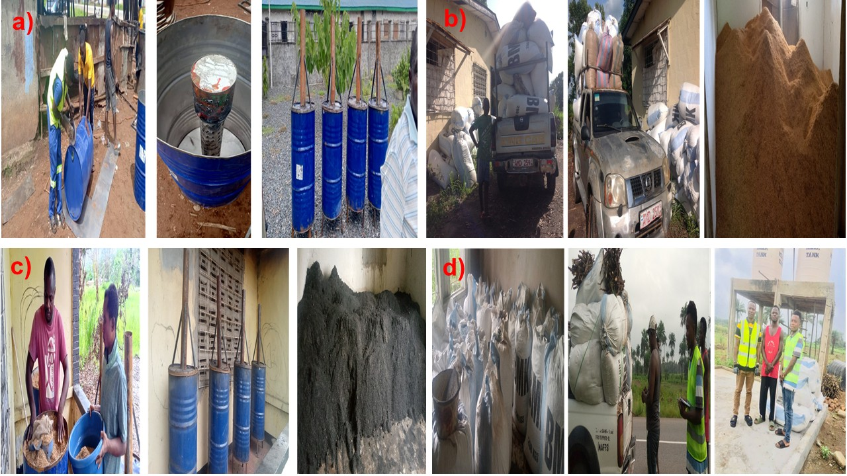
MLWERC
Table 3: Farmers’ Awareness on Biochar
Farmers' awareness on biochar | District
 | Port Loko |  | Tonkolili |  | Moyamba |  | Kenema
 | Freq | % | Freq | % | Freq | % | Freq | %
Awareness of biochar before the survey
Yes | 2 | 3.3 | 3 | 5 | 0 | 0 | 1 | 1.7
No | 58 | 96.7 | 57 | 95 | 60 | 100 | 59 | 98.3
Total | 60 | 100 | 60 | 100 | 60 | 100 | 60 | 100
Willingness to adopt new soil management practice like biochar
Yes | 53 | 88.3 | 56 | 93.3 | 54 | 90 | 58 | 96.7
No | 0 | 0 | 0 | 0 | 0 | 0 | 0 | 0
Maybe | 7 | 11.7 | 4 | 6.7 | 6 | 10 | 2 | 3.3
Total | 60 | 100 | 60 | 100 | 60 | 100 | 60 | 100
Willingness to produce biochar if trained
Yes | 56 | 93.3 | 55 | 91.7 | 59 | 98.3 | 59 | 98.3
No | 0 | 0 | 0 | 0 | 0 | 0 | 0 | 0
Maybe | 4 | 6.7 | 5 | 8.3 | 1 | 1.7 | 1 | 1.7
Total | 60 | 100 | 60 | 100 | 60 | 100 | 60 | 100
Figure F2. Photographic display of (a) fabrication of biochar drums, (b) assembling of rice husk at MLWERC, (c) production of biochar, (d) packaging and distribution

Slide 26
OCP AFRICA
NAME OF PROJECT | OBJECTIVES | BRIEF SUMMARY | CURRENT STATUS
OCP Africa Agronomic Demonstration Trials in Sierra Leone | To improve soil fertility and productivity for increased crop productivity. | The OCP Africa agronomic demonstration trials were established in 49 locations of Sierra Leone. Of the 49 sites, 17 were IVS rice, 14 maize, 13 cassava and 5 sites were groundnut; The potential impact of OCP Africa's initiatives is aimed at creating a resilient, productive, and sustainable agricultural sector in Sierra Leone | Some data inputting is ongoing.

Slide 27
Monographs and related assignments
A couple of monographs have been drafted
The yam monograph has been completed
The coffee monograph is about 90% complete.
The remaining monographs on the other value chains are in progress.
Draft Environmental and Social Commitment Plan (ESCP)
The first Annual Report for 2025 will be completed by end of January 2026.

Slide 28




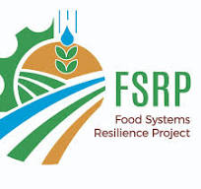




























ACKNOWLEDGMENTS
RESADE-SL
HELD AT RARC CONFERENCE ROOM, 17th DECEMBER, 2025.
62

