Slide 1


Sierra Leone Agricultural Research
Institute
PRESENTATION OF THE COMMERCIALIZATION AND AGRIBUSINESS DIRECTORATE
Council Meeting , RARC, Rokupr
16TH-18th December, 2025
Presenter --------Isata Kamanda (Ph. D)
Deputy Director General Commercialization and Agribusiness
Plant Breeder - SLARI-HQ

Slide 2
Sierra Leone Agricultural Research
Institute
Investment Plan –Developed and Submitted to the MoF in November 2024
COMMERCIALIZATION STRATEGY – RARC
PRODUCTION OF RICE FOUNDATION SEED`
Foundation Seeds have been processed, stored and sold with some quantities in store in RARC

Slide 3
Sierra Leone Agricultural Research
Institute
COMMERCIALIZATION STRATEGY – NARC
PRODUCTION OF CASSAVA, COWPEA, SOYBEAN,GROUNDNUT FOUNDATION SEED
Foundation Seeds have been established in Njala and it’s Out stationed were sold and also Multiplied for the 2025 cropping seasoning

Slide 4
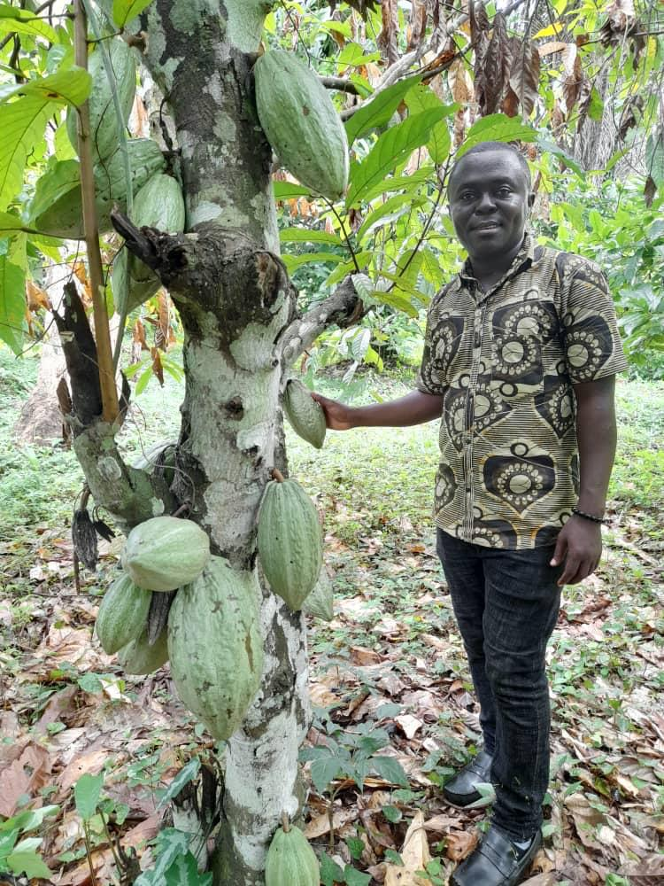
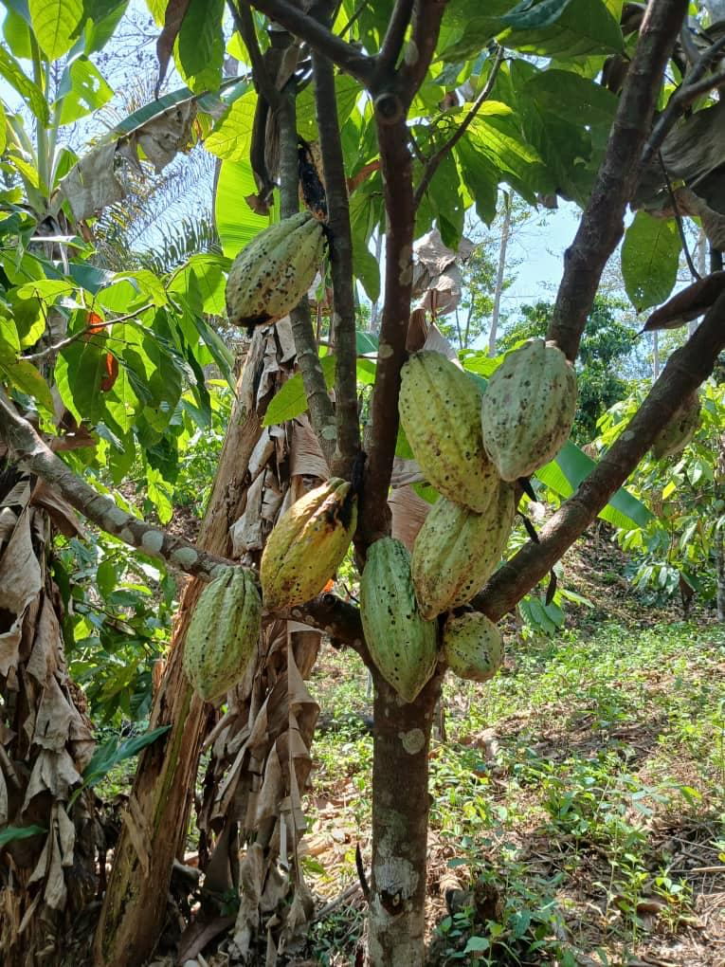
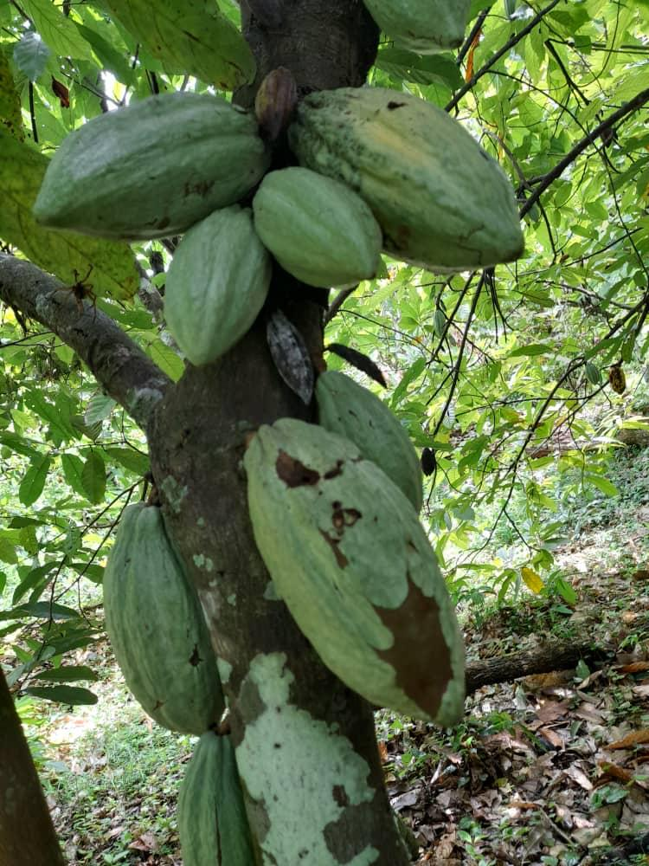
Sierra Leone Agricultural Research
Institute
COMMERCILAIZTION STRATEGY –KFTCRC
Cocoa and Coffee seedlings were nursed and sold to AVDP Project
2. Harvesting of Cocoa Beans was successfully completed they are been processed for sale.

Slide 5
Sierra Leone Agricultural Research
Institute
COMMERCIALIZATION STRATEGY –TLRC
Operationalization of the Feed Mill and Hatchery for the sales of Feed and Production of Day Old Chicks for sale- Awaiting Funding support from FSRP
2. Production of improved Livestock ( Goats, Sheeps, Rabbits, Bulls and Ducks as Foundation seeds for sale—Awaiting Funding support from FSRP

Slide 6
Sierra Leone Agricultural Research
Institute
COMMERCIALIZATION STRATEGY – KHCRC
PRODUCTION OF HORTICULTURAL CROPS FOUNDATION SEED
Installation of 2-Screen Houses –Production off Season Vegetable crops seed-( Breeders and Foundation Seeds) has been initiated and it is on going for
Pepper,
Okra,
Turmeric and
Tomatoes

Slide 7
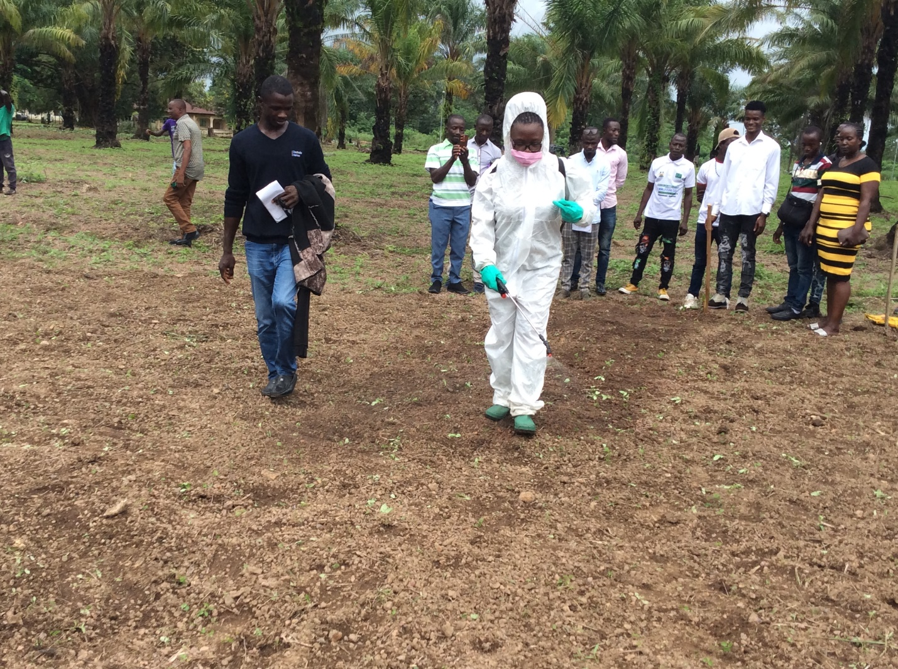
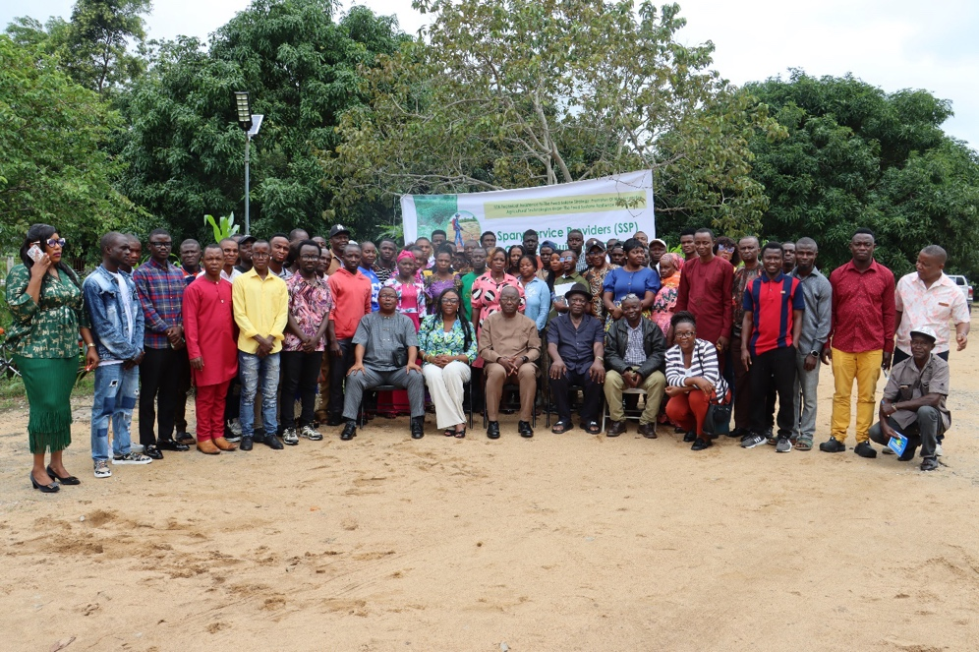
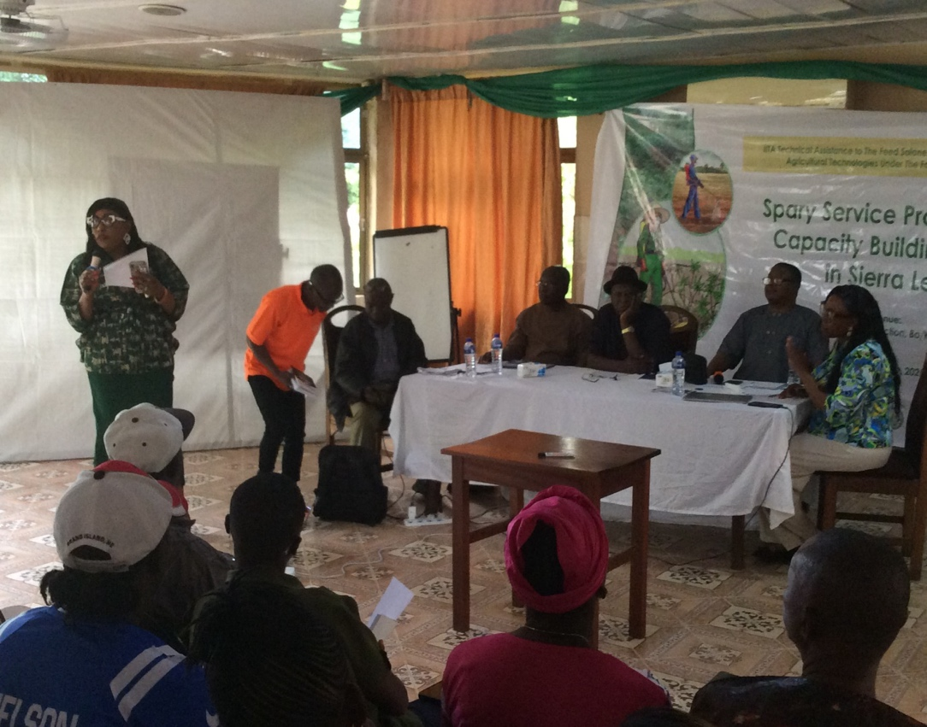
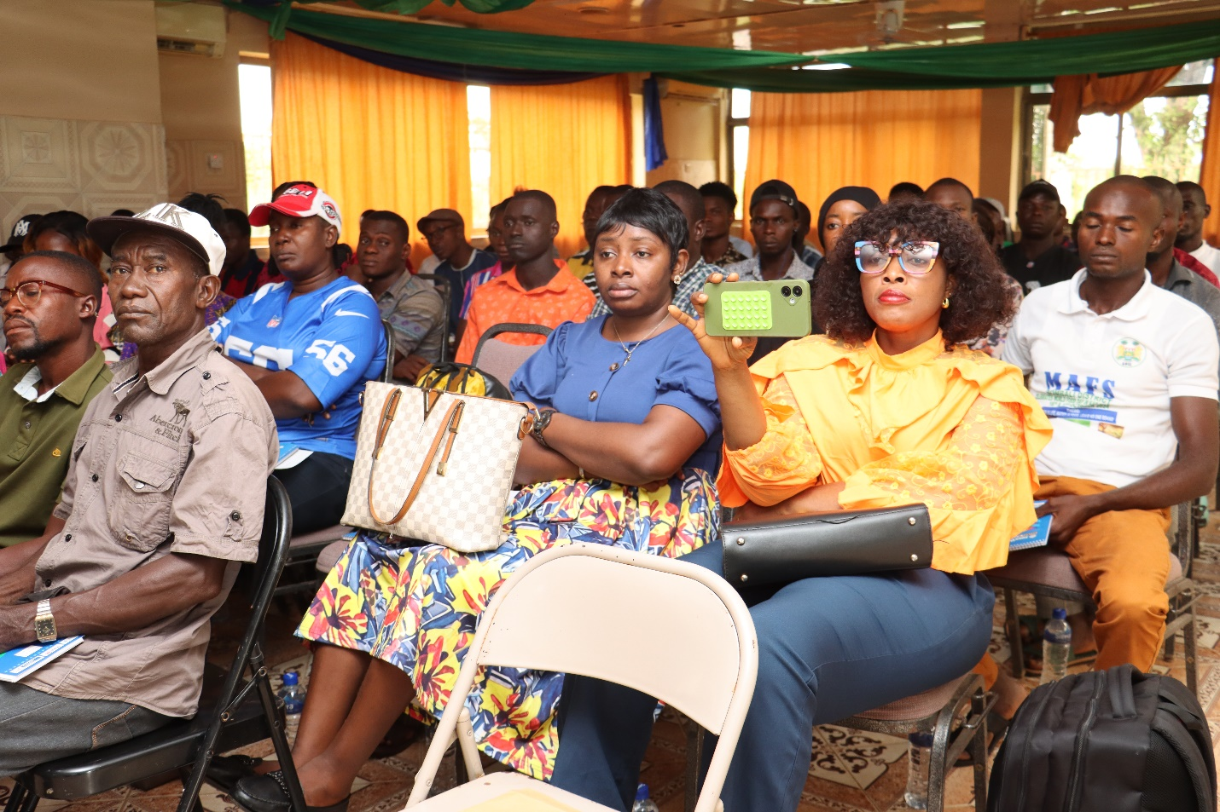
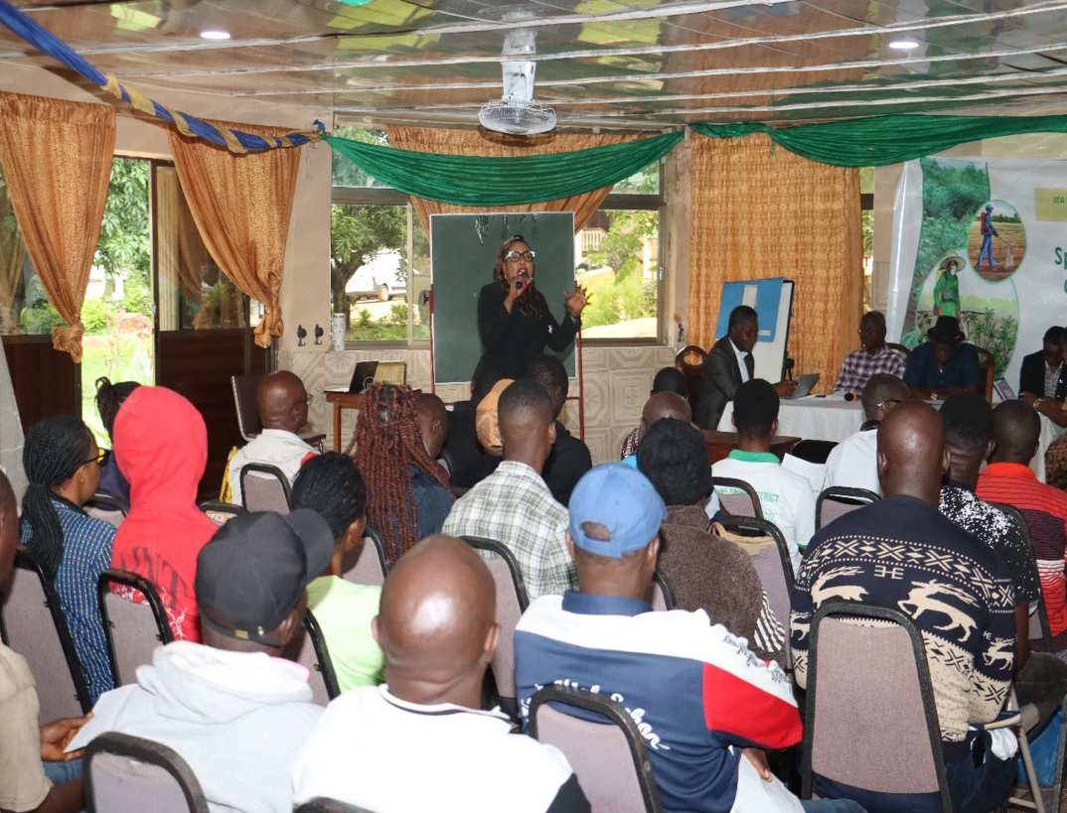
Sierra Leone Agricultural Research
Institute
Capacity Building Training for 50-Spray Service Provider in Sierra Leone for this reporting Period
ACHIEVEMENT RECORDED UNDER THE DIRECTORATE

Slide 8
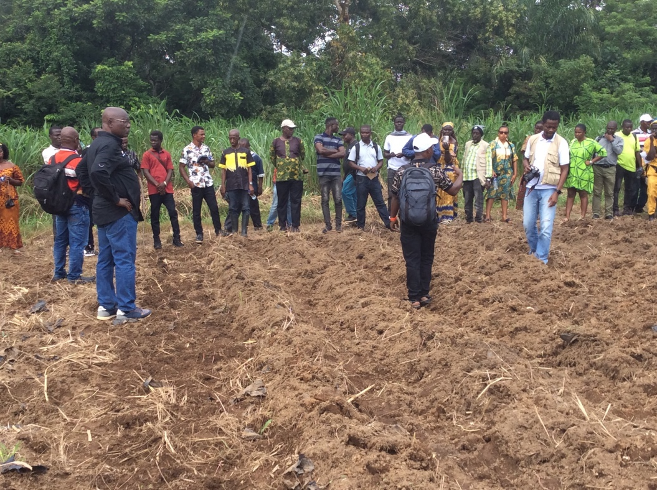
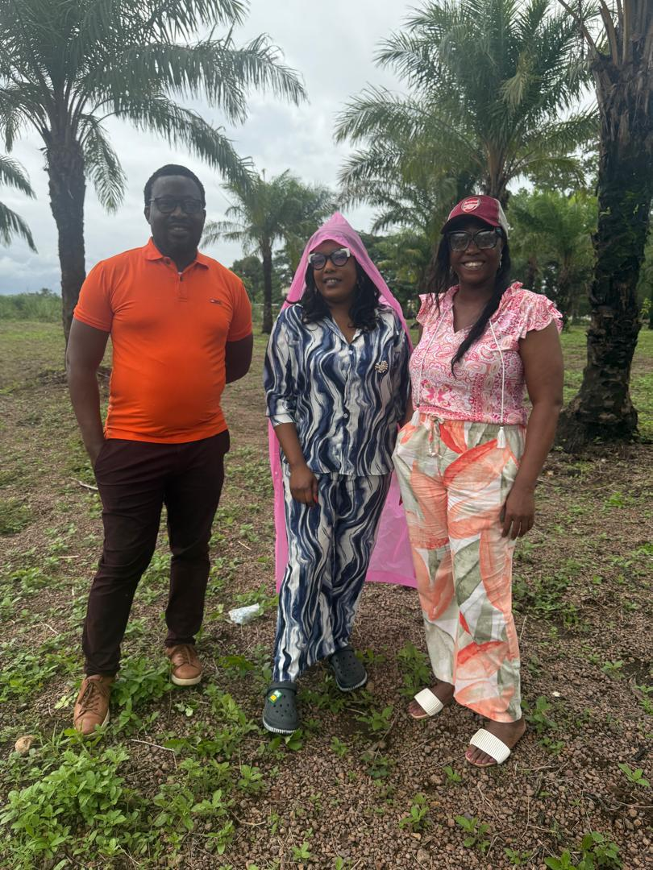
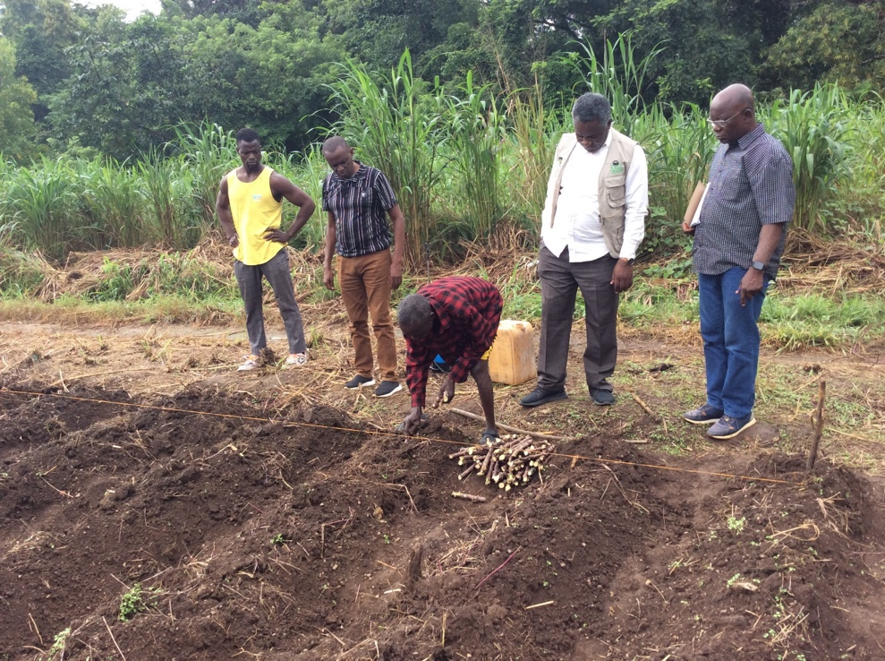
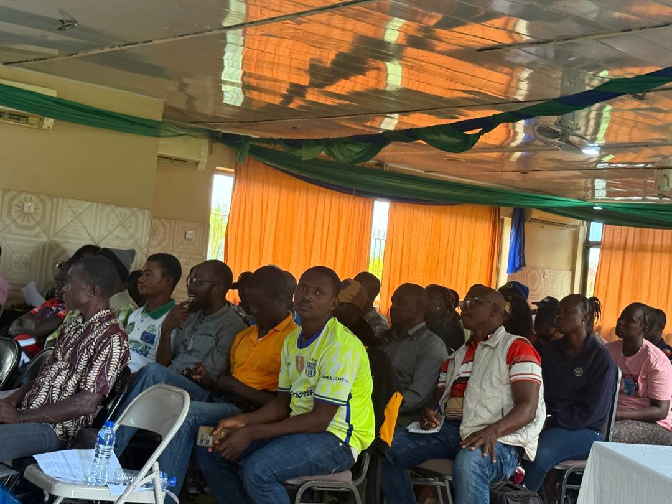
Sierra Leone Agricultural Research
Institute
Refreshers Training for 50-MAFS Extension Agents in Sierra Leone for this reporting Period
ACHIEVEMENT RECORDED UNDER THE DIRECTORATE

Slide 9
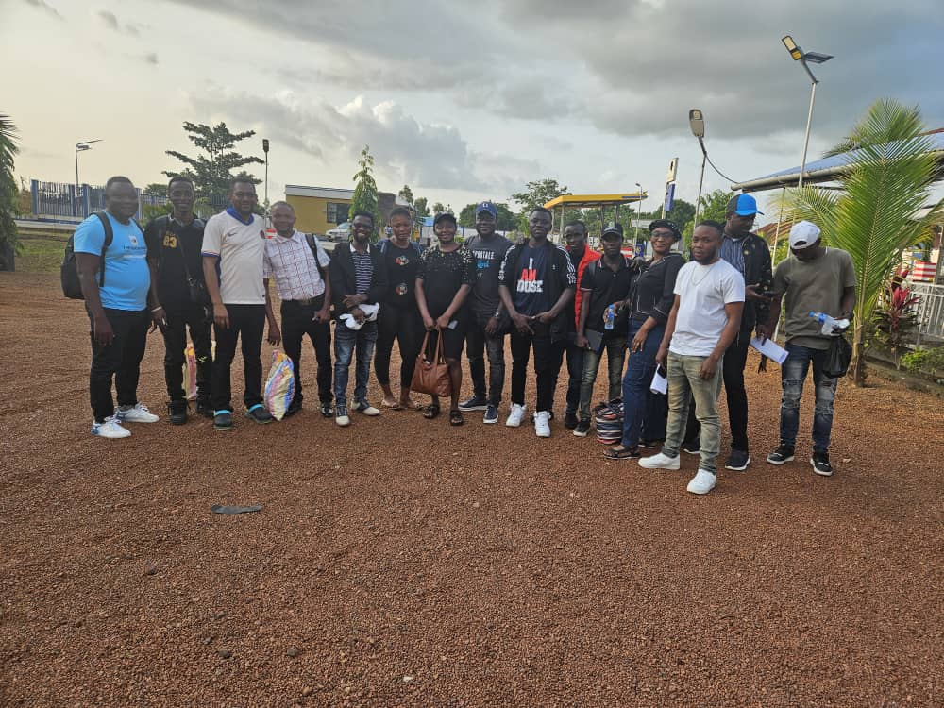
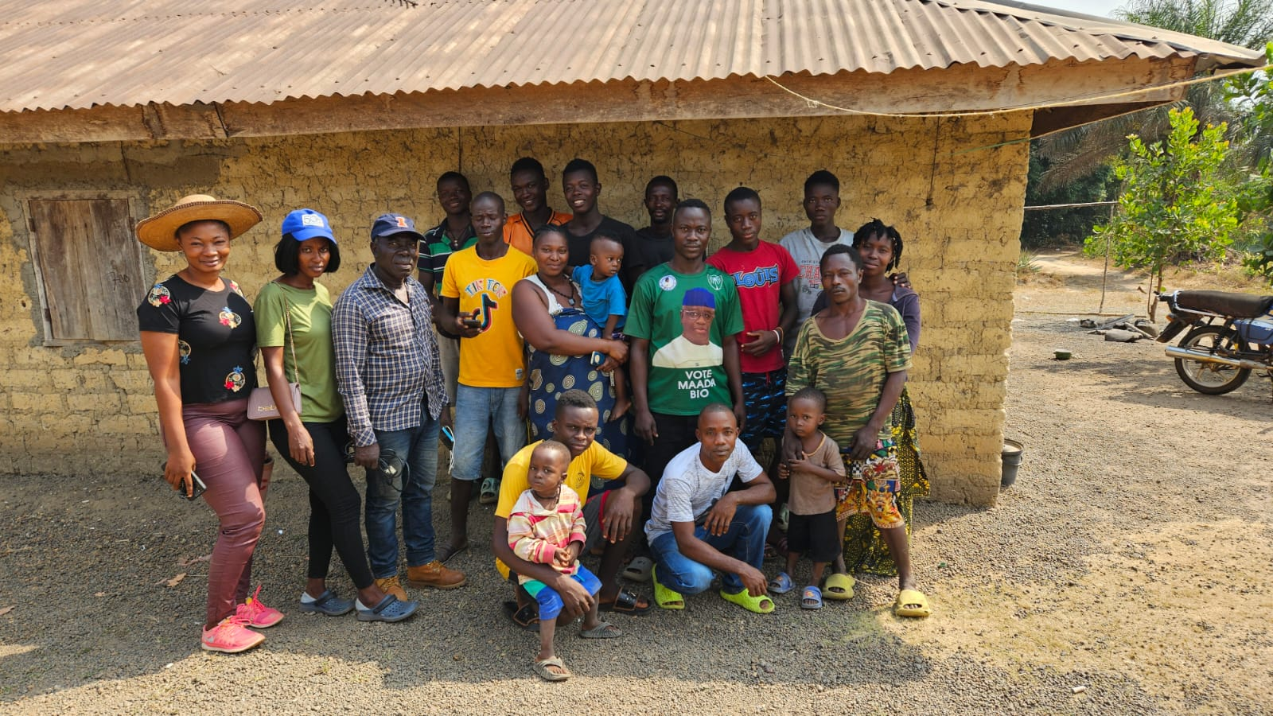
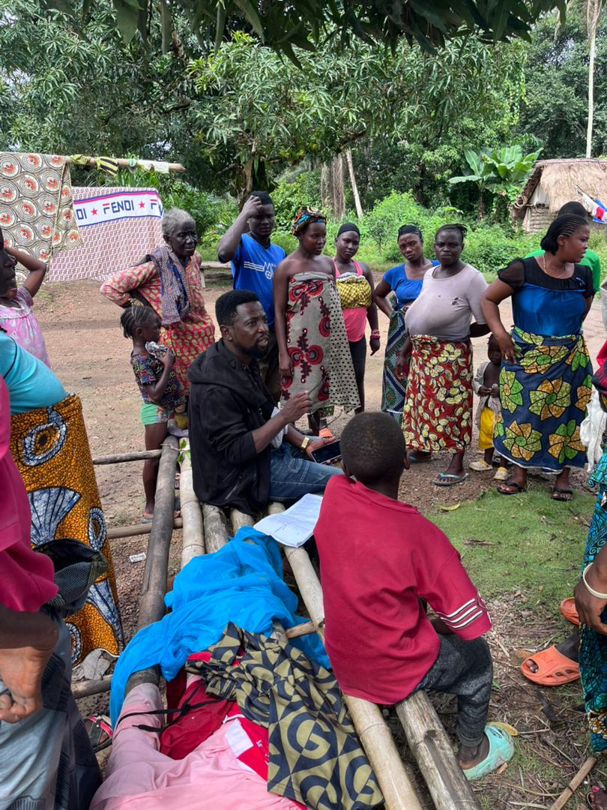
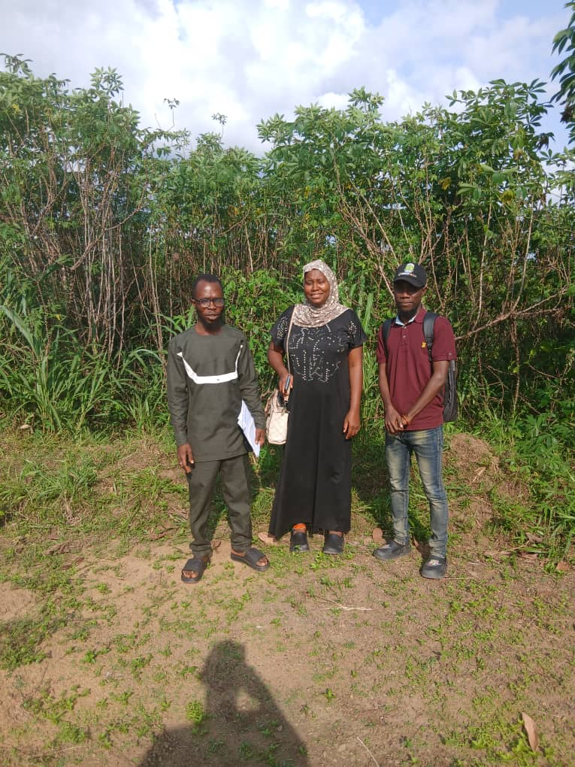
Sierra Leone Agricultural Research
Institute
ACHIEVEMENT RECORDED UNDER THE DIRECTORATE
The Sum of Nle= 4,000,000.00 was transferred to MAFS and the Directorate helped out in implementing the activities and the Reports Submitted
Activity Report 1: Stakeholder Engagement and Beneficiary Identification-Completed
Activity 2: Profiling and Selection of Project Beneficiaries in the Cassava Value Chain Development Initiative -Completed
Activity 3: Identification, Selection, Leasing and Survey of selected Cassava Multiplication Sites in the 7 districts (Travels, Land lease and Survey) Completed
Activity 6: Purchasing of cassava foundation seeds (700-bundles of Slicass-7 and Dixon and Baba-70) and other inputs for the multiplication of SAH plantlets-Initiated and its on-going

Slide 10
Sierra Leone Agricultural Research Institute
SALES OF TECHNOLOGIES RECORDED UNDER THE DIRECTORATE-2025
Supplied Improved Cassava Stems to Sierra Bo Gari -600-Bundles of Cassava
Seed Tech International supplied Improved Rice Seed 90-Bags
3. A Small Holder Farmer in Karena – 100 Bundles of Improved Cassava
DG-SLARI- 130 –Bundles of Cassava to OCP Project, 50-Kg of both Maize and Soybean as a Donation to Magbosi and for the OCP Project trials

Slide 11
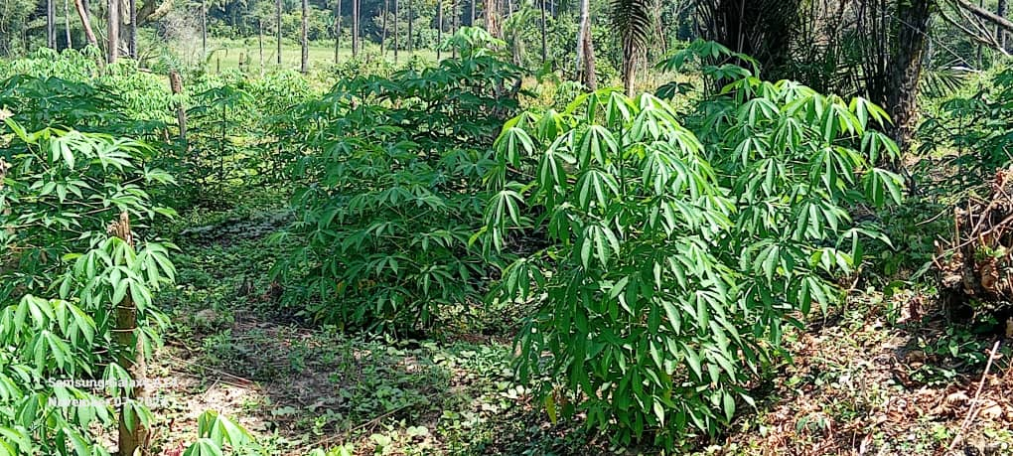
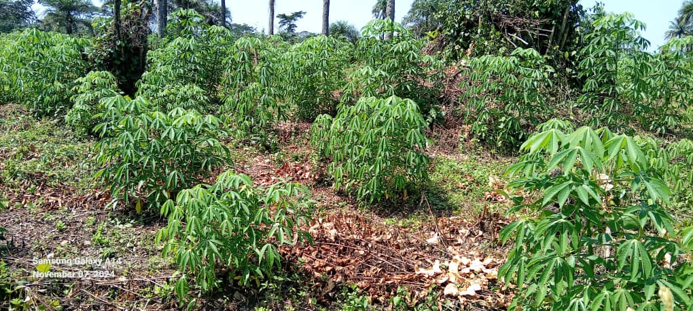
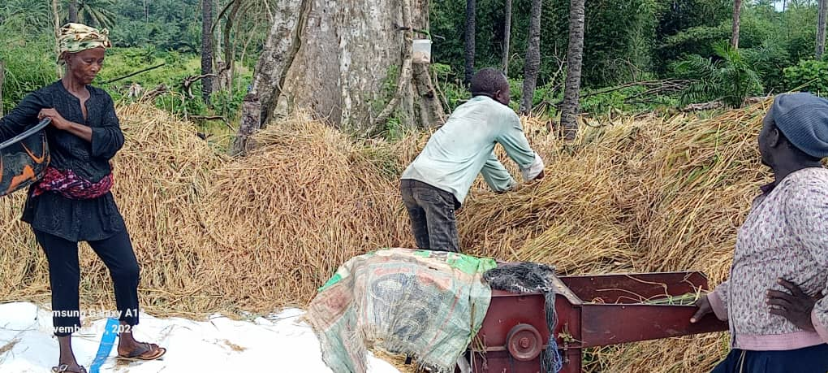
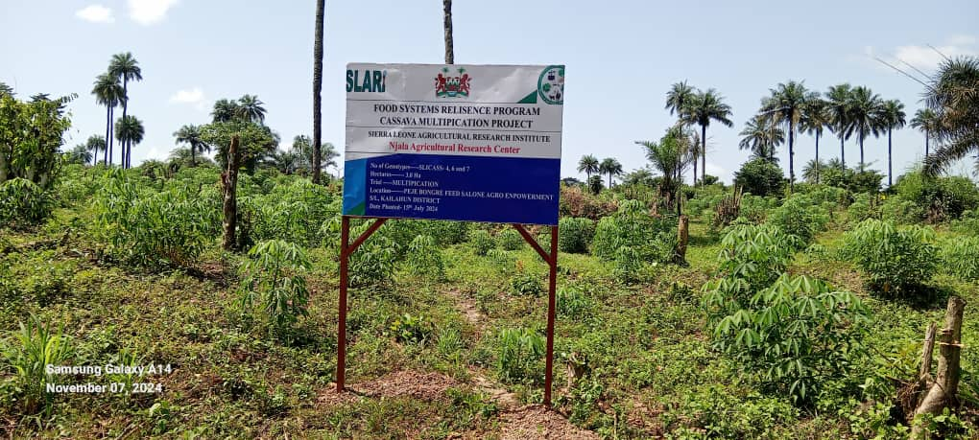
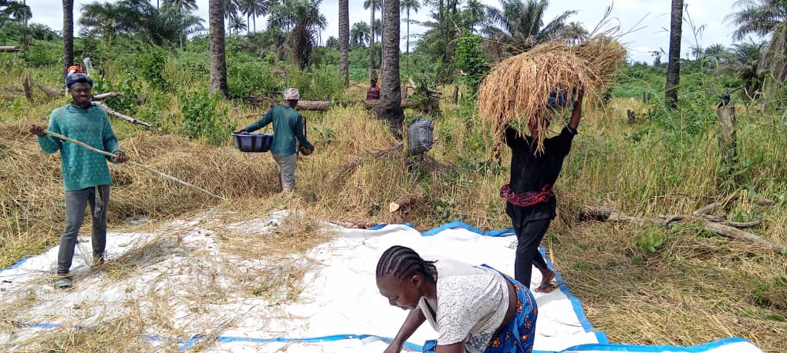
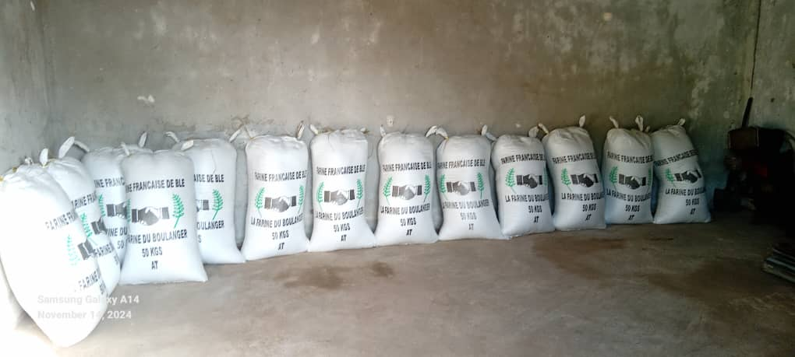
Sierra Leone Agricultural Research Institute
SUPPORT TO SCALE UP COMMERCIAL TECHNOLOGIES UNDER THE DIRECTORATE-2025 ---- FUNCTIONAL SEED SYSTEM IN SIERRA LEONE

Slide 12
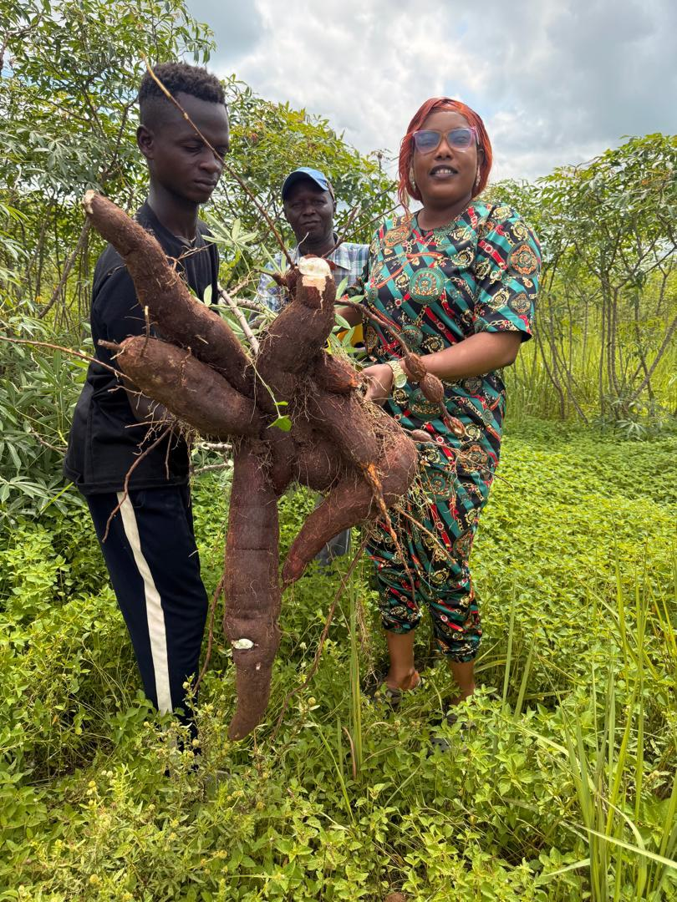
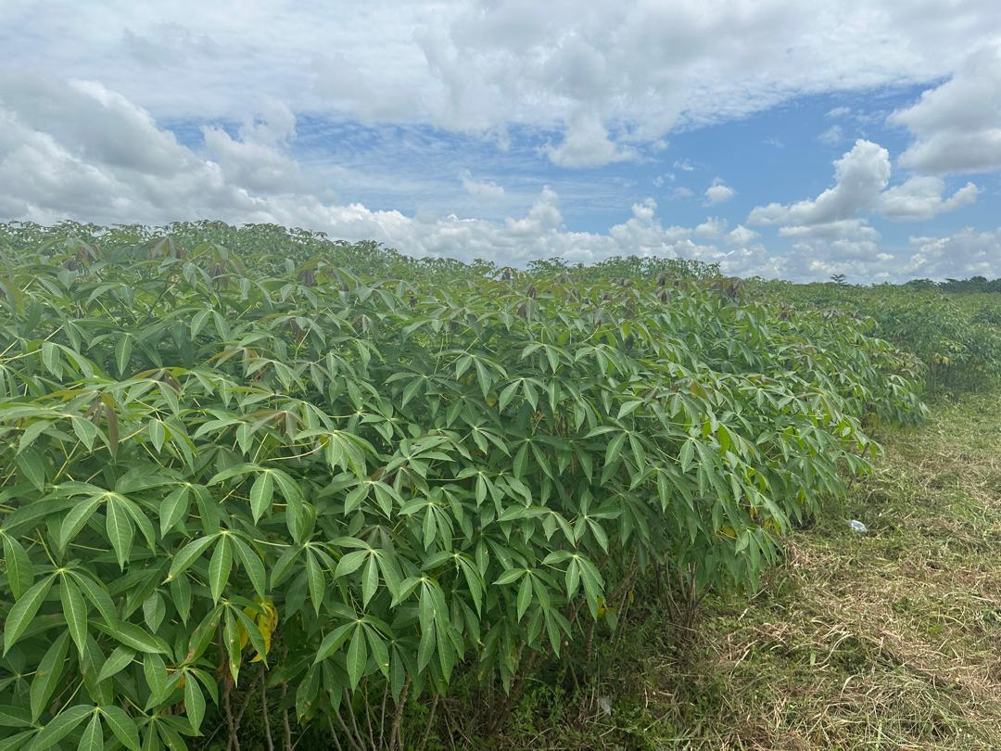
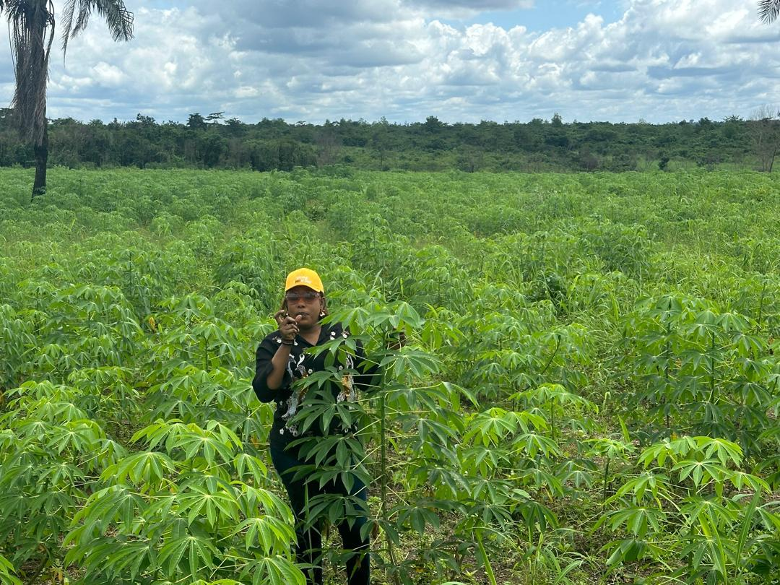
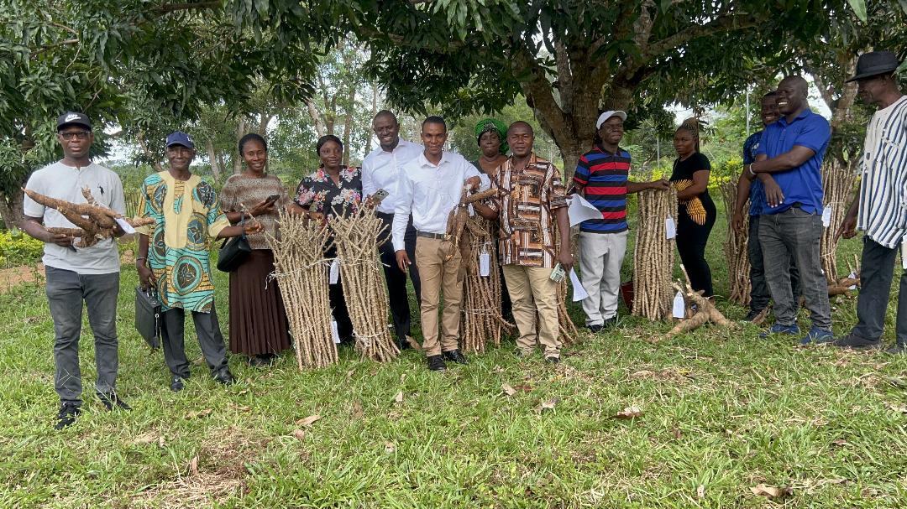
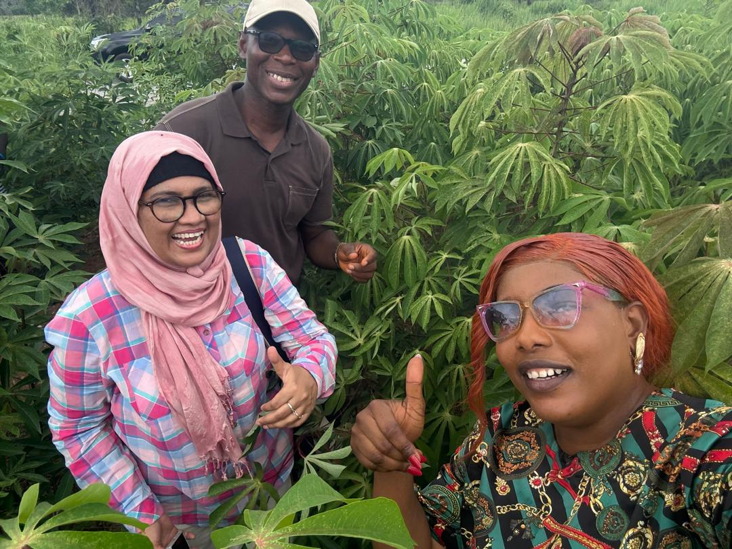
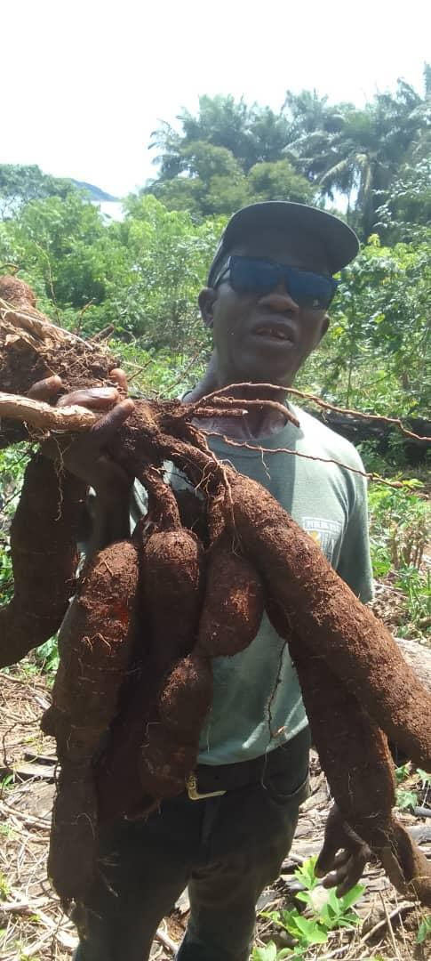
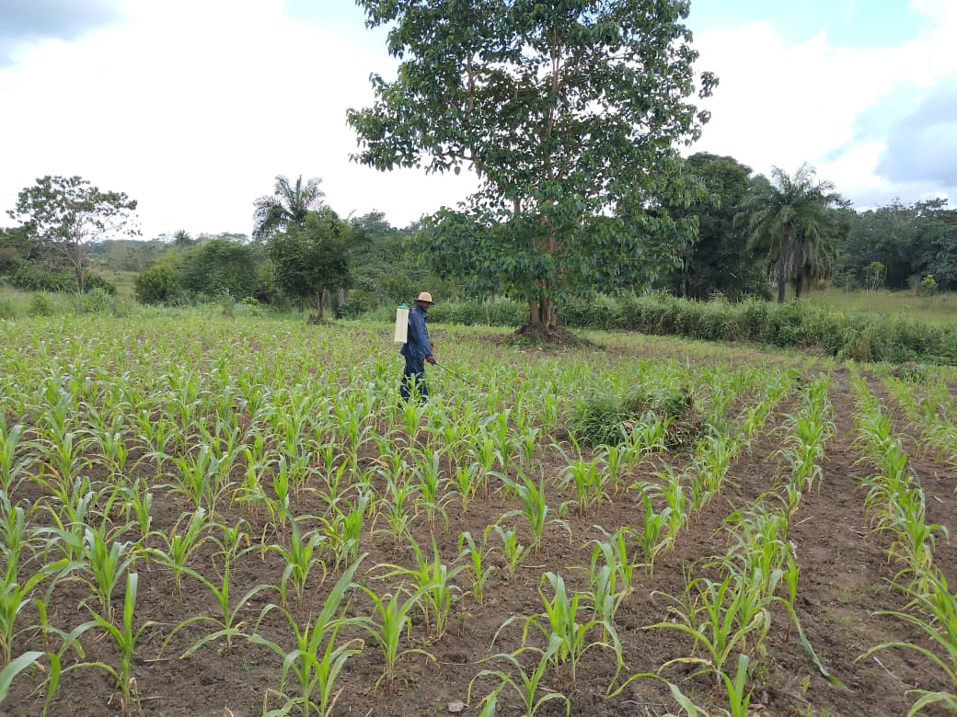
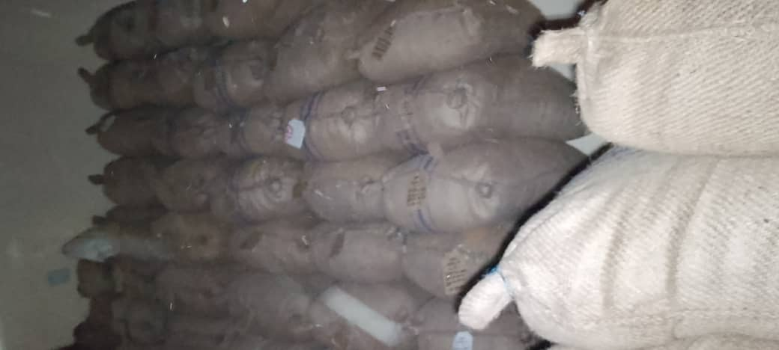
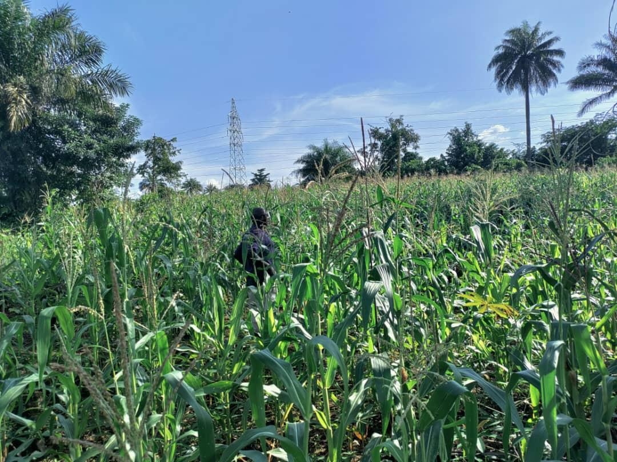
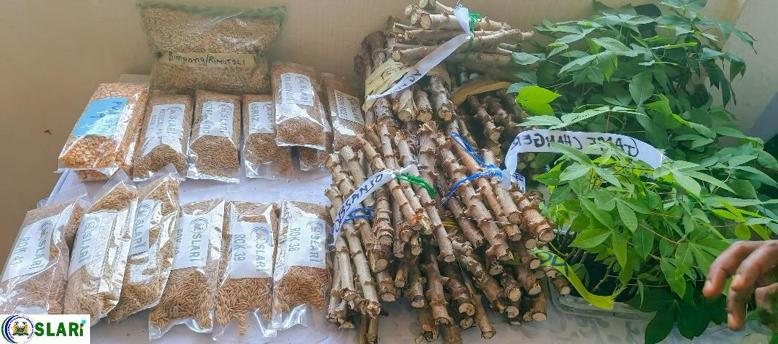
Sierra Leone Agricultural Research Institute
SUPPORT TO SCALE UP COMMERCIAL TECHNOLOGIES UNDER THE DIRECTORATE-2025 ---- FUNCTIONAL SEED SYSTEM IN SIERRA LEONE

Slide 13
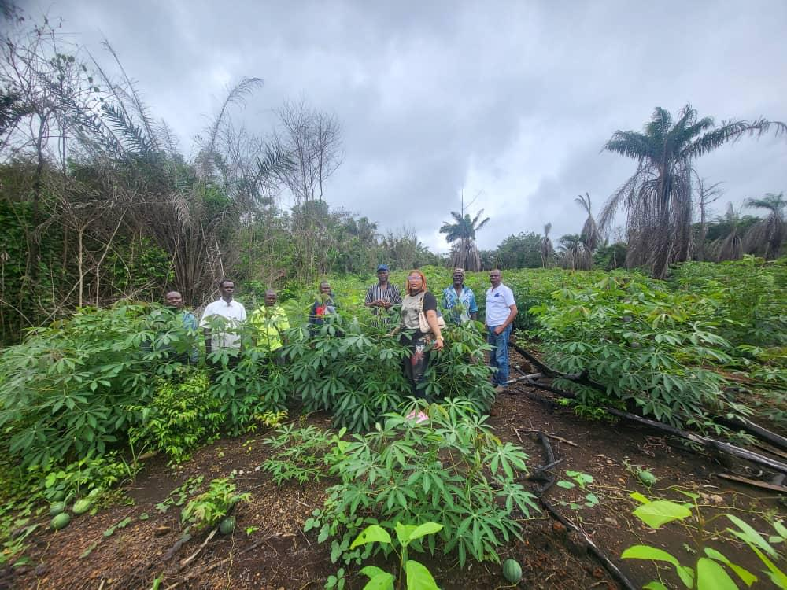
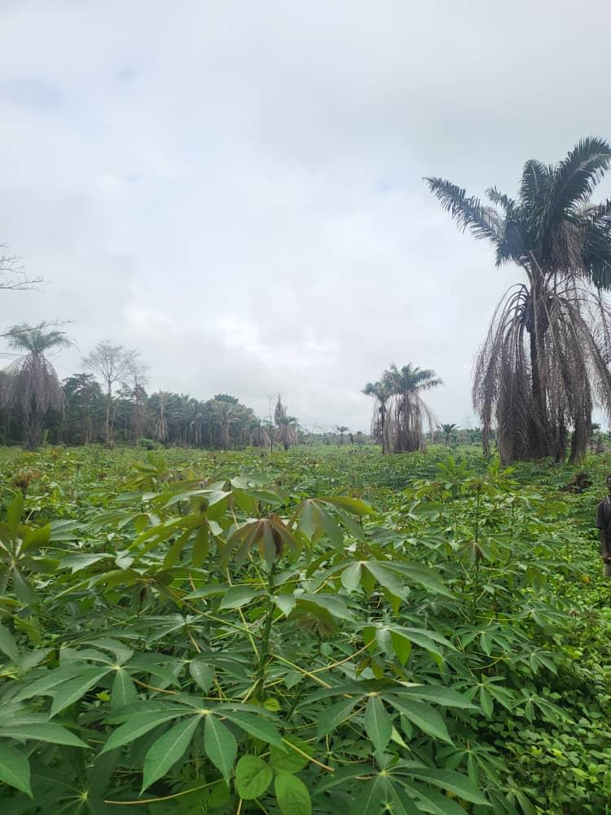
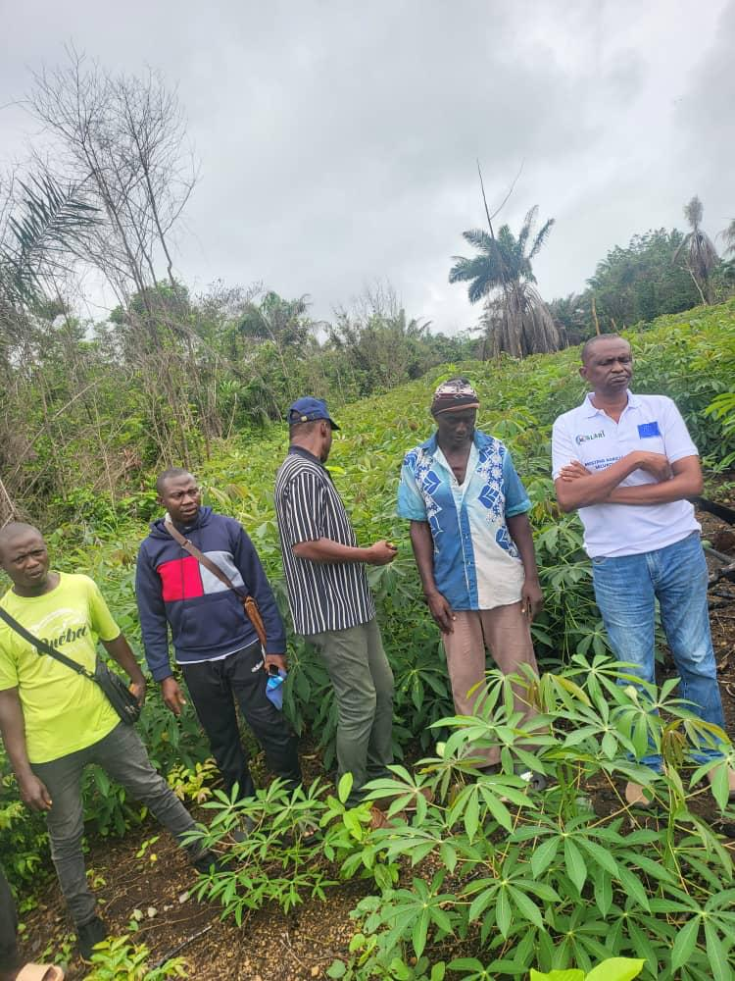
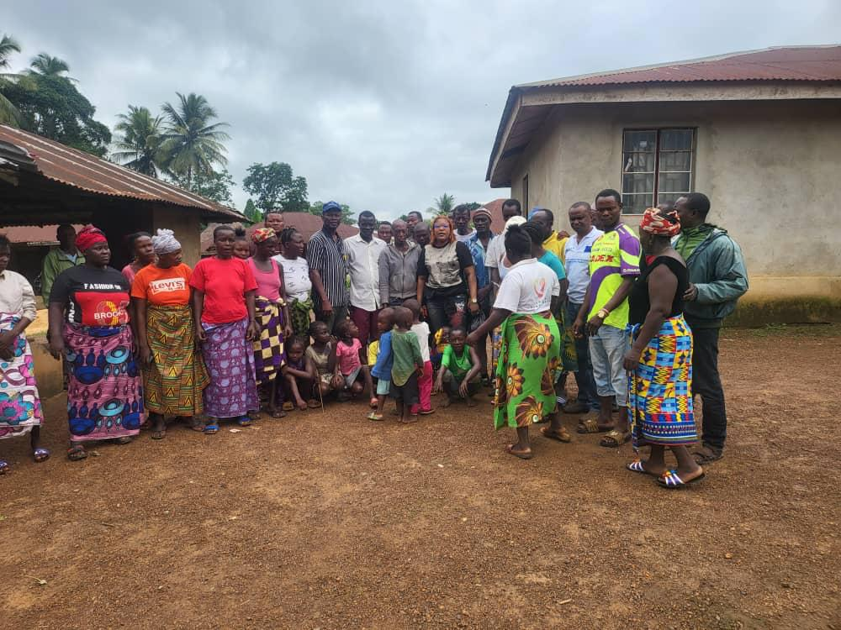
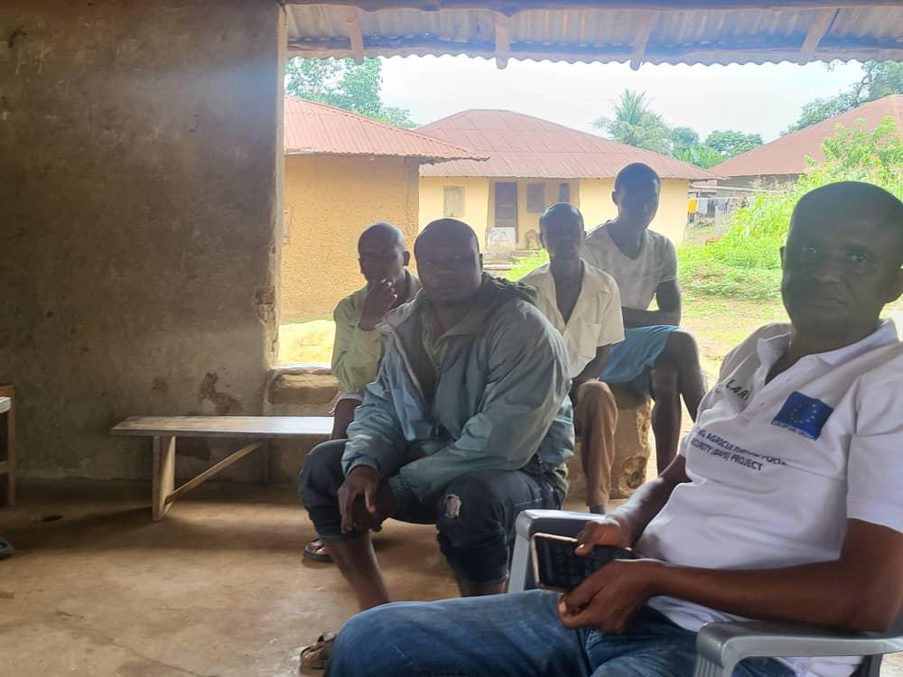
Sierra Leone Agricultural Research Institute
SUPPORT TO SCALE UP COMMERCIAL TECHNOLOGIES UNDER THE DIRECTORATE-2025 ---- FUNCTIONAL SEED SYSTEM IN SIERRA LEONE

Slide 14
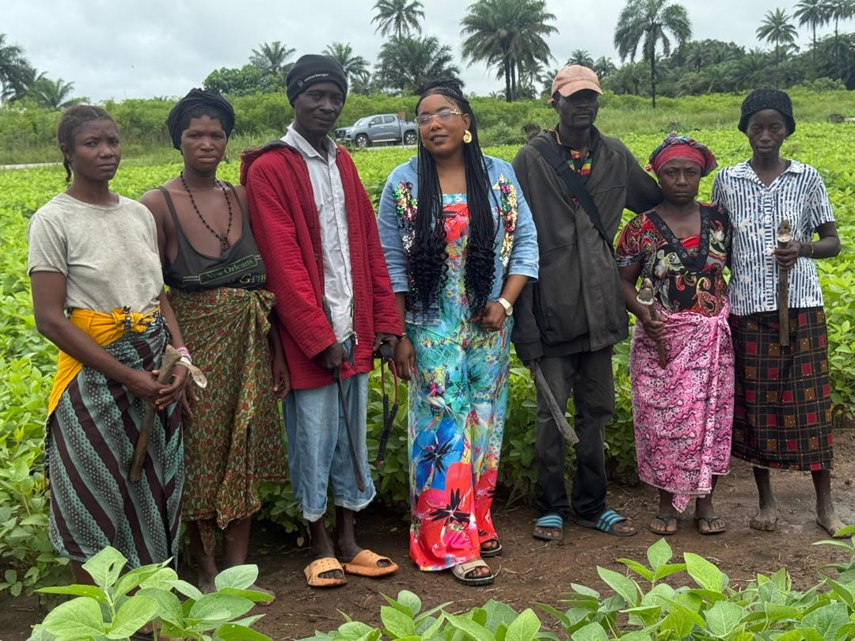
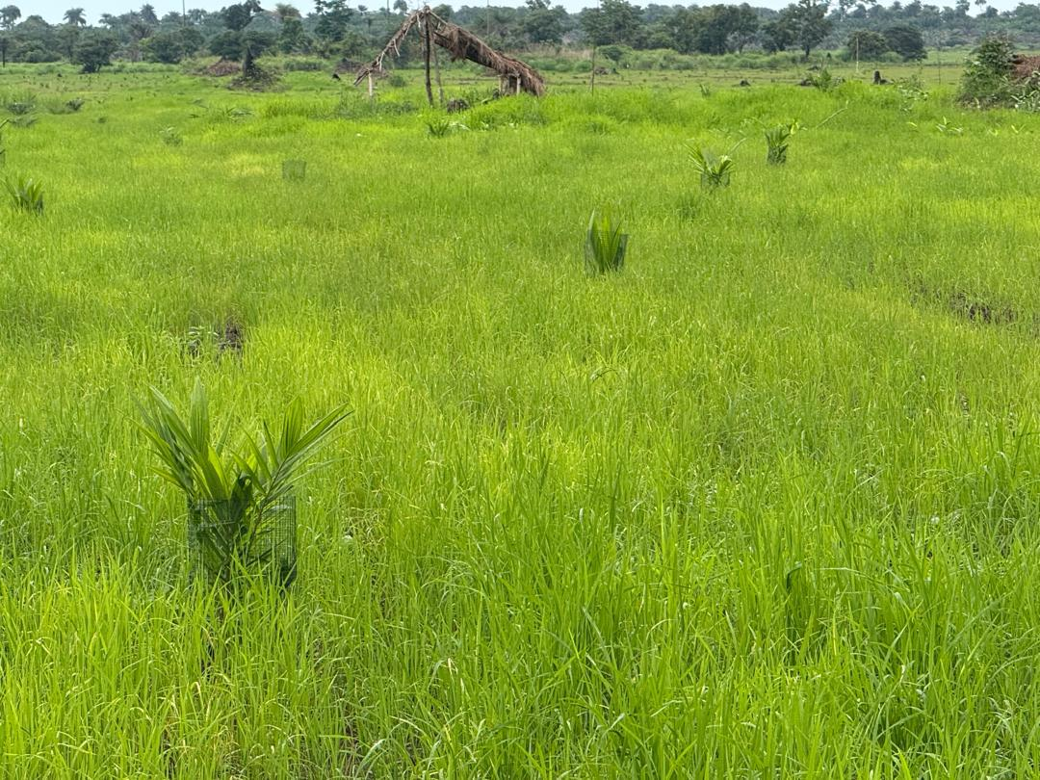
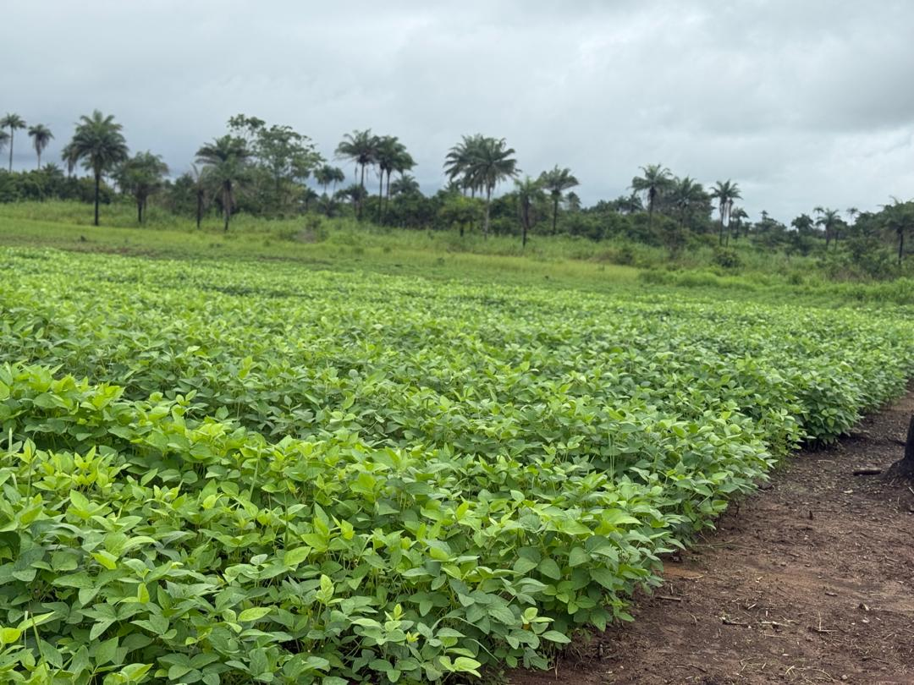
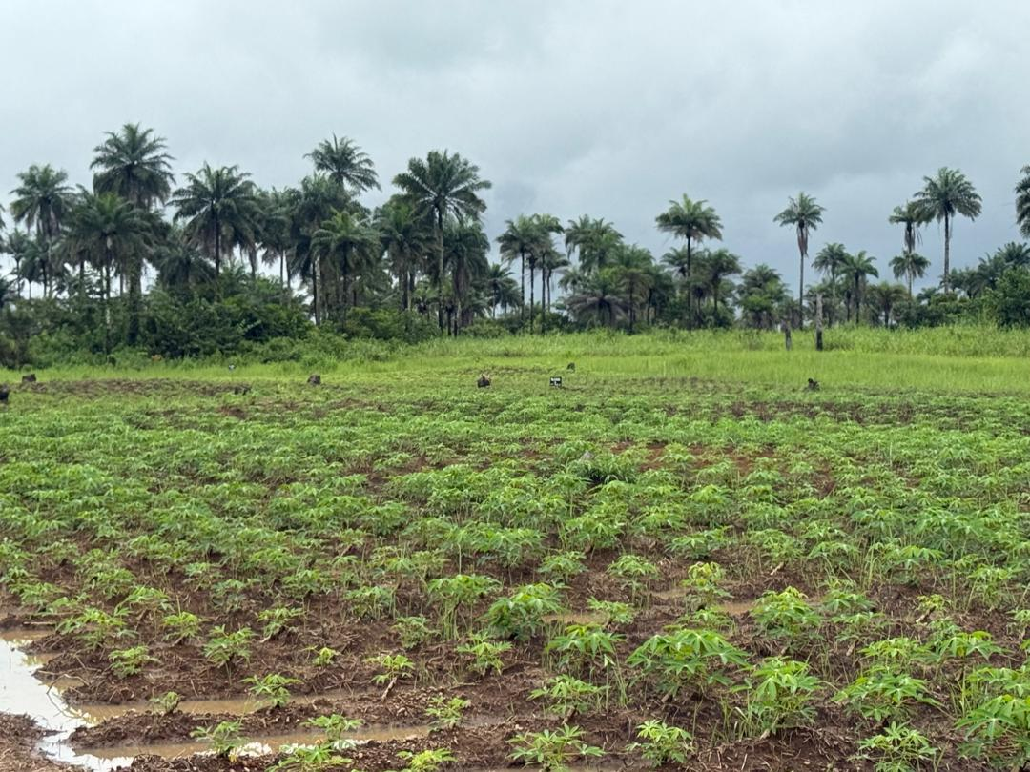
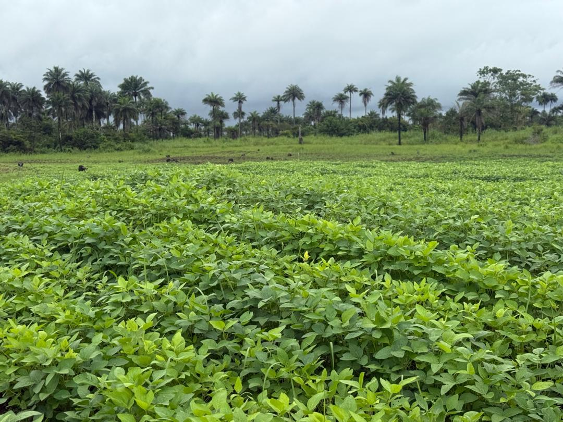
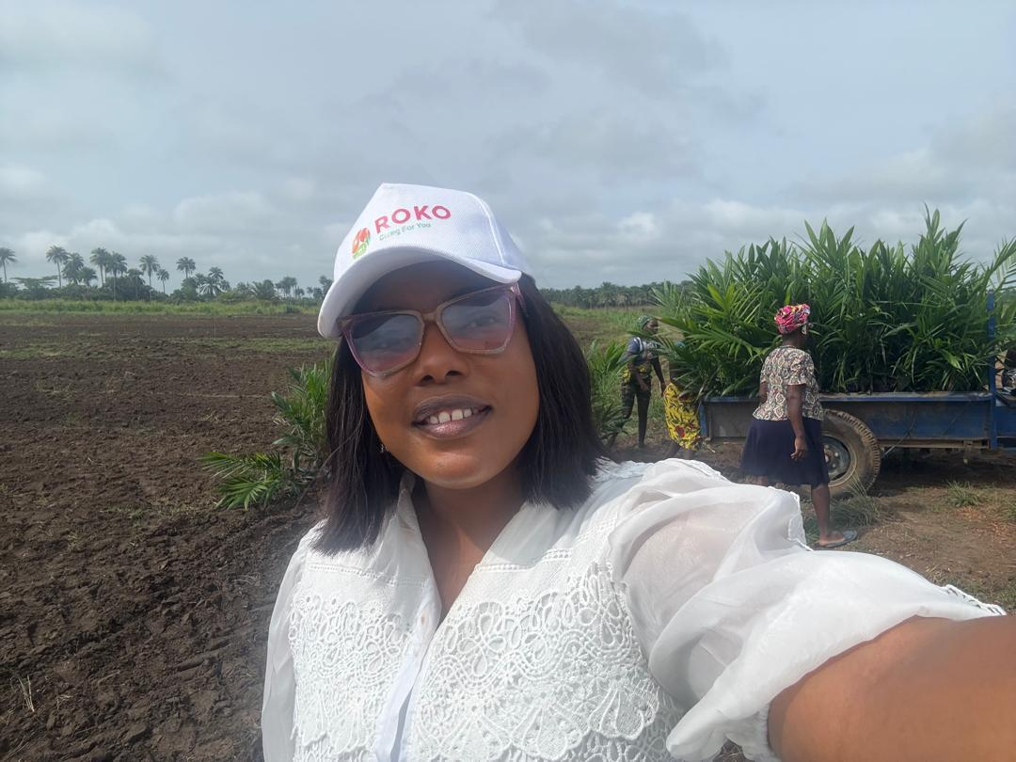
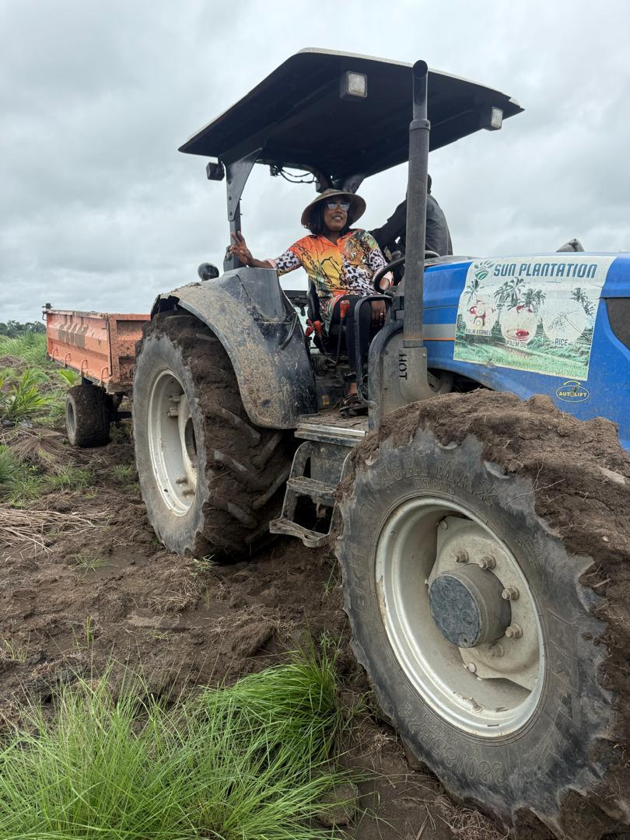
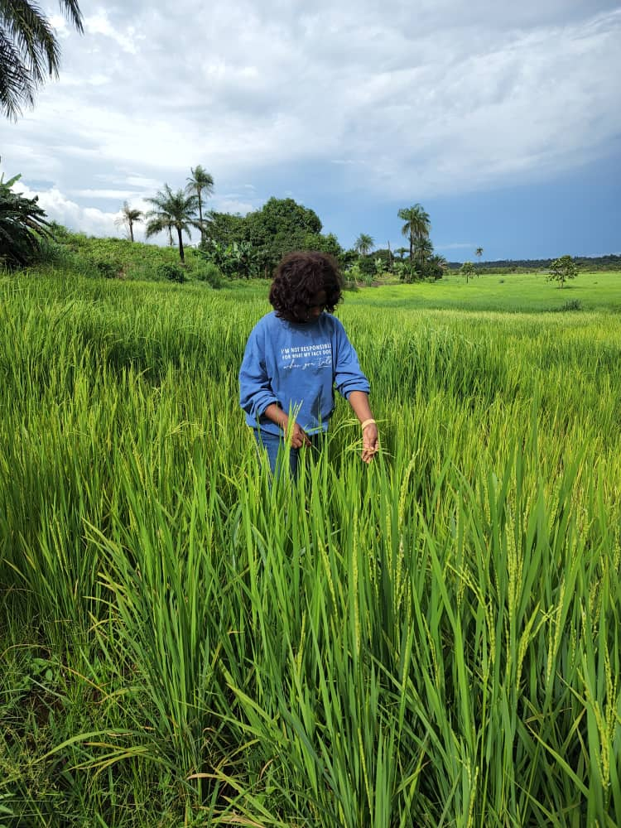
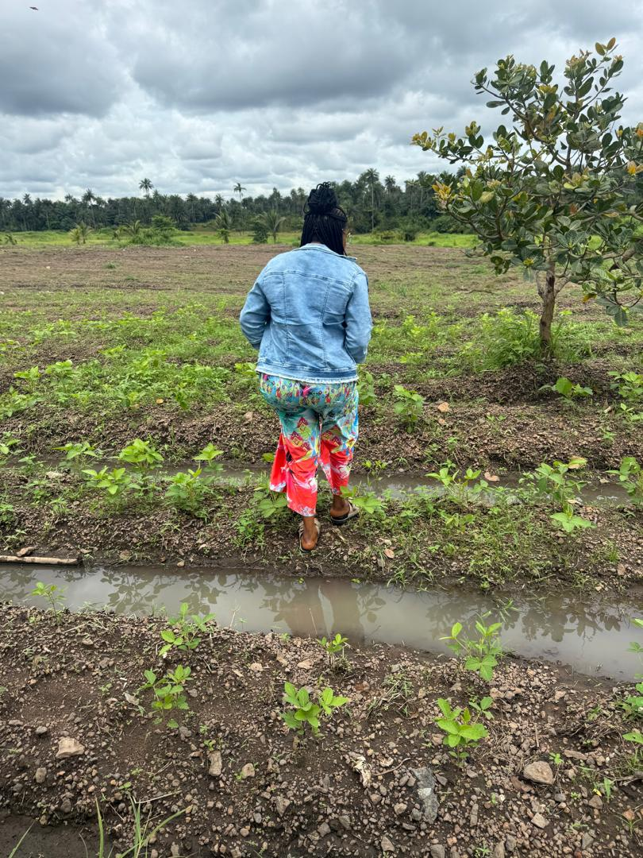
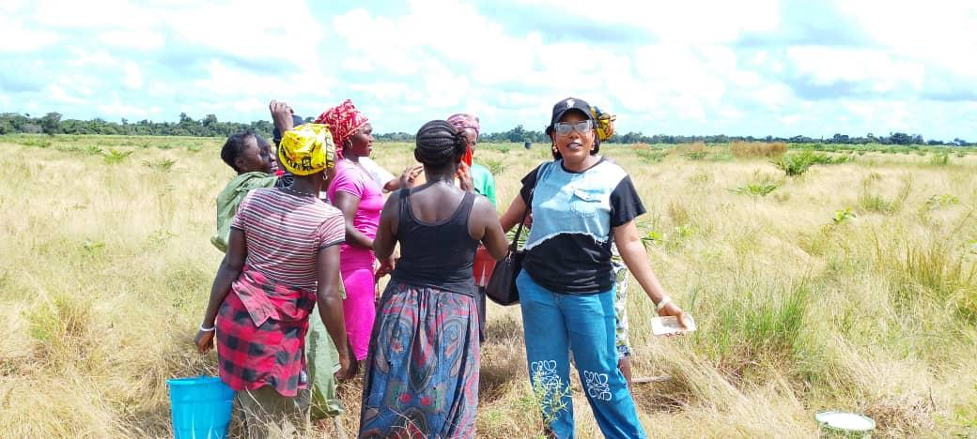
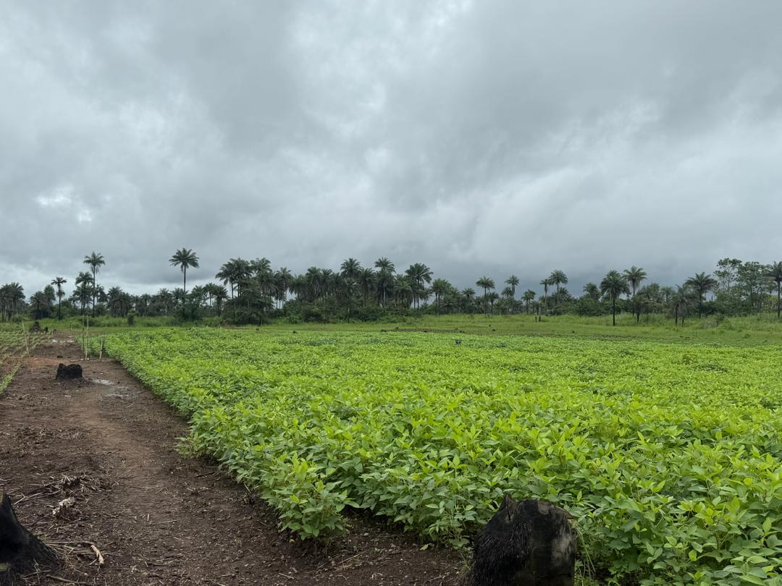
Sierra Leone Agricultural Research Institute
SUPPORT TO SCALE UP COMMERCIAL TECHNOLOGIES UNDER THE DIRECTORATE-2025 ---- FUNCTIONAL SEED SYSTEM IN SIERRA LEONE

Slide 15
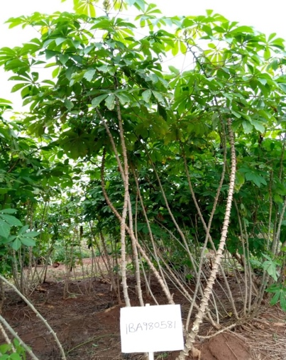
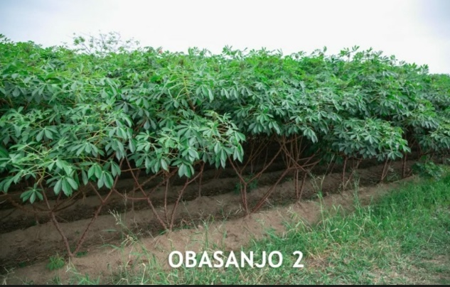


Sierra Leone Agricultural Research Institute
ACHIEVEMENT RECORDED UNDER THE DIRECTORATE
VARIETAL RELEASE (Six Cassava Varieties) -1 Biofortified –Yellow Flesh Cassava
Dixon
IBA980581
Yield – 25.6 t/ha
Dry matter - 28 %
Starch - 20 %
Plant type – Umbrella
Stem color - Grey
Petiole color – Purple
Leaf color – Light green
Leaf shape – Lanceolate
Growth habit – Straight
Granulated and paste product
Obasanjo 2
TMS13F1342P0022
Yield – 35.1 t/ha
Dry matter – 33 %
Starch – 24 %
Plant type - Umbrella
Stem colour - Light brown
Petiole colour - Light green
Leaf colour - Light green
Leaf shape - Lanceolate
Growth habit - zig-zag
Industrial product profile
Baba 70
IBA00070
Yield – 30.2 t/ha
Dry matter - 32 %
Starch - 23 %
Plant type - Compact
Stem colour - Light brown
Petiole colour - Purple
Leaf colour - Light green
Leaf shape - Lanceolate
Growth habit - Zig-zag
Granulated and paste Product
Game changer
TMS13F1160P0004
Yield – 23.2 t/ha
Dry matter - 37 %
Starch - 26 %
Plant type - Compact
Stem colour - Light brown
Petiole colour – Red
Leaf colour - Light green
Leaf shape - Lanceolate
Growth habit - Zig-zag
Stable dry matter
Industrial product profile

Slide 16


Sierra Leone Agricultural Research Institute
ACHIEVEMENT RECORDED UNDER THE DIRECTORATE
No Hunger
IBA164773
Yield – 25.2 t/ha
Dry matter - 29 %
Plant type - Compact
Stem colour - Light brown
Petiole colour – Light Green
Leaf colour - Dark green
Leaf shape - Lanceolate
Growth habit - Zig-zag
Biofortified food processing
Poundable
TMEB693 Maada Cassada
Yield - 22 t/ha
Dry matter - 20 %
Starch - 21 %
Plant type - Erect
Stem colour - Dark brown
Petiole colour - Purple
Leaf colour - Deep green
Leaf shape - Lanceolate
Growth habit – Straight
Fresh market

Slide 17



Sierra Leone Agricultural Research
Institute
ACHIEVEMENT RECORDED UNDER THE DIRECTORATE
PI-CREF ROUND TABLE CONFERENCE ON ENERGY, CLIMATE CHANGE AND FOOD SECURIRTY 2025

Slide 18



Sierra Leone Agricultural Research
Institute
ACHIEVEMENT RECORDED UNDER THE DIRECTORATE
AGRIFOOD SYSTEM SUMMIT IN SIERRA LEONE 2025

Slide 19





Sierra Leone Agricultural Research
Institute
ACHIEVEMENT RECORDED UNDER THE DIRECTORATE
Advanced Rehabilitation of of SLARI Guest House in RARC

Slide 20

Sierra Leone Agricultural Research Institute

Slide 21









Sierra Leone Agricultural Research
Institute
ACHIEVEMENT RECORDED UNDER THE DIRECTORATE
WORLD FOOD DAY CELEBRATION 2025

Slide 22
Sierra Leone Agricultural Research Institute
PROPOSED GOVERNANCE STRUCTURE OF THE DIRECTORATE
COMMERCIALIZATION AND AGRIBUSINESS DIRECTORATE STRATEGIC TEAM
Dr. Abdul Raham Conteh-DG-Supervisor
Dr. Isata Kamanda-DDG-CAD-Team Lead
COMPLIANCE TEAM AND INTERNAL CONTROL TEAM
Mr. Alieu Bah
Mr. Sheku Kanu
Mrs. Aminata Jabbie
Mr. Alpha Massaquoi
Mr. Bundor Gboyah
Mr. Alpha Mattia

Slide 23
Sierra Leone Agricultural Research Institute
VALUE CHAIN EXPERTS
Mr. Michael Benya
Mr. Lansana Sesay
Mr. Alhaji Massaquoi
Dr. Augustine Mansaray
Mr. Keiwoma Mark Yila
Dr. Dauda Yillah
Dr. Adams .S. Kanu
Mr. Paul Musa Lahai
MONITORING AND EVALUATION TEAM
Dr. Osman Nabay
Mr. Emmanuel Hinkley
AGRIBUSINESS SUPPORT STAFFS (4)
Madam Francess Alie and 3 others should be employed by SLARI

Slide 24
Sierra Leone Agricultural Research Institute
INITATIED & ONGOING ACTIVITY
DEVELOPMENT OF THE DIRECTORATE POLICY-
The SLARI GENDER POLICY DRAFT -COMPLETED

Slide 25





Sierra Leone Agricultural Research Institute
CHALLENGES
LACK OF STAFFS TO EFFECTIVELY RUN THE DIRECTRATE
LACK OF LOGISITIC VEHICLE TO TRANSPORT OF TECHNOLOGIES

Slide 26


Sierra Leone Agricultural Research Institute
CHALLENGES
LACK OF PROPER STORAGE TO STORE SEEDS AND OTHER STUFFS

Slide 27




Sierra Leone Agricultural Research Institute
THANK YOU

